Slide 1
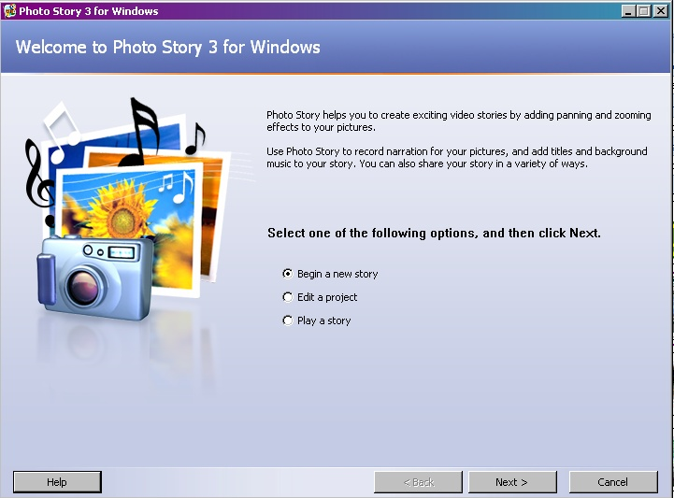
Photo Story 3 Project
How to use

Slide 2
Objective
How to download Microsoft’s Photo Story 3 to the computer.
Introduction to Photo Story 3.
Get started with Photo Story 3
Download digital pictures.
Arrange pictures, put type to pictures.
Add narrations to your project.
Background music.
Develop photo movement.
Create the video!

Slide 3
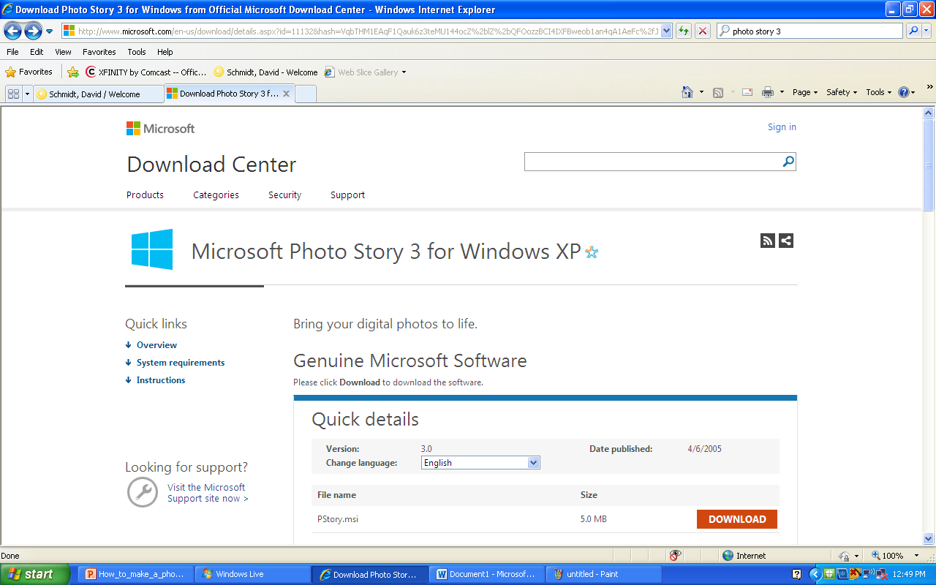
Get a free download of Photo Story 3 from Microsoft!
If your computer uses Microsoft Project you can get a free download software Photo Story 3.
Go to http://www.microsoft.com/en-us/download/details.aspx?id=11132
and get started!

Slide 4
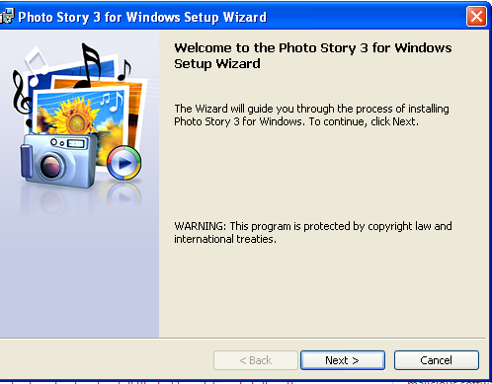
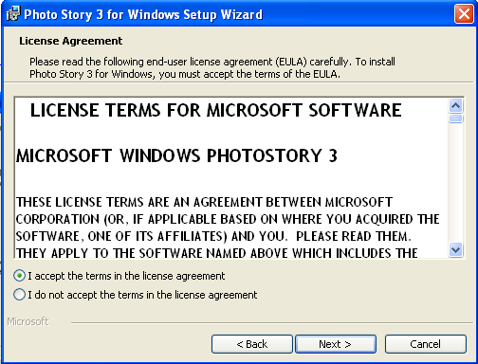
Downloading Photo Story 3
Windows Photo Story 3 Setup Wizard will come up
Accept the agreement
Just follow the set wizard and you will receive Photo Story 3 FREE for your computer.

Slide 5
Introduction of Photo Story 3
Photo Story 3 is a great way to show your digital pictures with movement and music.
Sharing your pictures of events your friends will enjoy.
Photo Story 3 is easy, creative and fun to do.
Lets get started!

Slide 6
Photo Story 3: Getting started
Click on the Start button on the taskbar on the bottom-left of the screen select “All Programs” and select “Photo Story 3.
The welcome screen will ask you three options:
Begin a new story
Edit a project
Play a story
Select the proper option.
Begin a new story.

Slide 7
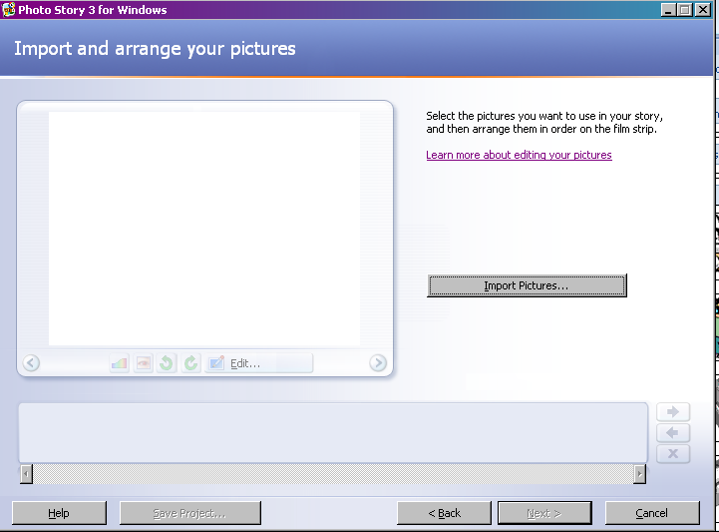
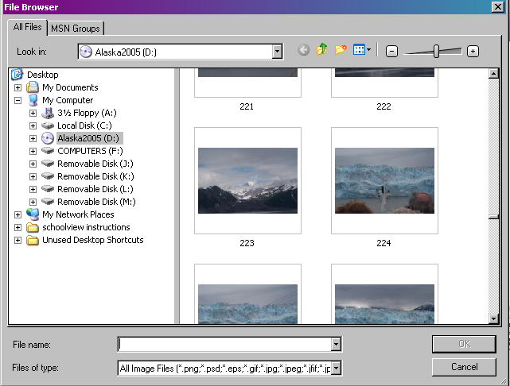
Import your pictures
First, click on the import button and select the files that the pictures you want to download.
Select the pictures that you want to download to your project.
Don’t forget to use Ctrl or the Shift key to choose multiple pictures.

Slide 8
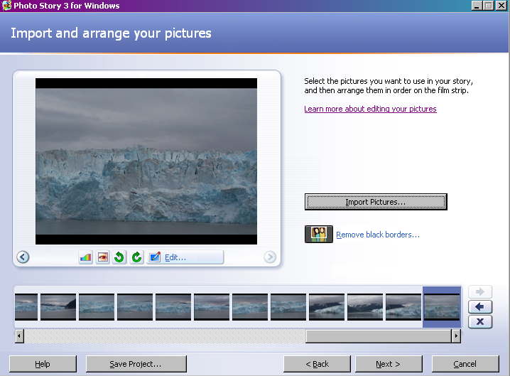
Arranging your pictures
Once the pictures are downloaded, now it is time to arrange your pictures in an order to tell a story.
Simply use drag-and-drop techniques to move pictures forward and backward.
Use the viewer to help you see your thumbnails better.
You can delete pictures or add more pictures at time as well.

Slide 9
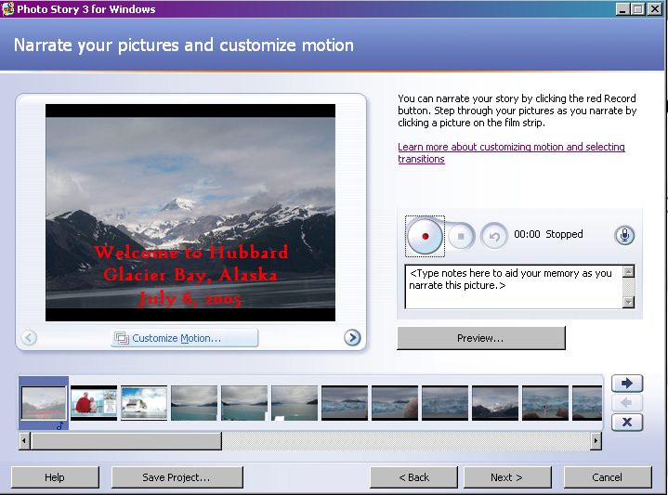
Narration of your project
With Photo Story 3 and a digital microphone you give a narration of your picture slides.
The large round button starts recording your voice for narration.
When you finish click on the stop button next to the recording.
Preview your slide for your narration to see if it is correct.
If not,click the Undo button and try again.

Slide 10
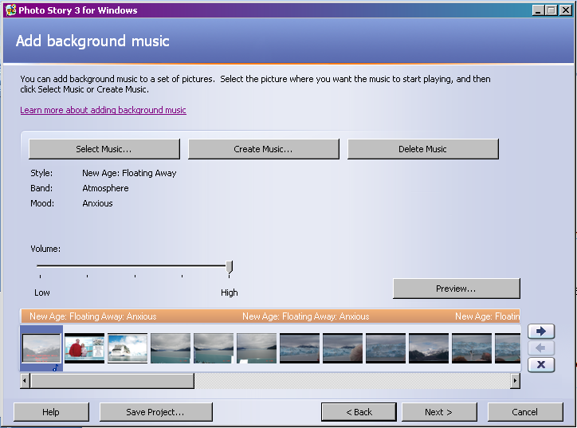
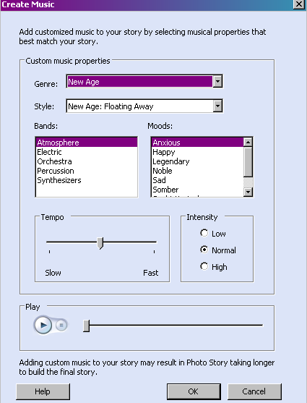
Create background music
If you want to use your favorite song from your I-pod, mpg or CDs you can download them to your project.
Simply click the first button
Select Music.
Photo Story has many prerecorded music to use for your project.
Select the second option
Create Music
If you want to change simply hit the third option and try again.
Delete Music
The music will load into your project. This could take a minute or two.

Slide 11
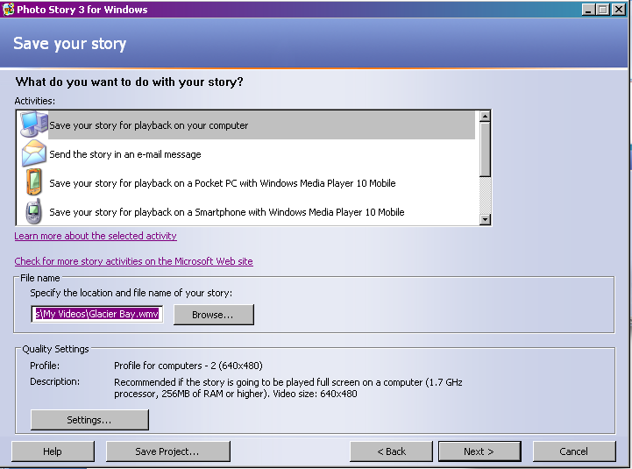
Saving your project
You can save your project in many different formats. To use in many different ways. You can save your project to use for the following:
The Computer
Your “Smart Phone”
Your I-pod or mpg
E-mail
Pocket PC, like Palm Pilot

Slide 12
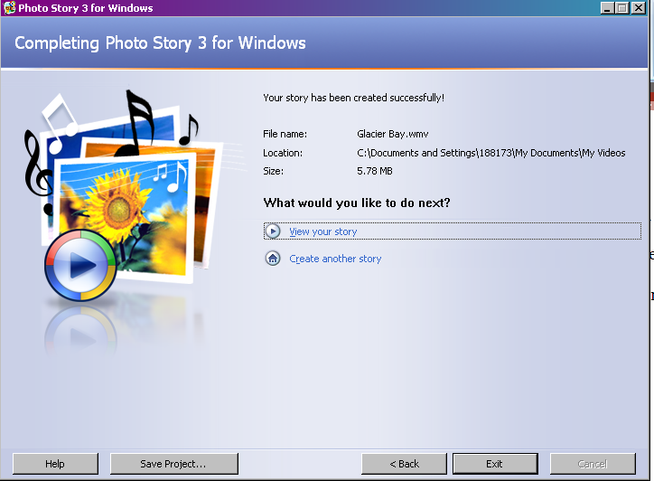
Completing your project
The last window of your project is to decide to:
View your project
You will see your project like a video format, like Real Player or other formats
Create a new project
You can begin another project quickly and efficiently.

Slide 13
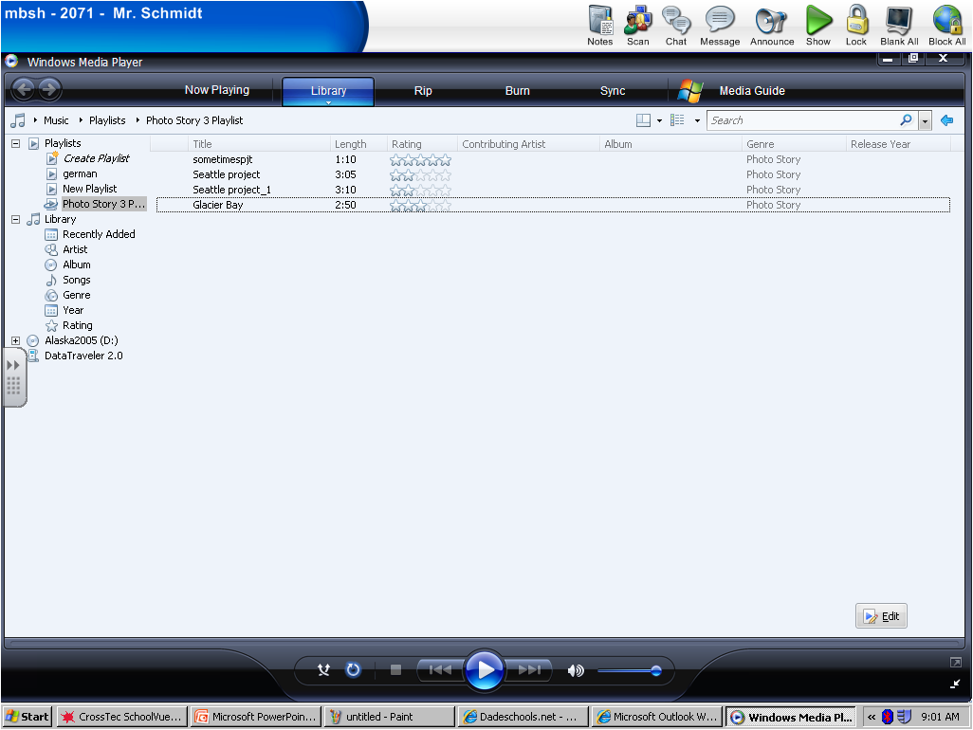
Lets take a look at a Photo Story 3 Project!

Slide 14
Enjoy working with Photo Story 3!

