Slide 1
The Cultural Landscape: An Introduction to Human Geography
Thirteenth Edition
Chapter 3 Lecture
Migration
Copyright © 2020 Pearson Education, Inc. All Rights Reserved
Notes:
If this PowerPoint presentation contains mathematical equations, you may need to check that your computer has the following installed:
1) MathType Plugin
2) Math Player (free versions available)
3) NVDA Reader (free versions available)

Slide 2
Migration: Key Issues
3.1 Where Are Migrants Distributed?
3.2 Where Do People Migrate Within Countries?
3.3 Why Do People Migrate?
3.4 Why Do Migrants Face Challenges?

Slide 3
Key Issue 1: Where Are Migrants Distributed?
3.1.1 Migration and Geography
3.1.2 International and Internal Migration
3.1.3 Immigration and Emigration
3.1.4 Changing U.S. Immigration

Slide 4
3.1.1 Migration and Geography (1 of 4)
Migration is a permanent move to new location
Mobility: one’s ability to move from place to place. Not all mobility is migration. Short-term, repetitive movement (e.g., going to work on a daily basis) is known as circulation

Slide 5
3.1.1 Migration and Geography (2 of 4)
The migration transition is a change in the migration pattern in a society that results from the social and economic changes that also produce the demographic transition migration patterns change with demographic transition (Wilbur Zelinsky)

Slide 6
3.1.1 Migration and Geography (3 of 4)
Table 3-1: Changes in the demographic transition happen in tandem with changes in the migration transition.
Stage | Demographic Transition | Migration Transition
1 | Low N I R, high C B R, high C D R | High daily or seasonal mobility in search of food
2 | High N I R, high C B R, rapidly falling C D R | High international emigration and interregional migration from rural to urban areas
3 | Declining N I R, rapidly declining C B R, declining C D R | High international immigration and intraregional migration from cities to suburbs
4 | Low N I R, low C B R, low C D R | Same as stage 3

Slide 7
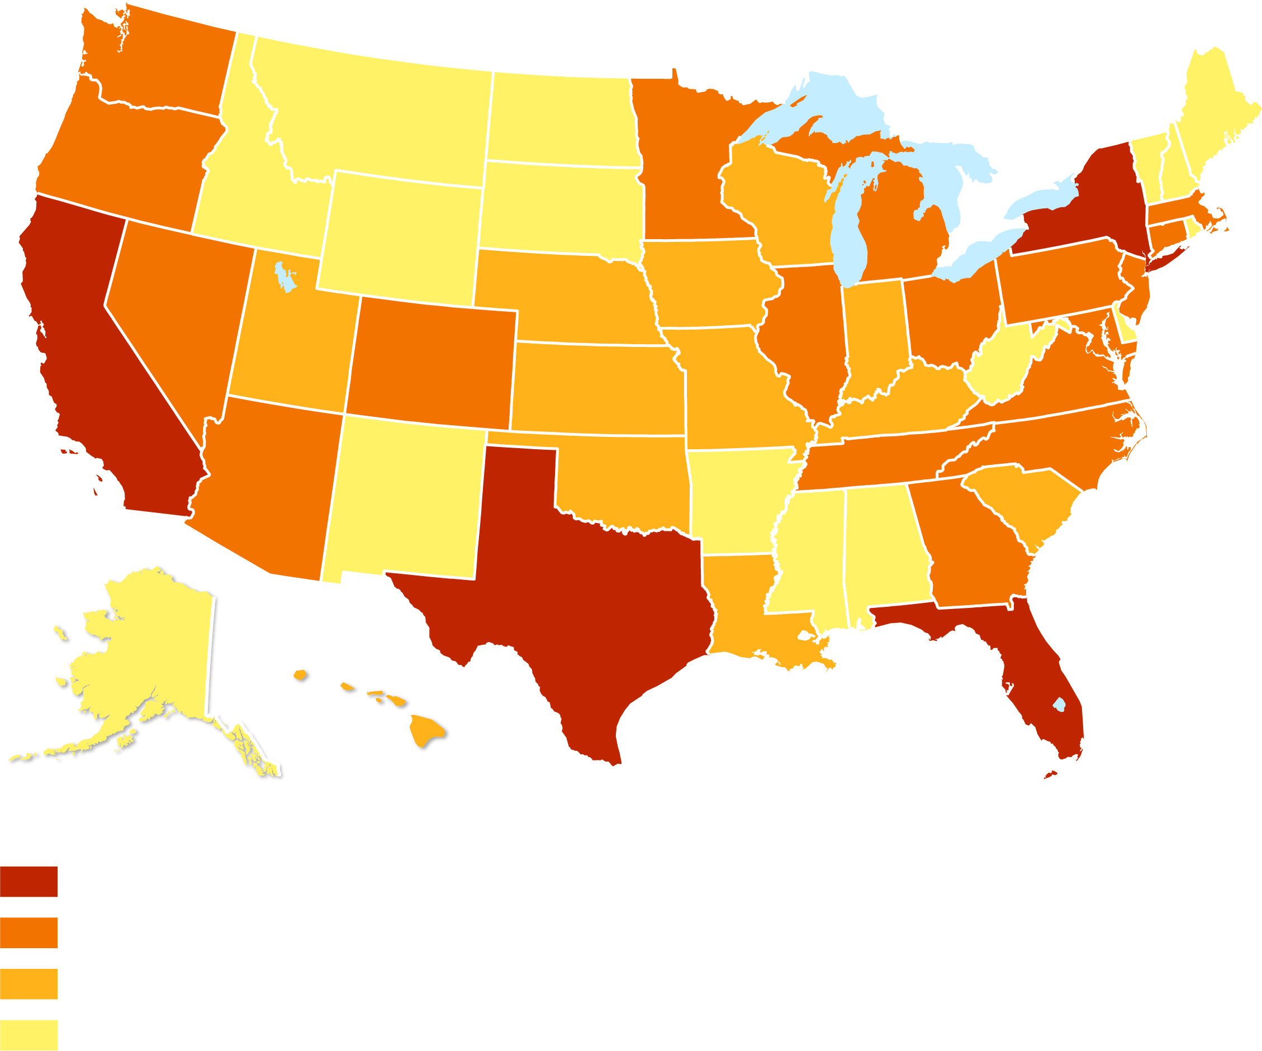
3.1.1 Migration and Geography (4 of 4)
Figure 3-3: California, New York, Florida, and Texas are the leading destinations for immigrants.
Immigrants, 2016
100,000 and above
10,000–99,999
5,000–9,999
below 5,000

Slide 8
3.1.2 International and Internal Migration (1 of 5)
A permanent move from one country to another is international migration. International migration is further divided into two types:
Voluntary migration means that the migrant has chosen to move, usually for economic reasons, though sometimes for environmental reasons
Forced migration means that the migrant has been compelled to move by political or environmental factors

Slide 9
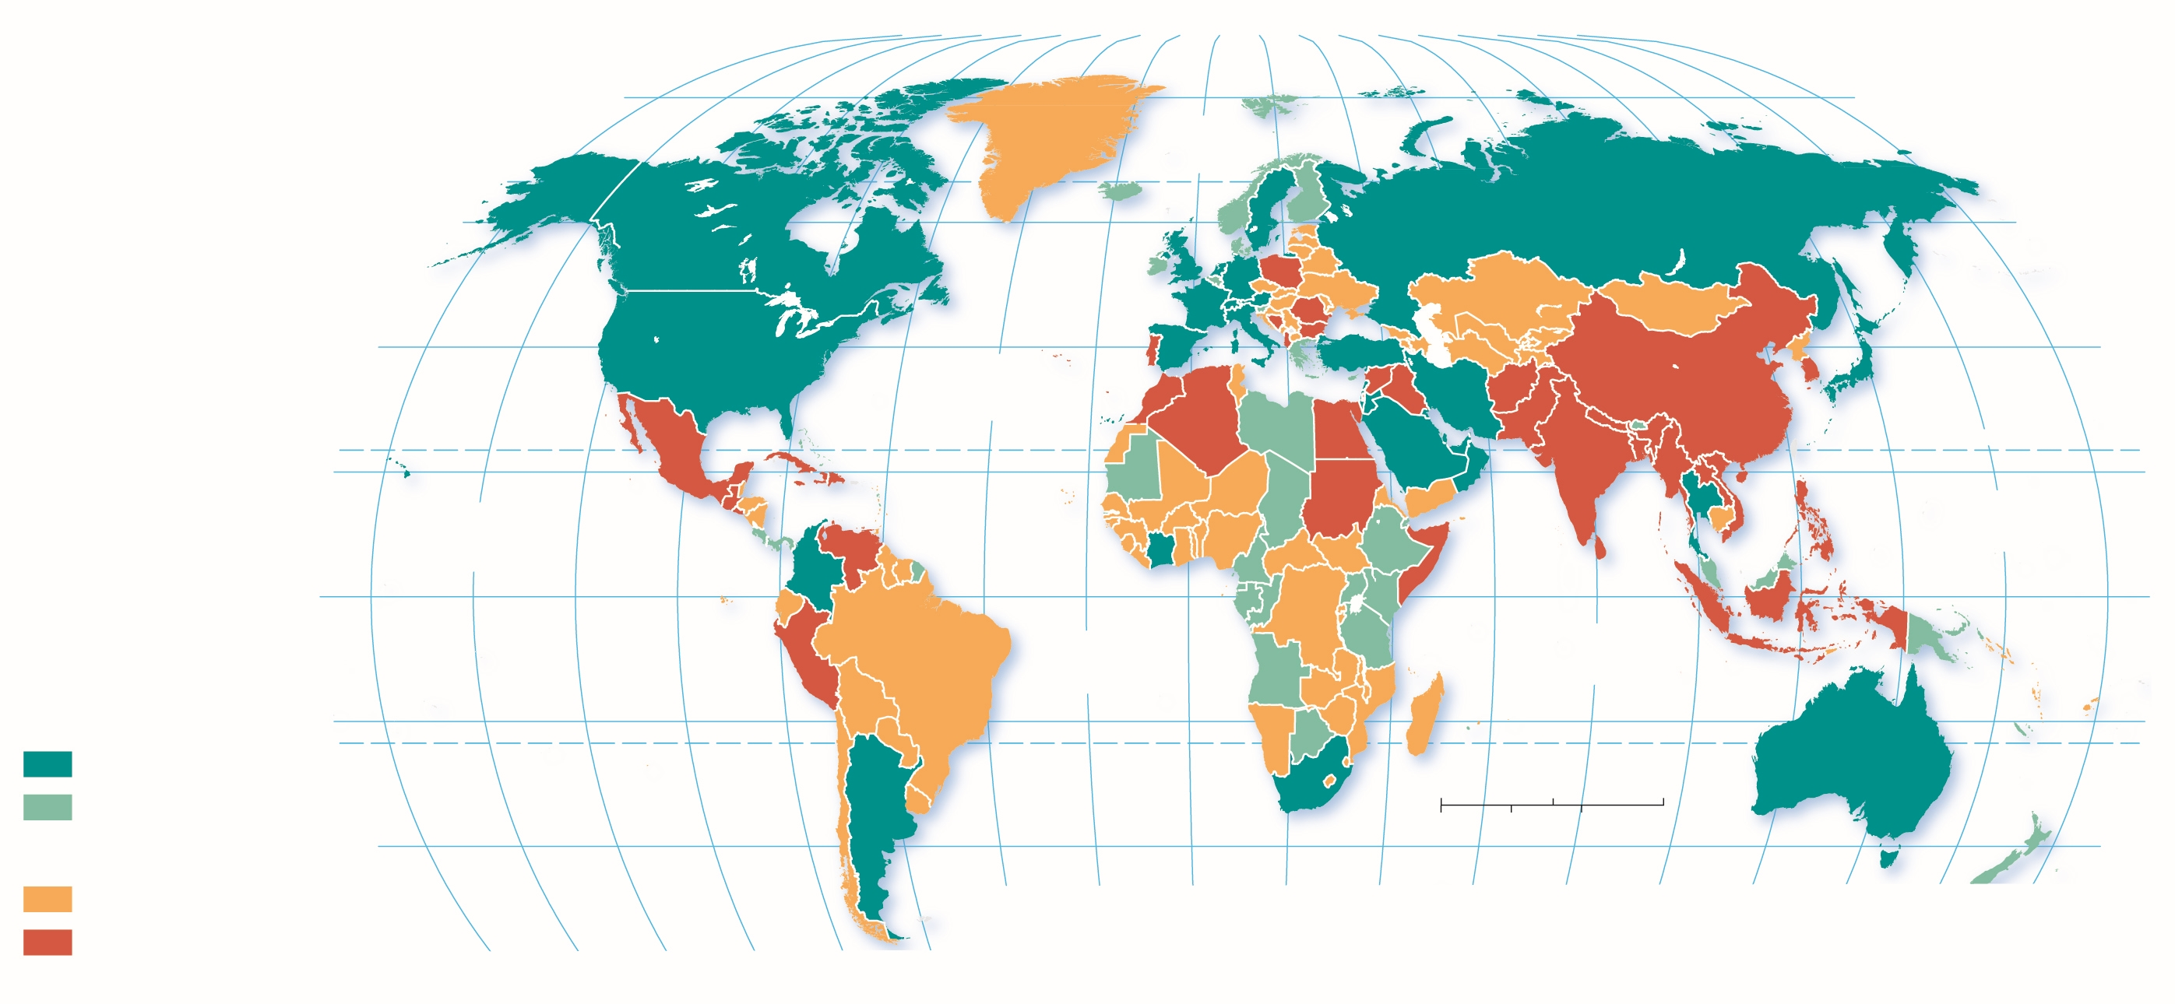
3.1.2 International and Internal Migration (2 of 5)
Figure 3-5: Major international flows in 2014 were out of South Asia, East Asia, and Latin America and into North America, Europe, and Southwest Asia.
80°
160°
140°
120°
100°
80°
60°
40°
20°
0°
20°
40°
60°
80°
100°
120°
140°
160°
180°
80°
ARCTIC OCEAN
60°
60°
40°
ATLANTIC OCEAN
40°
20°
TROPIC OF CANCER
20°
PACIFIC OCEAN
PACIFIC OCEAN
0°
EQUATOR
0°
ATLANTIC OCEAN
INDIAN OCEAN
Net in-migration
20°
20°
1 million and above
0
1,500
TROPIC OF CAPRICON
less than 1 million
0
1,500
3,000 Miles
Net out-migration
40°
3,000 Kilometers
40°
less than 1 million
40°
20°
0°
20°
40°
60°
80°
100°
120°
140°
160°
180°
1 million and above
160°
140°
120°
100°
80°
60°

Slide 10
3.1.2 International and Internal Migration (3 of 5)
A permanent move within the same country is internal migration
There are two types of internal migration:
Interregional: movement from one region to a different one
Intraregional: movement within one region

Slide 11
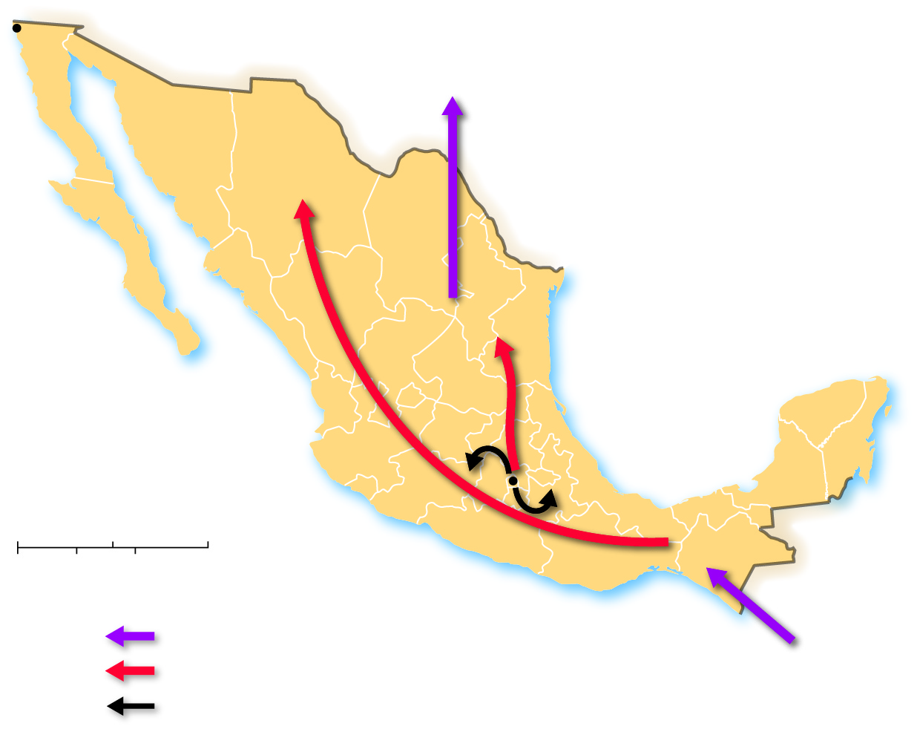
3.1.2 International and Internal Migration (4 of 5)
Figure 3-7: Mexico’s migration flows are both international and internal. Internal flows are both intraregional and interregional.
Tijuana
To the United States
BAJA
CALIFORNIA
SONORA
CHIHUAHUA
BAJA
CALIFORNIA
SUR
COAHUILA
NUEVO
LEÓN
SINALOA
DURANGO
TAMAULIPAS
ZACATECAS
QUERÉTARO
NAYARIT
SAN LUIS
POTOSÍ
HIDALGO
AGUASCALIENTES
CIUDAD DE MÉXICO
YUCATÁN
JALISCO
CAMPECHE
QUINTANA
ROO
GUANAJUATO
Mexico City
VERACRUZ
TABASCO
COLIMA
0
200
400 Miles
MICHOACÁN
MÉXICO
CHIAPAS
0
200
400 Kilometers
MORELOS
OAXACA
Migration
GUERRERO
PUEBLA
International
From
Central America
Internal interregional
Internal intraregional

Slide 12
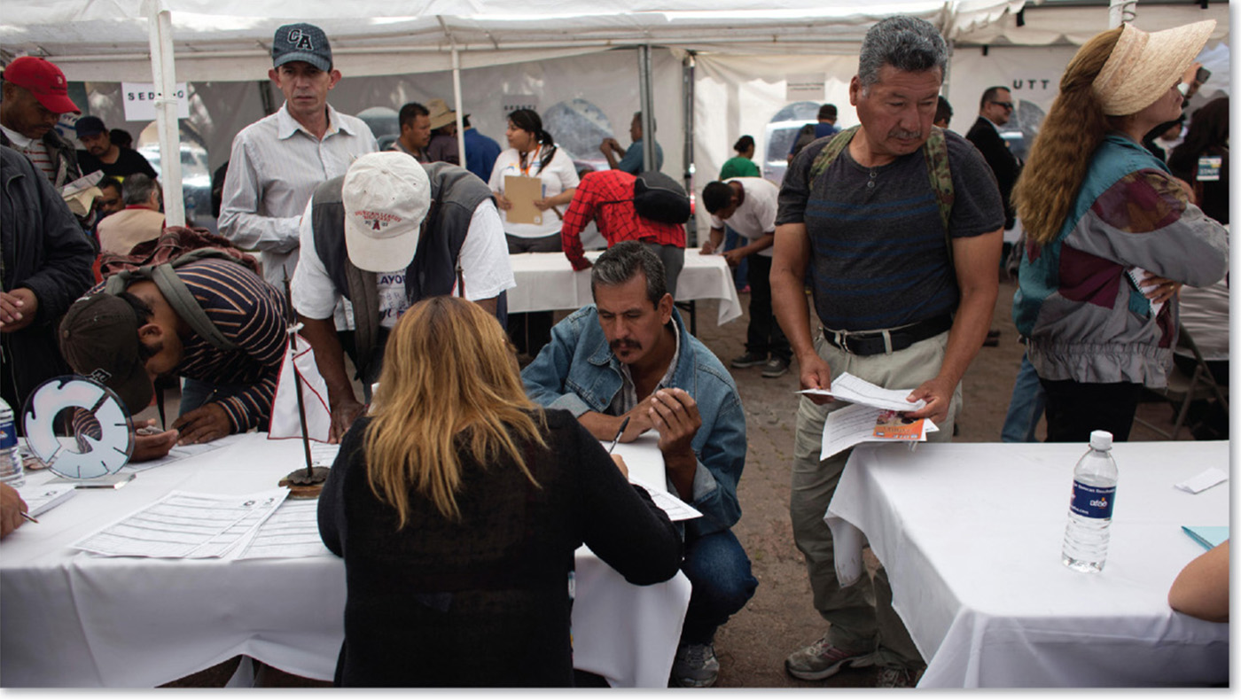
3.1.2 International and Internal Migration (5 of 5)
Figure 3-8: Jobs Fair for interregional migrants seeking work in Tijuana, Mexico.

Slide 13
3.1.3 Immigration and Emigration (1 of 5)
emigration is migration from a location; immigration is migration to a location
The difference between the number of immigrants and the number of emigrants is the net migration

Slide 14
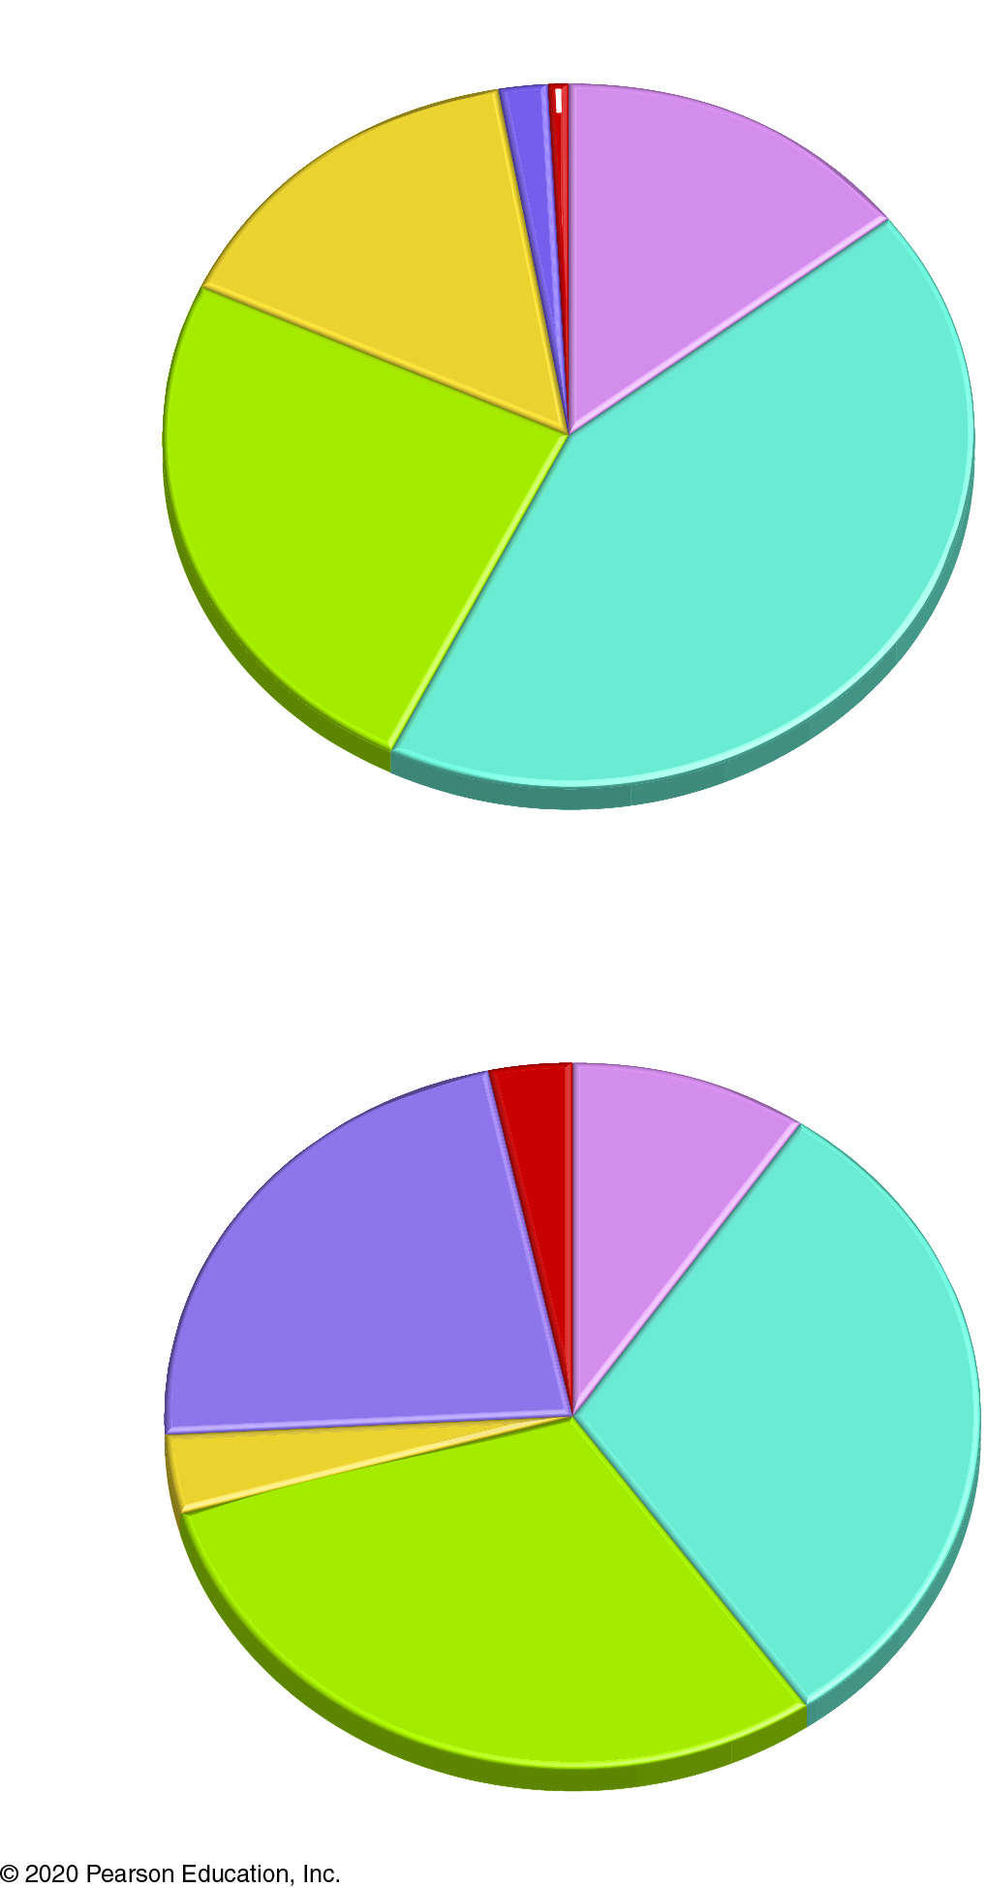
3.1.3 Immigration and Emigration (2 of 5)
Figure 3-9: More than 40 percent of international migrants originate in Asia.
North America 1.8%
South Pacific 1.0%
Latin
America
15.2%
Africa
14.6%
Europe
24.7%
Asia
42.7%
Origin
South Pacific 3.2%
Africa
9.7%
North
America
22.3%
Asia
30.8%
Latin
America
3.7%
Europe
30.3%
.
Destination

Slide 15
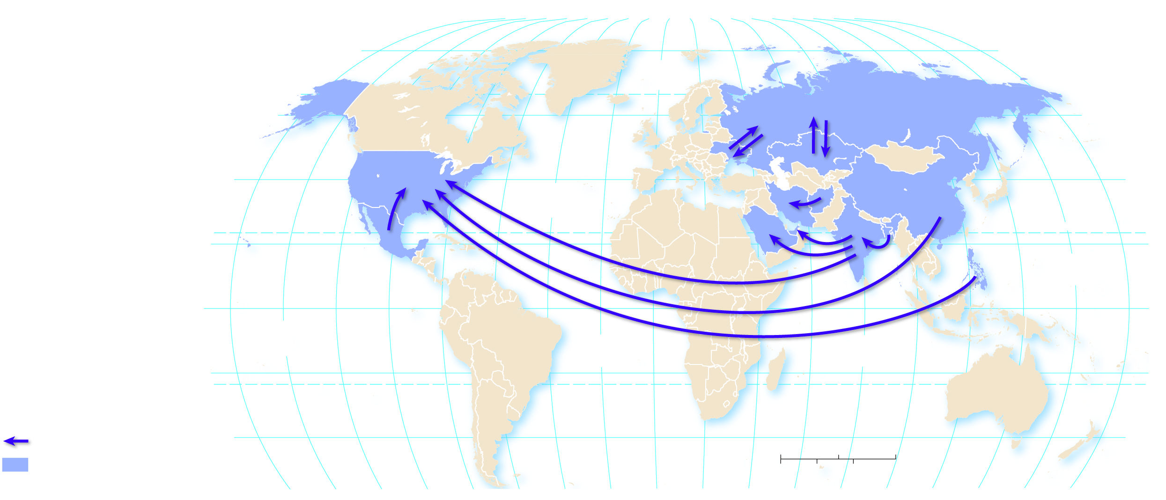
3.1.3 Immigration and Emigration (3 of 5)
Figure 3-10: Large migration flows are between countries in Asia and out of Asia, with the exception of Latin America to North America.
80°
160°
140°
120°
100°
80°
60°
40°
20°
0°
20°
40°
60°
80°
100°
120°
140°
160°
180°
80°
ARCTIC
OCEAN
60°
60°
40°
ATLANTIC
OCEAN
40°
20°
TROPIC OF CANCER
20°
PACIFIC
OCEAN
0°
EQUATOR
0°
PACIFIC
OCEAN
ATLANTIC
OCEAN
INDIAN
OCEAN
20°
20°
International migration
TROPIC OF CAPRICORN
Direction of migrant flow
40°
0
1,500
3,000 Miles
40°
Country with large migrant flow
0
1,500
3,000 Kilometers
160°
140°
120°
100°
80°
60°
40°
20°
0°
20°
40°
60°
80°
100°
120°
140°
160°
180°

Slide 16
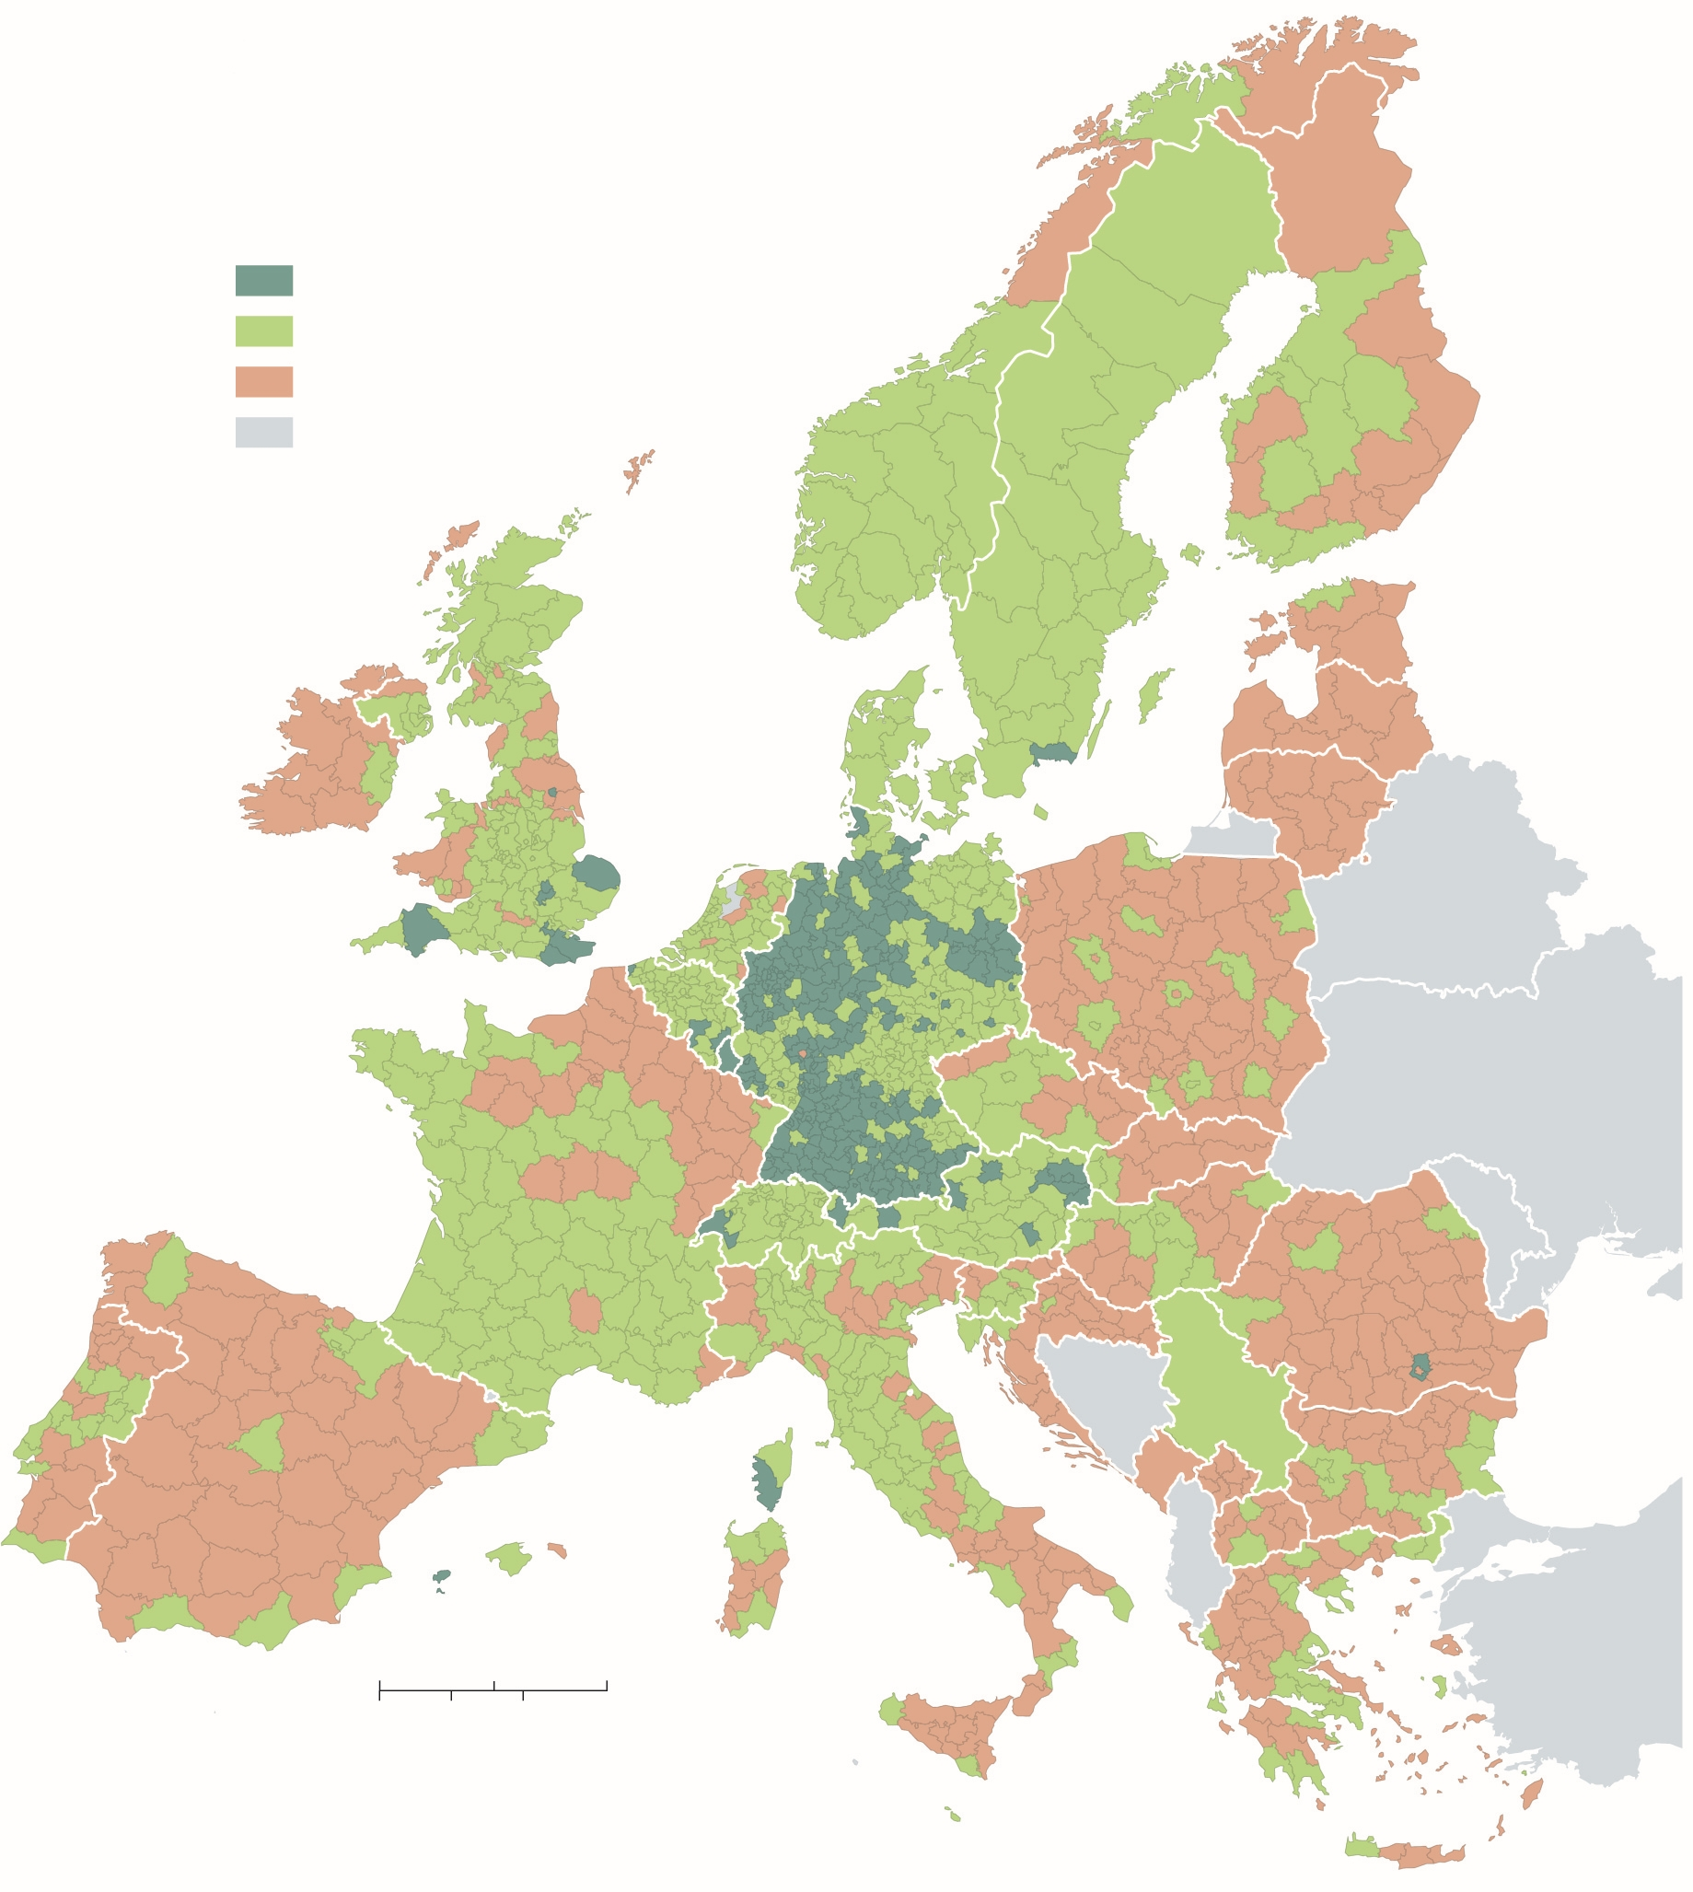
3.1.3 Immigration and Emigration (4 of 5)
Figure 3-11: Eastern Europe is a source region of migrants moving to Western and Northern Europe, in particular Germany.
Migration per
1,000 inhabitants
Gain 12 and above
Gain less than 12
Loss
SWEDEN
FINLAND
not in European Union
NORWAY
ESTONIA
IRELAND
UNITED
KINGDOM
DENMARK
LATVIA
LITHUANIA
NETH.
POLAND
BELARUS
BELGIUM
GERMANY
LUX.
CZECHIA
SLOVAKIA
FRANCE
SWITZ.
AUSTRIA
HUNGARY
SLOVENIA
ROMANIA
PORTUGAL
SPAIN
CROATIA
SERBIA
ITALY
BULGARIA
MONTENEGRO
MACEDONIA
KOSOVO
0
150
300 Miles
GREECE
0
150
300 Kilometers

Slide 17
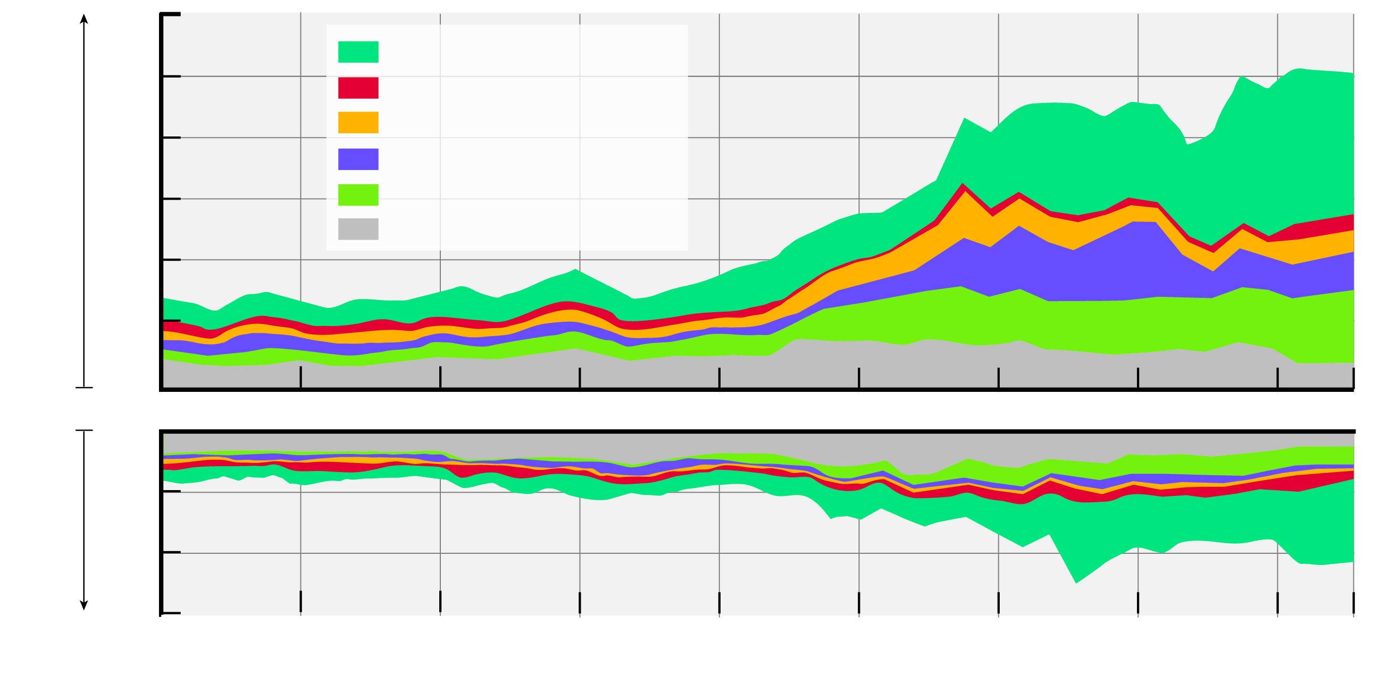
3.1.3 Immigration and Emigration (5 of 5)
Figure 3-12: Since the late twentieth century, the United Kingdom has had more immigration than emigration, especially from Europe and Asia.
600
500
European Union
Latin America & Caribbean
400
Africa
Immigration
(thousands)
South Asia
300
Other Asia
200
Rest of World
100
0
0
Emigration
(thousands)
100
200
300
1975
1980
1985
1990
1995
2000
2005
2010
2015
2017
Year

Slide 18
3.1.4 Changing U.S. Immigration (1 of 2)
The United States has had three main eras of immigration:
Colonial settlement in the 17th and 18th centuries
Mass European immigration in the late 19th and early 20th centuries
Asian and Latin American immigration in the late 20th and early 21st centuries

Slide 19
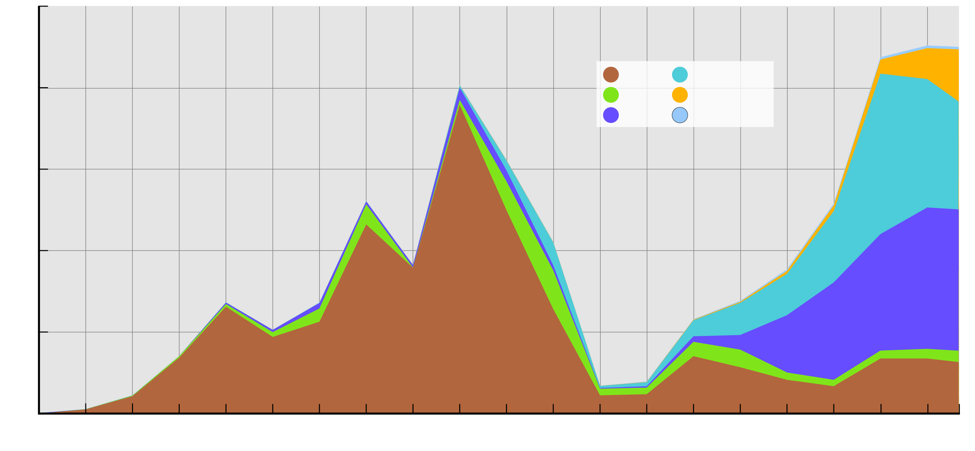
3.1.4 Changing U.S. Immigration (2 of 2)
Figure 3-13: Two centuries of immigration to the United States detail the changing source regions of immigrants to America.
10
8
Europe
Latin America
Canada
Africa
Most immigrants around
1900 came from Eastern
and Southern Europe.
Asia
South Pacific
6
Most recent immigrants
have come from Latin
America and Asia.
Number of immigrants by decade (million)
Most 19th century
immigrants came from
Western Europe.
4
2
0
1820
1830
1840
1850
1860
1870
1880
1890
1900
1910
1920
1930
1940
1950
1960
1970
1980
1990
2000
2010
2017
Decade

Slide 20
Key Issue 2: Where Do People Migrate Within a Countries?
3.2.1 Interregional Migration: United States
3.2.2 Interregional Migration in Other Large Countries
3.2.3 Intraregional Migration

Slide 21
3.2.1 Interregional Migration: United States (1 of 3)
The center of the United States population has consistently shifted westward
1790: Hugging the Coast
1800–1840: Crossing the Appalachians
1850–1890: Rushing to the Gold
1900–1940: Filling in the Great Plains
1950–2010: Moving South

Slide 22
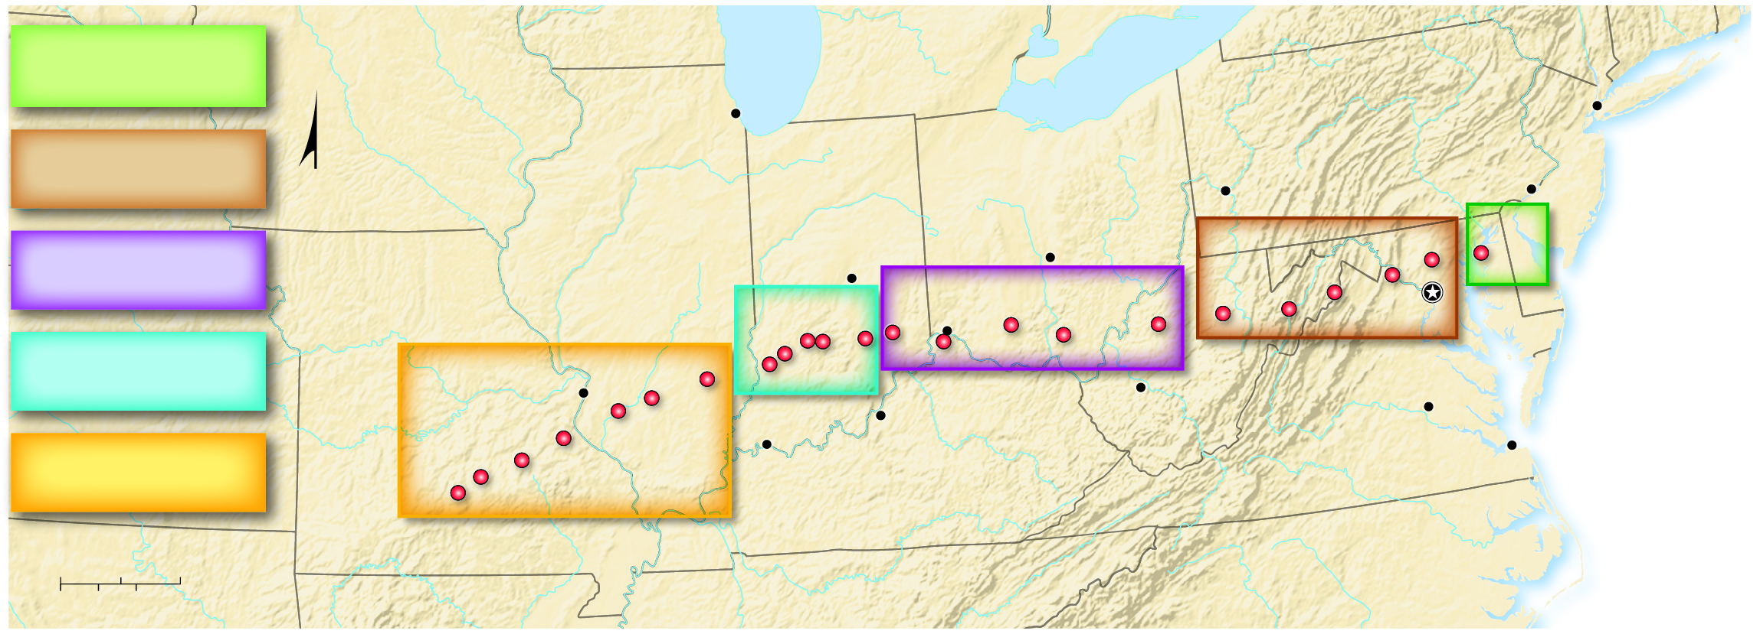
3.2.1 Interregional Migration: United States (2 of 3)
Figure 3-14: The population of the United States has consistently shifted to the south and the west.
1790
WISCONSIN
Lake
Michigan
NEW
YORK
Hugging the Coast
MICHIGAN
Lake Erie
1800–1840
IOWA
Chicago
PENNSYLVANIA
NEW YORK
Crossing the Appalachians
INDIANA
Pittsburgh
Philadelphia
NEW
JERSEY
OHIO
1800–1840
1790
1850–1890
Mississippi R.
ILLINOIS
Indianapolis
Columbus
1800
1790
Rushing to the Gold
MISSOURI
1900–1940
1850–1890
1810
DELAWARE
1920
1900
Cincinnati
1870
1840
1830
1820
Washington D.C.
1900–1940
1930
1890
1880
1860
1850
MARYLAND
Filling in the Great Plains
1950–2010
1950
1940
1910
Charleston
St Louis
1970
1960
Louisville
WEST VIRGINIA
Richmond
1950–2010
1980
Evansville
A P P A L A C H I A N M O U N T A I N S
1990
Ohio R.
VIRGINIA
Norfolk
Moving South
2010
2000
KENTUCKY
NORTH CAROLINA
0
50
100 Miles
0
50
100 Kilometers
ARKANSAS
TENNESSEE

Slide 23
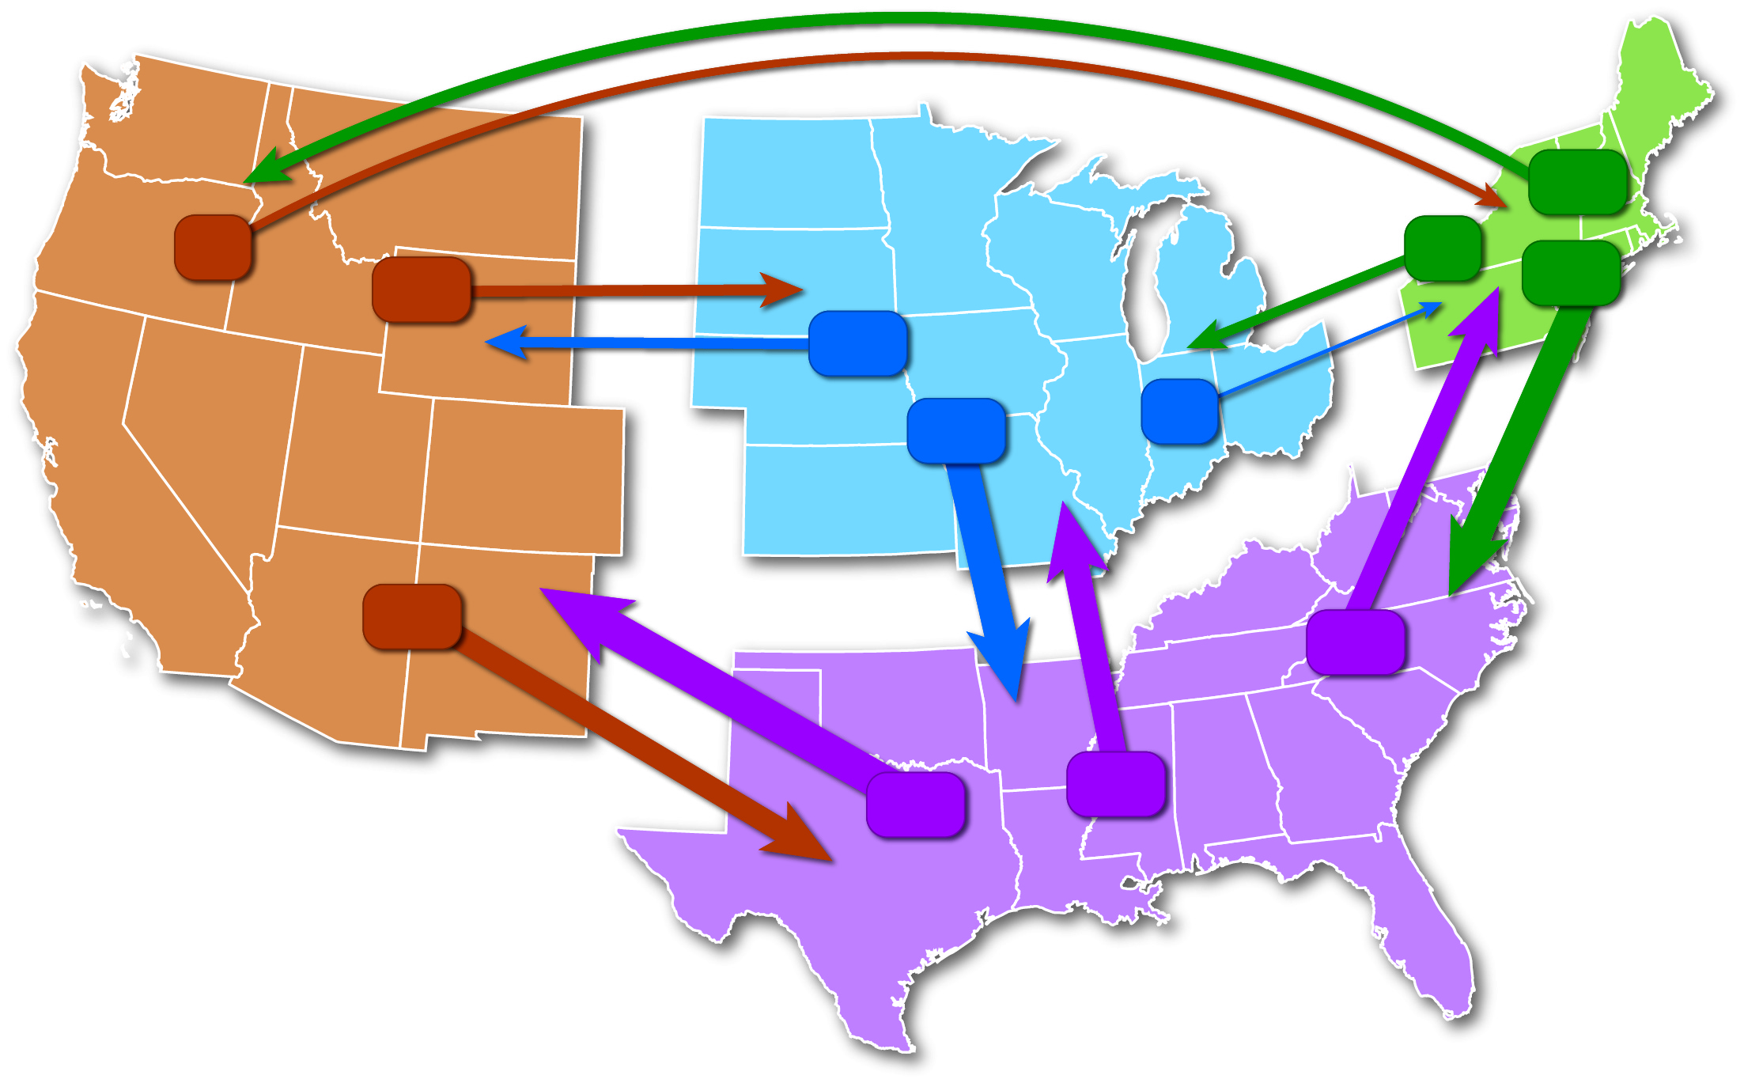
3.2.1 Interregional Migration: United States (3 of 3)
Figure 3-16: Recent net migration trends are to the South.
Northeast
110
73
Midwest
92
104
295
101
West
307
33
221
211
249
South
347
Migration flow in thousands
of people, age 16+, 2016–2017

Slide 24
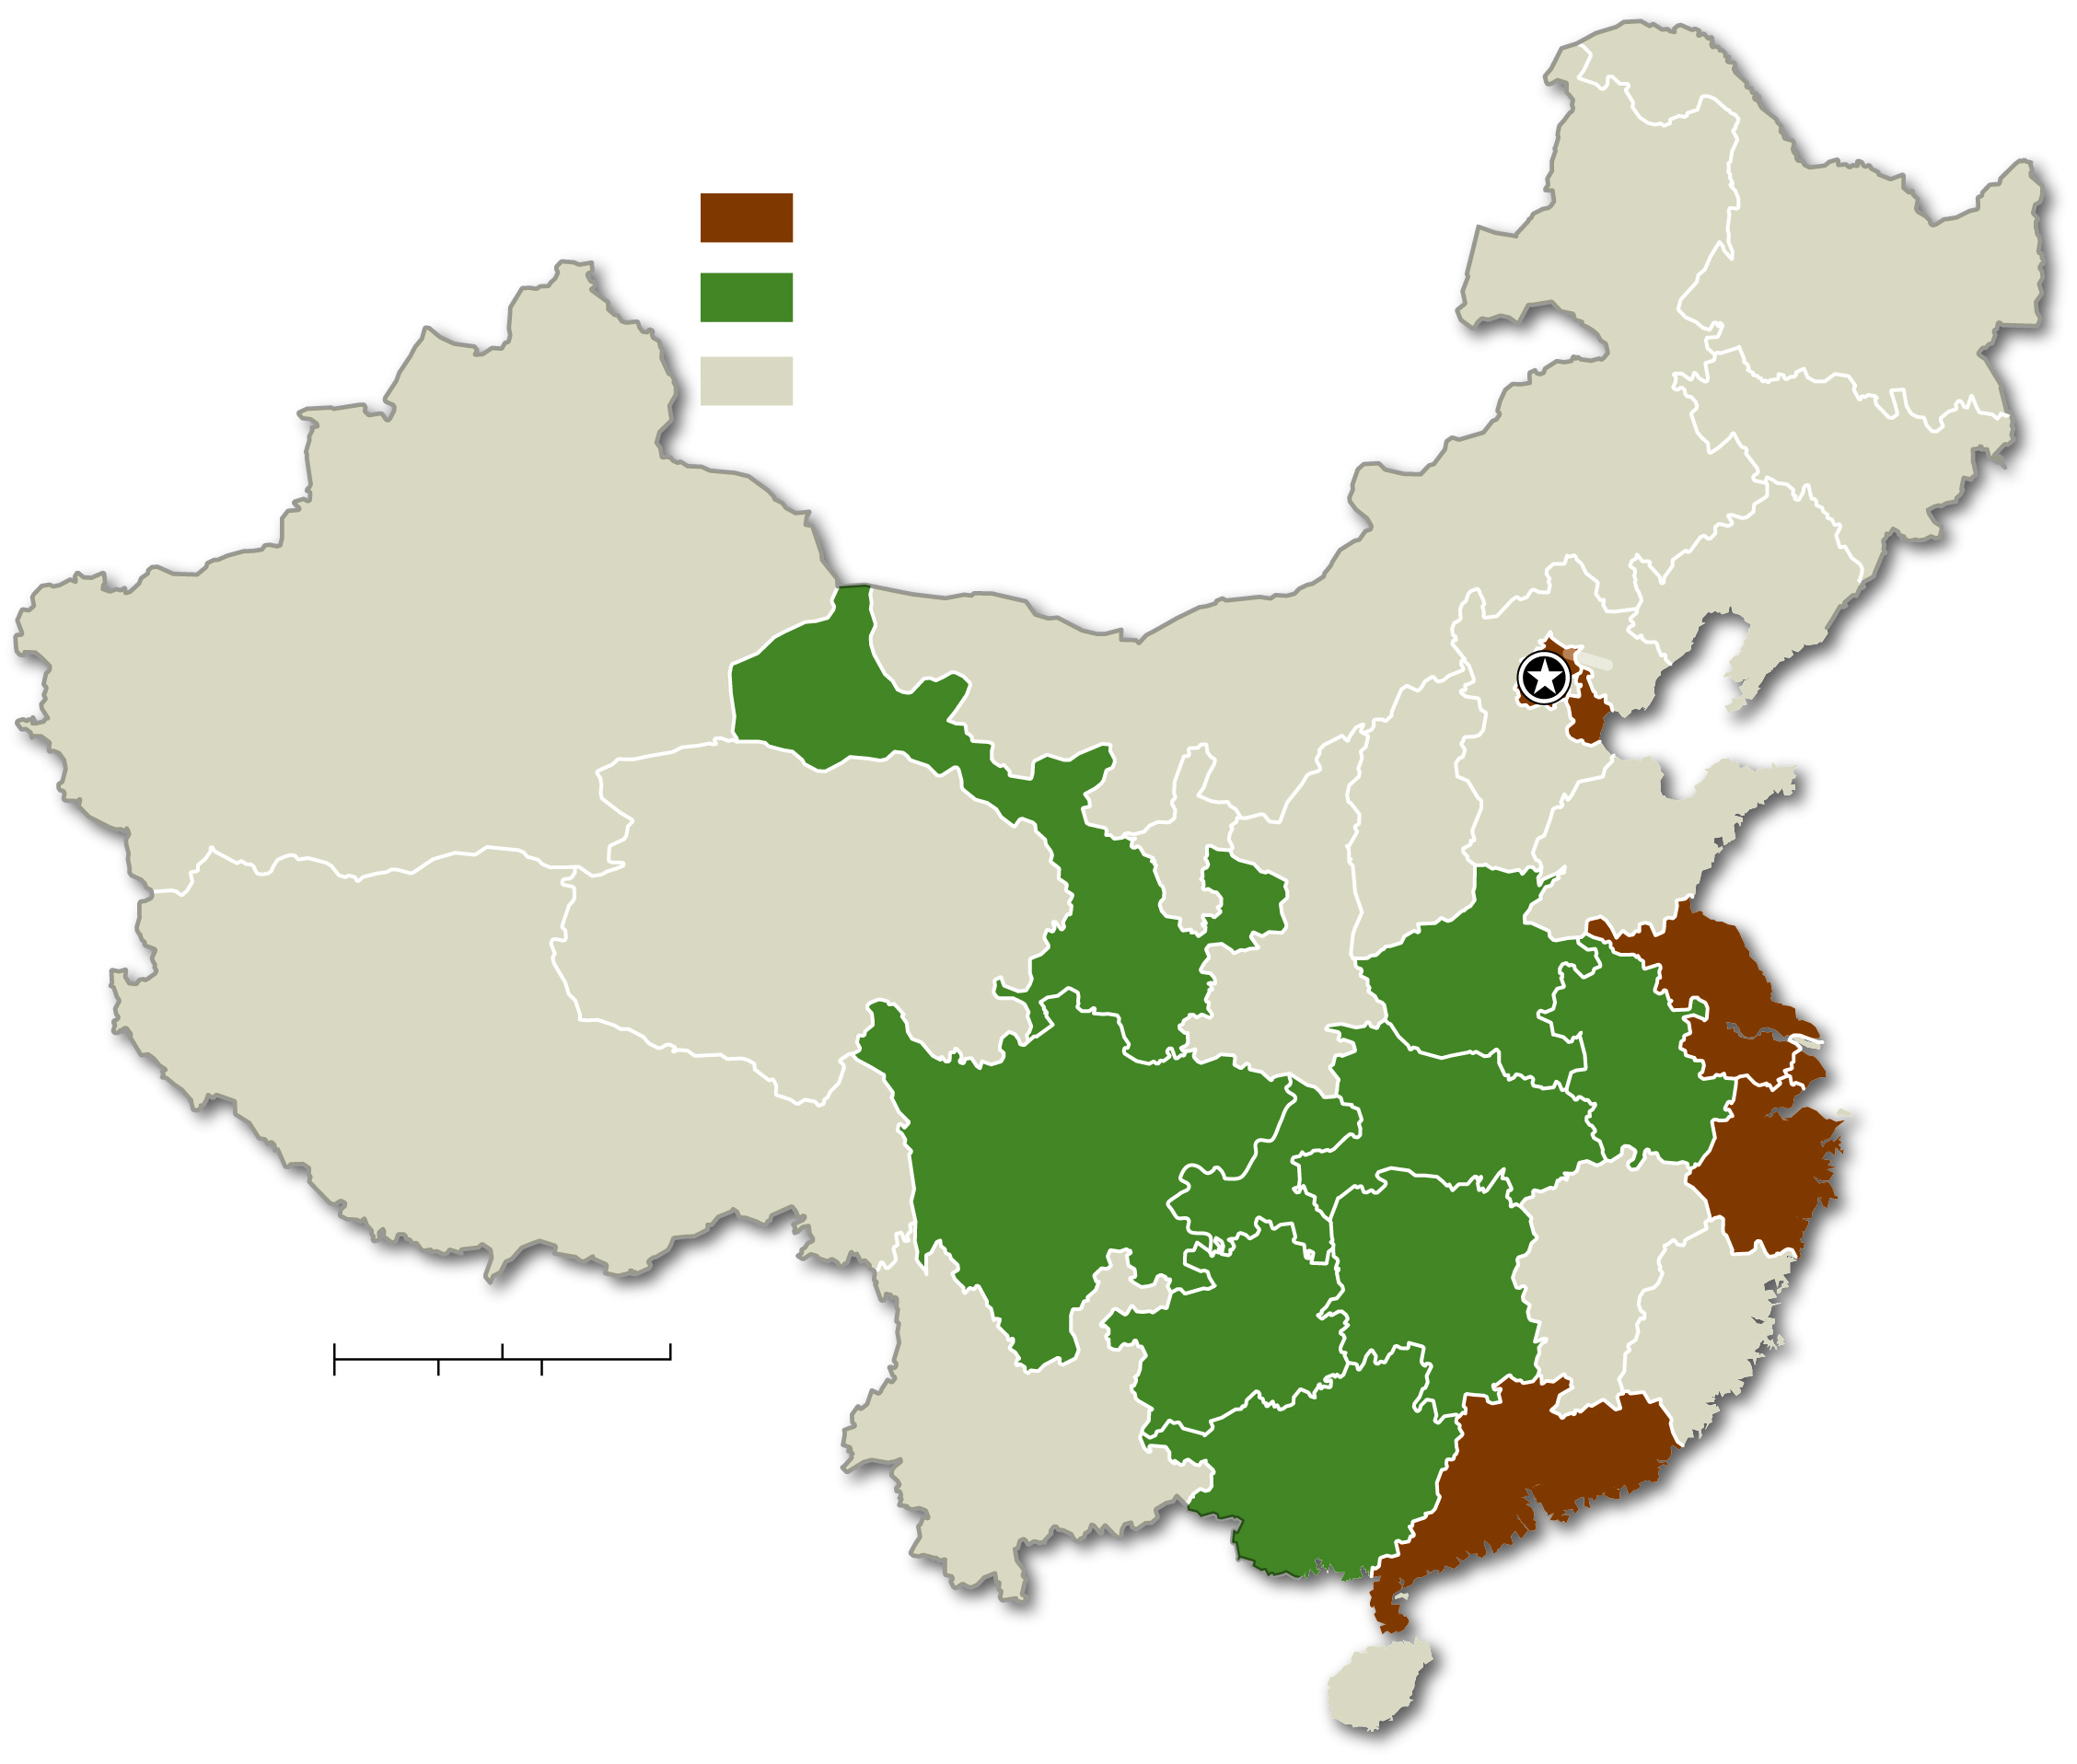
3.2.2 Interregional Migration in Other Large Countries (1 of 4)
Figure 3-17: Interregional migration in China reflects movement toward large coastal cities.
Interregional net migration,
2001–2015
gain 3 million and above
loss 3 million and above
HEILONGJIANG
gain or loss less than 1 million
JILIN
XINJIANG UYGUR
Beijing
LIAONING
GANSU
NEI MONGOL
BEIJING
HEBEI
TIANJIN
NINGXIA
SHANXI
SHANDONG
QINGHAI
SHAANXI
HENAN
JIANGSU
XIZANG
(TIBET)
HUBEI
ANHUI
SHANGHAI
SICHUAN
CHONGQING
ZHEJIANG
HUNAN
JIANGXI
0
200
400 Miles
GUIZHOU
FUJIAN
0
200
400 Kilometers
YUNNAN
GUANGXI
GUANGDONG
HAINAN

Slide 25
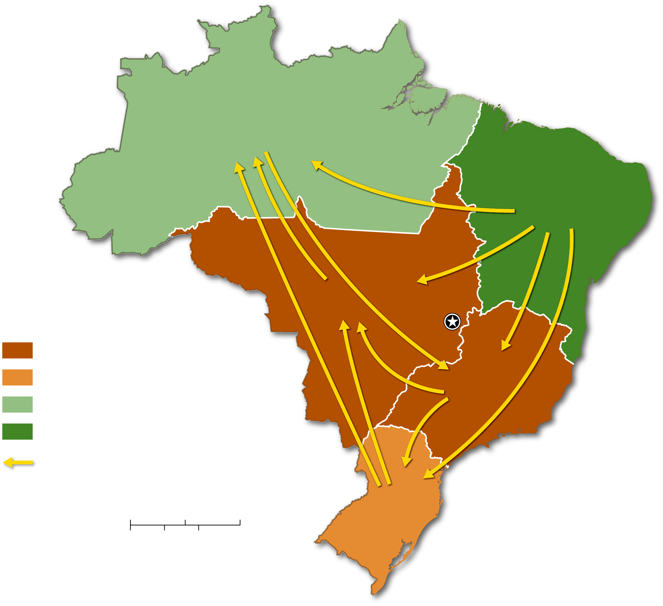
3.2.2 Interregional Migration in Other Large Countries (2 of 4)
Figure 3-18: : Brazil’s interregional migrations show evidence of development of the interior.
NORTH
NORTH EAST
Interregional net migration
CENTER WEST
Brasília
gain 500,000 and above
gain less than 500,000
SOUTH EAST
gain less than 100,000
loss 2 million and above
direction of net migration
0
250
500 Miles
SOUTH
0
250
500 Kilometers

Slide 26
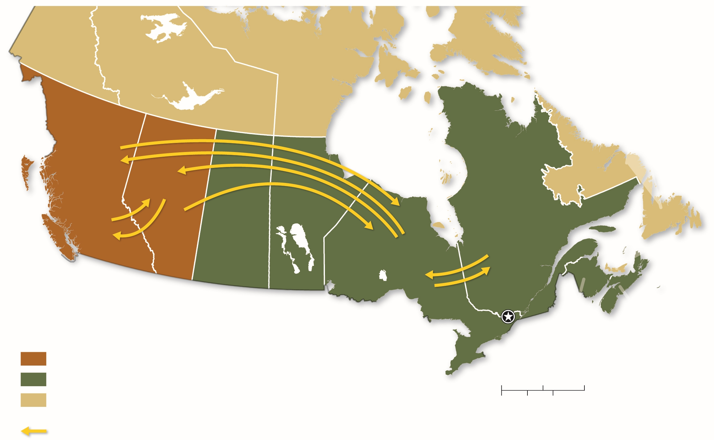
3.2.2 Interregional Migration in Other Large Countries (3 of 4)
Figure 3-20: Canada’s interregional migration patterns are to the west, like U.S. historical trend.
YUKON
NUNAVUT
NORTHWEST
TERRITORIES
NEWFOUNDLAND
AND LABRADOR
BRITISH
COLUMBIA
ALBERTA
MANITOBA
QUEBEC
SASKATCHEWAN
ONTARIO
PRINCE
EDWARD
ISLAND
Interregional net migration,
2011–2017
Ottawa
NOVA
SCOTIA
NEW
BRUNSWICK
gain 50,000 and above
loss over 10,000
0
200
400 Miles
gain or loss less than 4,000
0
200
400 Kilometers
at least 50,000 migrants

Slide 27
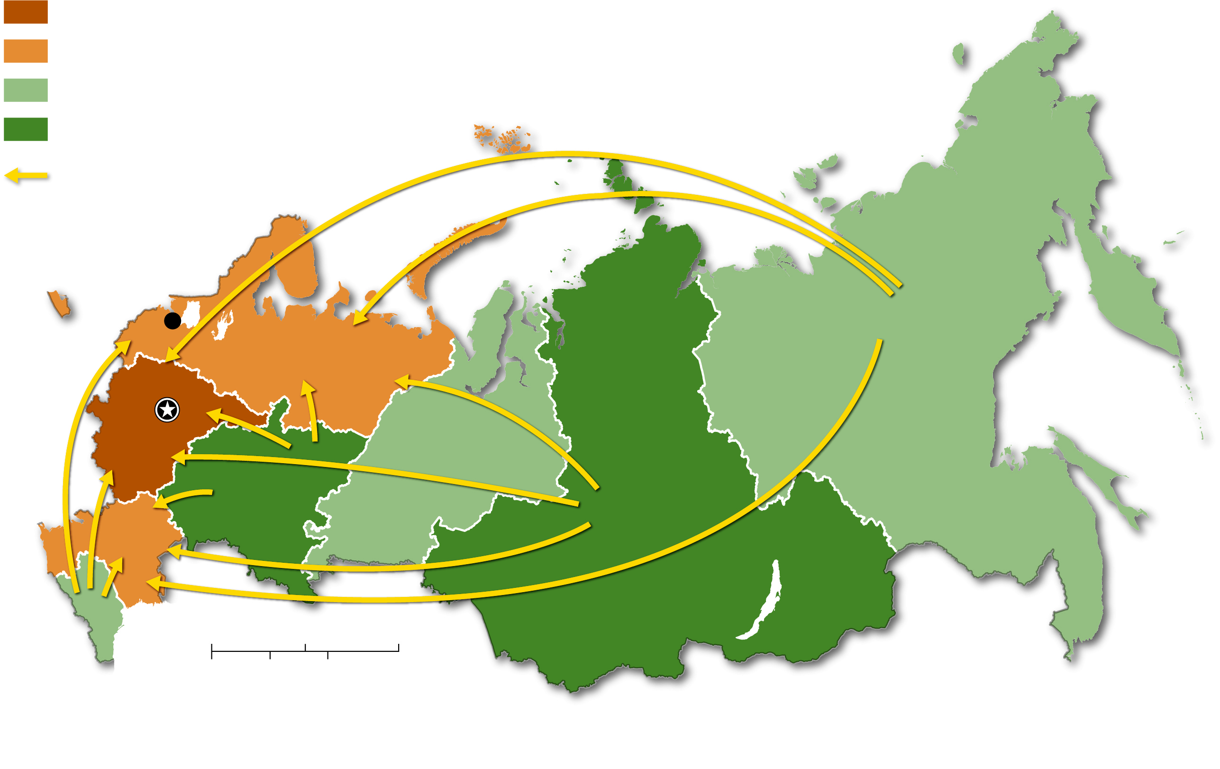
3.2.2 Interregional Migration in Other Large Countries (4 of 4)
Figure 3-23: Russia’s interregional migration patterns show the reversal of earlier attempts to populate its Asian regions.
Interregional net migration, 2013
gain 50,000 and above
gain less than 50,000
loss less than 50,000
loss 50,000 and above
direction of net migration
St. Petersburg
FAR EAST
Moscow
NORTHWEST
CENTRAL
URALS
VOLGA
SIBERIAN
SOUTHERN
NORTH CAUCASUS
0
400
800 Miles
0
400
800 Kilometers

Slide 28
3.2.3 Intraregional Migration (1 of 5)
Rural to urban migration most common in developing countries
Urban to suburban common in developed countries
Urban to rural (counterurbanization) observed in some cases

Slide 29
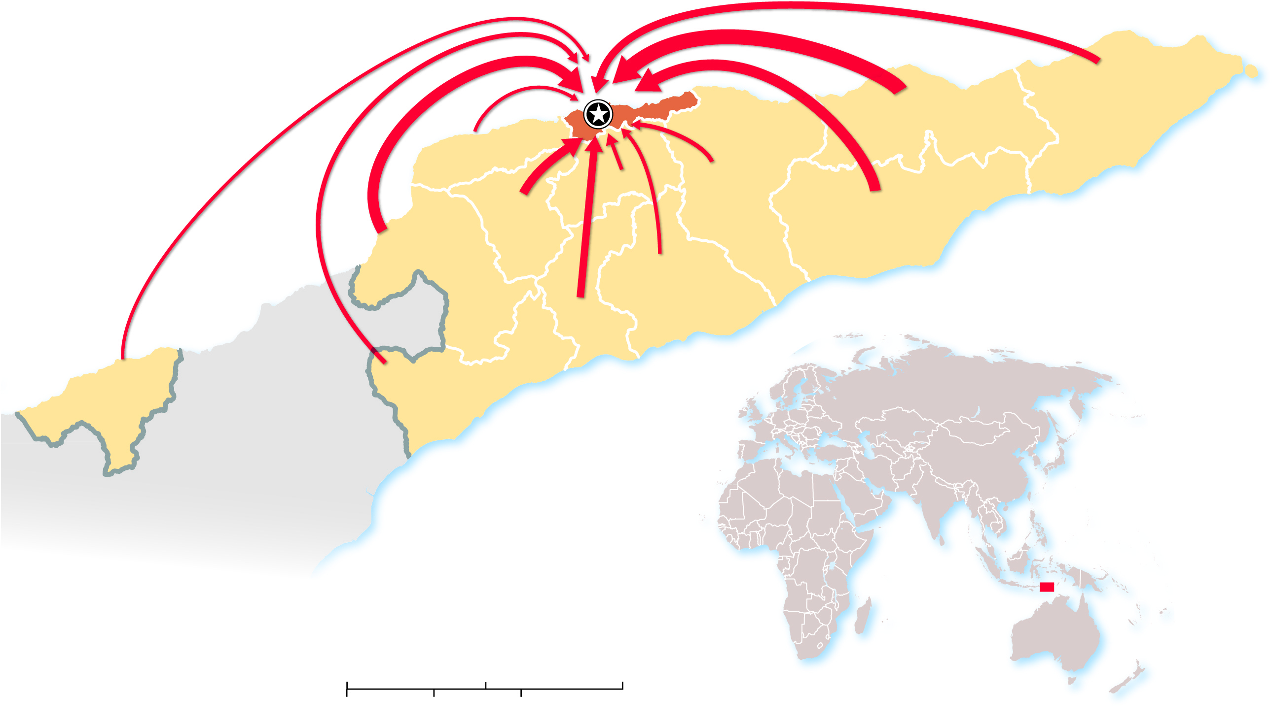
3.2.3 Intraregional Migration (2 of 5)
Figure 3-24: Migration flows in Timor-Leste are mostly from rural areas into the capital and largest city of Dili.
Dili
DILI
BAUCAU
LAUTÉM
LIQUIÇÁ
AILEU
MANATUTO
ERMERA
VIQUEQUE
BOBONARO
MANUFAHI
AINARO
OECUSSE
COVALIMA
INDONESIA
0
25
50 Miles
0
25
50 Kilometers
Area of map

Slide 30
3.2.3 Intraregional Migration (3 of 5)
Figure 3-26: The largest U.S. intraregional migration flow is from the city to the suburbs.
From city
to suburb
2,793,000
5,041,000
From suburb to city
403,000
From
Nonmetropolitan
to city
From suburb to
nonmetropolitan
530,000
474,000
605,000
From city to
nonmetropolitan
From nonmetropolitan
to suburb

Slide 31
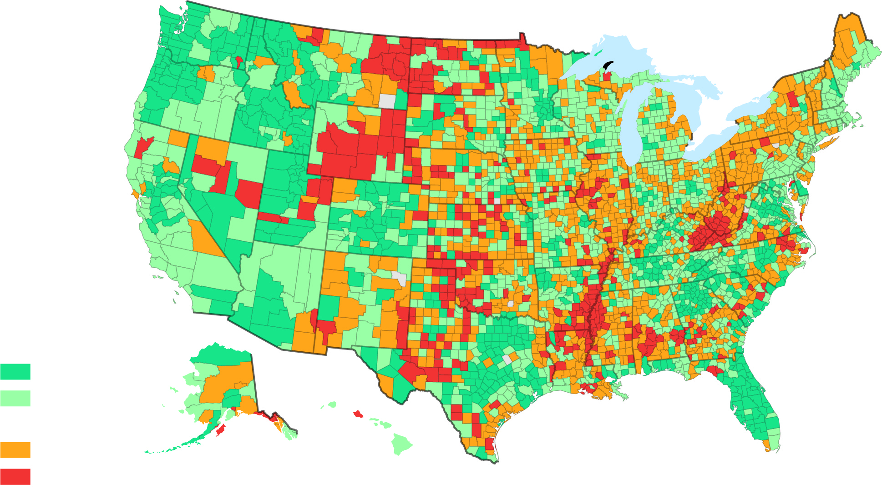
3.2.3 Intraregional Migration (4 of 5)
Figure 3-27: Most counties that had population growth between 2016 and 2017 are in the West. The northeast, Appalachia, and rural parts of the South lost population.
Population change,
2016–2017
Increase
1% and above
less than 1%
Decrease
less than 1%
1% and above

Slide 32
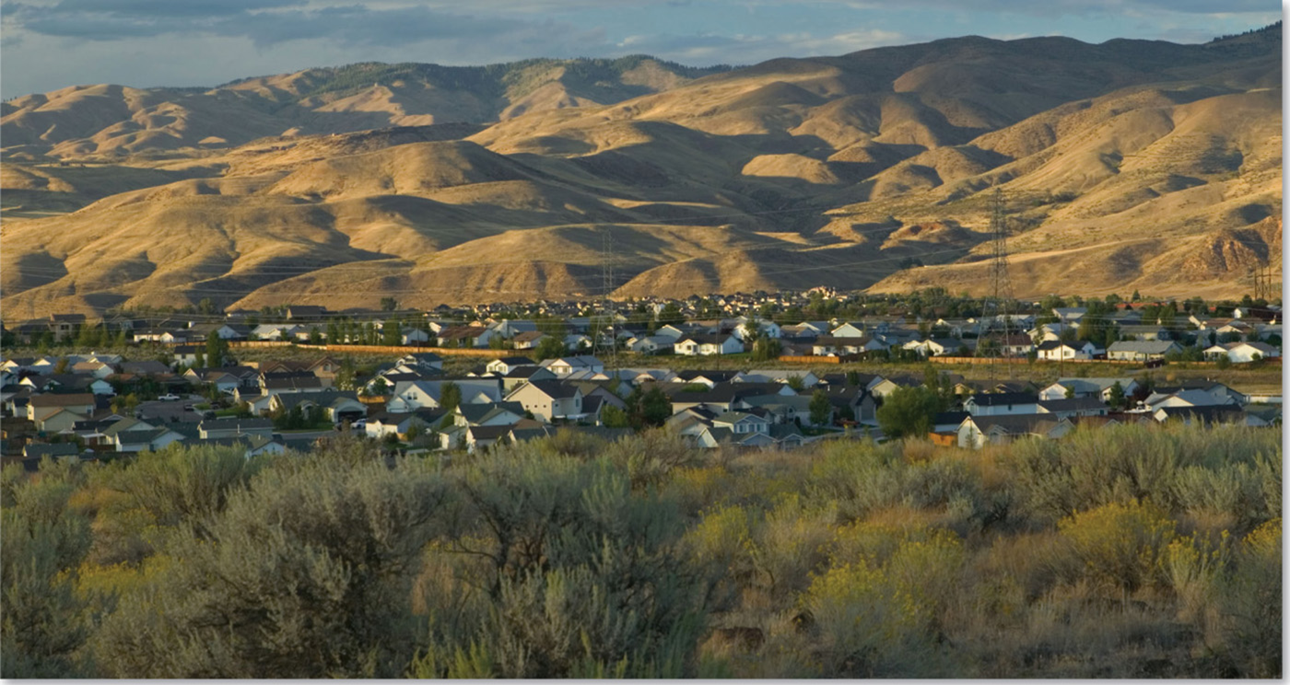
3.2.3 Intraregional Migration (5 of 5)
Figure 3-28: The phenomenon known as counterurbanization is recent and entails people leaving urban areas for small rural towns that have access to an urban area.

Slide 33
Key Issue 3: Why Do People Migrate?
3.3.1 Political Reasons for Migrating
3.3.2 Environmental Reasons for Migrating
3.3.3 Economic Reasons for Migrating
3.3.4 Gender and Age of Migrants

Slide 34
3.3.1 Political Reasons for Migrating (1 of 7)
Combination of push and pull factors
Push factor: induces people to move out of their present location (e.g., fleeing conflict and/or persecution, floods, droughts)
Pull factor: induces people to move into a new location (e.g., better cultural, environmental and/or political conditions, economic opportunities)
Intervening obstacles cause people to engage in step migration which follows a series of steps to the final destination

Slide 35
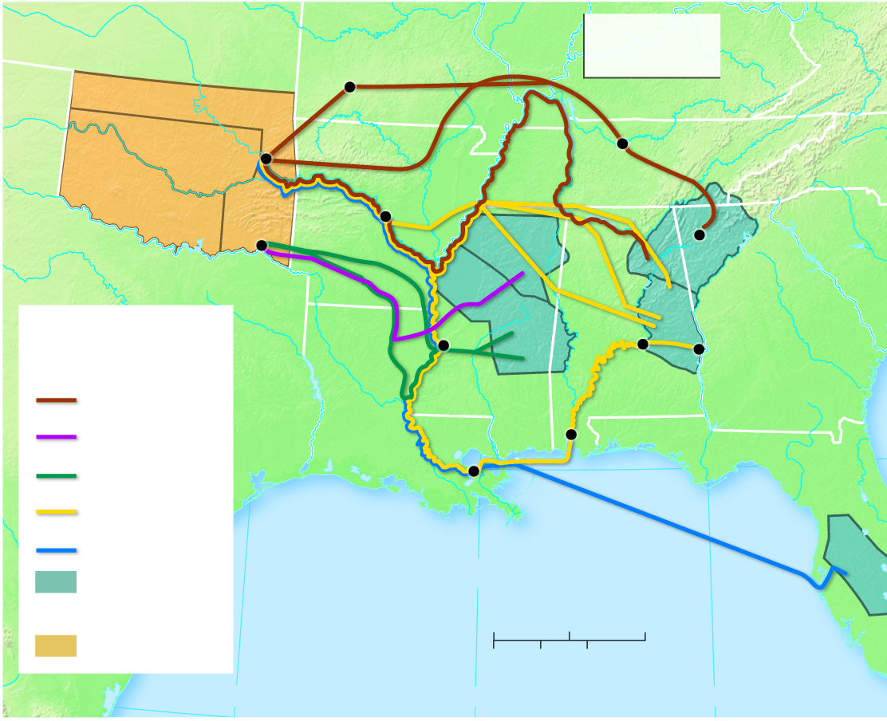
3.3.1 Political Reasons for Migrating (2 of 7)
Figure 3-29: The forced migration of Native Americans took place in the 1830s.
UNORG. TERR.
IL
Cherokee Trail of Tears
MO
VA
CHEROKEE
Springfield
KY
CREEK
Fort Gibson
Nashville
TN
NC
ARK. TERR.
CHICKASAW
CHOCTAW
Little Rock
CHICKASAW
CHEROKEE 1835
New Echota
Fort Towson
1832
SC
MEXICO
AL
CREEK 1832
GA
Routes of Native
American removal
CHOCTAW 1830
Fort Mitchell
Vicksburg
Montgomery
Cherokee
LA
MS
Chickasaw
Mobile
Choctaw
New Orleans
FLA. TERR.
Creek
Seminole
Tribal lands (date ceded)
Gulf of Mexico
0
100
200 Miles
SEMINOLE 1832–1833
Reservations
0
100
200 Kilometers
95°W
90°W
85°W

Slide 36
3.3.1 Political Reasons for Migrating (3 of 7)
Figure 3-30: A memorial sculpture in Chattanooga marking the start of the Trail of Tears.

Slide 37
3.3.1 Political Reasons for Migrating (4 of 7)
The U N High Commission for Refugees recognizes three groups of people who are forced to migrate for political reasons:
refugees have been forced to migrate to another country
An internally displaced person (I D P) is a refugee who has not migrated across an international border
an asylum seeker: is someone who has migrated to another country in the hope of being recognized as a refugee

Slide 38
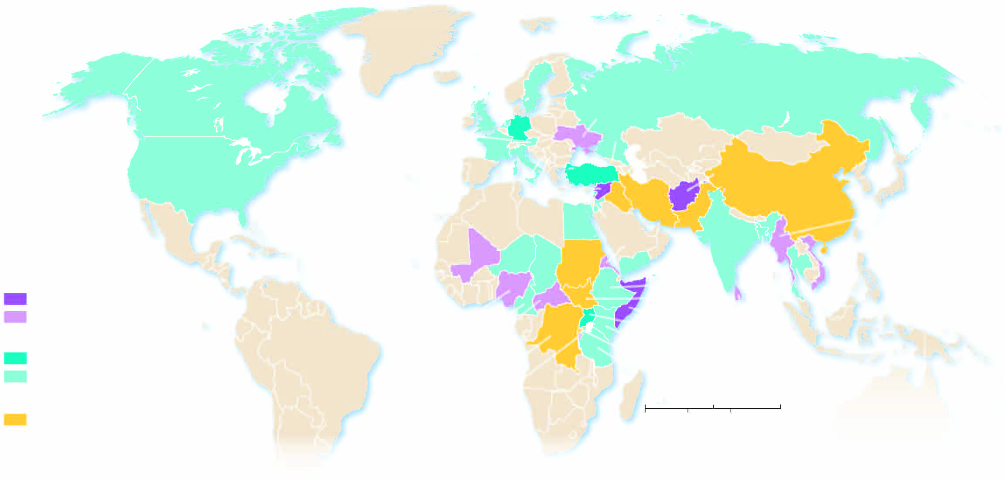
3.3.1 Political Reasons for Migrating (5 of 7)
Figure 3-31: Afghanistan, Syria, and Somalia are presently the sources of the largest numbers of refugees.
ARCTIC
OCEAN
NETHERLANDS
SWEDEN
RUSSIA
CANADA
UNITED KINGDOM
GERMANY
UKRAINE
PACIFIC
OCEAN
AUSTRIA
GEORGIA
FRANCE
ITALY
AZERBAIJAN
UNITED STATES
BOSNIA
S
YRIA
TURKEY
AFGHANISTAN
ATLANTIC
OCEAN
SERBIA
LEBANON
IRAQ
IRAN
CHINA
LIBYA
E
G
YPT
JORDAN
PAKISTAN
MYANMAR (BURMA)
PACIFIC
OCEAN
HONDURAS
MALI
NIGER
SUDAN
ERITREA
INDIA
VIETNAM
Origin of refugees
CHAD
YEMEN
ETHIOPIA
PHILIPPINES
1,000,000 and above
COLOMBIA
SOUTH SUDAN
THAILAND
100,000–999,999
NIGERIA
SOMALIA
BANGLADESH
Destination of refugees
CAMEROON
UGANDA
SRI LANKA
CENT. AF.REP
KENYA
INDIAN
OCEAN
1,000,000 and above
C
ONGO
RWANDA
100,000–999,999
DEM. REP.CONGO
TANZANIA
BURUNDI
Origin and destination
0
1,500
3,000 Miles
more than 100,000
0
1,500
3,000 Kilometers
Internally displaced persons
SYRIA
more than 100,000

Slide 39
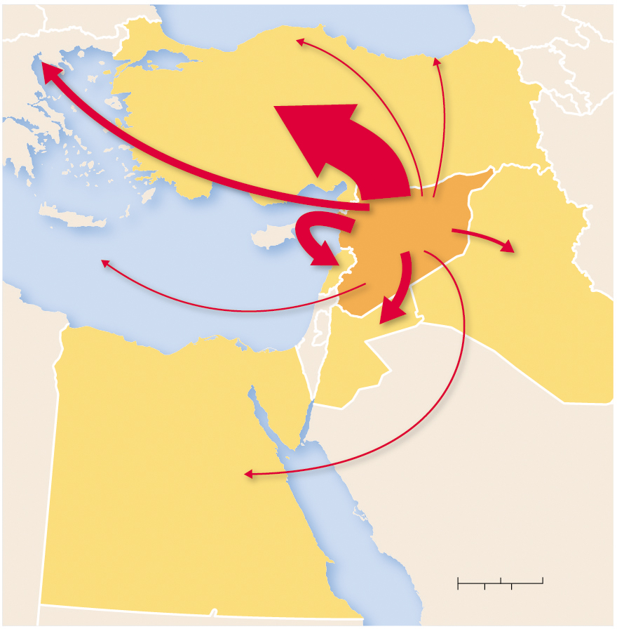
3.3.1 Political Reasons for Migrating (6 of 7)
Figure 3-32: The civil war in Syria has forced millions to flee the country.
to GERMANY
to AUSTRIA
to SWEDEN
530,000
50,000
110,000
TURKEY
3,600,000
GREECE
IRAN
to CANADA
SYRIA
54,000
LEBANON
& U.S.
1,000,000
IRAQ
33,000
250,000
LIBYA
ISRAEL
JORDAN
670,000
EGYPT
130,000
SAUDI ARABIA
Red Sea
0
100
200 Miles
0
100
200 Kilometers

Slide 40
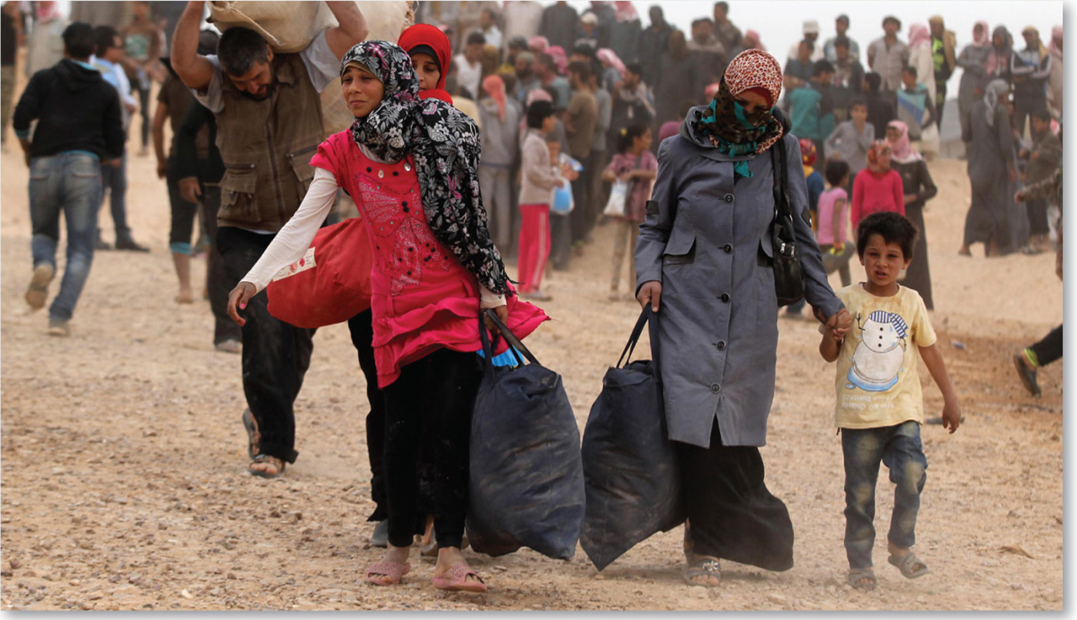
3.3.1 Political Reasons for Migrating (7 of 7)
Figure 3-33: Neighboring Jordan is an obvious destination for Syrian refugees

Slide 41
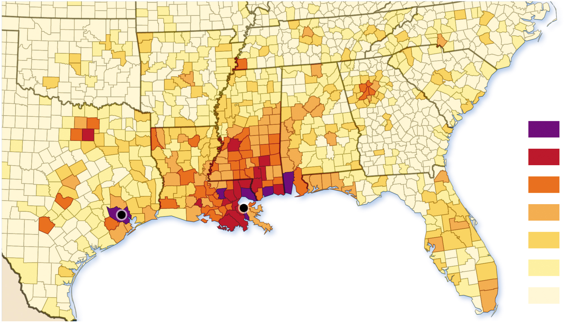
3.3.2 Environmental Reasons for Migrating (1 of 3)
Hurricane Katrina resulted in one million people being displaced
Figure 3-34: The largest numbers went to Mississippi, but many also went to Houston, Texas.
Displaced Hurricane
Katrina survivors
46,000 and above
15,501–45,999
4,201–15,500
New Orleans
1,201–4,200
Houston
251–1,200
Gulf of Mexico
41–250
below 41

Slide 42
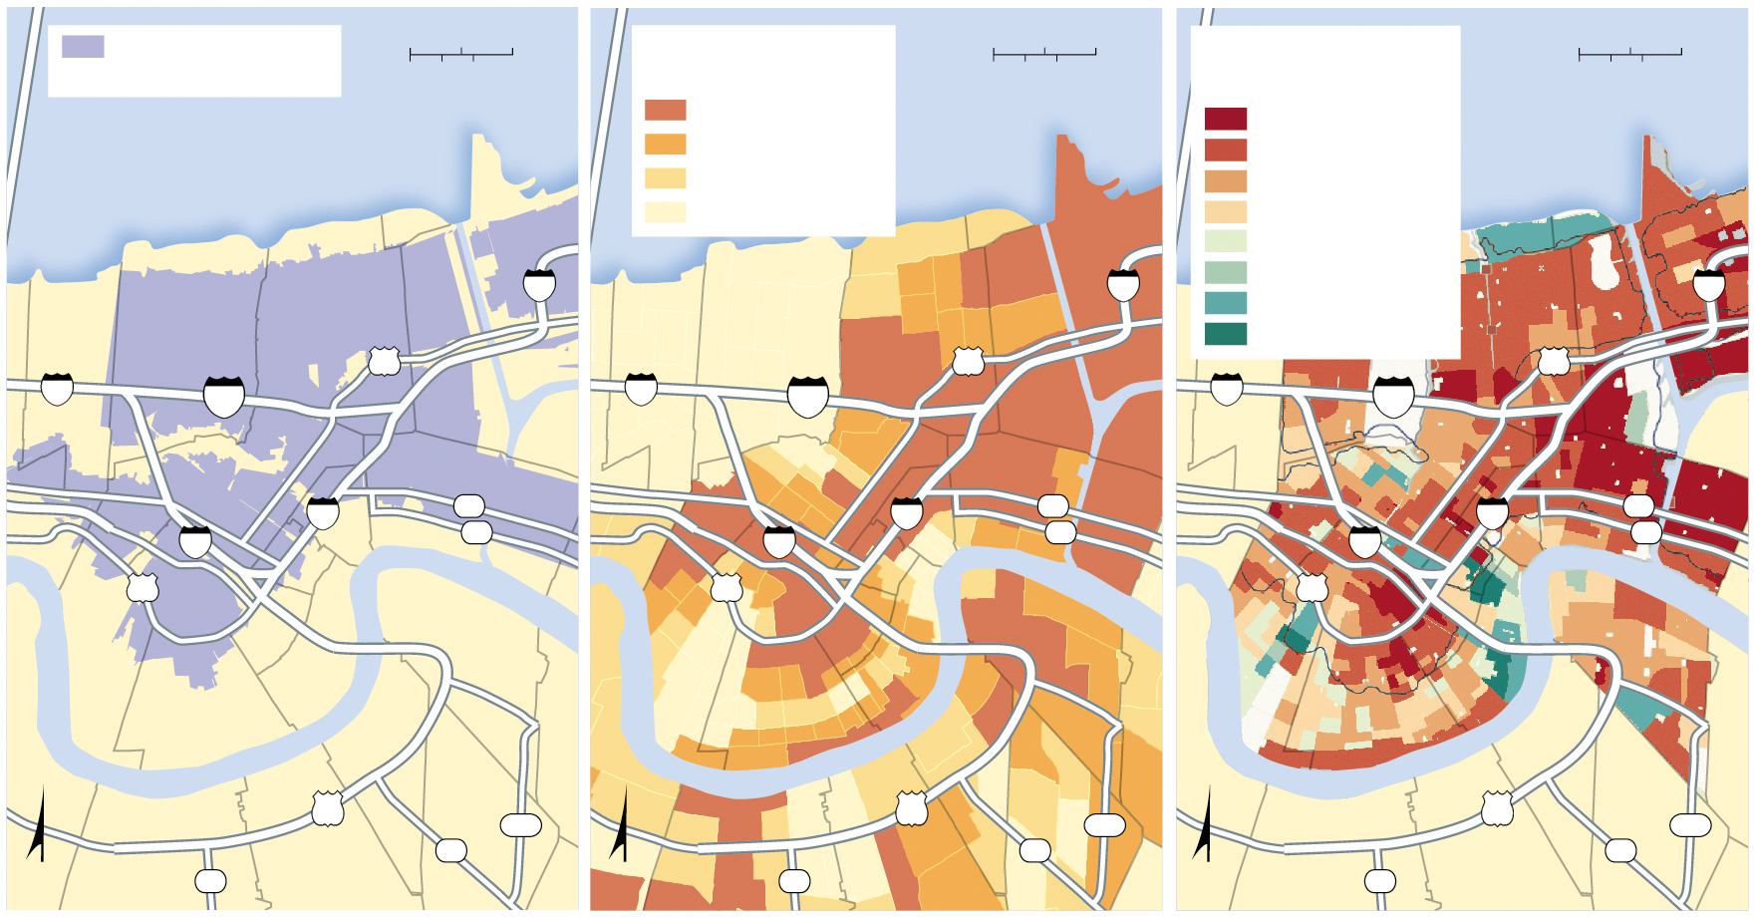
3.3.2 Environmental Reasons for Migrating (2 of 3)
Figure 3-35: African Americans were most impacted by flooding from Katrina.
September 11, 2005
flood extent
0
1
2 Miles
Percentage of African
Americans, 2000
0
1
2 Miles
Population change
2000 – 2010
0
1
2 Miles
0
1
2 Kilometers
0
1
2 Kilometers
0
1
2 Kilometers
75 and above
Lake
Pontchartrain
loss of 50 or more
Lake
Pontchartrain
Lake Pontchartrain
41–75
loss 25–49
15–40
loss 10–24
less than 15
loss 0–9
gain 0–9
10
10
gain 10–24
10
gain 50–49
gain 50 or more
10
90
10
90
10
90
610
610
610
ORLEANS
PARISH
ORLEANS
PARISH
ORLEANS
PARISH
10
39
10
39
10
39
10
French
Quarter
46
10
French
Quarter
46
10
French
Quarter
46
90
90
90
Mississippi River
Mississippi River
Mississippi River
JEFFERSON PARISH
BUS
JEFFERSON PARISH
BUS
JEFFERSON PARISH
BUS
90
428
90
428
90
428
N
45
23
N
45
23
N
45
23

Slide 43
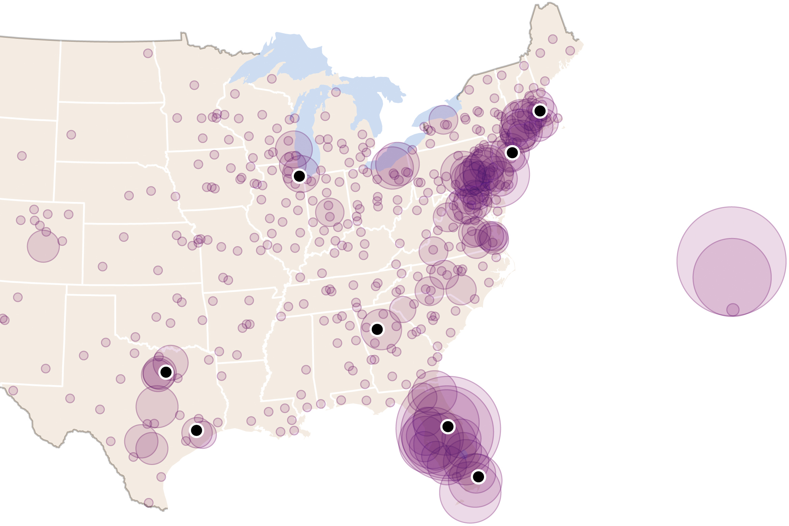
3.3.2 Environmental Reasons for Migrating (3 of 3)
Hurricane Maria resulted in mass emigration from Puerto Rico
Figure 3-36: Florida and New York received the greatest share of Puerto Ricans who emigrated to the mainland after Maria.
Boston
Address changes
from Puerto Rico
and the Virgin Is.
Chicago
New York
600
300
1
Dallas-
Fort Worth
Atlanta
Houston
Orlando
Miami

Slide 44
3.3.3 Economic Reasons for Migrating (1 of 5)
Economic push and pull factors cause majority of migration
Major flows of migration are between Asian countries and out of Asia
Remittances: payments sent home by migrants

Slide 45
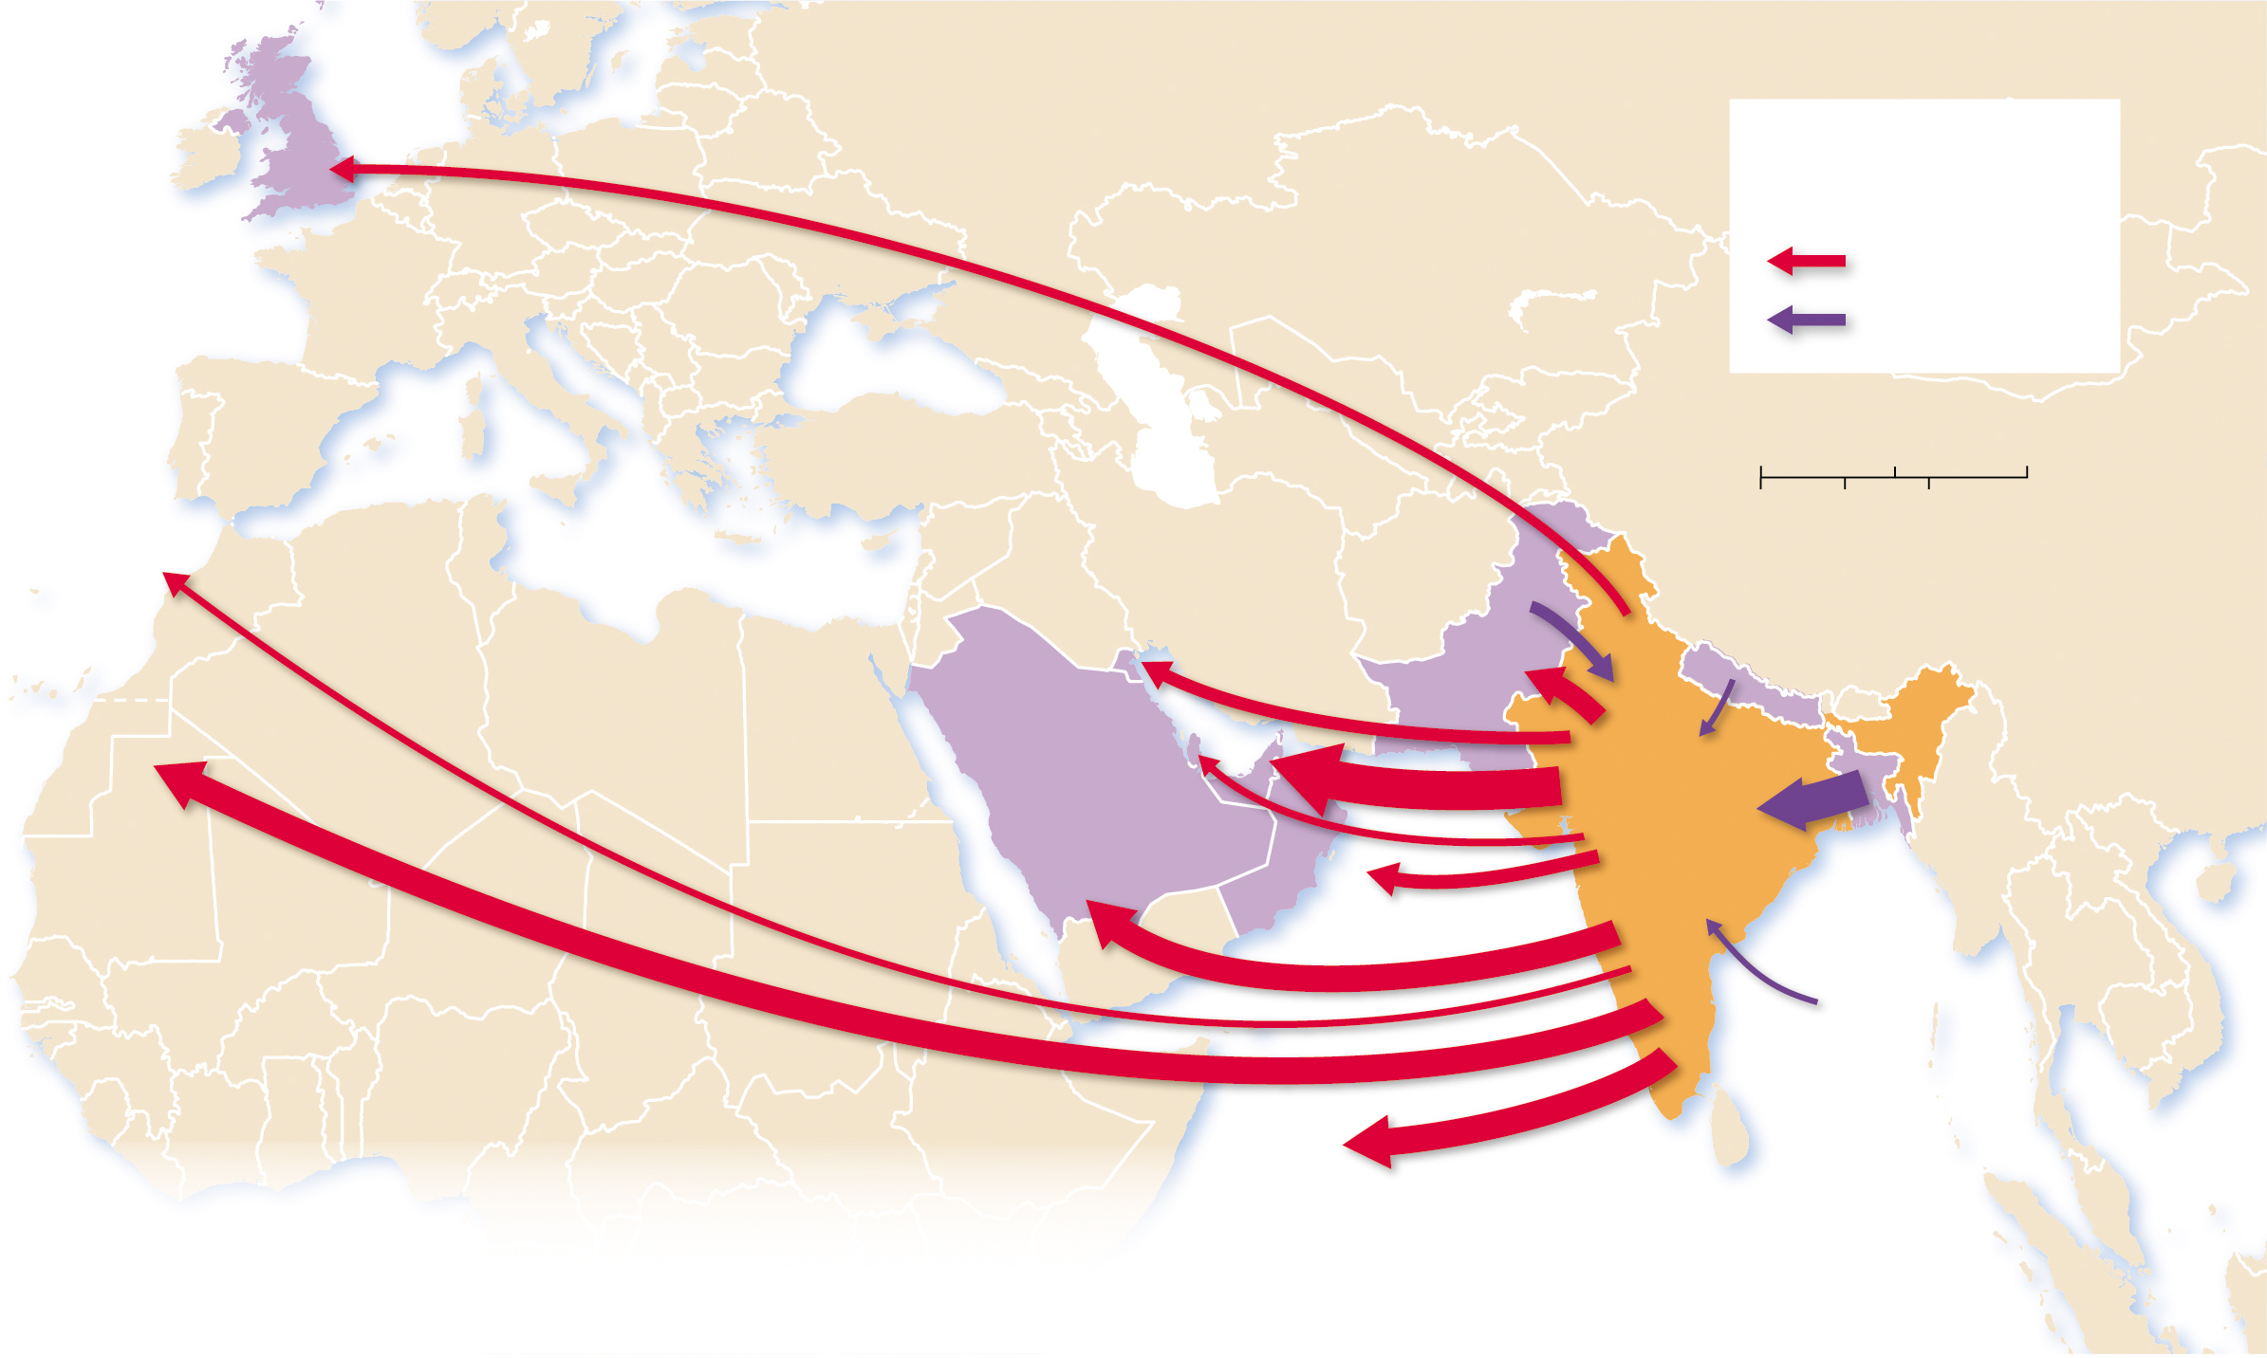
3.3.3 Economic Reasons for Migrating (2 of 5)
Figure 3-38: The majority of economic migrants from India are seeking work in Southwest Asia.
UNITED
KINGDOM
836,524
Migration to and
from India, 2017
ATLANTIC
OCEAN
Emigration
Immigration
0
500
1,000 Miles
to CANADA
UNITED ARAB
EMIRATES
0
500
1,000 Kilometers
602,146
KUWAIT
1,095,149
NEPAL
1,157,072
3,310,419
PAKISTAN
537,517
QATAR
1,873,650
to UNITED STATES
658,488
2,307,909
INDIA
SAUDI ARABIA
OMAN
BANGLADESH
2,266,216
1,201,995
3,139,311
OTHER
416,573
OTHER
2,373,301
INDIAN OCEAN

Slide 46
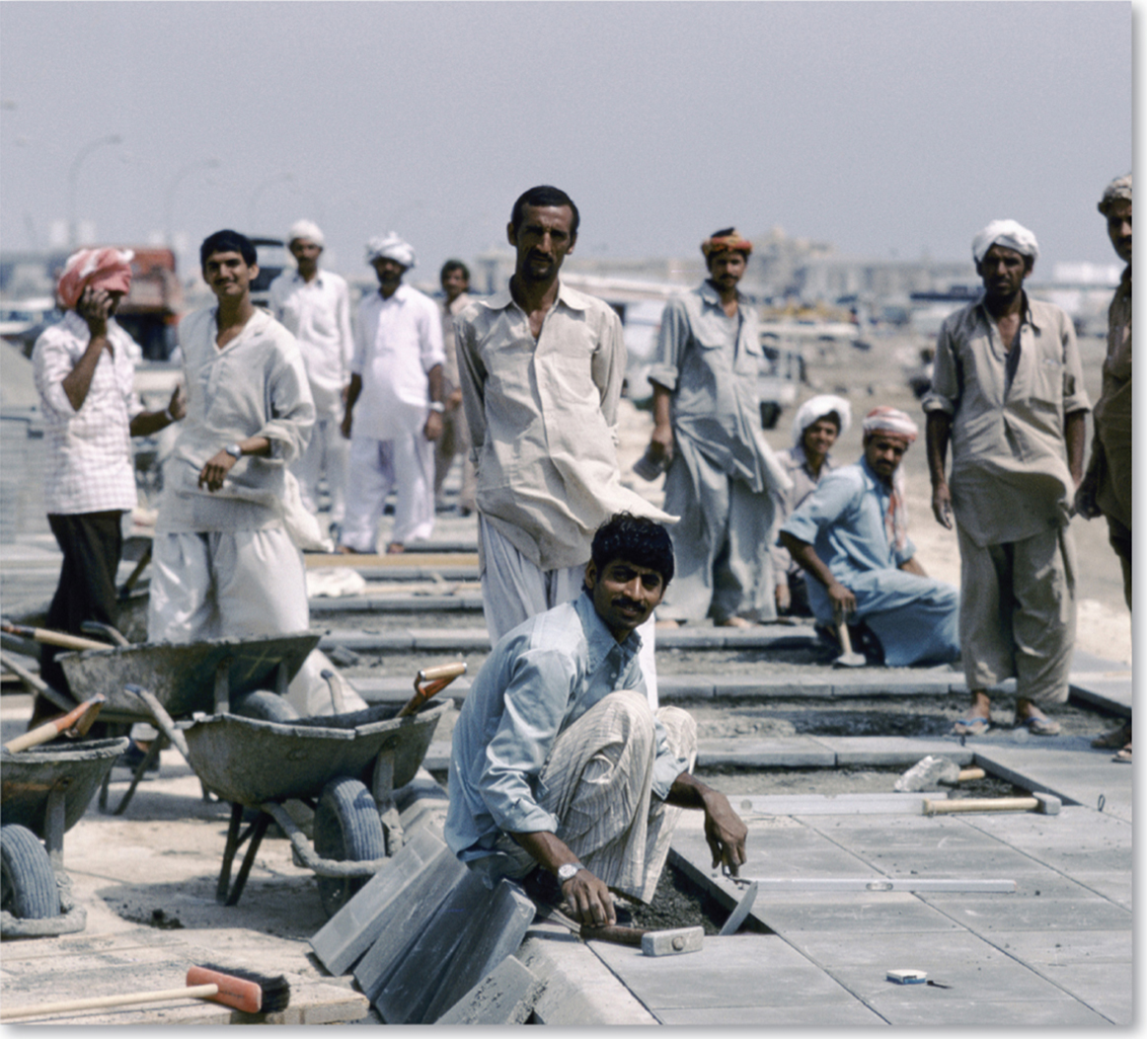
3.3.3 Economic Reasons for Migrating (3 of 5)
Figure 3-39: Indian economic migrants in Saudi Arabia.

Slide 47
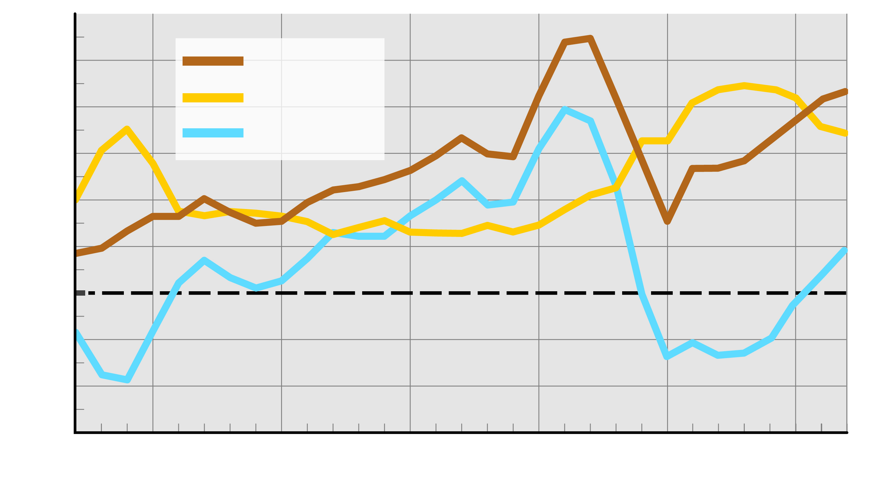
3.3.3 Economic Reasons for Migrating (4 of 5)
Figure 3-40: Economic recession transformed economic pull factors into push factors.
120
100
Immigration
80
Emigration
60
Net migration
40
Thousands
20
0
–20
–40
–60
1990
1995
2000
2005
2010
2017
Year

Slide 48
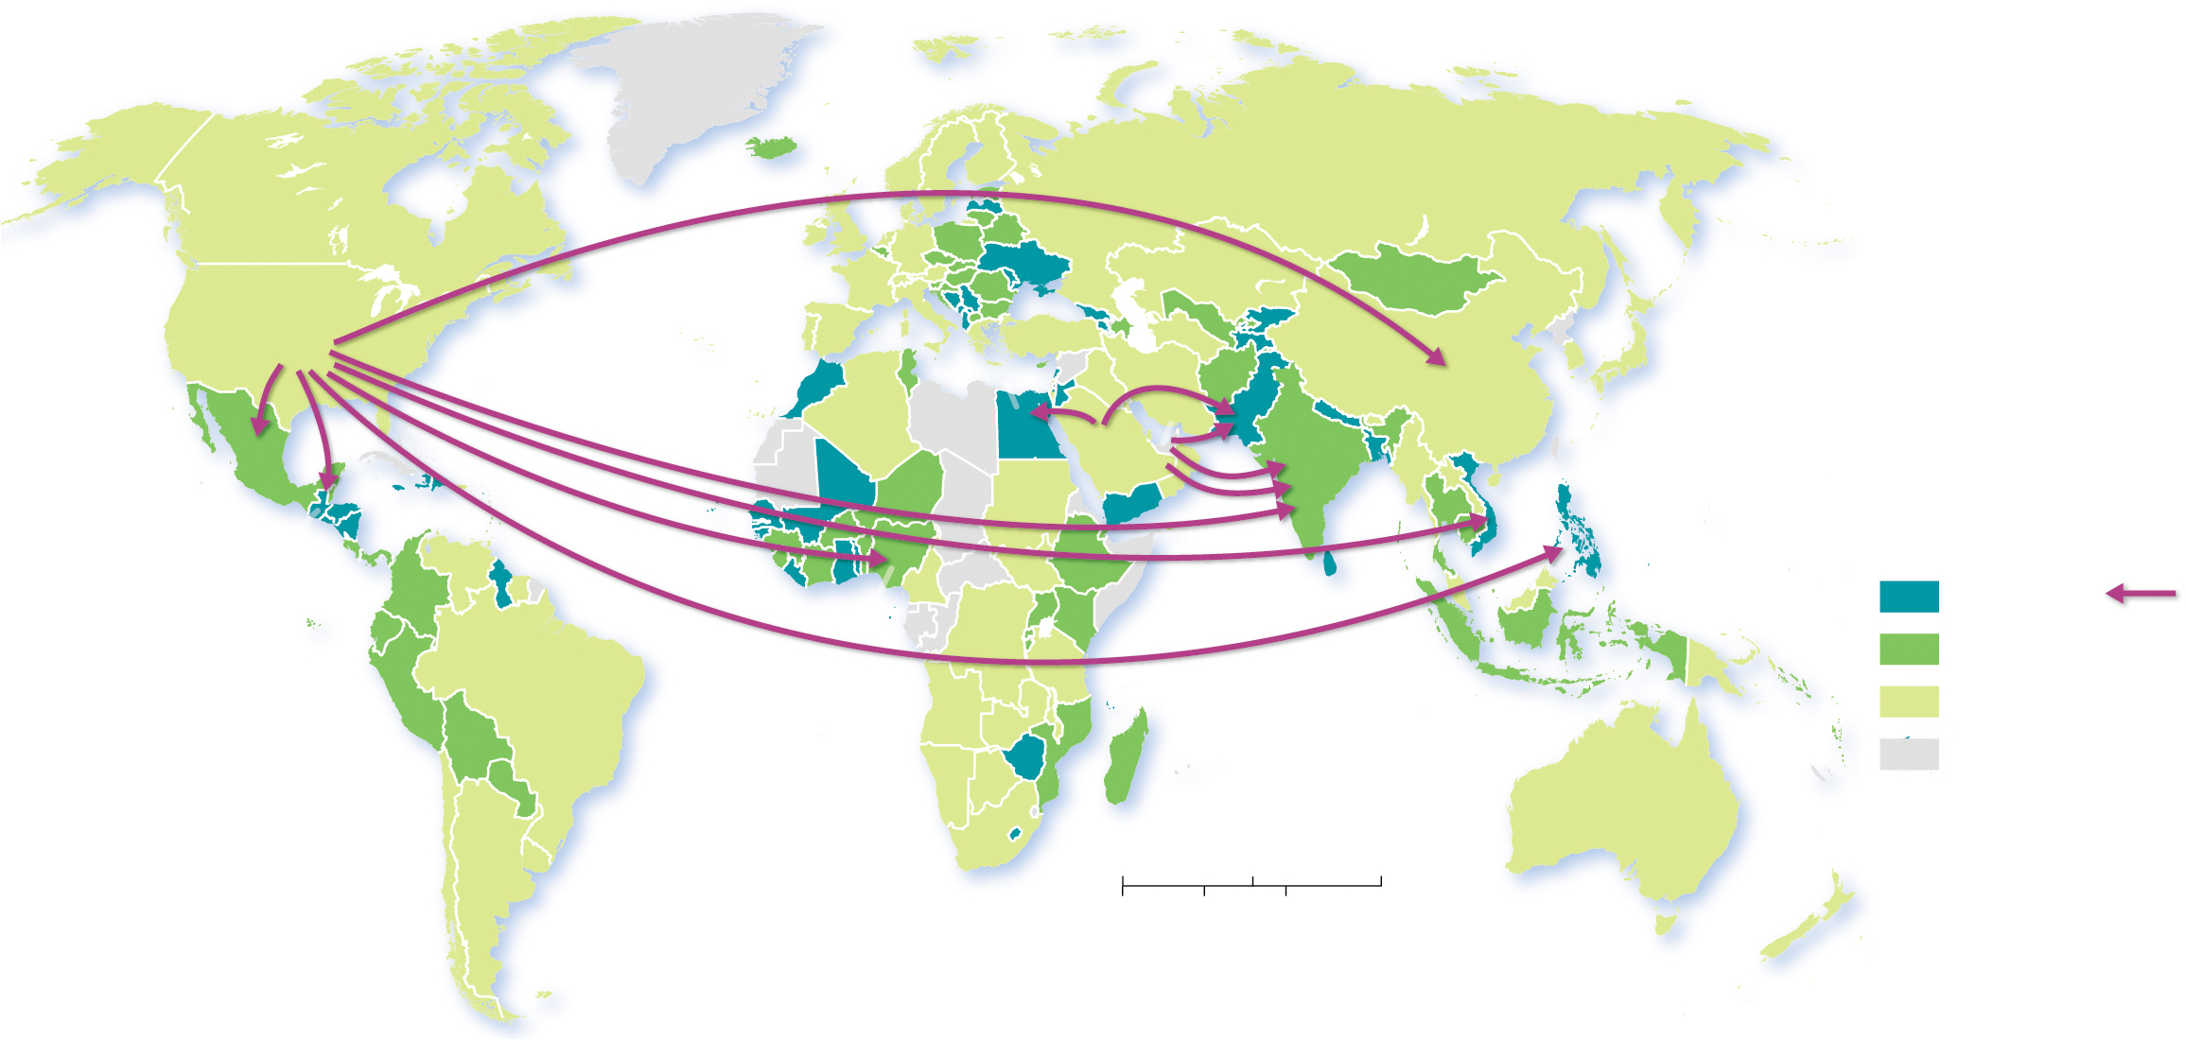
3.3.3 Economic Reasons for Migrating (5 of 5)
Figure 3-41: The United States and Saudi Arabia are the leading sources of remittances.
ARCTIC
OCEAN
UNITED
STATES
ATLANTIC
OCEAN
EGYPT
PAKISTAN
CHINA
SAUDI
ARABIA
U.A.E.
INDIA
PACIFIC
OCEAN
MEXICO
VIETNAM
GUATEMALA
PHILIPPINES
Remittances as % of GDP
NIGERIA
above 5
Top corridor
PACIFIC
OCEAN
1–5
U.A.E.
Source
INDIAN
OCEAN
below 1
INDIA
Recipient
no data
ATLANTIC
OCEAN
0
1,500
3,000 Miles
0
1,500
3,000 Kilometers

Slide 49
3.3.4 Gender and Age of Migrants (1 of 4)
During the 19th century, long-distance migrants were male adult individuals traveling without families
The pattern changed in the 20th century. Today, a high percentage of migrants are women and children
A large percentage of U.S. immigrants are young adults and are unlikely to be elderly. Children under the age of 20 comprise 21% of all immigrants to the United States

Slide 50
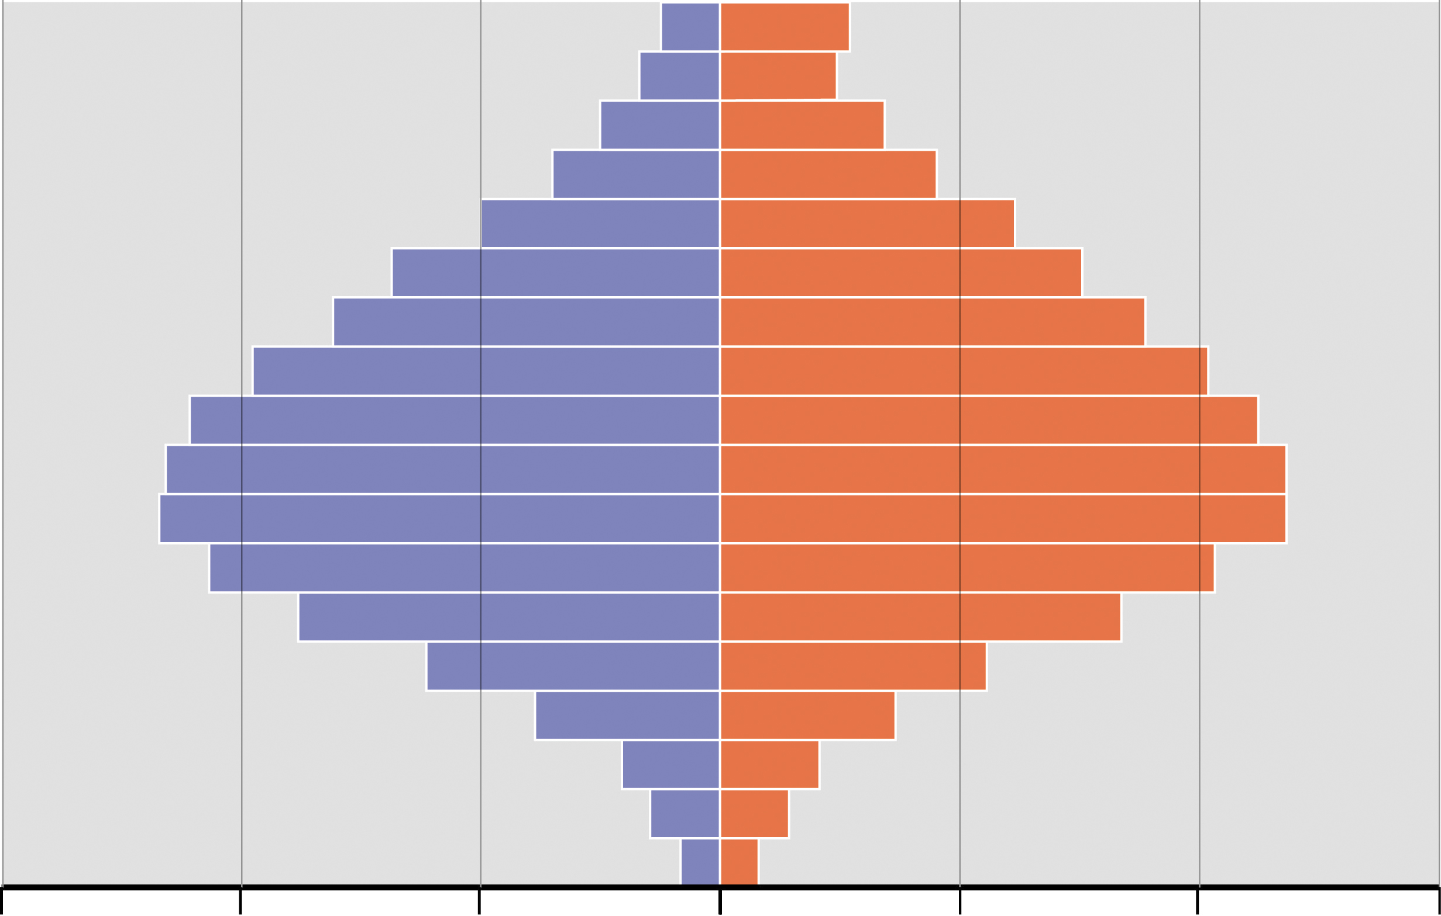
3.3.4 Gender and Age of Migrants (2 of 4)
Figure 3-42: Younger working-age people comprise the majority of the immigrants living in the United States.
Age
85+
80–84
Male
Female
75–79
70–74
65–69
60–64
55–59
50–54
45–49
40–44
35–39
30–34
25–29
20–24
15–19
10–14
5–9
0–4
3
2
1
0
1
2
3
Immigrants (millions)

Slide 51
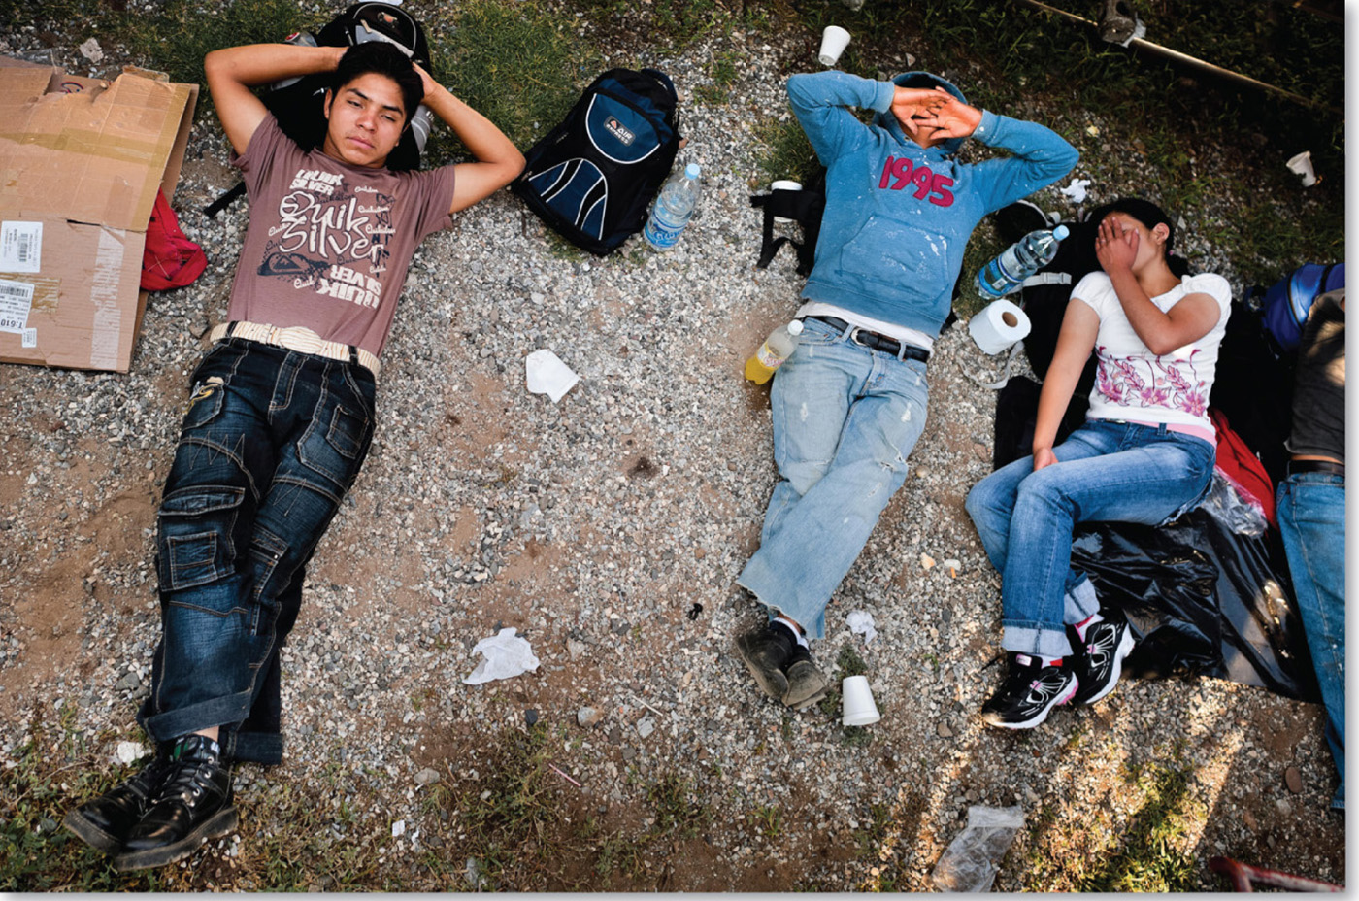
3.3.4 Gender and Age of Migrants (3 of 4)
Figure 3-43: Teenagers emigrating from Central America sleep at a train station in Mexico. They hope to reach the United States some day.

Slide 52
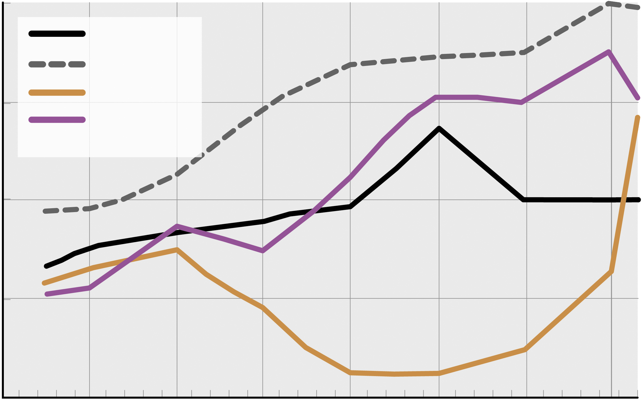
3.3.4 Gender and Age of Migrants (4 of 4)
Figure 3-44: Female immigrants outnumber males in developed countries and globally make up 48% of all immigrants.
52
World
Developed
South Asia
50
East and SE Asia
48
Female migrants (%)
46
44
1960
1970
1980
1990
2000
2010
2017
Year

Slide 53
Key Issue 4: Why Do Migrants Face Challenges?
3.4.1 Government Immigration Policies
3.4.2 Quotas
3.4.3 U.S.–Mexico Border Issues
3.4.4 Europe Immigration Issues

Slide 54
3.4.1 Government Immigration Policies (1 of 5)
The U.N. classifies countries according to four types of immigration policies:
maintain the current level of immigration
increase the level
reduce the level
no policy

Slide 55
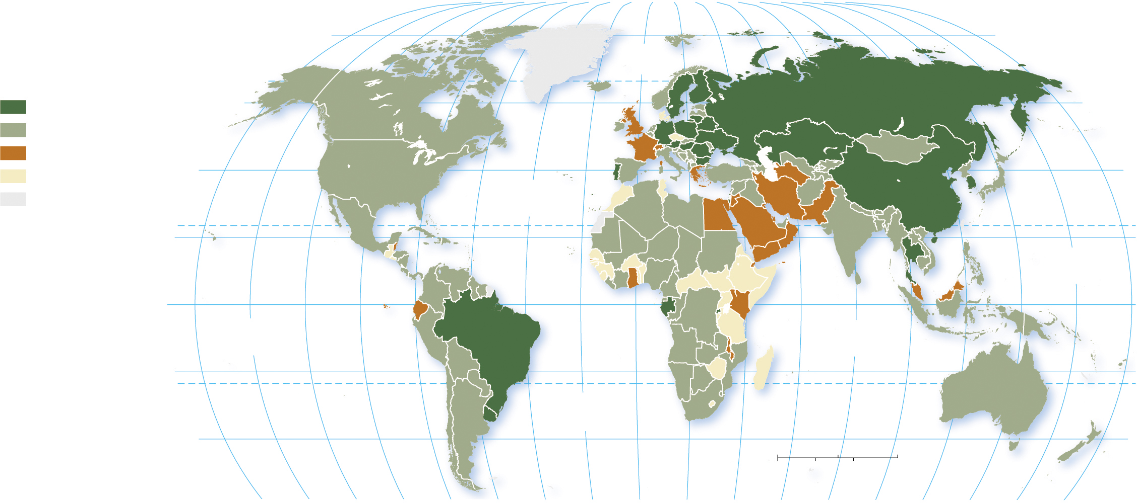
3.4.1 Government Immigration Policies (2 of 5)
Figure 3-47: Immigration policies vary around the world, but few countries have targeted increasing immigration.
80°
160°
140°
120°
100°
80°
60°
40°
20°
0°
20°
40°
60°
80°
100°
120°
140°
160°
180°
80°
ARCTIC
OCEAN
encourage more immigration
60°
60°
maintain current level
reduce immigration
40°
40°
no intervention or no policy
ATLANTIC
OCEAN
no data
20°
TROPIC OF CANCER
20°
PACIFIC
OCEAN
0°
EQUATOR
0°
PACIFIC
OCEAN
INDIAN
OCEAN
20°
20°
ATLANTIC
OCEAN
TROPIC OF CAPRICORN
40°
0
1,500
3,000 Miles
40°
0
1,500
3,000 Kilometers
160°
140°
120°
100°
80°
60°
40°
20°
0°
20°
40°
60°
80°
100°
120°
140°
160°
180°

Slide 56
3.4.1 Government Immigration Policies (3 of 5)
Those who enter a foreign country without documentation are called unauthorized immigrants. The principal reason for unauthorized immigration to the United States is to seek a job
5.9 million of the 11 million unauthorized immigrants in the United States are from Mexico
2.4 million lived in California and 1.7 million in Texas
1 million are children

Slide 57
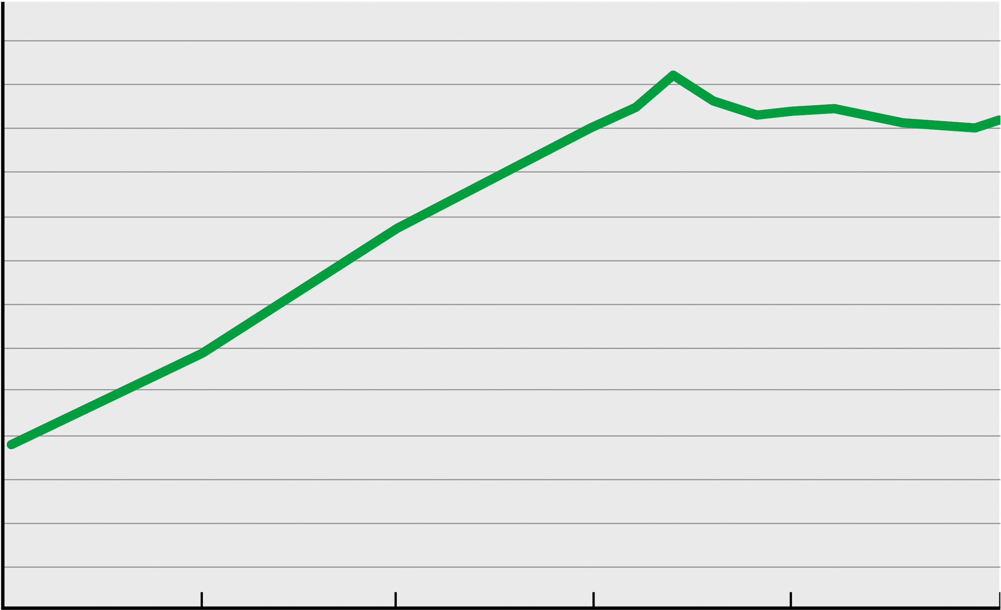
3.4.1 Government Immigration Policies (4 of 5)
Figure 3-48: The number of unauthorized immigrants in the United States has increased sharply since 1990.
14
13
12
11
10
9
8
Unauthorized immigrants (millions)
7
6
5
5
4
3
2
1
1990
1995
2000
2005
2010
2016
Year

Slide 58
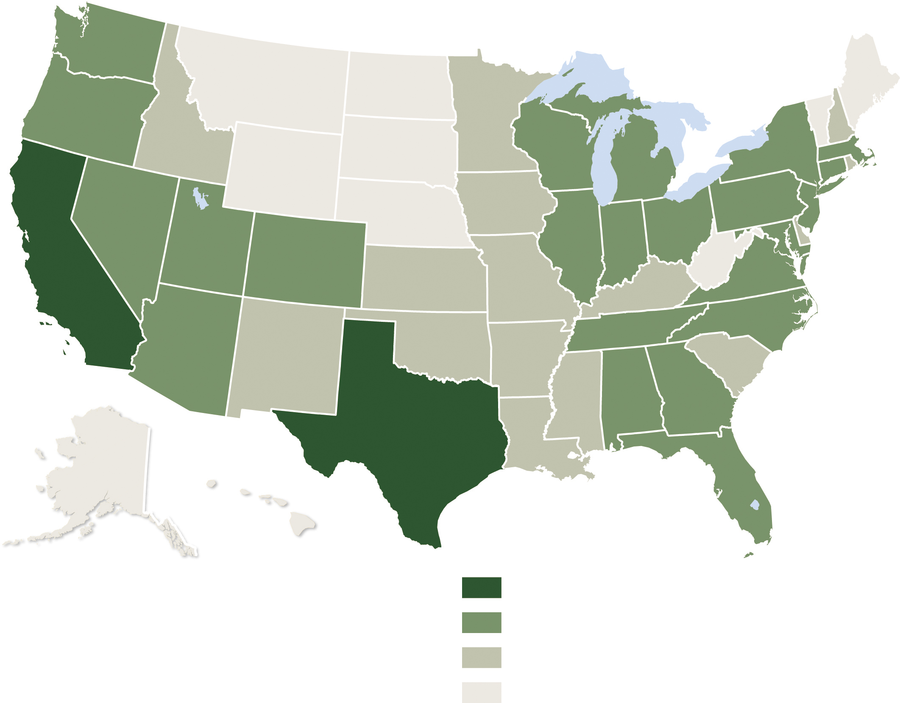
3.4.1 Government Immigration Policies (5 of 5)
Figure 3-49: Texas and California have the largest numbers of unauthorized immigrants.
Unauthorized immigrants
1 million and above
100,000–999,999
10,000–99,999
below 10,000

Slide 59
3.4.2 Quotas
1924: 2% of U.S. base population by country
1965: quotas by hemisphere (Eastern and Western) totaling 290,000 per year
1978: global quota of 290,000 per year
1990: quota raised to 700,000 per year
Preferences for family reunification, skilled workers, and diversity criterion
Skilled worker preference criticized for “brain drain”

Slide 60
3.4.3 U.S.–Mexico Border Issues (1 of 6)
Americans are divided concerning whether unauthorized migration helps or hurts the country
Most Americans would like more effective border patrols
Most Americans support work-related programs to make them legal
Most Americans believe that enforcement of unauthorized immigration is a federal responsibility

Slide 61
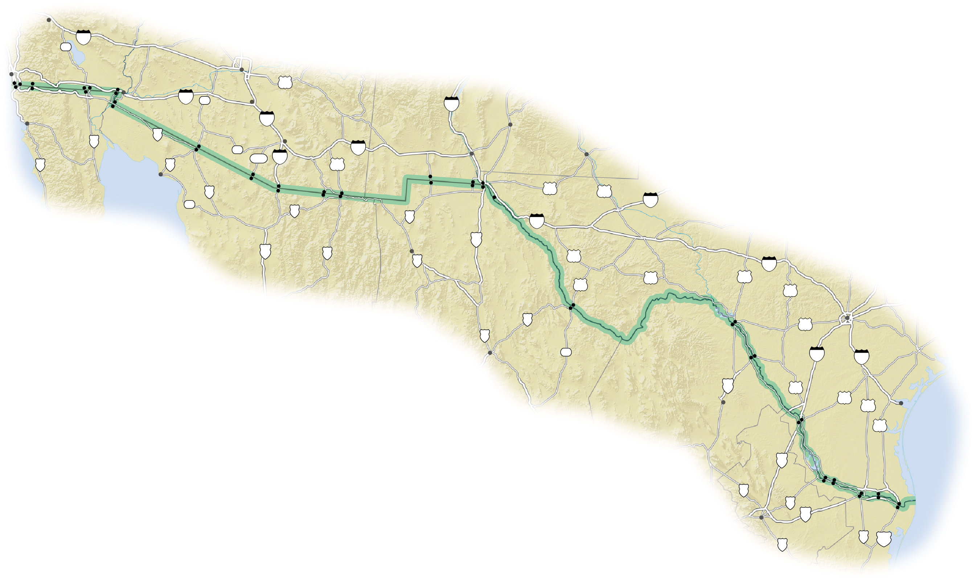
3.4.3 U.S.–Mexico Border Issues (2 of 6)
Figure 3-54: Policy concerning unauthorized migration from Mexico is a contentious topic. Debate includes the level of border enforcement, the role of unauthorized workers in the economy, and protecting the civil rights of U.S. citizens.
Palm Springs
CALIFORNIA
San Diego
Otay Mesa
86
10
Tecate
Calexico West
Calexico East
Phoenix
San
Andrade
Gila
60
Ysidro
Tecate
Mexicali
Yuma
8
85
Casa
Grande
Tijuana
Los Algodones
San Luis
ARIZONA
UNITED STATES
25
Ensenada
San Luis
10
Alamogordo
Río Colorado
2
Lukeville
Tucson
NEW MEXICO
5
Sonoyta
86
10
Las Cruces
Carlsbad
PACIFIC
OCEAN
1
BAJA
8
286
19
191
Santa
Teresa
CALIFORNIA
Puerto
Peñasco
Sásabe
Sasabe
Nogales
Naco
Columbus
El Paso
Gulf of
California
2
Nogales
Naco
Douglas
Palomas
Santa
Teresa
Tornillo
62
285
20
37
2
Agua
Prieta
2
Ciudad
Juárez
10
Pecos
SONORA
MEXICO
45
15
17
Nuevo
D
D
Casas Grandes
10
90
TEXAS
10
Rio Grande
90
277
CHIHUAHUA
67
83
16
Ojinaga
Presidio
Del Rio
San Antonio
45
Ciudad Acuña
Eagle
Pass
90
Chihuahua
18
Piedras Negras
35
37
COAHUILA
57
Rio Grande
D
83
Sabinas
59
281
Corpus Christi
Nuevo Laredo
Laredo
77
Gulf of
Mexico
85
Roma
Rio Grande
D
City
Ciudad Miguel Alemán
Camargo
Hidalgo
Progreso
53
54
Reynosa
Nuevo
Brownsville
40
Progreso
Matamoros
Monterrey
D
85
NUEVO
LEÓN
97
101
TAMAULIPAS

Slide 62
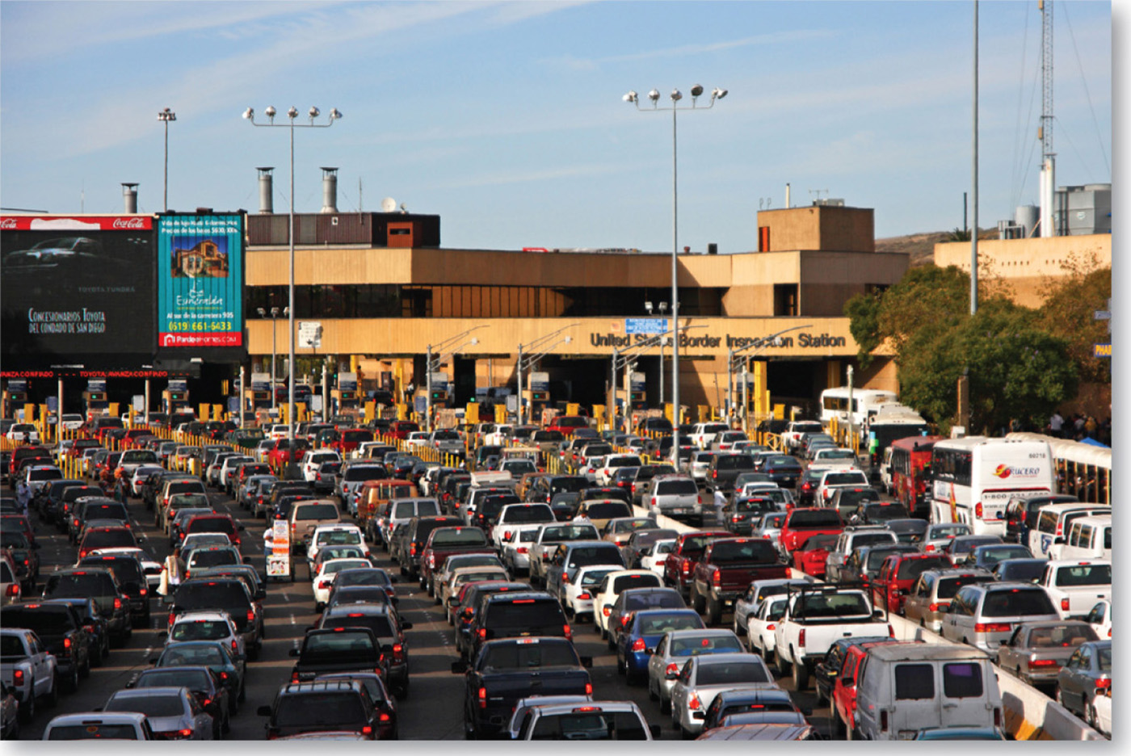
3.4.3 U.S.–Mexico Border Issues (3 of 6)
The U.S.–Mexico border is quite diverse, with both urban and rural crossings
Figure 3-55: : Images of the U.S.–Mexico Border.

Slide 63
3.4.3 U.S.–Mexico Border Issues (4 of 6)
Figure 3-56: : Images of the U.S.–Mexico Border.

Slide 64
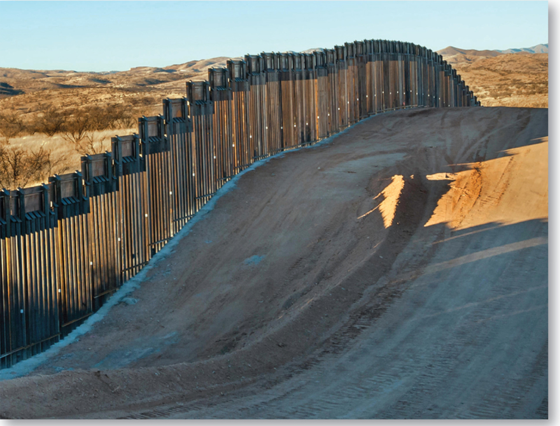
3.4.3 U.S.–Mexico Border Issues (5 of 6)
Figure 3-57: : Images of the U.S.–Mexico Border.

Slide 65
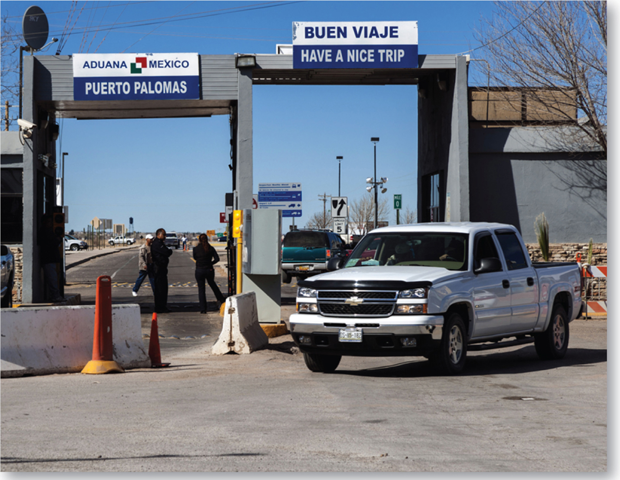
3.4.3 U.S.–Mexico Border Issues (6 of 6)
Figure 3-58: : Images of the U.S.–Mexico Border.

Slide 66
3.4.4 Europe Immigration Issues (1 of 2)
Europe is home to many migrants from North Africa and Eastern Europe
Germany and other wealthy European countries operated guest worker programs, in which people from poorer countries were allowed to immigrate temporarily via circular migration
Increased hostility to immigrants in many European countries with the arrival of more than 1 million refugees from Southwest Asia beginning in 2015

Slide 67
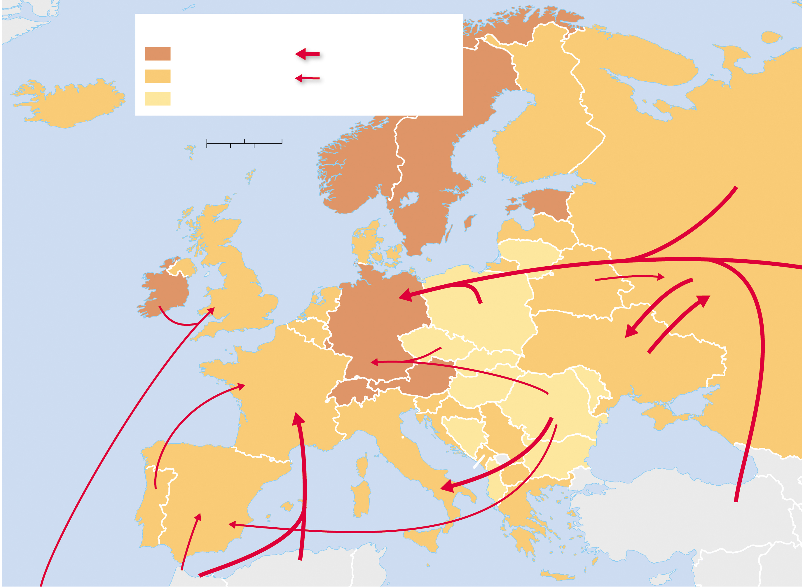
3.4.4 Europe Immigration Issues (2 of 2)
Figure 3-59: Western European nations (most notably Germany) and Scandinavia receive the largest share of immigrants.
Percent foreign born
Migration flows
Barents Sea
15 and above
More than 1,000,000
5–15
500,000–1,000,000
ICELAND
below 5
0
250
500 Miles
FINLAND
RUSSIA
0
250
500 Kilometers
NORWAY
SWEDEN
ESTONIA
North Sea
DENMARK
Baltic Sea
LATVIA
From
Kazakhstan
LITHUANIA
IRELAND
UNITED
KINGDOM
NETH.
BELARUS
BELG.
GERMANY
POLAND
ATLANTIC
OCEAN
CZECHIA
SLOVAKIA
UKRAINE
FRANCE
SWITZ.
AUSTRIA
HUNGARY
MOLDOVA
SLOV.
ROMANIA
from India
and Pakistan
CROATIA
BOS. &
SERBIA
Black Sea
ITALY
HERZ.
BULGARIA
SPAIN
MONT.
ALB.
MAC.
PORTUGAL
GREECE
TURKEY
MOROCCO
ALGERIA
Mediterranean Sea

Slide 68
Copyright
This work is protected by United States copyright laws and is provided solely for the use of instructors in teaching their courses and assessing student learning. Dissemination or sale of any part of this work (including on the World Wide Web) will destroy the integrity of the work and is not permitted. The work and materials from it should never be made available to students except by instructors using the accompanying text in their classes. All recipients of this work are expected to abide by these restrictions and to honor the intended pedagogical purposes and the needs of other instructors who rely on these materials.

