Slide 1
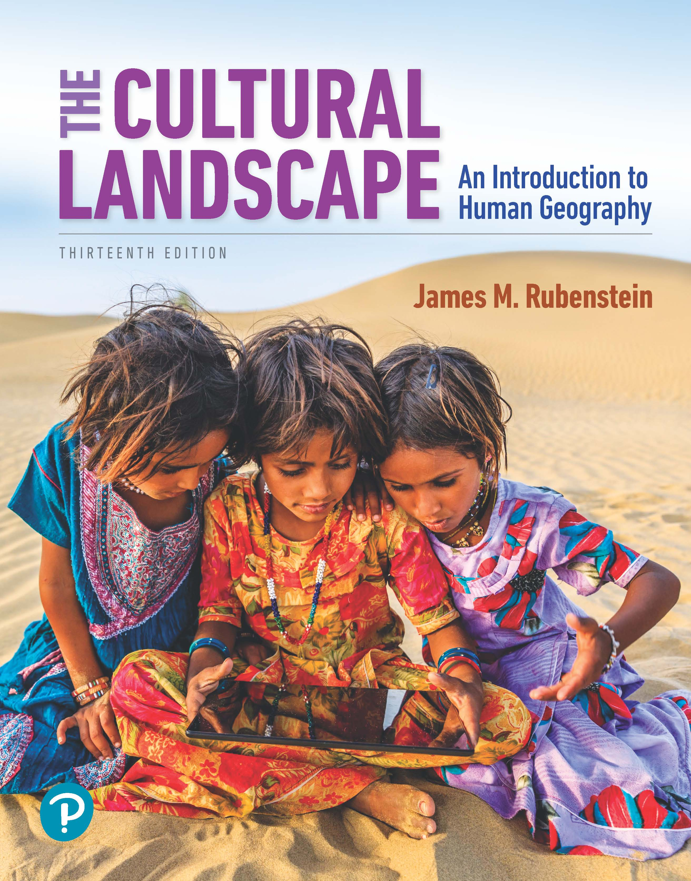
The Cultural Landscape: An Introduction to Human Geography
Thirteenth Edition
Chapter 6 Lecture
Religions
Copyright © 2020 Pearson Education, Inc. All Rights Reserved
Notes:
If this PowerPoint presentation contains mathematical equations, you may need to check that your computer has the following installed:
1) MathType Plugin
2) Math Player (free versions available)
3) NVDA Reader (free versions available)

Slide 2
Religions: Key Issues
6.1 Where Are Religions Distributed?
6.2 Why Do Religions Have Distinctive Distributions?
6.3 Why Do Religions Organize Space in Specific Patterns?
6.4 Why Do Territorial Conflicts Arise Among Religious Groups?

Slide 3
Key Issue 1: Where Are Religions Distributed?
6.1.1 Religions and Geography
6.1.2 Global Distribution of Religions
6.1.3 Distribution of Christians
6.1.4 Distribution of Buddhists and Muslims
6.1.5 Distribution of Ethnic Religions
6.1.6 Distribution of Other Religions

Slide 4
6.1.1 Religions and Geography (1 of 4)
The world’s four largest religions are:
Christianity (2.4 billion)
Islam (1.9 billion)
Hinduism (1.2 billion)
Buddhist (507 million)
Folk religions account for roughly 6% of the world population
About 1% of the world population adheres to a different religion (e.g., Judaism, Sikhism)
About 16% of the world population is unaffiliated with a religion

Slide 5
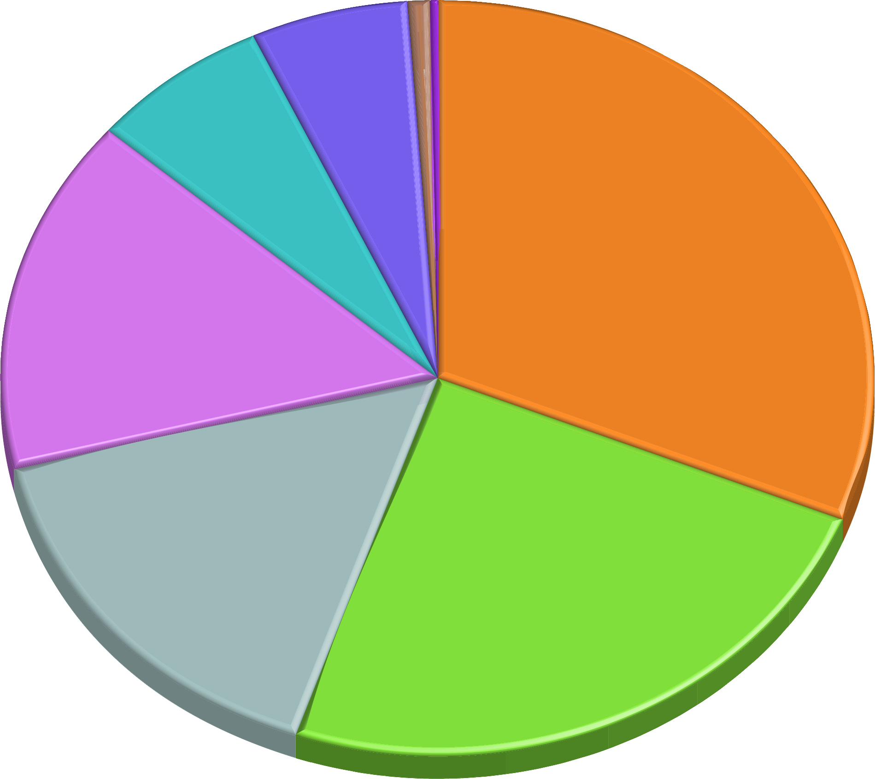
6.1.1 Religions and Geography (2 of 4)
Figure 6-1: More than 77% of the world population follows a branch of Christianity, Islam, Hinduism, or Buddhism, the four largest religions.
0.8%
0.2%
other religions
Jewish
folk religion
Buddhist
5.6%
6.6%
31.1%
15.2%
Christian
Hindu
15.6%
unaffiliated
24.9%
Muslim

Slide 6
6.1.1 Religions and Geography (3 of 4)
Universalizing religions attempt to be global and appeal to all people, wherever they may live in the world, not just to those of one culture or location
Ethnic religions appeal primarily to one ethnic or cultural group, or the people of a specific region

Slide 7
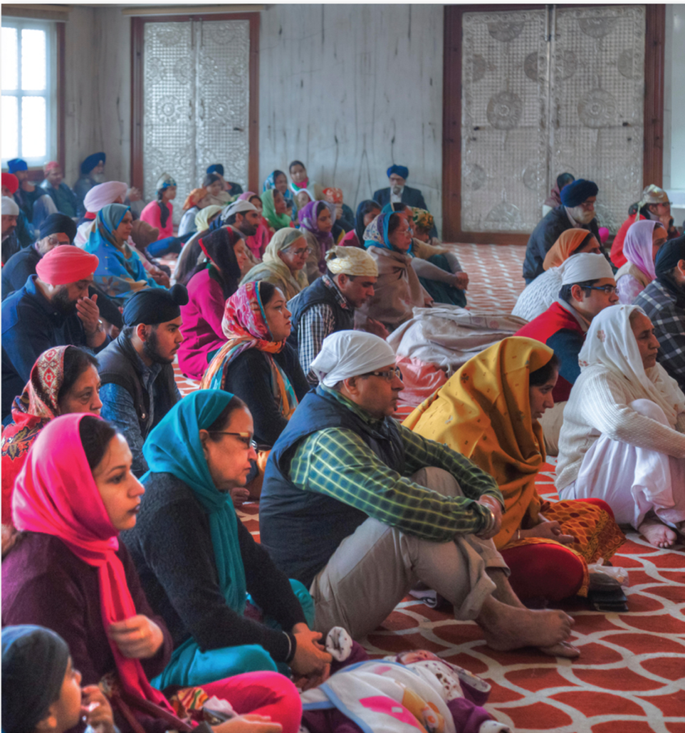
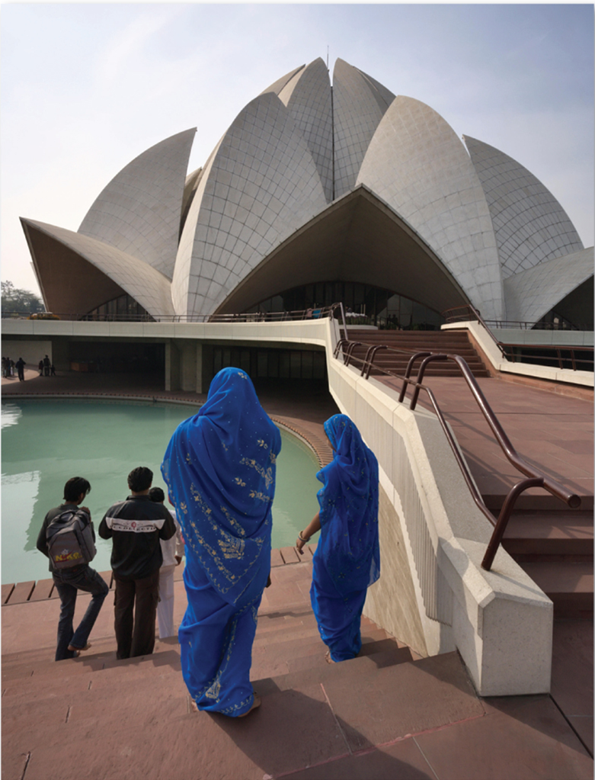
6.1.1 Religions and Geography (4 of 4)
Figures 6-3 and 6-4: Sikhs and Baha’i are two examples of religions with relatively small numbers of adherents.

Slide 8
6.1.2 Global Distribution of Religions (1 of 3)
Christianity is the most widespread of the major world religions
Islam is spread in a wide arc stretching from West Africa to Southeast Asia
Hinduism is concentrated in South Asia (India and Nepal)
Buddhism is concentrated in East Asia and Southeast Asia

Slide 9
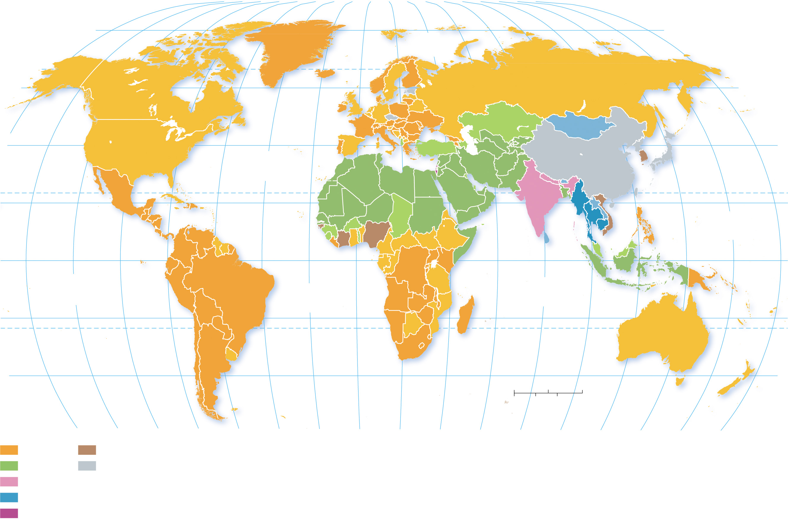
6.1.2 Global Distribution of Religions (2 of 3)
Figure 6-5: The Western Hemisphere, Europe, and sub-Saharan Africa are predominantly Christian; Southwest Asia and North Africa are majority Muslim.
80°
160°
140°
120°
100°
80°
60°
40°
20°
0°
20°
40°
60°
80°
100°
120°
140°
160°
180°
80°
ARCTIC
OCEAN
60°
60°
160°
40°
ATLANTIC
OCEAN
40°
20°
TROPIC OF CANCER
20°
PACIFIC
OCEAN
0°
EQUATOR
0°
PACIFIC
OCEAN
ATLANTIC
OCEAN
INDIAN
OCEAN
20°
TROPIC OF CAPRICORN
20°
40°
0
1,000
2,000 Miles
40°
0
1,000
2,000 Kilometers
140°
120°
100°
80°
60°
40°
20°
0°
20°
40°
60°
80°
100°
120°
140°
160°
180°
Christianity
No clear majority
Islam
Unaffiliated
Hinduism
Larger majorities within a
religion are shaded darker.
Buddhism
Judaism

Slide 10
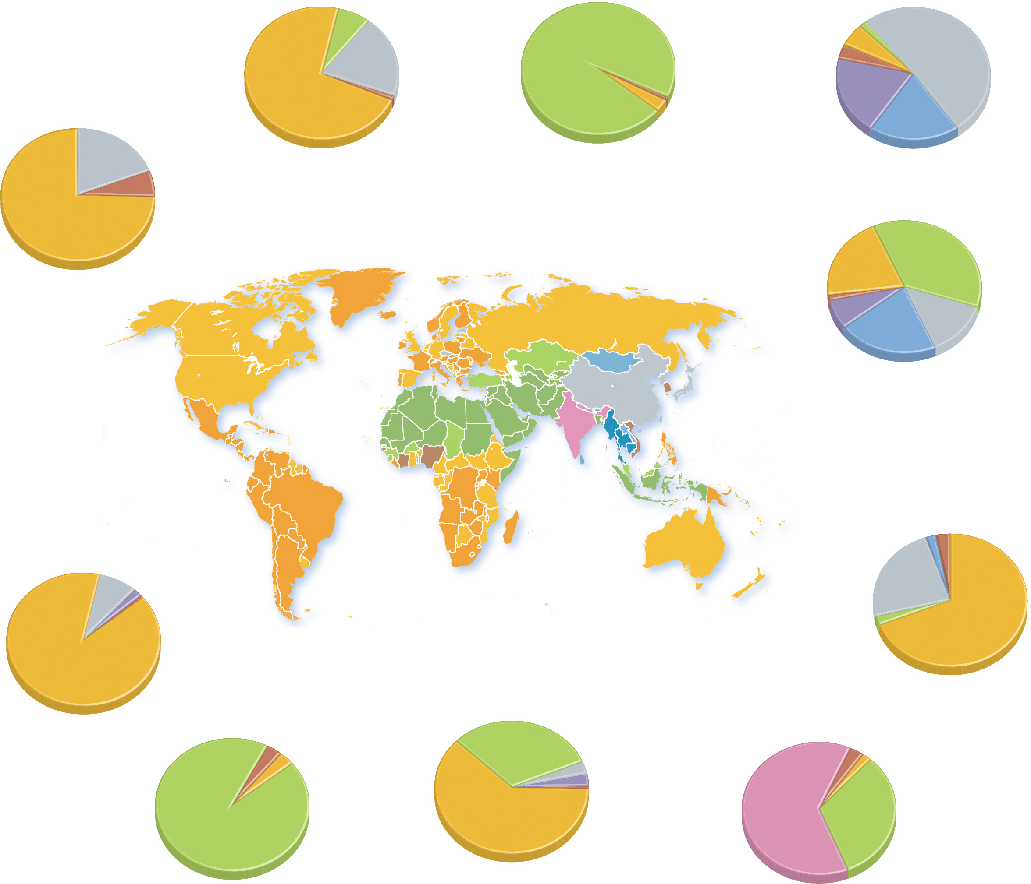
6.1.2 Global Distribution of Religions (3 of 3)
Figure 6-7: Central Asia is the region most dominated by one religion, while Southeast Asia is the most religiously diverse world region.
6.8%
Muslim
1.8% Muslim
unaffiliated
unaffiliated
96.0%
Muslim
5.7% Christian
72.2%
Christian
20.0%
3.4% other
52.0%
1.0% other
0.8% other
folk
19.7%
unaffiliated
3.2% Christian
19.4%
19.2%
6.2%
other
EUROPE
CENTRAL ASIA
Buddhist
Christian
74.6%
EAST ASIA
Christian
22.5%
40.4%
Muslim
NORTH AMERICA
ARCTIC
OCEAN
1.3% other
14.7%
7.9% folk
23.2%
unaffiliated
ATLANTIC
OCEAN
Buddhist
SOUTHEAST ASIA
PACIFIC
OCEAN
PACIFIC
OCEAN
ATLANTIC
OCEAN
INDIAN
OCEAN
SOUTH PACIFIC
LATIN
AMERICA
2.2% Buddhist
3.0% other
8.0% unaffiliated
unaffiliated
1.8% folk
23.6%
0.5% other
2.2% Muslim
69.0%
Christian
89.7%
Christian
SOUTHWEST
ASIA & NORTH
AFRICA
SUB-SAHARAN
AFRICA
3.3% other
SOUTH
ASIA
2.8% other
3.6% Christian
31.4%
Muslim
3.0% unaffiliated
2.1% Christian
3.2% folk
93.1%
Muslim
62.0%
Christian
0.4% other
63.0%
Hindu
32.1%
Muslim

Slide 11
6.1.3 Distribution of Christians (1 of 7)
A congregation is a local assembly of persons brought together for common religious worship
A denomination unites a number of local congregations in a single legal and administrative body
A branch is a large and fundamental division within a religion

Slide 12
6.1.3 Distribution of Christians (2 of 7)
Christianity has three major branches:
Roman Catholicism
Protestantism
Orthodox
Europe is geographically divided by the three branches of Christianity. Catholics are the most widespread. Protestants tend to cluster in northern Europe. Orthodox Christians are mainly located in Eastern Europe

Slide 13
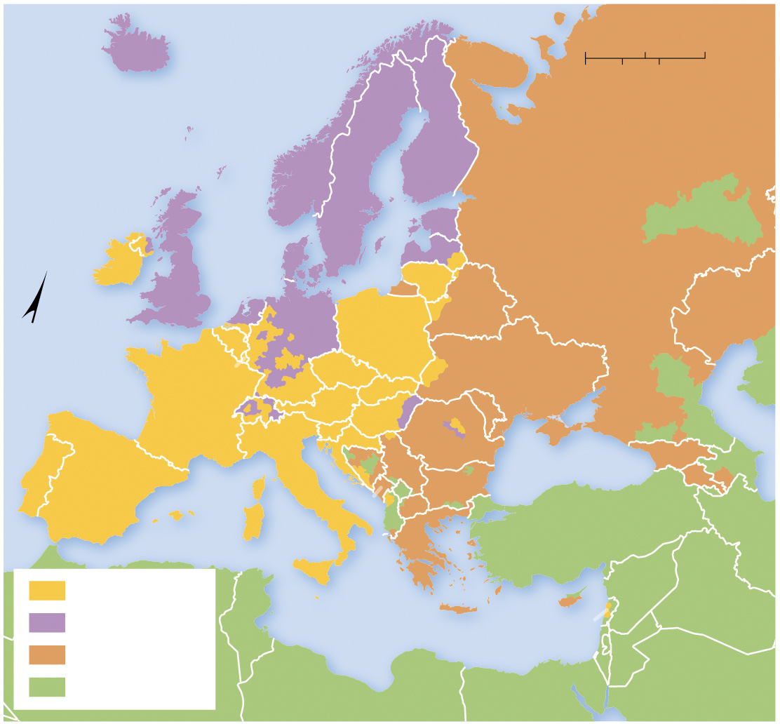
6.1.3 Distribution of Christians (3 of 7)
Figure 6-8: Christianity is divided into Roman Catholic, predominantly in the south, Protestant in the north, and Orthodox in the east.
ICELAND
0
250
500 Miles
0
250
500 Kilometers
ATLANTIC
OCEAN
NORWAY
FINLAND
SWEDEN
ESTONIA
RUSSIA
IRELAND
UNITED
DENMARK
LATVIA
KINGDOM
LITHUANIA
N
NETH.
POLAND
BELARUS
KAZAKHSTAN
BELG.
GERMANY
LUX.
CZECHIA
SLOVAKIA
UKRAINE
FRANCE
SWITZ.
AUSTRIA
HUNGARY
MOLD.
Caspian Sea
SLO.
CRO.
ROMANIA
GEORGIA
PORTUGAL
ITALY
BOS. &
HERZ.
SERBIA
BULGARIA
Black Sea
ARM.
AZER.
SPAIN
MONT.
KOS.
ALBANIA
MAC.
IRAN
GREECE
TURKEY
Roman Catholic
Mediterranean Sea
CYPRUS
SYRIA
IRAQ
Protestant
TUNISIA
LEBANON
Orthodox
ISRAEL
JORDAN
Other religions
LIBYA
EGYPT
SAUDI
ARABIA

Slide 14
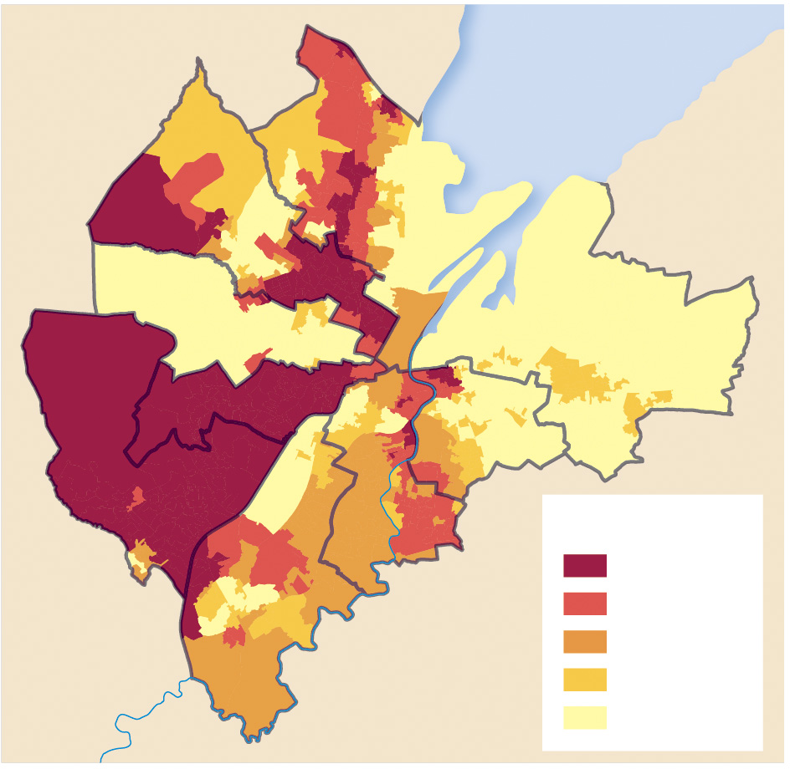
6.1.3 Distribution of Christians (4 of 7)
Figure 6-9: Roman Catholics are clustered in the western part of Belfast and Protestants in the east.
Belfast
Lough
Castle
Oldpark
Court
Victoria
Lower Falls
Pottinger
Upper Falls
Laganbank
Percent Catholic
80–100
Balmoral
60–79
River Lagan
40–59
20–39
0–19

Slide 15
6.1.3 Distribution of Christians (5 of 7)
Table 6-1: The United States has a diversity of distinct faiths with multiple denominations of Christianity.
Christian | Blank | Blank | 70.6
Roman Catholic | Blank | 20.8 | Blank
Evangelical Protestant | Blank | 25.4 | Blank
Southern Baptist Convention | 5.3 | Blank | Blank
Independent Baptist in the Evangelical Tradition | 2.5 | Blank | Blank
Other Baptist in the Evangelical Tradition | 1.4 | Blank | Blank
Lutheran in the Evangelical Tradition | 1.5 | Blank | Blank
Assemblies of God | 1.4 | Blank | Blank
Other Pentecostal in the Evangelical Tradition | 2.2 | Blank | Blank

Slide 16
6.1.3 Distribution of Christians (6 of 7)
Table 6-1 [Continued]
Restorationalist in the Evangelical Tradition (primarily Church of Christ) | 1.6 | Blank | Blank
Nondenomonational in the Evangelical Tradition | 4.9 | Blank | Blank
Other Evangelical Protestant Traditions | 6.0 | Blank | Blank
Mainline Protestant Churches | Blank | 14.7 | Blank
Baptist in the Mainline Tradition | 2.1 | Blank | Blank
Methodist in the Mainline Tradition | 3.9 | Blank | Blank
Lutheran in the Mainline Tradition | 2.1 | Blank | Blank
Presbyterian in the Mainline Tradition | 1.4 | Blank | Blank
Anglican/Episcopal in the Mainline Tradition | 1.2 | Blank | Blank
Other Mainline Protestant Traditions | 4.0 | Blank | Blank
Historically Black Churches | Blank | 6.5 | Blank

Slide 17
6.1.3 Distribution of Christians (7 of 7)
Table 6-1 [Continued]
National Baptist Convention | 1.4 | Blank | Blank
Other Baptist in the Historically Black Tradition | 2.6 | Blank
Latter-day Saints | Blank | 1.6
Other Christian | Blank | 1.7 | Blank
Jewish | Blank | Blank | 1.9
Buddhist | Blank | Blank | 0.7
Muslim | Blank | Blank | 0.9
Hindu | Blank | Blank | 0.7
Other religions or don't know | Blank | Blank | 2.4
Unaffiliated | Blank | Blank | 22.8
Source: Pew Research Center

Slide 18
6.1.4 Distribution of Buddhists and Muslims (1 of 6)
Buddhism is concentrated in East Asia and Southeast Asia. The three major branches of Buddhism are:
Theravada (mainland Southeast Asia, Sri Lanka)
Mahayana (China, Japan, Korea)
Vajrayana (Mongolia and Tibet)

Slide 19
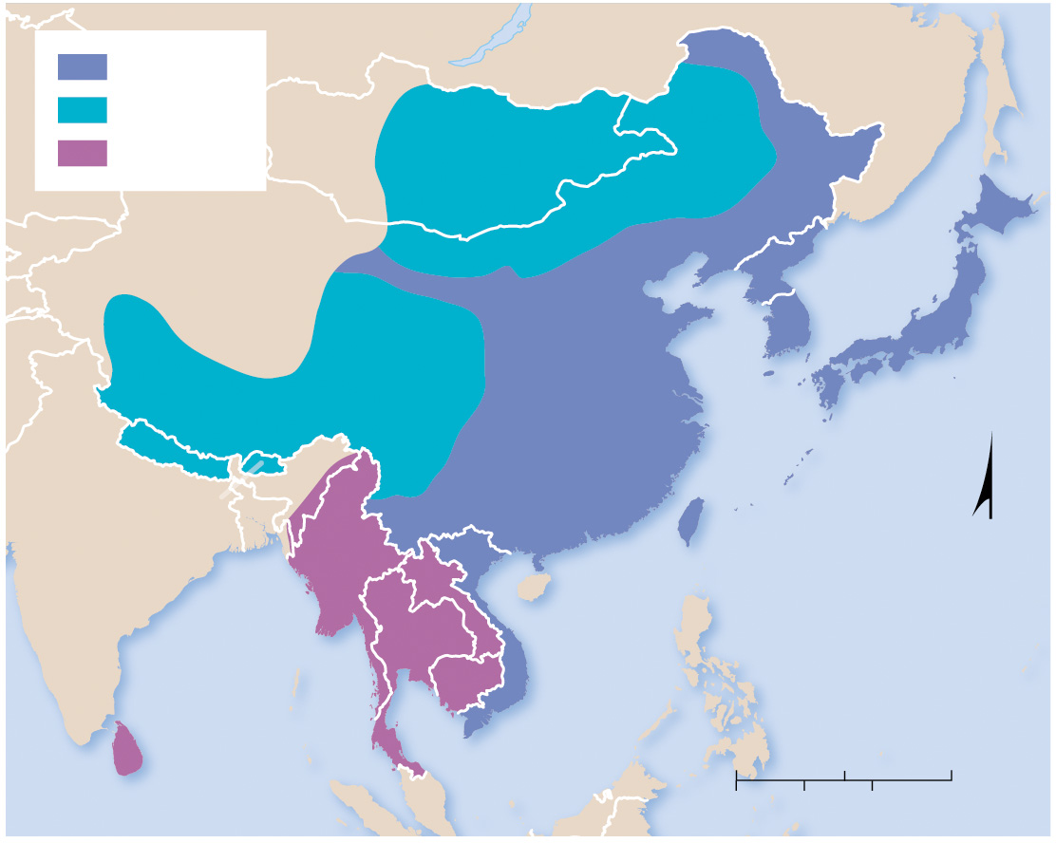
6.1.4 Distribution of Buddhists and Muslims (2 of 6)
Figure 6-11: Buddhism is practiced throughout East and Southeast Asia.
Mahayana
Vajrayana
Theravada
MONGOLIA
N. KOREA
CHINA
S. KOREA
JAPAN
NEPAL
BHUTAN
TAIWAN
N
MYANMAR
LAOS
PACIFIC
OCEAN
Bay of
Bengal
THAILAND
VIETNAM
CAMBODIA
0
500
1,000 Miles
0
500
1,000 Kilometers

Slide 20
6.1.4 Distribution of Buddhists and Muslims (3 of 6)
Islam covers a wide arc stretching from the Atlantic coast of West Africa to Southeast Asia. Southwest Asia is the region in which Islam dominates the most, but the most populous Muslim nations—Indonesia, Pakistan, Bangladesh, and India (where Muslims are a minority)—all are outside of Southwest Asia

Slide 21
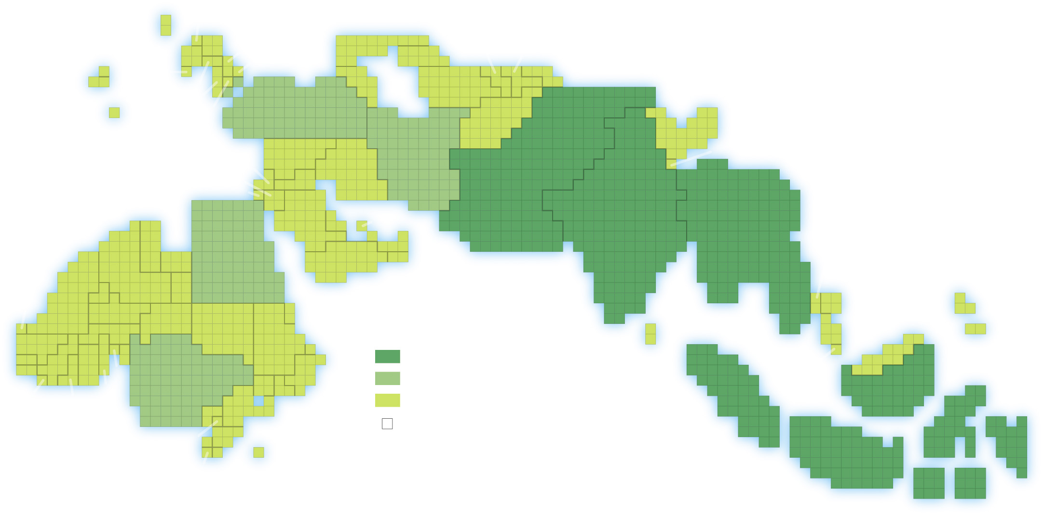
6.1.4 Distribution of Buddhists and Muslims (4 of 6)
Figure 6-12: Cartogram of Muslim populations reveals there are very large Muslim populations in South Asia and Indonesia.
UNITED KINGDOM
NETHERLANDS
FRANCE
GERMANY
KOSOVO
RUSSIA
TURKMENISTAN
TAJIKISTAN
CANADA
SPAIN
BULGARIA
KAZAKHSTAN
KYRGYZSTAN
UNITED STATES
BOSNIA
AZERBAIJAN
UZBEKISTAN
ALBANIA
TURKEY
ARGENTINA
MACEDONIA
AFGHANISTAN
IRAN
CHINA
NEPAL
LEBANON
SYRIA
IRAQ
PAKISTAN
PALESTINIAN TERR.
JORDAN
ISRAEL
SAUDI
ARABIA
INDIA
BANGLADESH
KUWAIT
BAHRAIN
TUNISIA
EGYPT
QATAR
U.A.E
LIBYA
YEMEN
OMAN
BURMA (MYANMAR)
WESTERN
SAHARA
MOROCCO
ALGERIA
CHAD
MAURITANIA
THAILAND
MALI
BURKINA FASO
NIGER
SUDAN
ERITREA
PHILIPPINES
SENEGAL
CÔTE
D’IVOIRE
ETHIOPIA
DJIBOUTI
Muslim population
SRI LANKA
MALAYSIA
GAMBIA
GUINEA
BENIN
SOMALIA
100 million and above
SINGAPORE
TOGO
NIGERIA
UGANDA
50–99 million
GUINEA BISSAU
SIERRA
LEONE
GHANA
KENYA
below 50 million
CAMEROON
TANZANIA
1 million Muslims
INDONESIA
CONGO
MOZAMBIQUE
COMOROS
The size of each country is proportional
to its population of Muslims.
SOUTH
AFRICA
MALAWI

Slide 22
6.1.4 Distribution of Buddhists and Muslims (5 of 6)
Islam has two branches—Sunni and Shiite. Sunni Muslims make up 88% of the world Muslim population and are the most numerous branch in most Muslim countries of Africa, Southwest Asia, and South Asia. Shiite Muslims comprise a majority of the population of Iran and in several smaller countries throughout Southwest Asia

Slide 23
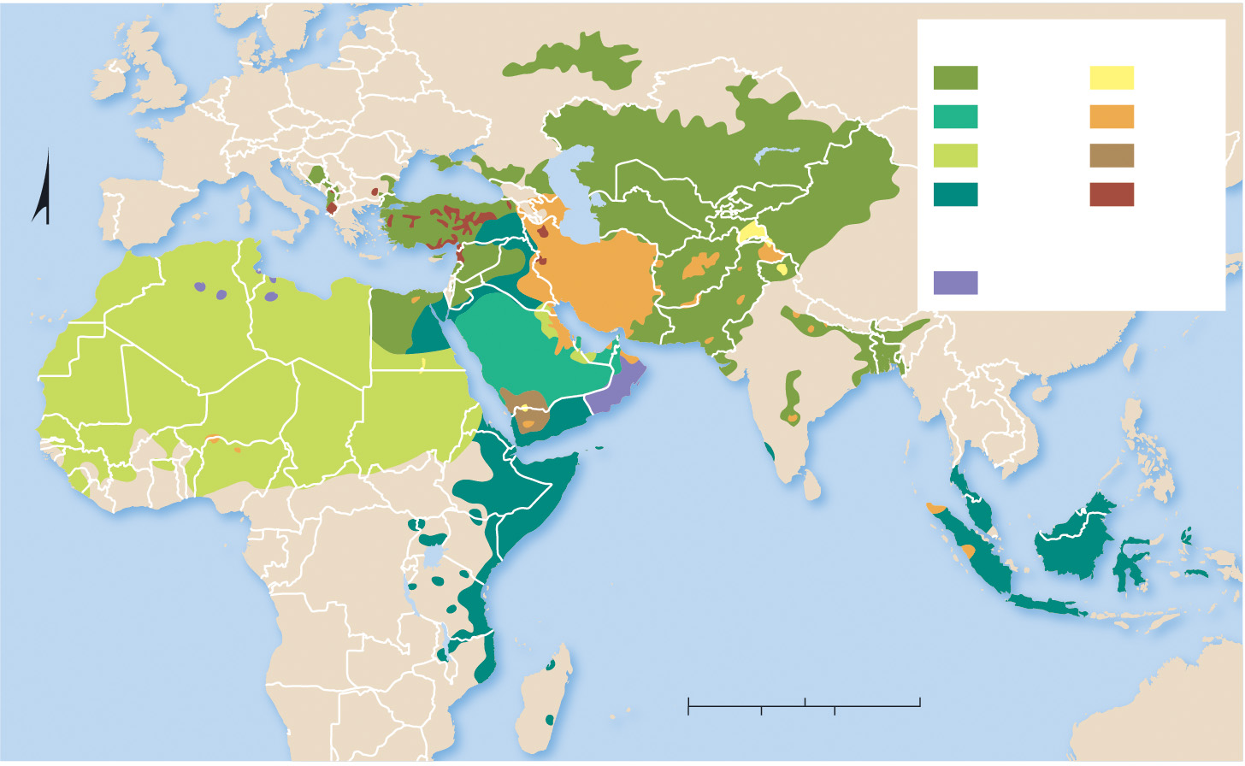
6.1.4 Distribution of Buddhists and Muslims (6 of 6)
Figure 6-13: Sunni Islam dominates most of the Muslim world. Shiites Muslims form a majority in Iran and several smaller countries in Southwest Asia.
Sunni
Shiite
Hanafi
Ismaili
Hanbali
Jafari
Maliki
Zaidi
Shafi’i
other
N
Other
Ibadi
INDIAN OCEAN
ATLANTIC
OCEAN
0
1,000
2,000 Miles
0
1,000
2,000 Kilometers

Slide 24
6.1.5 Distribution of Ethnic Religions (1 of 6)
Ethnic religions typically have much more clustered distributions than do universalizing religions. Adherents to an ethnic religion are typically a people with a shared history, language, and destiny
Hinduism is by far the largest ethnic religion in the world. It is concentrated in India and Nepal
Hundreds of millions of people practice primal-indigenous religions in East and Southeast Asia

Slide 25
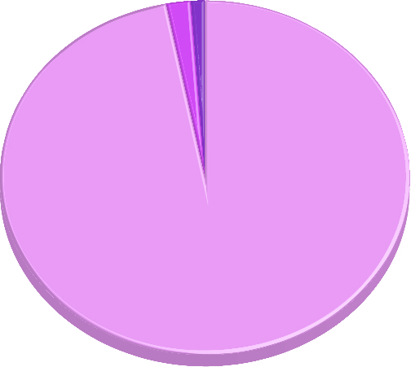
6.1.5 Distribution of Ethnic Religions (2 of 6)
Figure 6-16: Hindus are concentrated nearly entirely in India.
1%
Bangladesh
2%
Nepal
97%
India

Slide 26
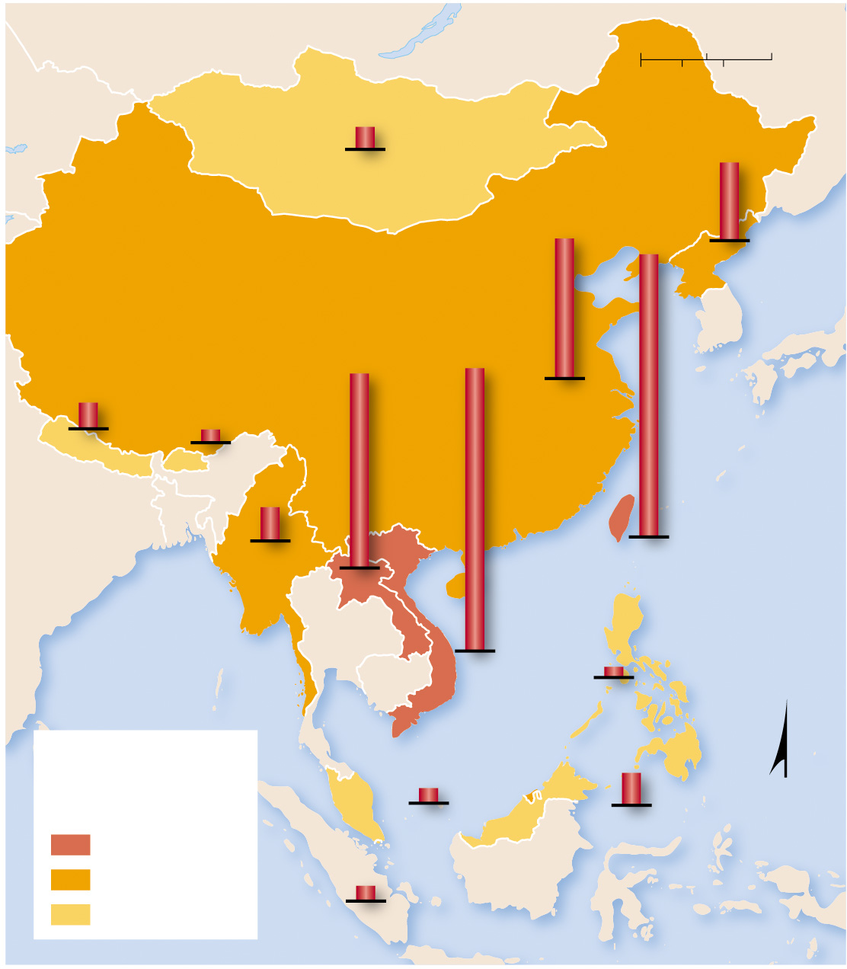
6.1.5 Distribution of Ethnic Religions (3 of 6)
Figure 6-17: Primal-indigenous ethnic religions are relatively common in Southeast Asia.
0
300
600 Miles
0
300
600 Kilometers
3.6%
MONGOLIA
12.3%
22.0%
44.4%
NORTH
KOREA
4.1%
30.0%
44.4%
1.4%
CHINA
NEPAL
BHUTAN
5.2%
MYANMAR
LAOS
TAIWAN
PACIFIC
OCEAN
VIETNAM
1.5%
PHILIPPINES
Percent practicing
primal-indigenous
religions
2.3%
5.1%
MALAYSIA
N
30 and above
BRUNEI
5–29
2.3%
below 5
SINGAPORE

Slide 27
6.1.5 Distribution of Ethnic Religions (4 of 6)
Chinese traditional religions are syncretic, which means they combine several traditions. These include Confucianism and Taoism
Almost 35 million people in Africa practice various folk religions (also known as animism) where elements of the natural world are animated or have discrete spirits and conscious life

Slide 28
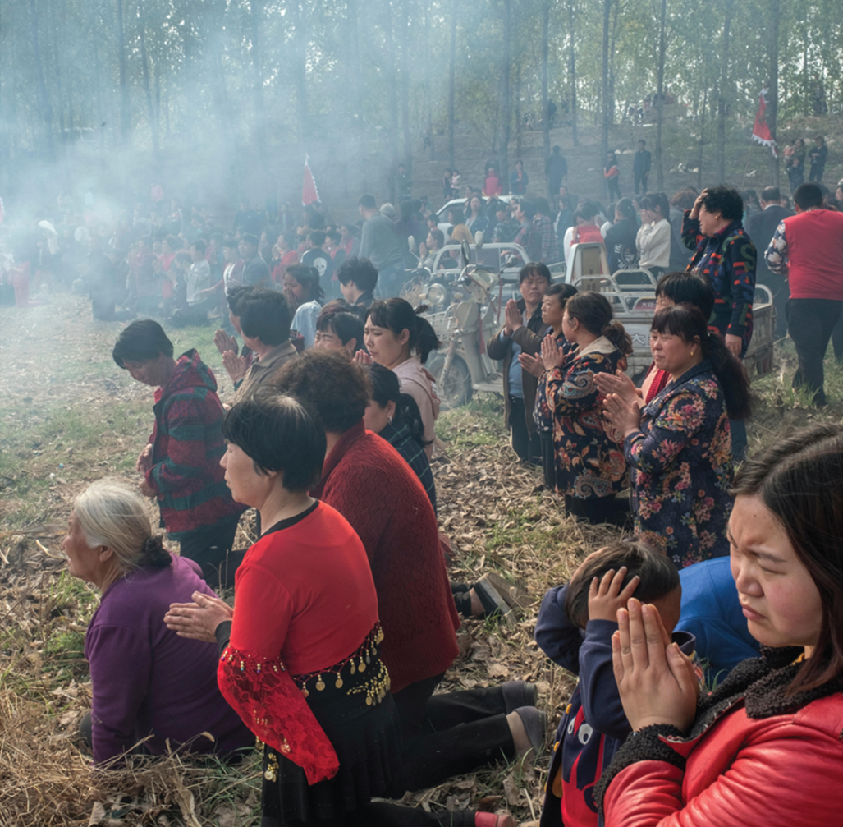
6.1.5 Distribution of Ethnic Religions (5 of 6)
Figure 6-18: Taoists pray during a birthday celebration for the Tao goddess Bixia Yuanjun (Lady of Mount Tai), Liutong, China.

Slide 29
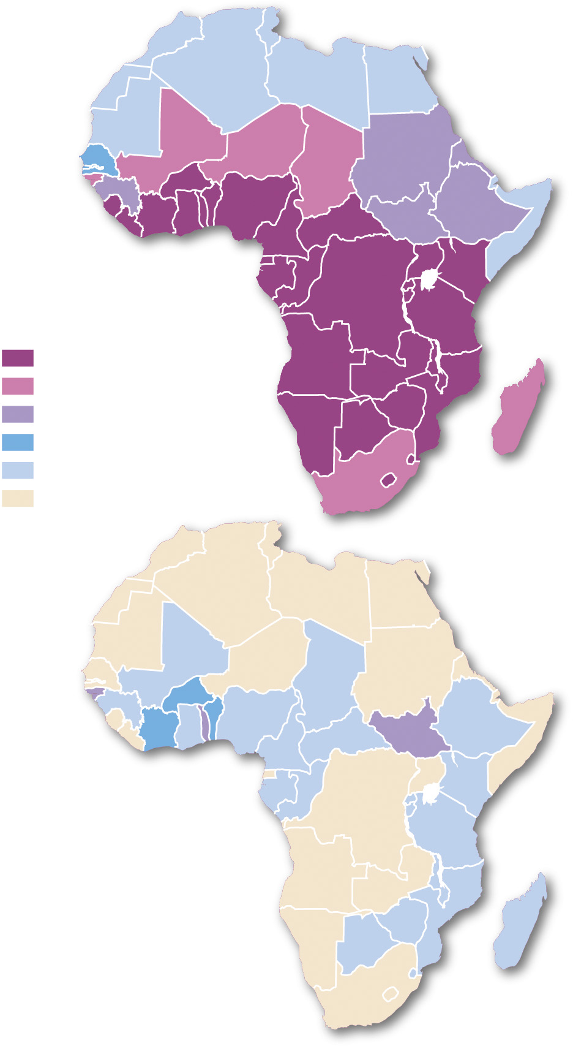
6.1.5 Distribution of Ethnic Religions (6 of 6)
Figure 6-19: Traditional folk religions in Africa have become less common in part because of the activity of Christian and Muslim missionaries.
(a) 1900
Percent traditional
folk religions
70–100
50–69
30–49
11–29
1–10
below 1
modern borders shown
(b) 2010

Slide 30
6.1.6 Distribution of Other Religions (1 of 4)
Smaller religions tend to cluster within one country (excepting Baha’i). They include:
Sikhs (Punjab region of India)
Juche (North Korea)
Spiritism (Brazil)
Judaism (Israel and the United States)
Baha’i (India and various Asian countries)
Tenrikyo (Japan)
Jainism (South Asia)
Shintoism (Japan)
Cao Dai (Vietnam)
Zoroastrianism (India, Iran)

Slide 31
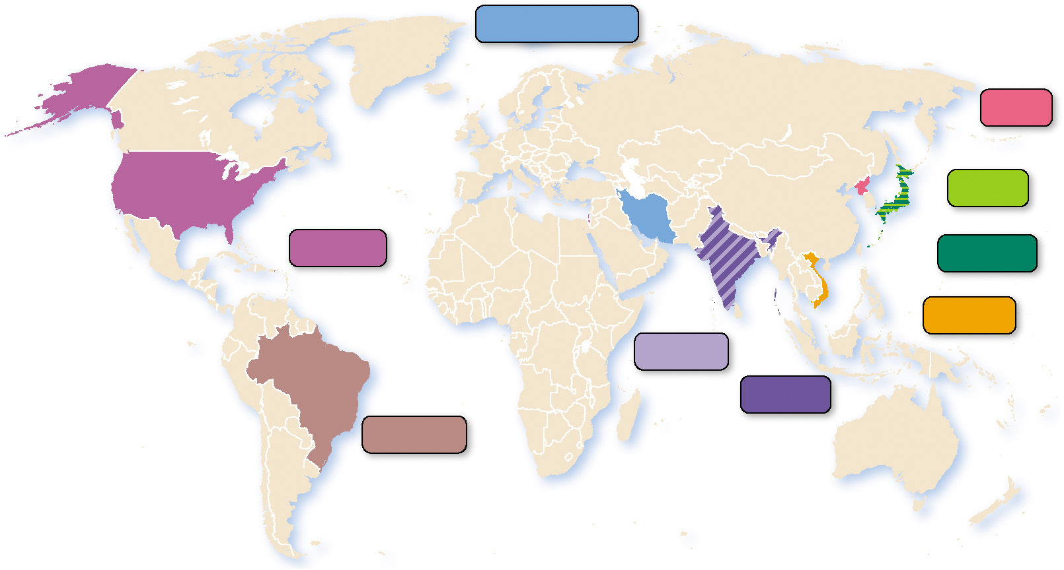
6.1.6 Distribution of Other Religions (2 of 4)
Figure 6-20: Most of the world’s smaller religions are concentrated within one country.
Zoroastrianism
Juche
Shinto
Judaism
Tenrikyo
Cao Dai
Sikhism
Jainism
Spiritism

Slide 32
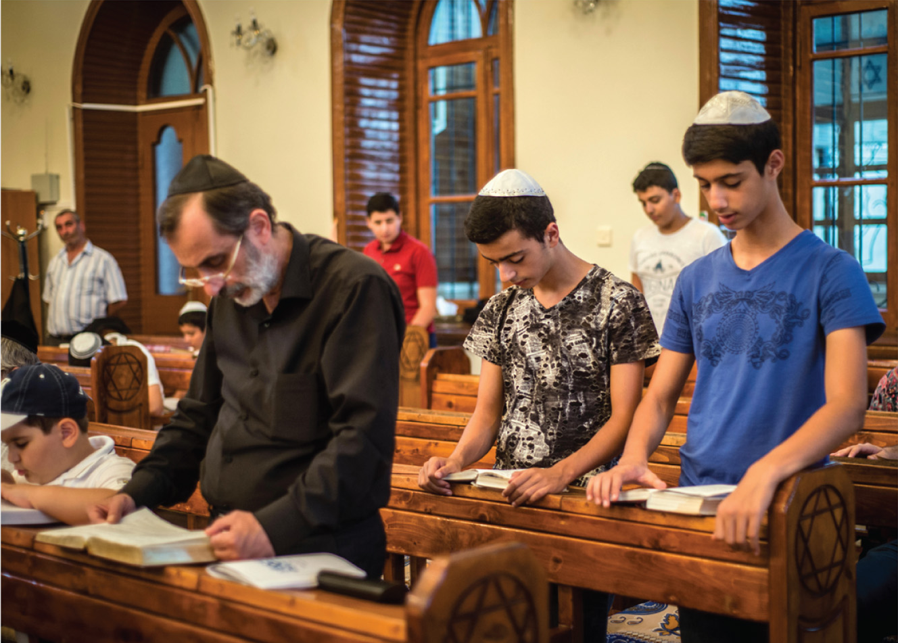
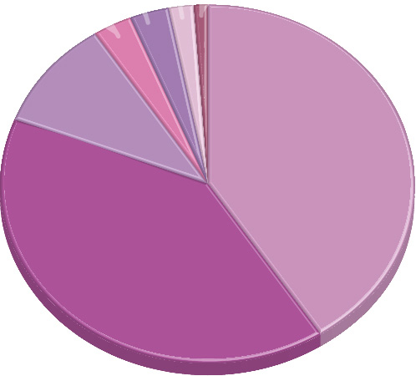
6.1.6 Distribution of Other Religions (3 of 4)
Figures 6-21 and 6-22: Jews are located throughout the world but largely are in Israel and the United States.
2% Asia
3% Latin America
1% South Pacific
3% Canada
10%
Europe
41%
United States
40%
Israel

Slide 33
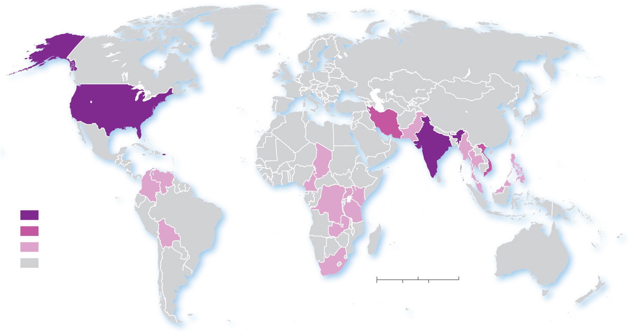
6.1.6 Distribution of Other Religions (4 of 4)
Figure 6-23: Bahá’í is relatively dispersed in its distribution but is primarily found in India, Iran, and the United States.
ARCTIC
OCEAN
PACIFIC
OCEAN
ATLANTIC
OCEAN
PACIFIC
OCEAN
Percent of world’s
total Bahí’í
10 and above
INDIAN
OCEAN
5.0–9.9
1–4.9
ATLANTIC
OCEAN
less than 0.5
0
1,500
3,000 Miles
0
1,500
3,000 Kilometers

Slide 34
Key Issue 2: Why Do Religions Have Distinctive Distributions?
6.2.1 Origin of Christianity and Islam in Southwest Asia
6.2.2 Origin of Buddhism and Hinduism in South Asia
6.2.3 Historical Diffusion of Religions
6.2.4 Recent Migration of Christians
6.2.5 Migration of Muslims and Jews

Slide 35
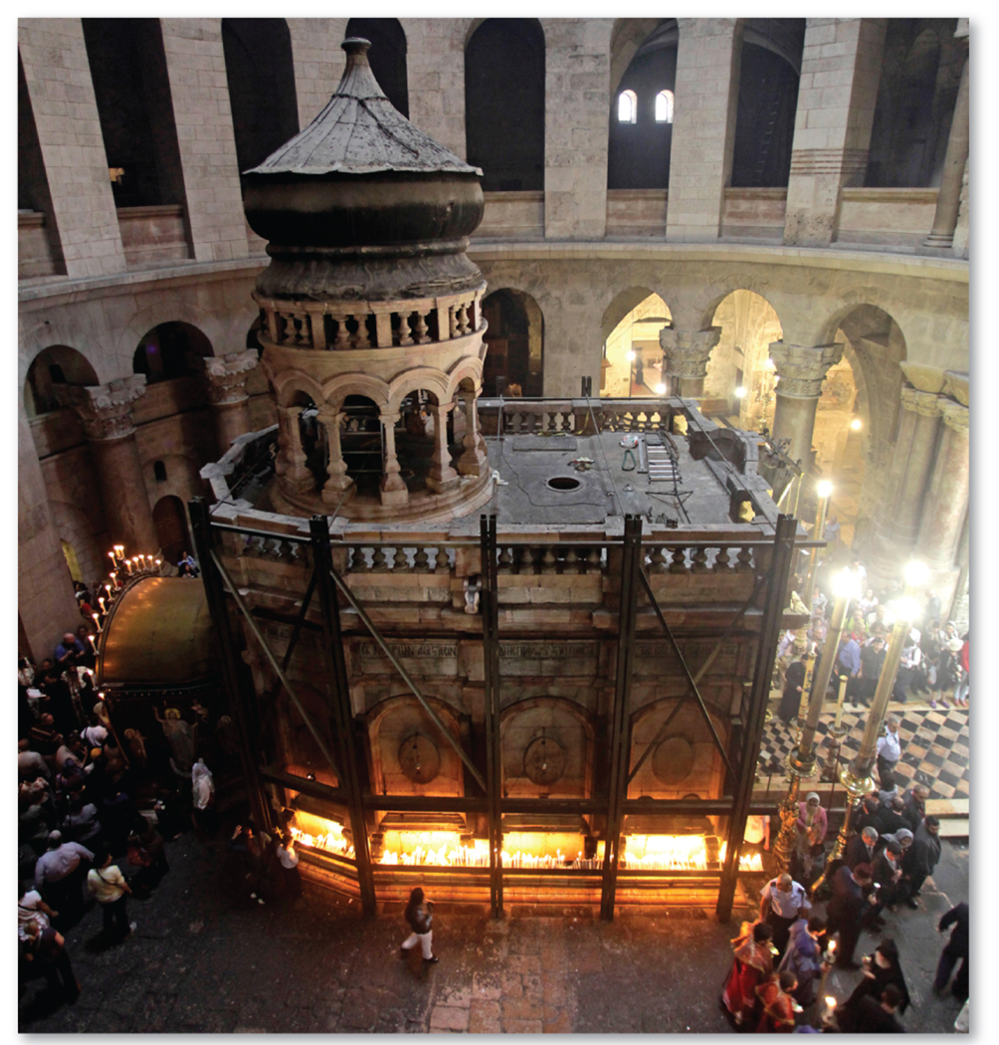
6.2.1 Origin of Christianity and Islam in Southwest Asia (1 of 4)
Figure 6-24: The Church of the Holy Sepulchre in Jerusalem, Israel is a historic site in the origin of Christianity as the site of Jesus’s resurrection.

Slide 36
6.2.1 Origin of Christianity and Islam in Southwest Asia (2 of 4)
Christianity and Islam are both universalizing religions
Christianity has three major branches—Roman Catholic, Protestant, and Orthodox
Islam has two major branches—Sunni and Shiite. The primary disagreement between the two branches is line of succession in Islamic leadership after the death of Prophet Muhammed

Slide 37
6.2.1 Origin of Christianity and Islam in Southwest Asia (3 of 4)
The core of Islamic belief involves performing five acts, known as the Five Pillars of Islam
Shahadah—the recitation there is no deity worth worshipping except the one God
Salat—praying five times a day to Makkah
Zakat—giving generously to charity
Sawm of Ramadan—fasting during the daylight hours of the month of Ramadan
Hajj—making a once-in-a-lifetime pilgrimage to Makkah

Slide 38
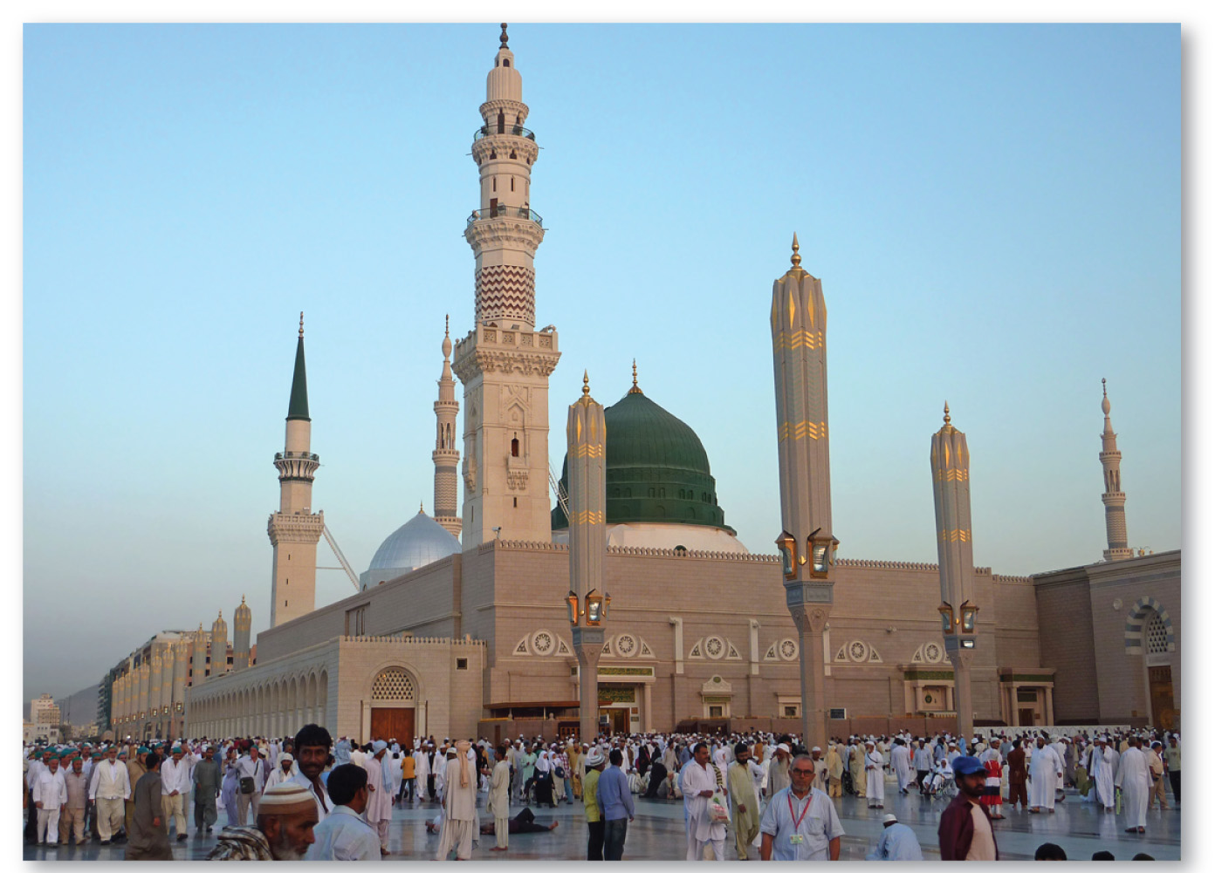
6.2.1 Origin of Christianity and Islam in Southwest Asia (4 of 4)
Figure 6-25: The Mosque of the Prophet in Madinah, Saudi Arabia, marks the burial place of Muhammad, the Prophet of Islam.

Slide 39
6.2.2 Origin of Buddhism and Hinduism in South Asia (1 of 3)
Buddhism originated in the region of the present-day border between India and Nepal. There are three branches of Buddhism:
Theravada
Mahayana
Vajrayana
The origins of Hinduism are unknown but date back to South Asia between 2500 B.C.E. and 1500 B.C.E.

Slide 40
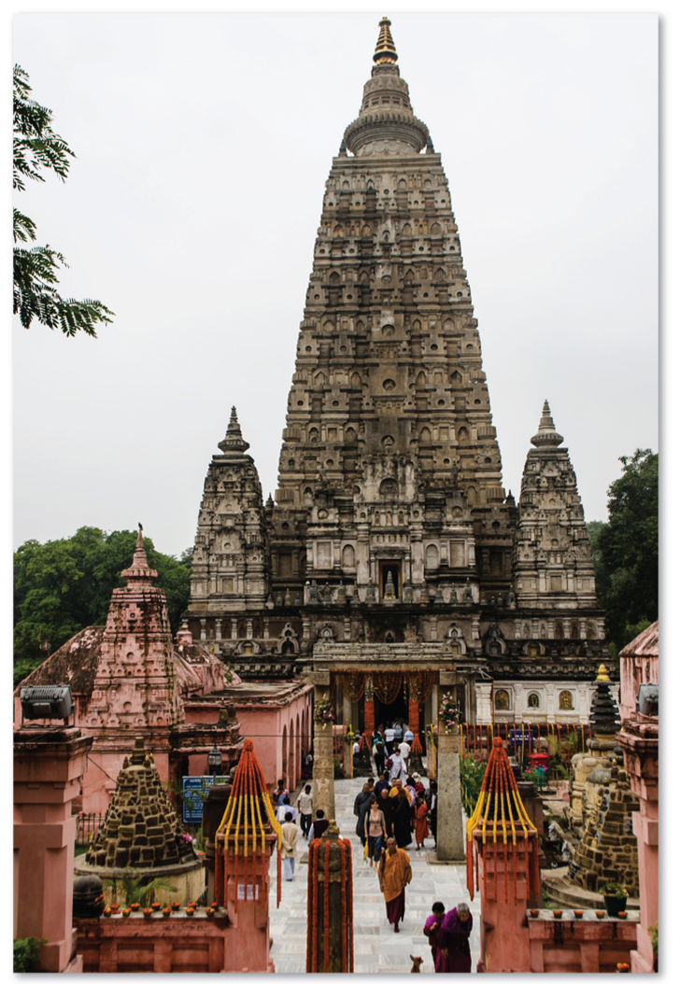
6.2.2 Origin of Buddhism and Hinduism in South Asia (2 of 3)
Figure 6-26: The Mahabodhi (Great Awakening) Temple represents the place where Buddha attained enlightenment.

Slide 41
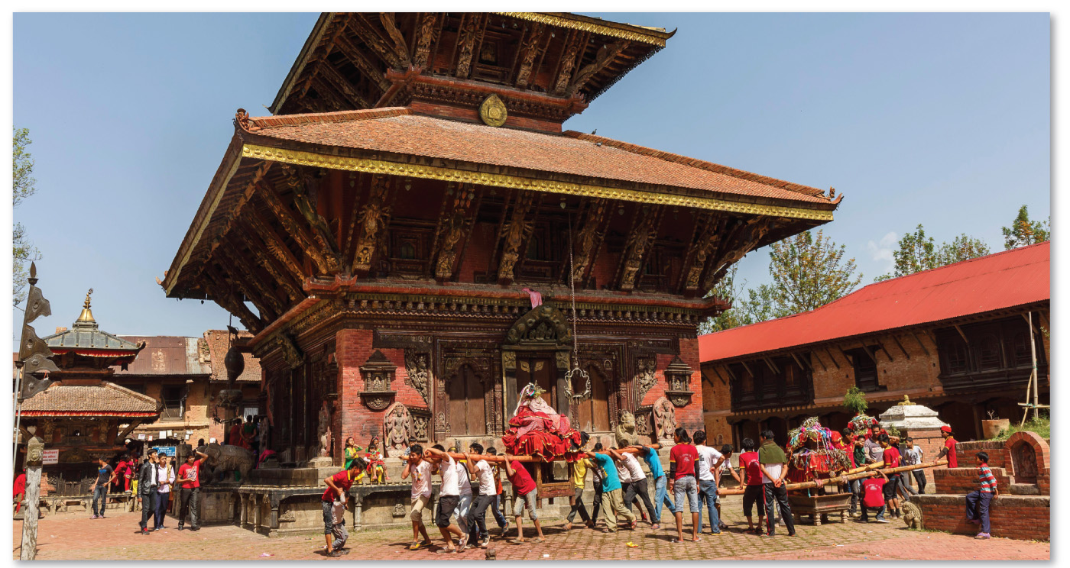
6.2.2 Origin of Buddhism and Hinduism in South Asia (3 of 3)
Figure 6-27: Changu Narayan, from around A.D. 325, is the oldest surviving Hindu temple in Nepal, but there is not a known single origin of Hinduism.

Slide 42
6.2.3 Historical Diffusion of Religions (1 of 5)
Buddhism diffused along the trading routes from northeastern India. It was introduced to China by Buddhist missionaries
Islam diffused rapidly from Saudi Arabia. Within 200 years, Muslims controlled much of Southwest Asia and North Africa
Christianity first spread from its hearth in Judea through relocation diffusion by missionaries. It spread during Roman times by hierarchical diffusion and since 1500 C.E. by contagious diffusion

Slide 43
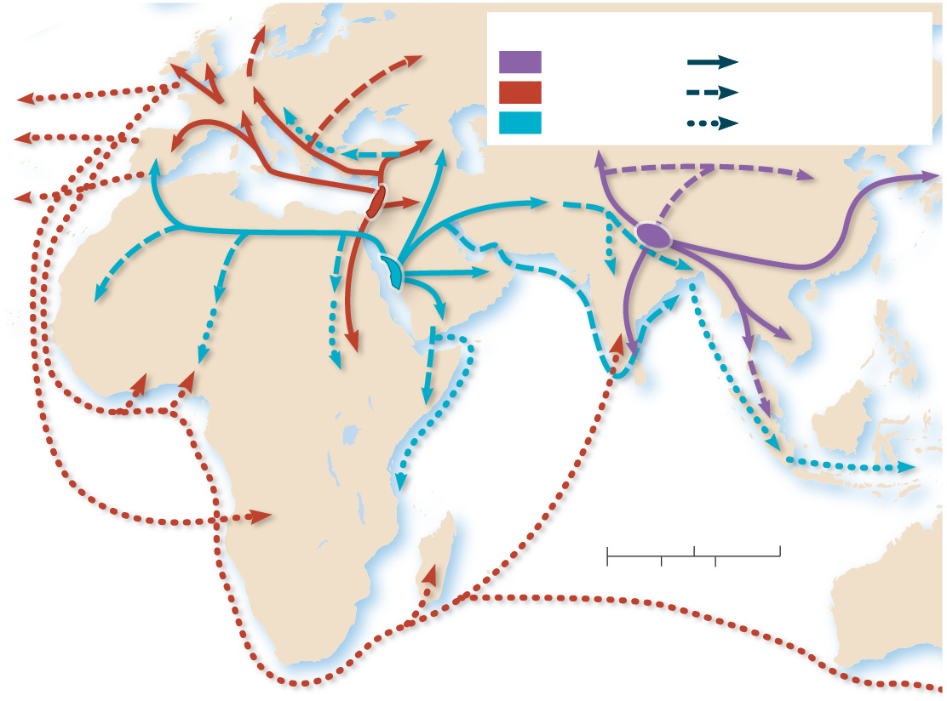
6.2.3 Historical Diffusion of Religions (2 of 5)
Figure 6-29: Universalizing religions have diffused around the world.
Hearth
Diffusion
To North America
Buddhism
by 8th century
Christianity
by 12th century
To Brazil
Islam
after 12th century
To Latin
America
Arabian
Sea
Bay
of
Bengal
INDIAN OCEAN
ATLANTIC
OCEAN
0
1,000
2,000 Miles
0
1,000
2,000 Kilometers

Slide 44
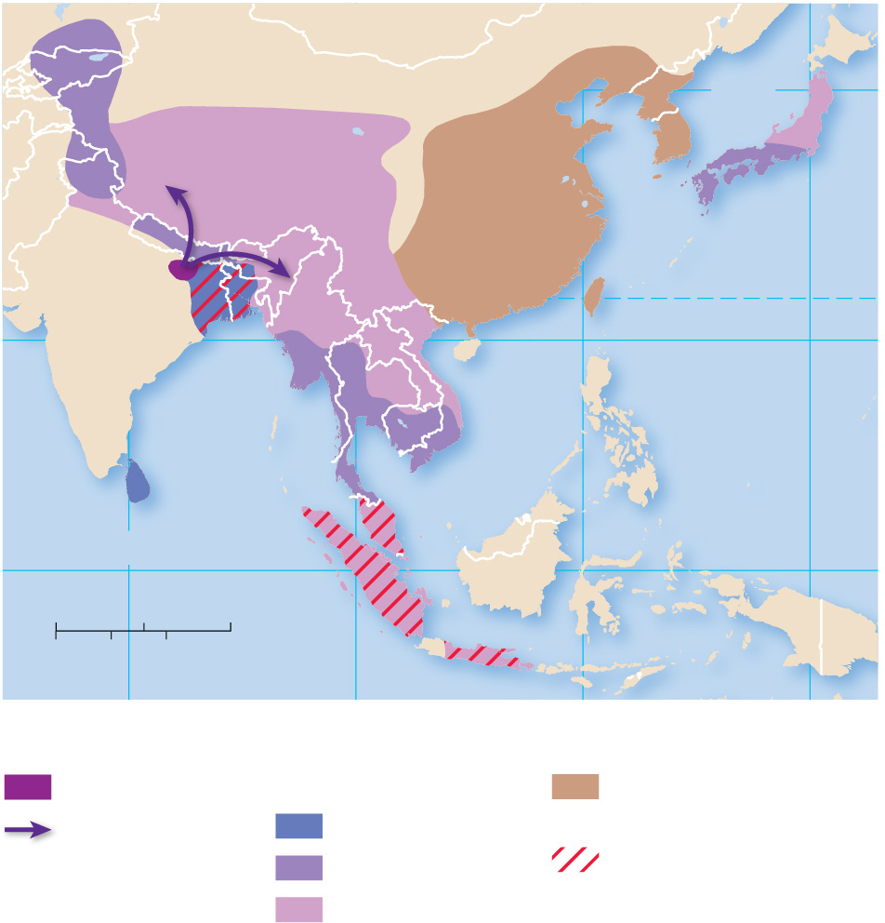
6.2.3 Historical Diffusion of Religions (3 of 5)
Figure 6-30: Buddhism diffused slowly from its hearth in India as missionaries carried the faith into East and Southeast Asia.
140°
Sea of
Japan
(East Sea)
40°
East
China
Sea
TROPIC OF CANCER
20°
Bay of
Bengal
South
China
Sea
PACIFIC
OCEAN
INDIAN OCEAN
0°
0
500
1,000 Miles
0
500
80°
1,000 Kilometers
100°
120°
140°
Buddhist hearth
Became predominant:
Mixed with Confucianism
and ethnic religions
Route of diffusion
from 300
B.C.E.
300 B.C.–700 C.E.
No longer predominant
800 A.D.–1100 C.E.

Slide 45
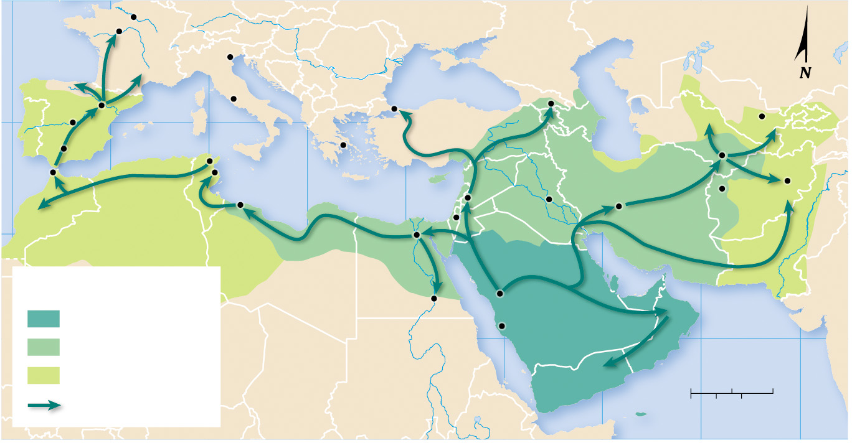
6.2.3 Historical Diffusion of Religions (4 of 5)
Figure 6-31: Islam diffused through a combination of military campaigns and missionary activity.
10°W
Tours
Paris
ATLANTIC
OCEAN
FRANKISH
KINGDOM
Venice
N
Black Sea
Tiflis
Toledo
Zaragoza
Rome
Constantinople
Caspian Sea
Samarkand
40°N
10°E
BYZANTINE EMPIRE
Cordova
Tunis
Athens
Merv
Tangier
Kairwan
Mediterranean Sea
Kabul
Tripoli
20°E
Jerusalem
Damascus
Baghdad
Herat
Isfahan
Cairo
Muslim by:
Aswan
Medina
632 C.E.
Red Sea
Mecca
661 C.E.
20°N
750 C.E.
Arabian Sea
0
250
500 Miles
Military campaign
50°E
0
250
500 Kilometers
60°E
70°E

Slide 46
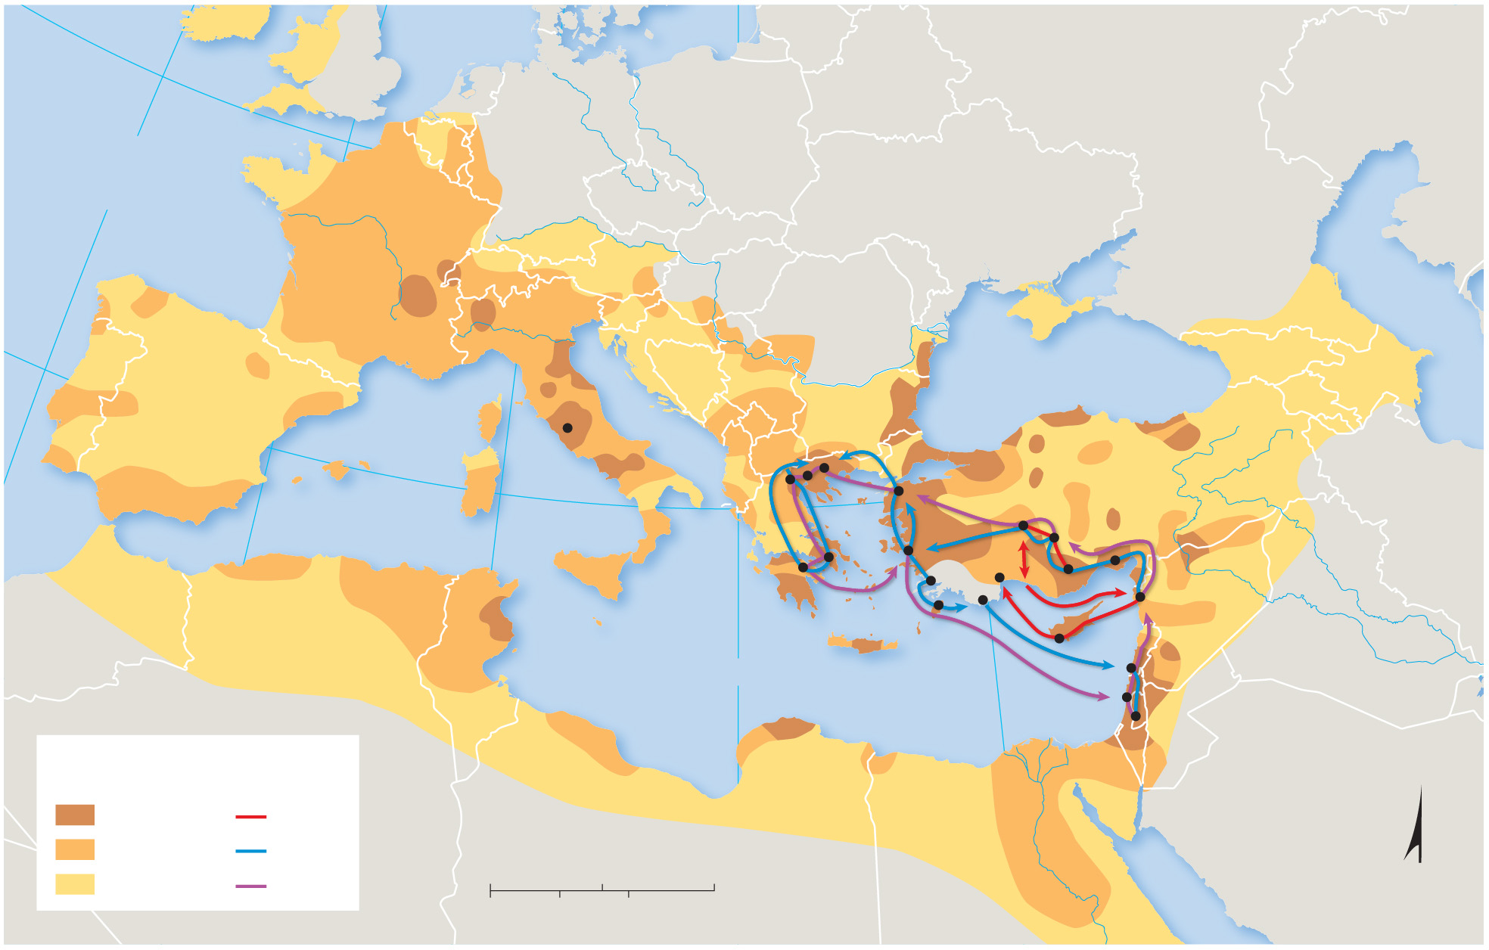
6.2.3 Historical Diffusion of Religions (5 of 5)
Figure 6-32: Christianity was spread around the Mediterranean by missionaries and the conversion of rulers.
50°N
10°W
ATLANTIC
OCEAN
Caspian Sea
40°N
Black Sea
Rome
Thessalonica
Philippi
Beroea
Troas
Antioch
Iconium
0°
10°E
Athens
Ephesus
Derbe
Corinth
Tarsus
Miletus
Antioch
Rhodes
Paphos
Mediterranean Sea
Patara
Attalia
Tyre
20°E
Caesarea
Jerusalem
Strongly
Christian by:
Paul’s
journeys
200 C.E.
First
400 C.E.
Second
0
250
500 Miles
600 C.E.
Third
0
250
500 Kilometers
Red Sea

Slide 47
6.2.4 Recent Migration of Christians (1 of 6)
Christians comprise only one-third of the world’s population but account for one-half of the world’s international migrants. About 5% of all Christians have migrated
Around 25% of all Jews have migrated from one country to another at some point in their lives
Christians and Jews overwhelmingly migrate to other lands which share their faith

Slide 48
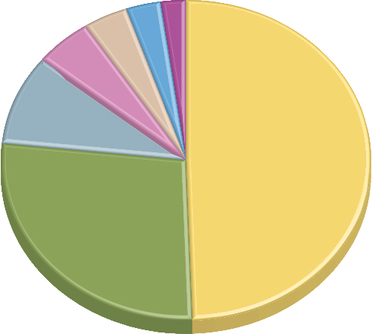
6.2.4 Recent Migration of Christians (2 of 6)
Figure 6-33: Christians make up a disproportionate share of migrants.
Buddhists
7.3
Jews
3.7
Other religions
9.0
Hindus
10.7
Unaffiliated
19.5
Christians
106.0
Muslims
58.3

Slide 49
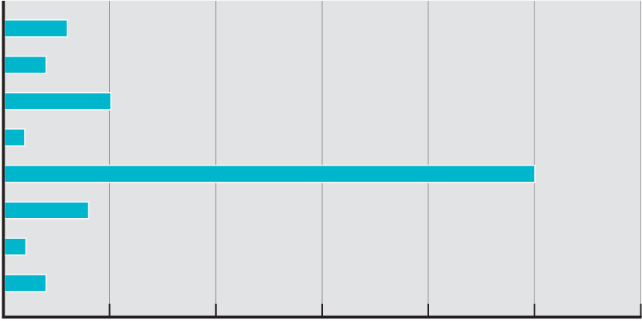
6.2.4 Recent Migration of Christians (3 of 6)
Figure 6-34: More than 25% of Jews who are alive today are migrants.
Global average
Buddhist
Christian
Hindu
Jewish
Muslim
other
unaffiliated
0
5
10
15
20
25
30
Percentage of people alive today who have migrated

Slide 50
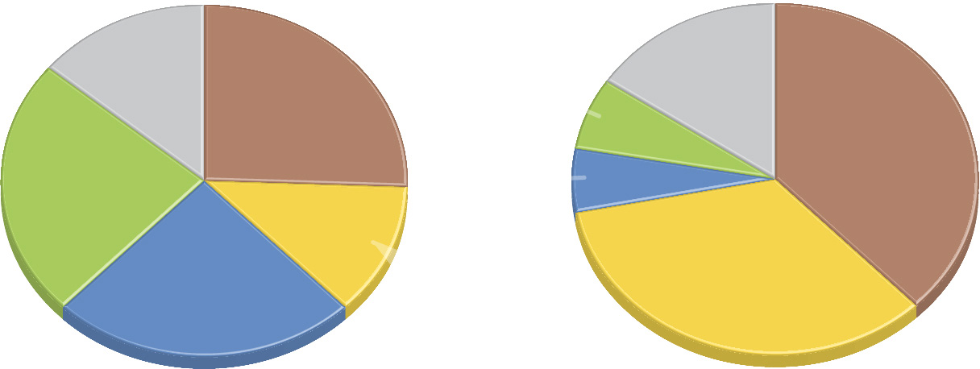
6.2.4 Recent Migration of Christians (4 of 6)
Figure 6-35: Europe and North America are popular destinations for Christian migrants.
Origin of
Christian migrants
Destination of
Christian migrants
13.8%
15.4%
Other
regions
25.7%
sub-Saharan
Africa
Other
regions
Eu
r
ope
37.8%
6.6%
23.8%
Europe
sub-Saharan
Africa
Latin
America
6.0%
12.3%
24.4%
34.2%
Latin America
North America
North
America

Slide 51
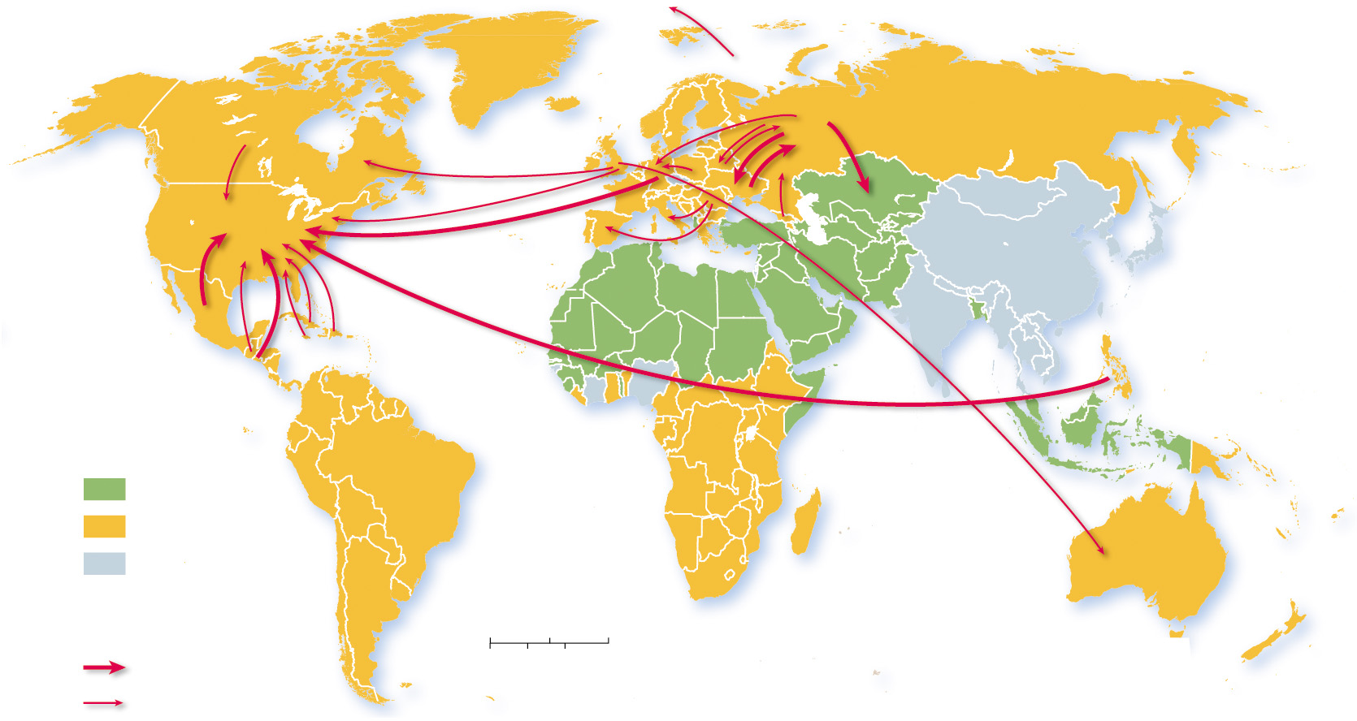
6.2.4 Recent Migration of Christians (5 of 6)
Figure 6-36: Large flows of Christians are from countries with Christian majorities into other countries with Christian majorities.
ARCTIC
OCEAN
ATLANTIC
OCEAN
PACIFIC
OCEAN
PACIFIC
OCEAN
Religious
majority
INDIAN
OCEAN
Muslim
Christian
other or none
Christian
migrants
0
1,000
2,000 Miles
1 million or more
0
1,000
2,000 Kilometers
  ½ million

Slide 52
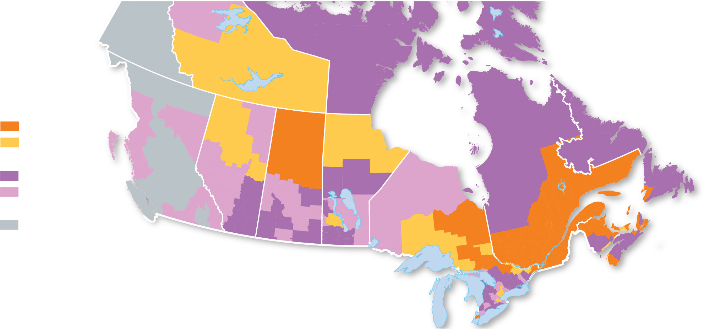
6.2.4 Recent Migration of Christians (6 of 6)
Figure 6-37: Catholics largely migrated into Quebec, whereas Protestants migrated into English-speaking provinces of Canada.
YUKON
NUNAVUT
NORTHWEST
TERRITORIES
Percent Roman Catholic
NEWFOUNDLAND
AND LABRADOR
50 and above
below 50
BRITISH
COLUMBIA
Percent Protestant
ALBERTA
50 and above
MANITOBA
below 50
QUEBEC
Percent no religion
SASKATCHEWAN
PRINCE
EDWARD
ISLAND
40 and below
ONTARIO
NOVA SCOTIA
NEW
BRUNSWICK

Slide 53
6.2.5 Recent Migration of Muslims and Jews (1 of 6)
Israel and the United States are the primary destinations for Jewish migrants
Southwest Asia and North Africa is home to 20% of the world’s Muslims but attracts 34% of Muslim migrants. Saudi Arabia is the country that attracts the largest number of Muslim migrants
Europe is also a primary destination of Muslim migrants

Slide 54
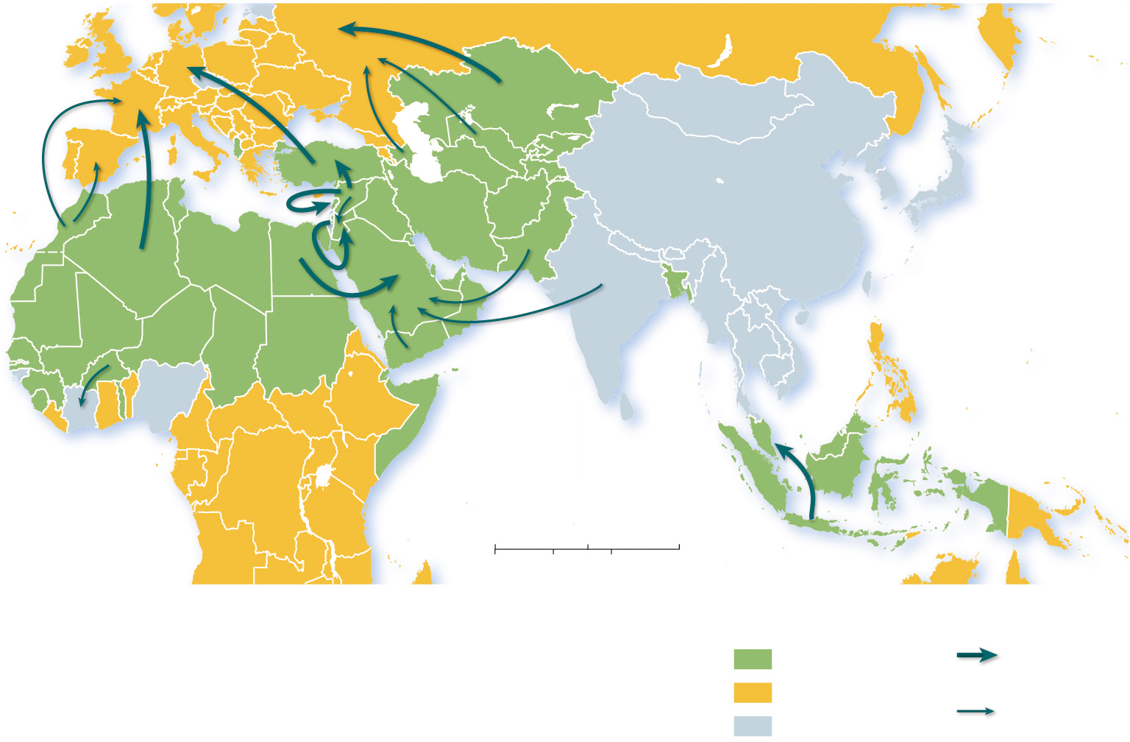
6.2.5 Recent Migration of Muslims and Jews (2 of 6)
Figure 6-39: Some large flows of Muslim migrants are from Muslim-majority countries to other Muslim-majority countries. There are also large flows of Muslims into Christian-majority Europe.
PACIFIC
OCEAN
INDIAN
OCEAN
0
1,000
2,000 Miles
0
1,000
2,000 Kilometers
Religious majority
Islamic migrants
Muslim
1 million
or more
Christian
½ million
other or none

Slide 55
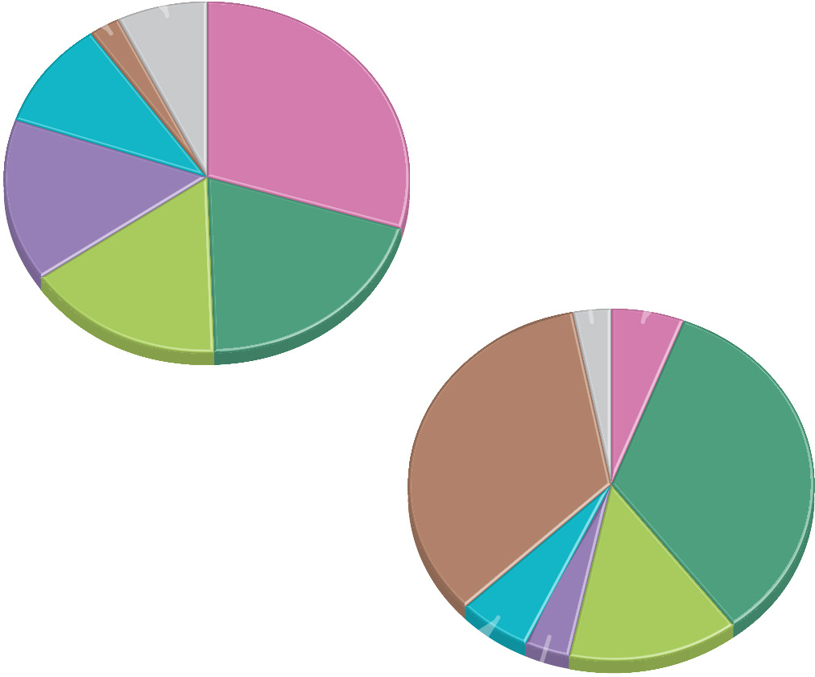
6.2.5 Recent Migration of Muslims and Jews (3 of 6)
Figure 6-40: Europe and other countries in Southwest Asia are the primary destinations of Islamic migrants.
Percent Islamic
by region
Other regions
Europe 2.7
7.0
9.9
Central Asia
29.8
South Asia
14.9
Southeast
Asia
19.8
Southwest Asia
& North Africa
Percent Islamic
migrant destination
15.9
sub-Saharan
Africa
Other regions 2.8
South Asia
6.0
34.4
Europe
33.8
Southwest Asia
& North Africa
5.7
13.6
sub-Saharan
Africa
Central Asia
Southeast Asia 3.7

Slide 56
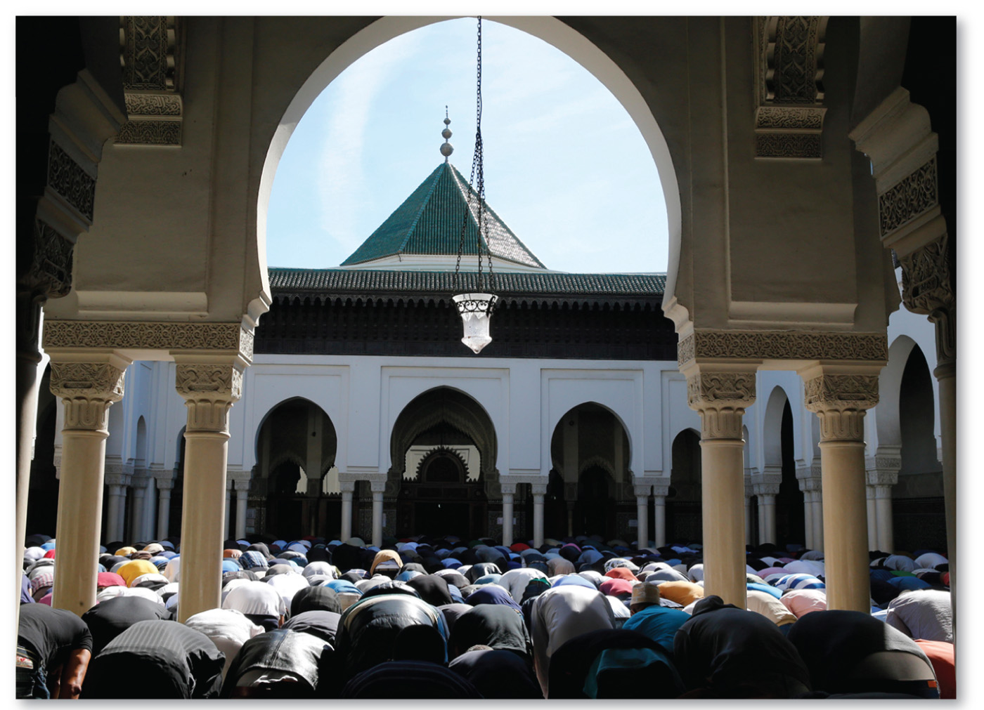
6.2.5 Recent Migration of Muslims and Jews (4 of 6)
Figure 6-41: Muslims pray in the Great Mosque in Paris. France is a major migrant destination for Muslims from North Africa.

Slide 57
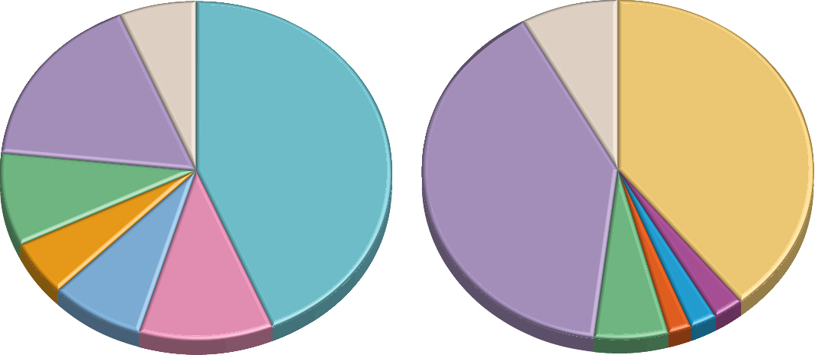
6.2.5 Recent Migration of Muslims and Jews (5 of 6)
Figure 6-42: The Jewish population has undergone a major change in distribution from being mostly in Europe to mostly in the United States and Israel.
1910
2012
6.2%
8.2%
other
other
17.1%
United
States
40.1%
43.8%
40.6%
Israel
8.9%
Russia
United
other Europe
States
5.2%
Germany
7.8%
11.0%
Austria
6.4%
Canada 2.5%
Hungary
France 2.2%
other Europe
U.K. 2.0%

Slide 58
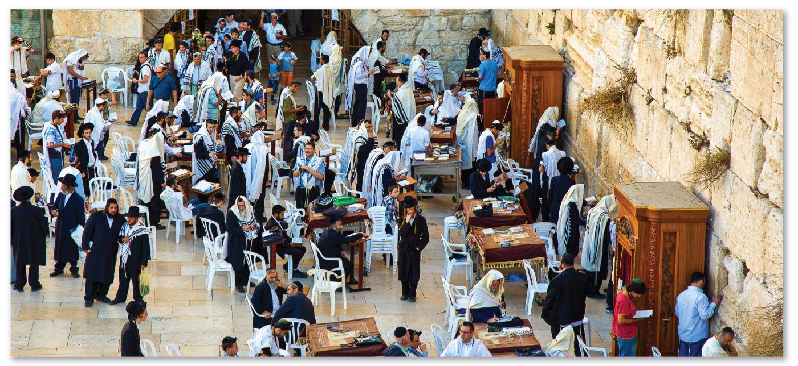
6.2.5 Recent Migration of Muslims and Jews (6 of 6)
Figure 6-43: Jews worship at the Western Wall, the holiest site in Judaism, at the base of the Temple Mount, Jerusalem, Israel.

Slide 59
Key Issue 3: Why Do Religions Organize Space in Specific Patterns?
6.3.1 Places of Worship
6.3.2 Pilgrimages to Religious Shrines
6.3.3 Religious Settlements and Toponyms
6.3.4 Administration of Religious Space
6.3.5 The Landscape in Ethnic Religions
6.3.6 Religious Calendars and the Environment

Slide 60
6.3.1 Places of Worship (1 of 2)
Christians worship in churches
Muslims worship in mosques
Jews worship in synagogues
Sikhs worship in gurdwaras
Buddhists visit pagodas
Hindus visit pagodas

Slide 61
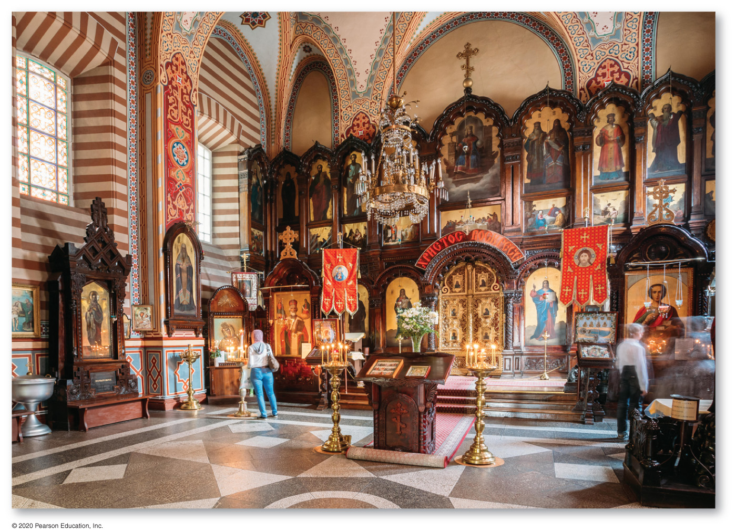
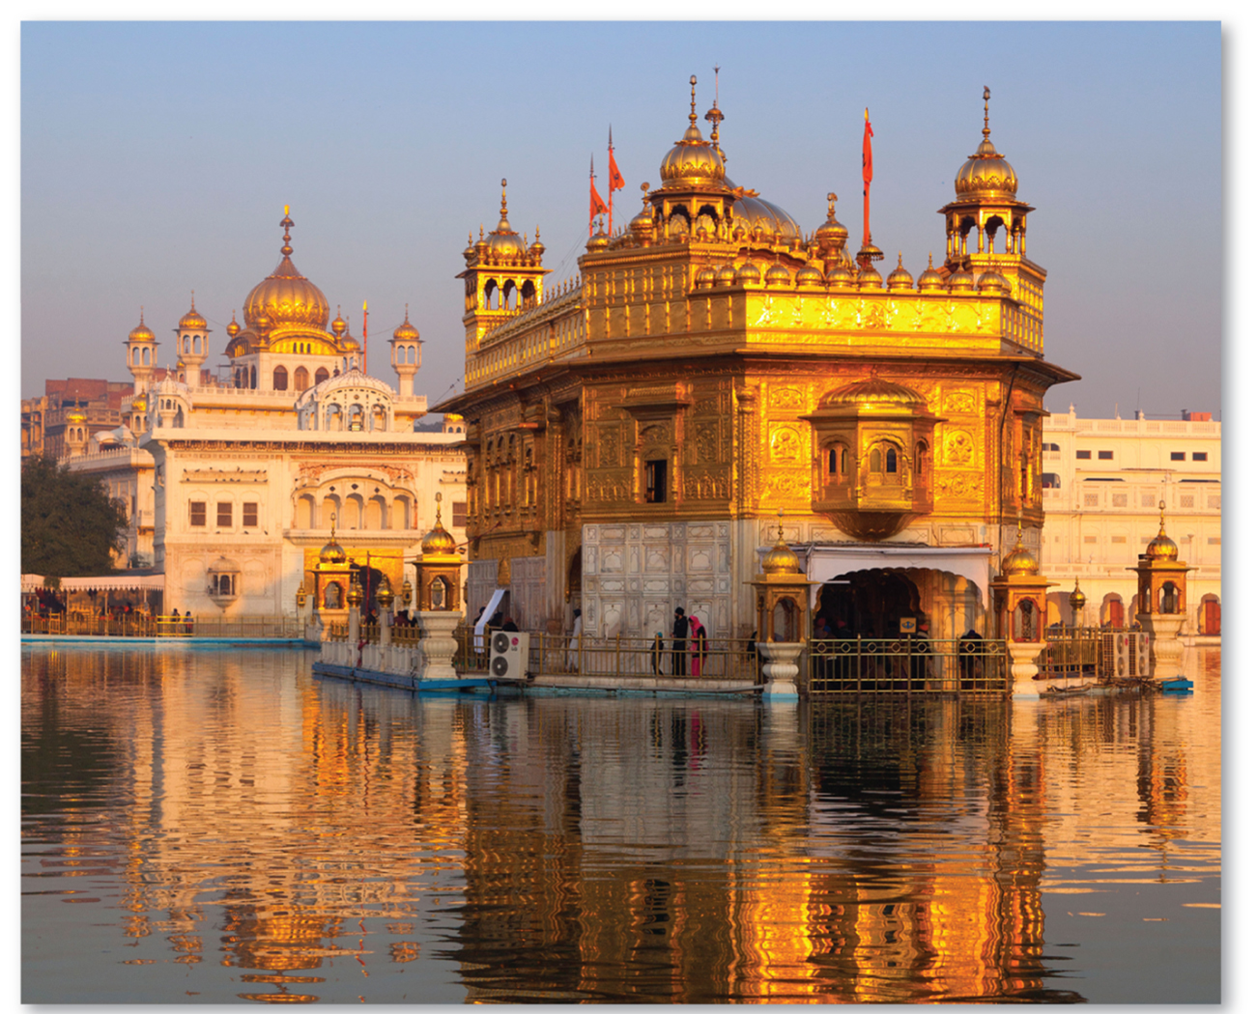
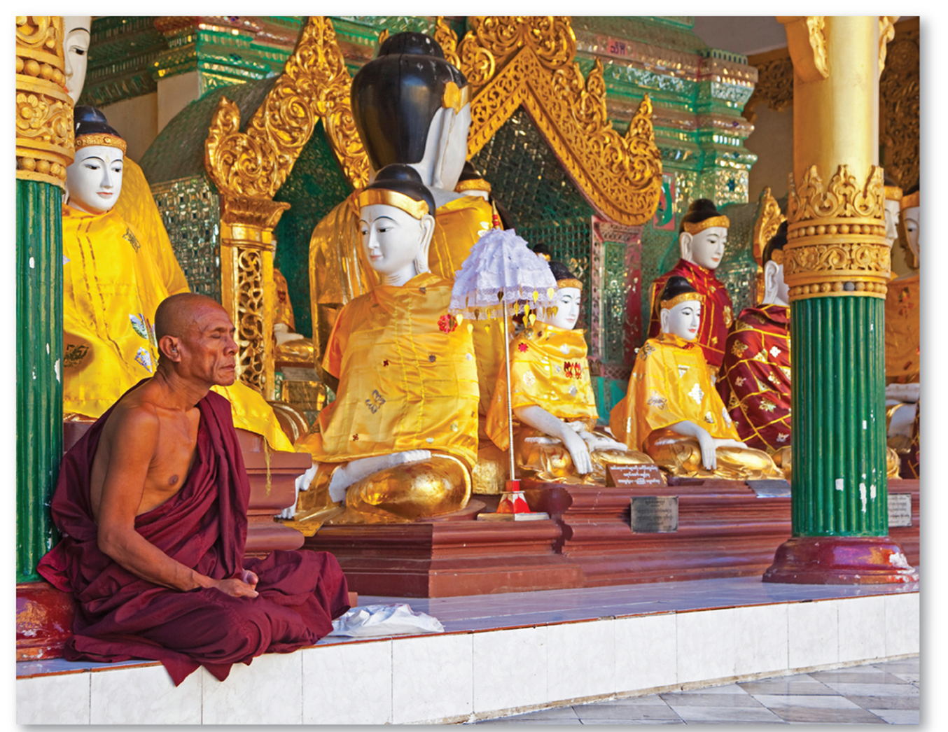
6.3.1 Places of Worship (2 of 2)
Figures 6-44, 6-45, and 6-46: Saint Nicolas Orthodox Church in Vilnius, Lithuania, the Golden Temple in Amritsar, India, and Shwedagon Pagoda in Yangon, Myanmar.

Slide 62
6.3.2 Pilgrimages to Religious Shrines (1 of 4)
Buddhism and Islam are the universalizing religions that place the most emphasis on identifying shrines
A pilgrimage is a journey for religious purposes to a place considered sacred
Muslims are expected to make a pilgrimage to Makkah known as the hajj

Slide 63
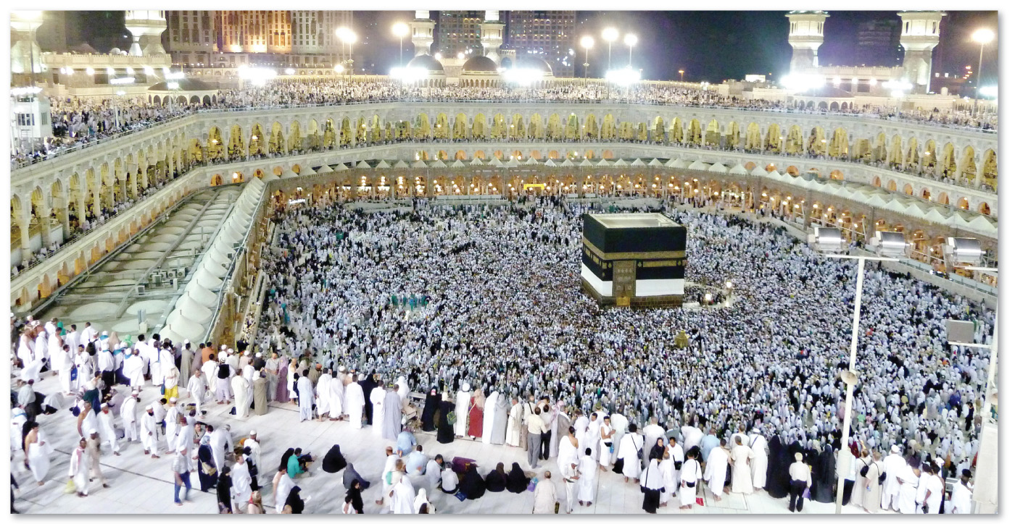
6.3.2 Pilgrimages to Religious Shrines (2 of 4)
Figure 6-47: Muslims who undertook a hajj surround al-Ka’ba.

Slide 64
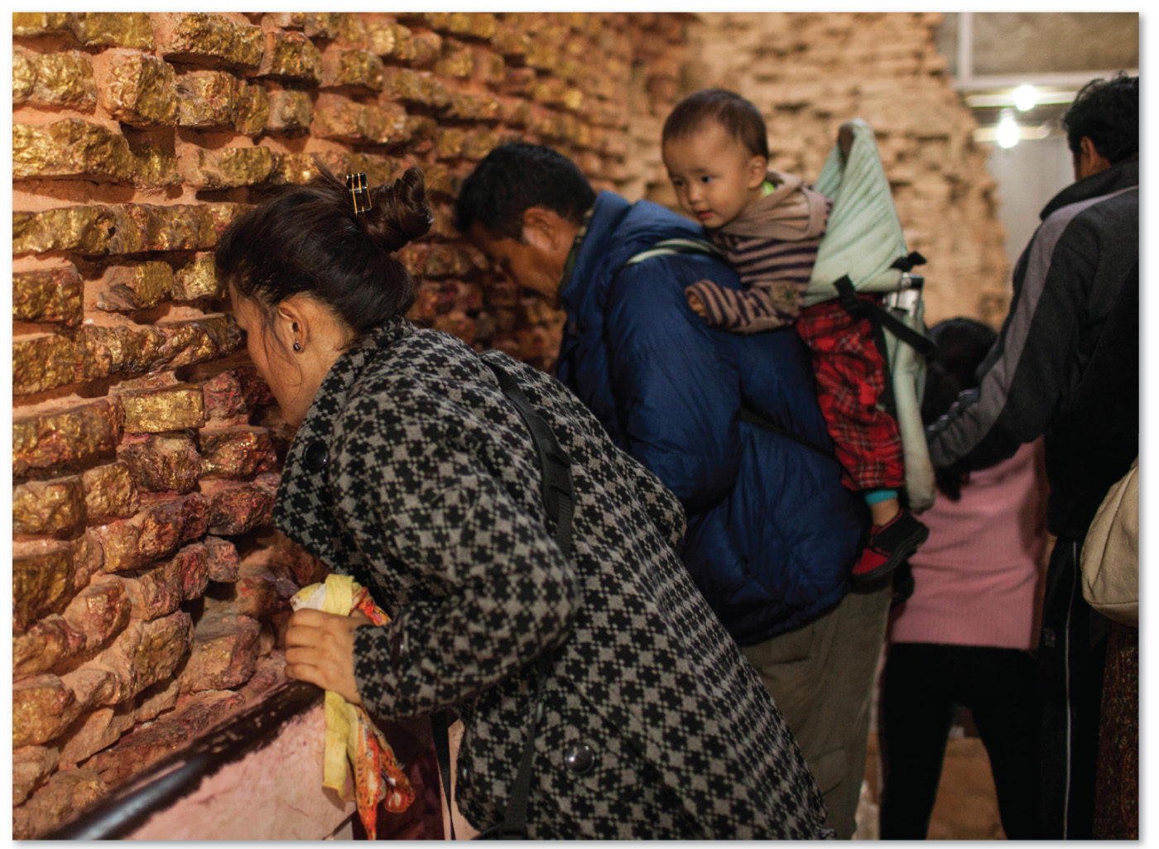
6.3.2 Pilgrimages to Religious Shrines (3 of 4)
Figure 6-48: Buddhists pray in Maya Devi Temple, Lumbini, Nepal. According to Buddhists, the temple is built at the location of Buddha’s birth.

Slide 65
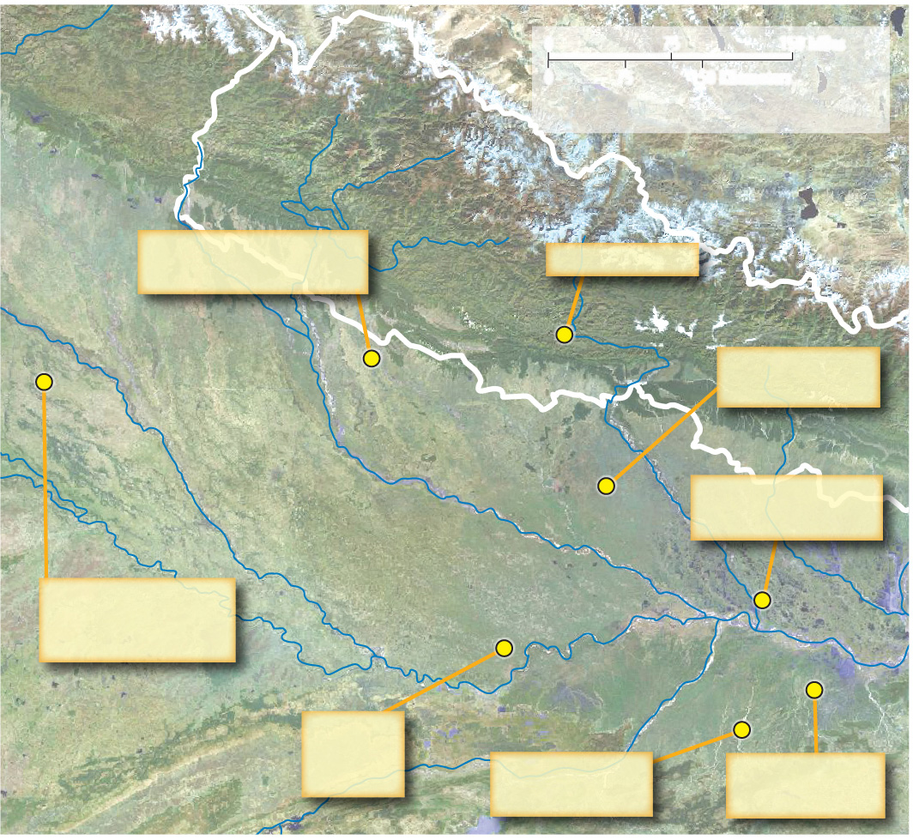
6.3.2 Pilgrimages to Religious Shrines (4 of 4)
Figure 6-49: Buddha and his disciples would have walked from place to place amid the river valleys and plains of northern India, then a region of farming villages divided among several kingdoms.
0
75
150 Miles
0
75
150 Kilometers
NEPAL
Satellite imagery provided by GlobeXplorer.com
CHINA
Buddha created multiple
images of himself
Birth of Buddha
Lumbini
Sankasya
Shravasti
Buddha attained
Nirvana
Ganges R.
Kushinagar
Yamuna R.
INDIA
Ghāghra R.
Buddha announced
his impending death
Buddha ascended to
heaven and returned
to Earth
Vaishali
Sarnath
Rajgir
Buddha’s
sermon at
Deer Park
Bodh Gaya
Buddha attained
Enlightenment
Buddha tamed a
wild elephant

Slide 66
6.3.3 Religious Settlements and Toponyms (1 of 5)
A utopian settlement is a community built to reflect the ideals of a particular religious or social group
A toponym is the general name for any place or geographical entity. Many places around the world incorporate religious toponym into the landscape

Slide 67
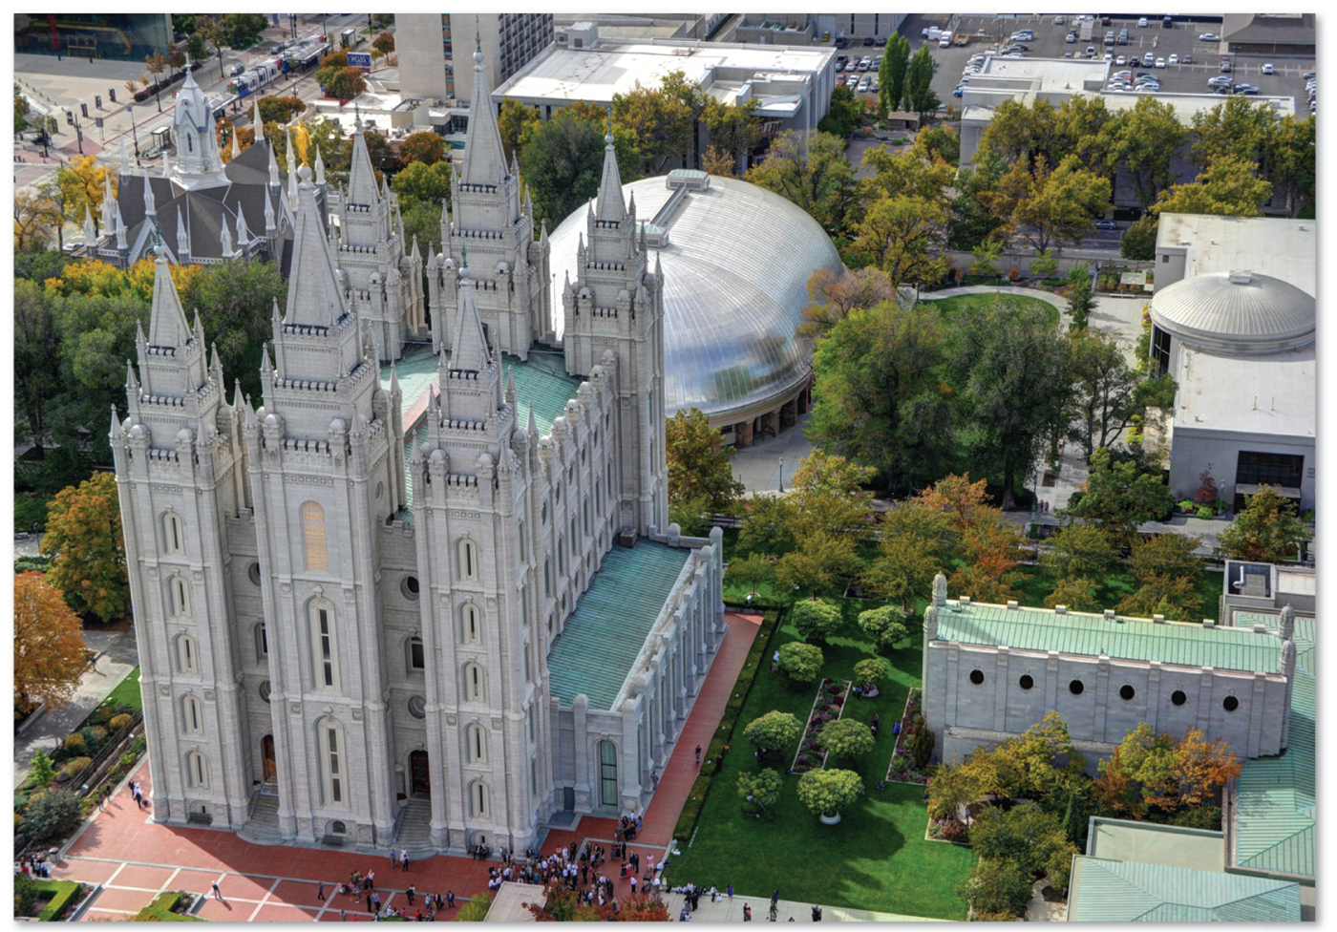
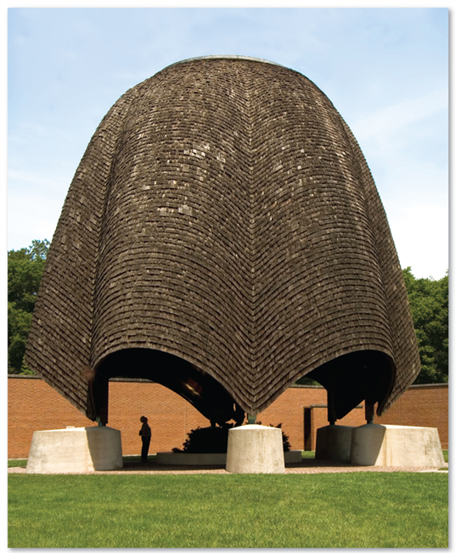
6.3.3 Religious Settlements and Toponyms (2 of 5)
Figures 6-50 and 6-51: The Salt Lake Temple of The Church of Jesus Christ of Latter-day Saints is positioned at the center of the city. The Roofless Church is located in New Harmony, Indiana.

Slide 68
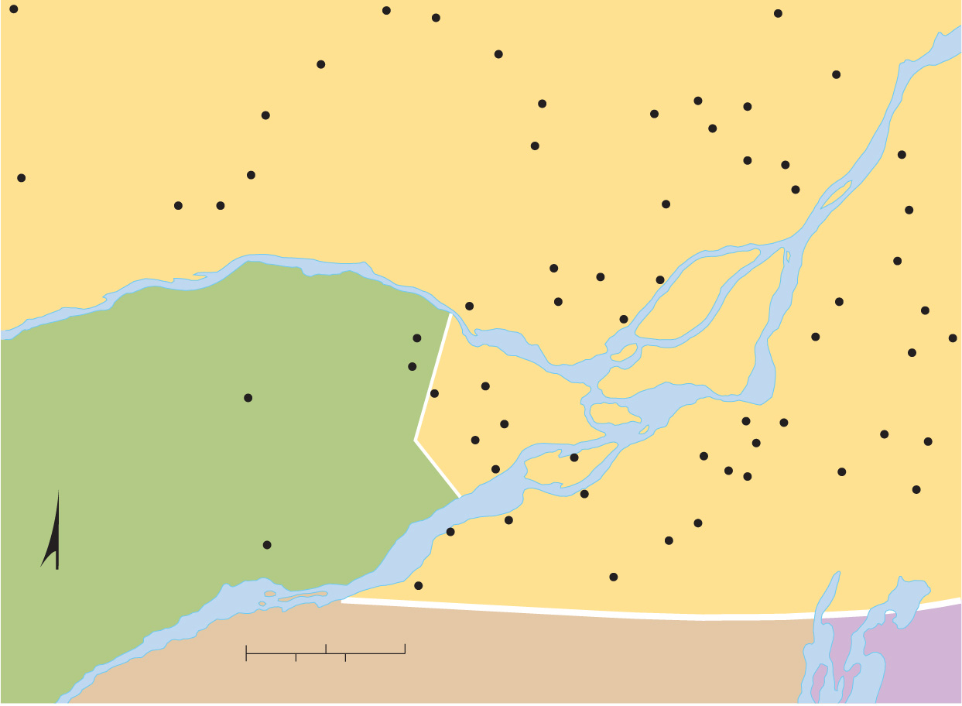
6.3.3 Religious Settlements and Toponyms (3 of 5)
Figure 6-52: Places named after saints reflect the influence of Roman Catholicism.
Notre-Dame-du-Laus
St.-Jovite
St.-Faustin
St.-Mélanie
St.-Rémi-d'Amherst
Ste.-Agathe-des-Monts
St.-Thomas
St.-Émile-de-Suffolk
Ste.-Adèle
St.-Calixte
Ste.-Julienne
St.-Sauveur-
des-Monts
St.-Espirit
St.-Jacques
Notre-Dame-
de-la-Salette
Notre-Dame-
de-la-Paix
St.-Roch-de-l'Achigan
L'Epiphanie
St.-Roch
St.-Sixte
St.-André-Avellin
Ste.-Anne-des-Plaines
L'Assomption
St.-Denis
QUÉBEC
Ste.-Scholastique
St.-Augustin
St.-Charles
St.-André-Est
St.-Benoit
Ste.-Thérèse
Ste.-Julie
St.-Eugène
St.-Eustache
Ste.-Madeleine
St.-Bruno-de-Montarville
St.-Damase
Ste.-Anne-de-Prescott
Ste.-Marthe
St.-Jean-
Baptiste
St.-Isidore-de-Prescott
Ste.-Justine-
de-Newton
St.-Clet
St.-Constant
St.-Philippe
St.-Grégorie
ONTARIO
St.-Polycarpe
St.-Timothee
St.-Isidore
St.-Mathieu
Ste.-Brigide
St.-Zotique
Ste.-Martine
St.-Rémi
St.-Louis-de-
Gonzague
St.-Jean-
sur-Richelieu
St.-Alexandre
St.-Anicet
Ste.-Barbe
Ste.-Clothilde-
de-Chateauguay
St. Andrews West
St.-Chrysotome
N
Ste.-Agnes
CANADA
St.-Antoine-Abbé
0
10
20 Miles
UNITED STATES
0
10
20 Kilometers
NEW YORK
VT

Slide 69
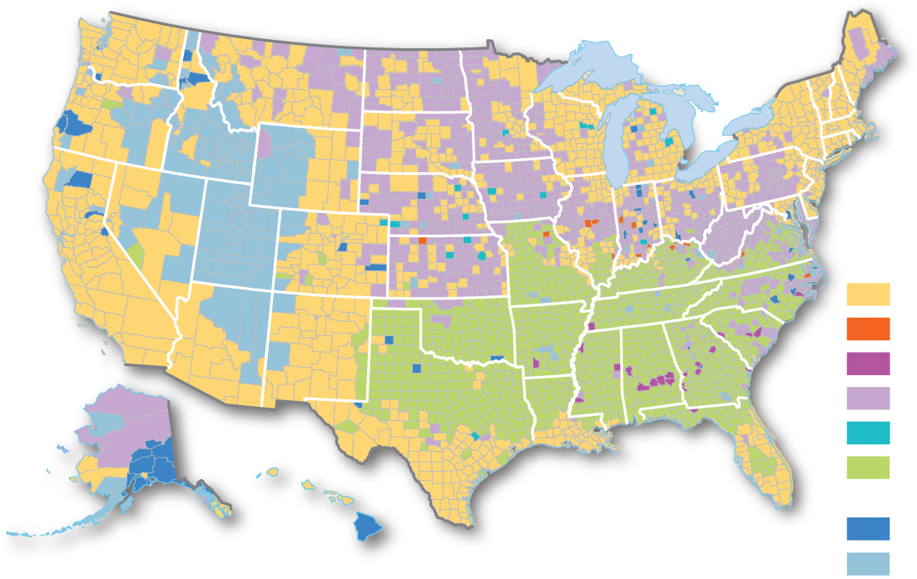
6.3.3 Religious Settlements and Toponyms (4 of 5)
Figure 6-53: Southern Baptists dominate across the southeastern United States, whereas Lutherans dominate the Upper Midwest. Roman Catholics predominate in the southwestern United States and in New England.
Major Christian
denominations
Roman Catholic
Church of Christ
Black Protestant
Mainline Protestant
Lutheran
Southern Baptist
Convention
Non-denominational
Other

Slide 70
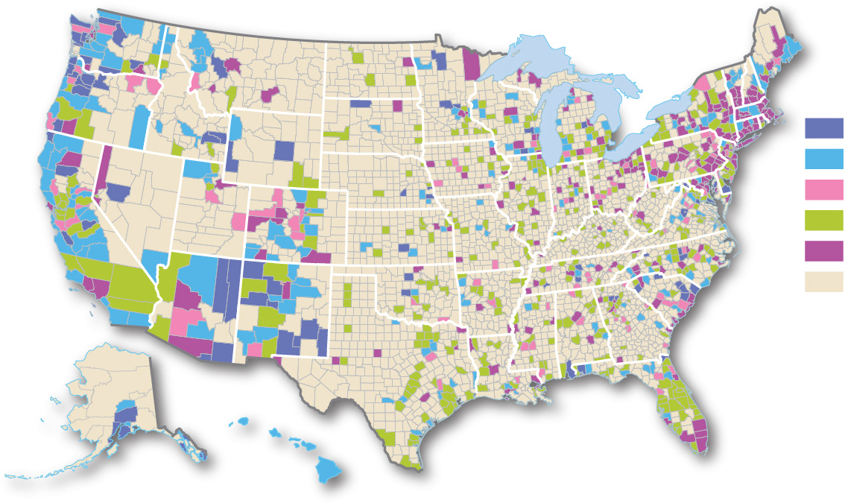
6.3.3 Religious Settlements and Toponyms (5 of 5)
Figure 6-54: Non-Christian faiths tend to be more common closer to the coast and in urban areas.
Non-Christian
religions
Bahá’í
Buddhism
Hinduism
Islam
Judaism
Limited number
or none

Slide 71
6.3.4 Administration of Religious Space (1 of 3)
Some universalizing religions are highly autonomous religions. Islam and some Protestant denominations are good examples
Hinduism is a highly autonomous ethnic religion because worship is usually done alone or with others in the household
Hierarchical religions have well-defined geographic structure and organize territory into local administrative units. Mormons and the Roman Catholic Church are examples

Slide 72
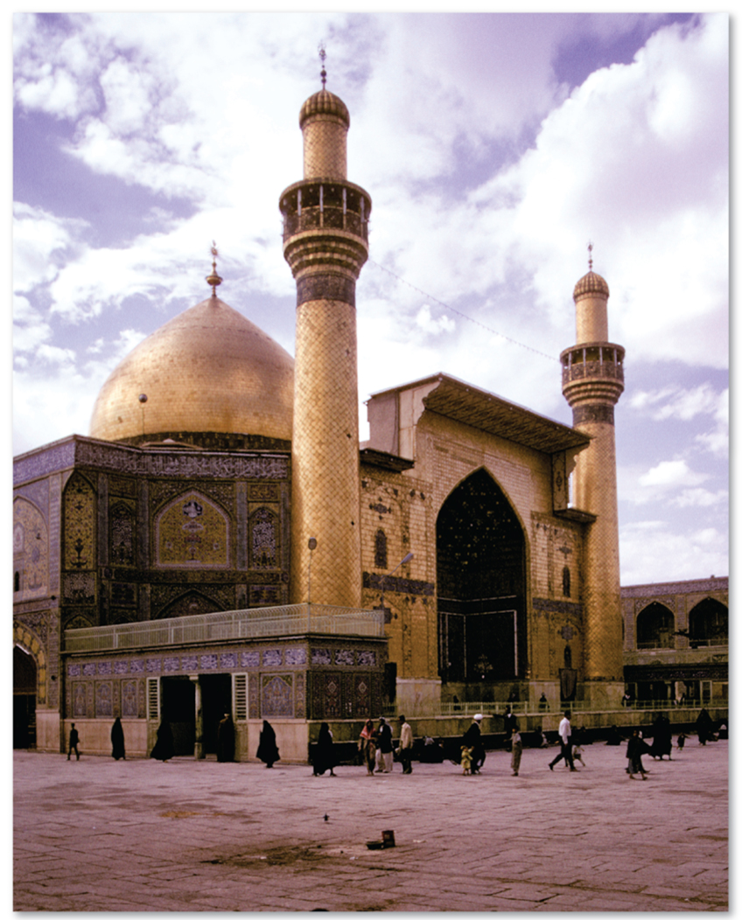
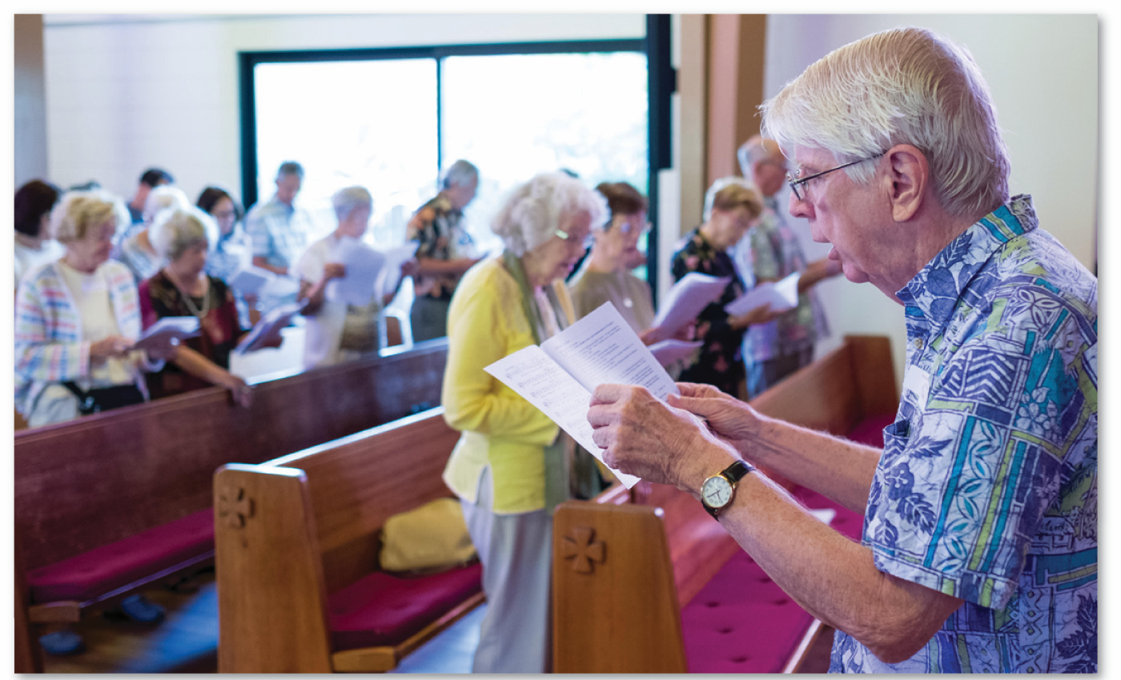
6.3.4 Administration of Religious Space (2 of 3)
Figures 6-55 and 6.56: Islam and Protestant local autonomy. The shrine of Imam Ali, in Najaf, Iraq (left), contains the tomb of Ali, from whom the Shiite branch is traced. Waiokeola Congregational Church (right), Honolulu.

Slide 73
6.3.4 Administration of Religious Space (3 of 3)
Figure 6-57: The Catholic Church divides space into provinces and dioceses with administrative clergy over each level of the hierarchy.
0
200
400 Miles
0
200
400 Kilometers
Province (archbishop)
Diocese (bishop)
Archdiocese

Slide 74
6.3.5 The Landscape in Ethnic Religions (1 of 3)
Cosmogony is a set of religious beliefs concerning the origin of the universe
Hinduism is closely tied to the physical geography of India
Christians, Muslims, Jews, and Buddhists bury their dead, while Hindus prefer to cremate their dead Hinduism
Zoroastrians traditionally expose their dead to scavenging birds and animals

Slide 75
6.3.5 The Landscape in Ethnic Religions (2 of 3)
Figure 6-58 Mount Kailash is sacred to Hindus as the birthplace of Shiva.

Slide 76
6.3.5 The Landscape in Ethnic Religions (3 of 3)
Figures 6-59 and 6-60: Ethnic religions differ in views of disposal of the dead. Hindus favor cremation at Varanasi (left), while Zoroastrians historically preferred open exposure (right).

Slide 77
6.3.6 Religious Calendars and the Environment (1 of 3)
Universalizing religions tend to recognize dates in the life of the founder
Ethnic religions have calendars more organized around seasons. The solstice (June 21-22, December 20-21) has special significance in some ethnic religions

Slide 78
6.3.6 Religious Calendars and the Environment (2 of 3)
Figure 6-61: Jews bless the etrog (citron) and lulav (date palm branches) during the holiday of Sukkot at a synagogue in Brooklyn, New York.

Slide 79
6.3.6 Religious Calendars and the Environment (3 of 3)
Figure 6-62: Stonehenge is Celtic site positioned along the subsolar points of the solstice.

Slide 80
Key Issue 4: Why Do Territorial Conflicts Arise Among Religious Groups?
6.4.1 Religions and Social Change
6.4.2 Challenges for Religions in Southwest Asia
6.4.3 Geographic Perspectives in Southwest Asia
6.4.4 Jerusalem’s Challenging Geography

Slide 81
6.4.1 Religions and Social Change (1 of 3)
Hindu’s traditional caste system—conflict with social equality
Contributing to more intense religious conflict has been a resurgence of religious fundamentalism—a literal interpretation and a strict and intense adherence to the basic principles of a religion
Continued conflict between Tibetan Buddhism and communism in China

Slide 82
6.4.1 Religions and Social Change (2 of 3)
Figure 6-63: Women demonstrate for Dalit rights, Bangalore, India.

Slide 83
6.4.1 Religions and Social Change (3 of 3)
Figure 6-64: The Dalai Lama is the spiritual leader of the Tibetan people.

Slide 84
6.4.2 Challenges for Religions in Southwest Asia (1 of 2)
Jews, Christians, and Muslims have co-existed for two millennia in the eastern end of the Mediterranean. All three consider the city of Jerusalem holy
The modern state of Israel was founded in 1948 and has expanded its original boundaries through territorial gains as a result of wars. Palestinians are split whether to seek a compromise with Israel or to refuse to recognize its existence

Slide 85
6.4.2 Challenges for Religions in Southwest Asia (2 of 2)
Figure 6-66: Israel’s territory has expanded since 1947. Israel’s possession of territory dedicated to Palestinians remains controversial.
U.N. Partition Plan 1947
LEBANON
After 1948–1949 War
LEBANON
Since 1967 War
LEBANON
SYRIA
Arab state
SYRIA
Israel
Egypt
SYRIA
Captured by Israel,
GOLAN
HEIGHTS
Jewish state
Jordan
Israeli control
City of Jerusalem
Captured by Israel,
returned to Egypt
Mediterranean
Sea
Mediterranean
Sea
Captured by Israel,
Palestinian control
WEST
BANK
Jerusalem
Jerusalem
Jerusalem
Gaza
Gaza
Mediterranean
Sea
GAZA
STRIP
Dead
Sea
Dead
Sea
Dead
Sea
ISRAEL
ISRAEL
Suez Canal
Suez Canal
Suez Canal
TRANS-
JORDAN
Sinai
JORDAN
Peninsula
JORDAN
EGYPT
EGYPT
EGYPT
SAUDI
ARABIA
SAUDI
ARABIA
SAUDI
ARABIA
N
N
N

Slide 86
6.4.3 Geographic Perspectives in Southwest Asia (1 of 2)
Figure 6-67: The area of present-day Israel has a long history of conflicting Jewish, Christian, and Muslim claims.
Elevations in meters
LEBANON
GOLAN
HEIGHTS
900–1,200
600–899
300–599
150–299
0–149
SYRIA
Below sea level
Sea
Of
Galilee
Built up area
0
10
20 Miles
0
10
20 Kilometers
Mediterranean
Sea
Jordan R.
Tel Aviv
WEST BANK
32°N
Jerusalem
ISRAEL
JORDAN
Hebron
Dead
Sea
GAZA
STRIP

Slide 87
6.4.3 Geographic Perspectives in Southwest Asia (2 of 2)
Figures 6-68 and 6-69: Israel is building a security fence on the boundary with the West Bank.
Tulkarm
Jordan R.
WEST BANK
JORDAN
Barrier
Ramallah
1949 Armistice Line
Jericho
Area A Administered by the
Palestinian Authority
Jerusalem
ISRAEL
Bethlehem
Area B Administered by both the
Palestinian Authority and Israel
Area C Administered by Israel
Hebron
Dead
Sea

Slide 88
6.4.4 Jerusalem’s Challenging Geography (1 of 2)
Figure 6-70: The Old City of Jerusalem is divided into quarters due to competing religious claims.
2
1–14 Stations
of the Cross
Herod’s Gate
0
250
500 Feet
Damascus
Gate
Mawlawiya
Mosque
0
75
150 Meters
Church of
St. Anne
Sheikh Lulu
Mosque
MUSLIM QUARTER
Armenian
Catholic
Church
2
Church of The
Flagellation
Lion’s
Gate
New Gate
Ethiopian
Patriarchate
CHRISTIAN
QUARTER
3
1
St. Saviour’s
Church
Khanqah
Mosque
7
4
5
Mount Moriah
VIA DOLOROSA
8
6
Golden
Gate
Greek Orthodox
Patriarchate
9
Coptic Patriarchate
St. Veronica
Church
Church of The
Holy Sepulchre
al-Haram
al-Sharif
Greek Orthodox
Monastery
Mosque
of Omar
10-14
Church of
Alexander
Dome of
The Chain
Greek Catholic
Patriarchate
Hezekiah’s
Pool
Church of
The Redeemer
Main
Gate
Jaffa Gate
Western
Wall
Dome of
The Rock
David’s Tower
Maronite Church
al-Aqsa
Mosque
Citadel
St. Marks
Church
The Cardo
JEWISH
QUARTER
Barracks
Christ
Church
Temple
Gate
Ramban
Synagogue
Hurva
Synagogue
Islamic
Museum
ARMENIAN
St. James
Cathedral
Armenian
Patriarchate
Sephardic
Synagogue
Dung
Gate
QUARTER
Valley of
Kidron
Zion
Gate
Armenian
Museum
Mount Ophel
(City of David)

Slide 89
6.4.4 Jerusalem’s Challenging Geography (2 of 2)
Figure 6-71: The Dome of the Rock, a holy site to Muslims, is next to the Western Wall, a site sacred to Jews.

Slide 90
Copyright
This work is protected by United States copyright laws and is provided solely for the use of instructors in teaching their courses and assessing student learning. Dissemination or sale of any part of this work (including on the World Wide Web) will destroy the integrity of the work and is not permitted. The work and materials from it should never be made available to students except by instructors using the accompanying text in their classes. All recipients of this work are expected to abide by these restrictions and to honor the intended pedagogical purposes and the needs of other instructors who rely on these materials.

