Slide 1
The Cultural Landscape: An Introduction to Human Geography
Thirteenth Edition
Chapter 10 Lecture
Development
Copyright © 2020 Pearson Education, Inc. All Rights Reserved
Notes:
If this PowerPoint presentation contains mathematical equations, you may need to check that your computer has the following installed:
1) MathType Plugin
2) Math Player (free versions available)
3) NVDA Reader (free versions available)

Slide 2
Development: Key Issues
10.1 Why Does Development Vary Among Countries?
10.2 Where Are Inequalities in Development Found?
10.3 Why Do Countries Face Challenges to Development?
10.4 Why Are Countries Able to Make Progress in Development?

Slide 3
Key Issue 1: Why Does Development Vary Among Countries?
10.1.1 Development and Geography
10.1.2 A Decent Standard of Living
10.1.3 Access to Knowledge
10.1.4 Health and Welfare

Slide 4
10.1.1 Development and Geography (1 of 3)
Development is the process of improving the conditions of people through diffusion of knowledge and technology. Countries and regions ranked by development
The Human Development Index (H D I) measures development:
decent standard of living
long and healthy life
access to knowledge

Slide 5
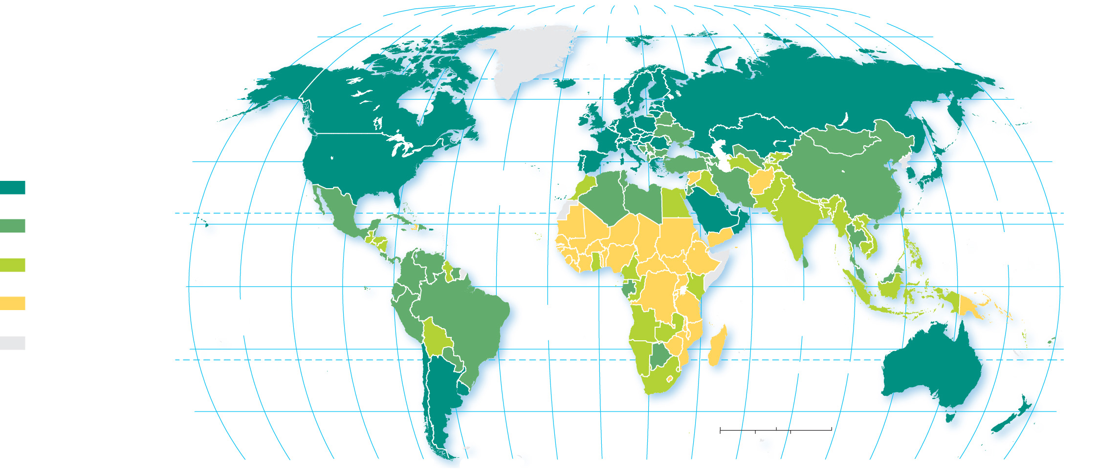
10.1.1 Development and Geography (2 of 3)
Figure 10-2: The Human Development Index measures development by country around the world.
80°
160°
140°
120°
100°
80°
60°
40°
20°
0°
20°
40°
60°
80°
100°
120°
140°
160°
180°
80°
ARCTIC
OCEAN
60°
60°
40°
ATLANTIC
OCEAN
40°
Very high developed
(above 0.80)
High developing
(0.70–0.80)
20°
TROPIC OF CANCER
20°
PACIFIC
OCEAN
Medium developing
(0.55–0.69)
EQUATOR
Low developing
(below 0.55)
0°
PACIFIC
OCEAN
INDIAN
OCEAN
0°
ATLANTIC
OCEAN
no data
20°
20°
TROPIC OF CAPRICORN
40°
0
1,500
3,000 Miles
40°
0
1,500
3,000 Kilometers
160°
140°
120°
100°
80°
60°
40°
20°
0°
20°
40°
60°
80°
100°
120°
140°
160°
180°

Slide 6
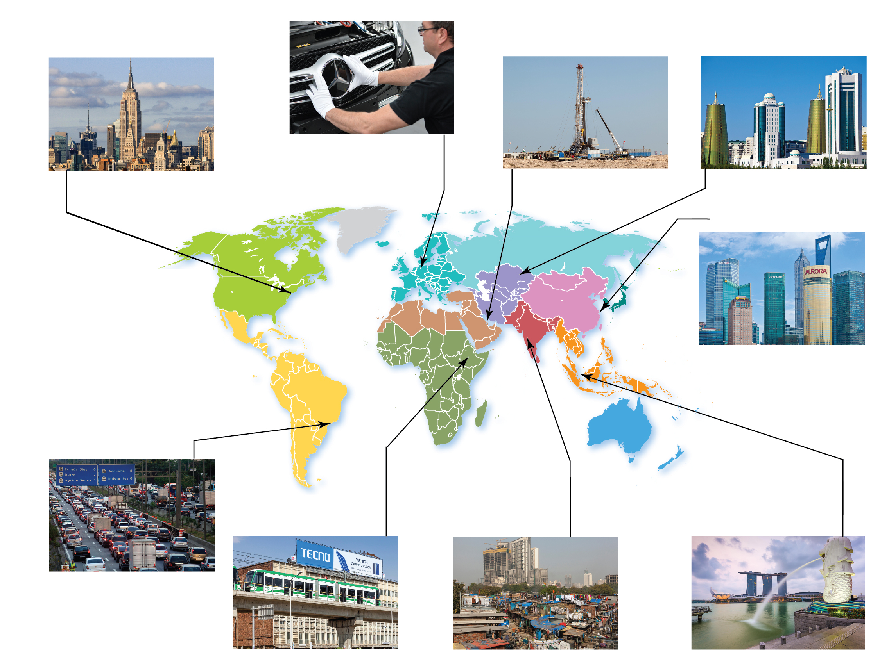
10.1.1 Development and Geography (3 of 3)
Figure 10-3: World regions vary in development; some have greater intra-regional variation than others.
EUROPE
HDI = .88
SOUTHWEST ASIA
& NORTH AFRICA
HDI = .70
CENTRAL ASIA
HDI = .72
NORTH AMERICA
HDI = .92
All but a handful are very
high developed.
Medium developing on average
but wide variation between
high developing (Saudi Arabia)
and low developing (Yemen).
Medium developing on
average but wide variation
between high developing
(Iran) and low developing
(Afghanistan).
Both the United States
and Canada are very high
developed.
MERCEDES-BENZ
FACTORY, BREMEN,
GERMANY
EMPIRE STATE
BUILDING, NEW YORK
OIL DRILL, BAHRAIN
ASTANA, KAZAKHSTAN
SHANGHAI, CHINA
EAST ASIA
HDI = .75
China is high developing.
SÃO PAULO, BRAZIL
ADDIS ABABA LIGHT
RAIL, ETHIOPIA
MUMBAI, INDIA
PORT OF SINGAPORE
LATIN AMERICA
HDI = .76
Most are high developing.
SUB-SAHARAN AFRICA
HDI = .54
SOUTH ASIA
HDI = .64
SOUTHEAST ASIA
HDI = .69
Most are low developing.
Most are medium developing.
Most are medium developing.

Slide 7
10.1.2 A Decent Standard of Living (1 of 5)
A key measure of standard of living is Gross national income (G N I) adjusted for purchasing power parity (P P P) per capita
Other measures examine the percent of the population employed in the primary, secondary, and tertiary sectors
primary sector: agriculture, mining
secondary sector: manufacturing
tertiary sector: services

Slide 8
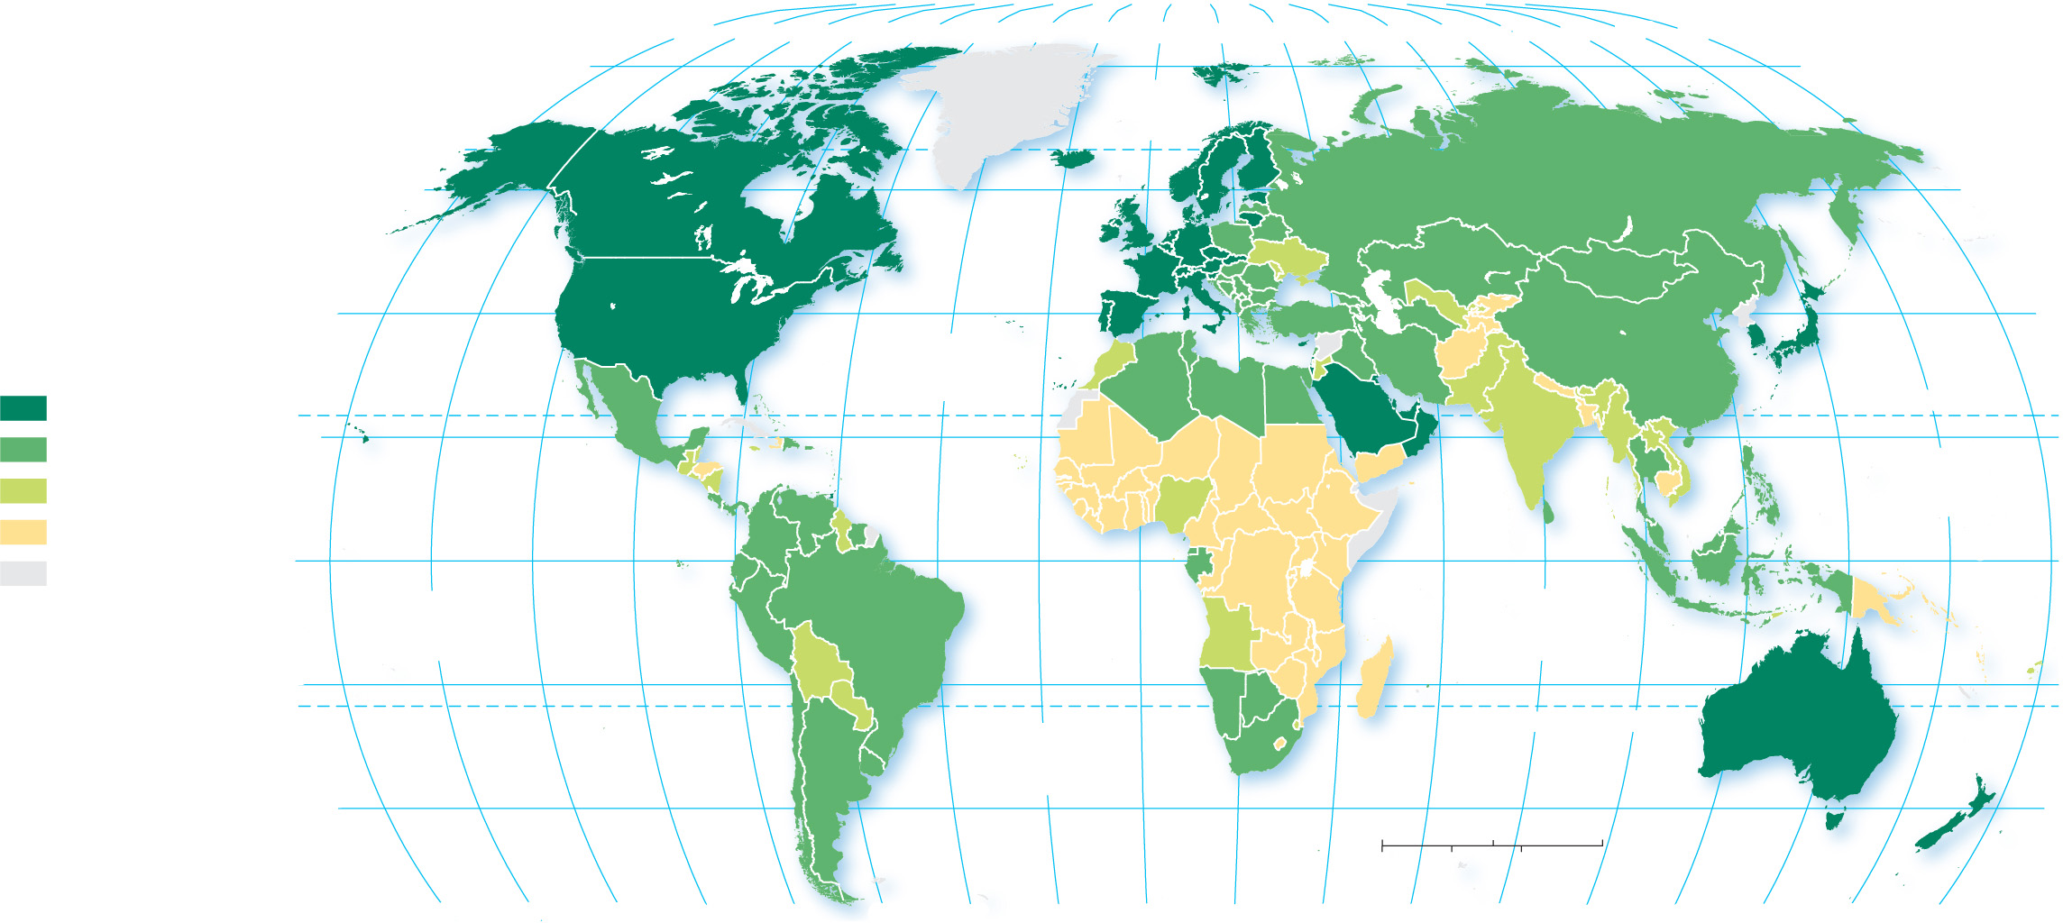
10.1.2 A Decent Standard of Living (2 of 5)
Figure 10-4: Gross national income per capita, adjusted for purchasing power parity.
80°
160°
140°
120°
100°
80°
60°
40°
20°
0°
20°
40°
60°
80°
100°
120°
140°
160°
180°
ARCTIC
OCEAN
80°
60°
60°
GNI PPP per capita
(current US$)
40°
ATLANTIC
OCEAN
40°
$30,000 and above
20°
TROPIC OF CANCER
20°
$10,000–$29,999
PACIFIC
OCEAN
$5,000–$9,999
below $5,000
0°
EQUATOR
0°
no data
PACIFIC
OCEAN
INDIAN
OCEAN
20°
20°
ATLANTIC
OCEAN
TROPIC OF CAPRICORN
40°
0
1,500
3,000 Miles
40°
0
1,500
3,000 Kilometers
160°
140°
120°
100°
80°
60°
40°
20°
0°
20°
40°
60°
80°
100°
120°
140°
160°
180°

Slide 9
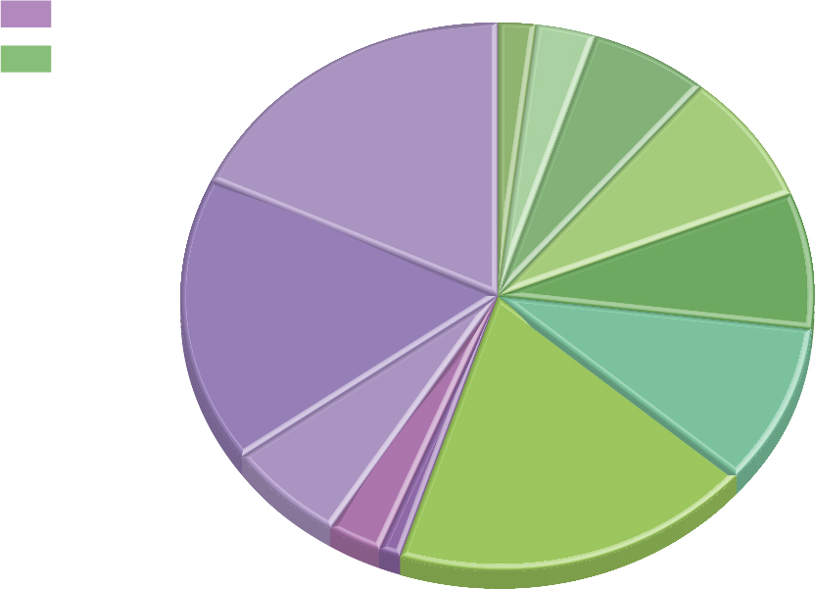
10.1.2 A Decent Standard of Living (3 of 5)
Figure 10-5: Developed and developing countries each have around half the world's total G N I.
$2.5 Central Asia
GNI in trillion $
$3.9 Sub-Saharan Africa
Developed
Southeast Asia
Developing
$7.9
Latin America
$22.8
Europe
$9.9
$10.3
Southwest Asia
& North Africa
$21.4
North America
$12.0
South Asia
$7.7
$23.4
East Asia
Japan & South Korea
$3.7 Russia
$1.4 South Pacific

Slide 10
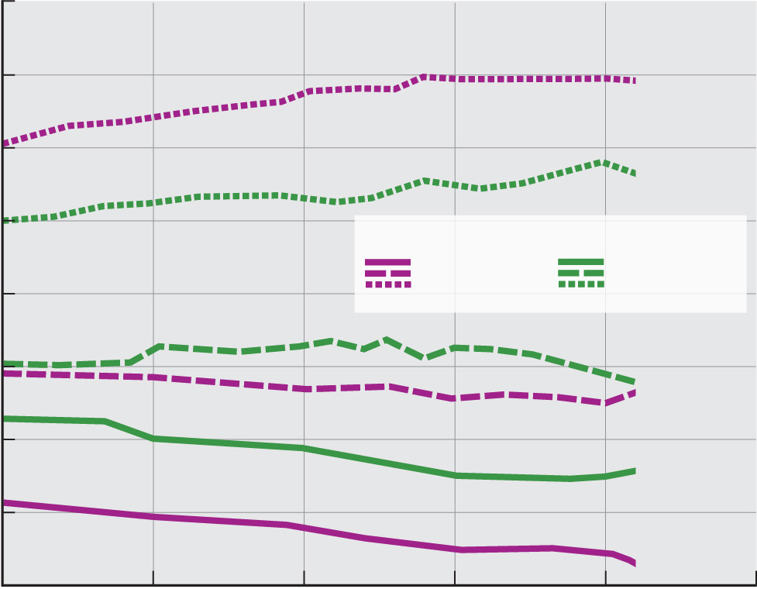
10.1.2 A Decent Standard of Living (4 of 5)
Figure 10-6: Employment in the tertiary sector (services) has grown in both developed and developing countries, while the primary and secondary sectors have declined.
80
70
Tertiary
60
Tertiary
50
Job sectors
Percent of jobs
Developed
countries
Developing
countries
40
Secondary
30
Secondary
Primary
20
10
Primary
0
1995
2000
2005
2010
2015
2020
Year

Slide 11
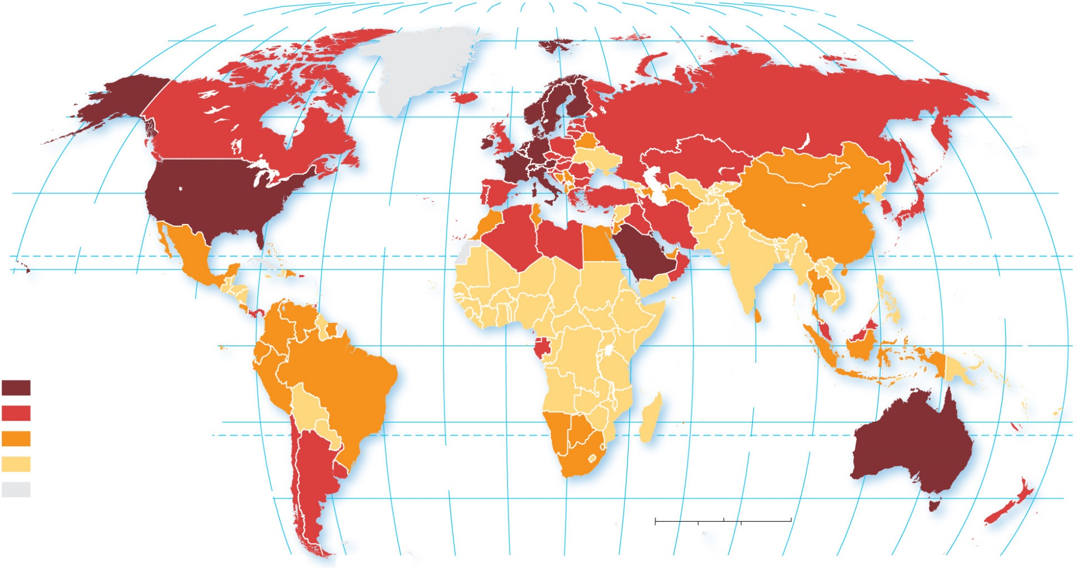
10.1.2 A Decent Standard of Living (5 of 5)
Figure 10-7: Workers contribute more to a nation’s G D P per hour in developed countries than developing countries, representing a higher value added.
80°
160°
140°
120°
100°
80°
60°
40°
20°
0°
20°
40°
60°
80°
100°
120°
140°
160°
180°
80°
ARCTIC
OCEAN
60°
60°
40°
PACIFIC
OCEAN
40°
ATLANTIC
OCEAN
20°
TROPIC OF CANCER
160°
140°
120°
PACIFIC
OCEAN
20°
100°
GDP per person
employed (US$)
0°
EQUATOR
0°
$100,000 and above
INDIAN
OCEAN
$50,000–$99,999
20°
20°
$25,000–$49,999
TROPIC OF CAPRICORN
below $25,000
ATLANTIC
OCEAN
no data
40°
40°
0
1,500
3,000 Miles
0
1,500
3,000 Kilometers
80°
60°
40°
20°
0°
20°
40°
60°
80°
100°
120°
140°
160°
180°

Slide 12
10.1.3 Access to Knowledge (1 of 5)
To form the access to knowledge component of H D I, the U.N. combines two measures of years of schooling:
Years of school for adults
Expected years schooling for youth
Other measures of access to knowledge:
Pupil/teacher ratio
Literacy rate

Slide 13
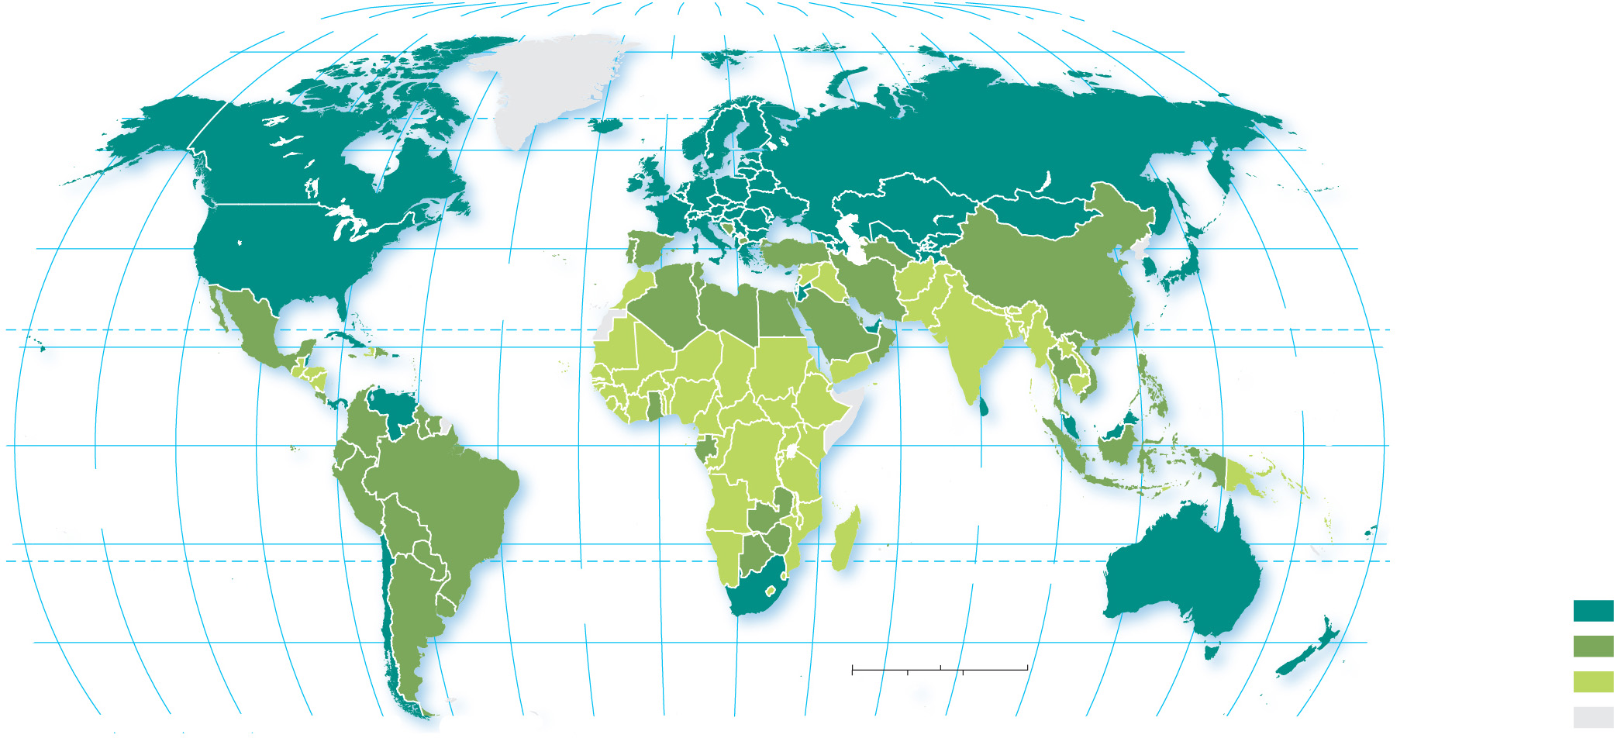
10.1.3 Access to Knowledge (2 of 5)
Figure 10-8: Mean years of schooling is the average number of years people aged 25 or older have spent in school.
80°
160°
140°
120°
100°
80°
60°
40°
20°
0°
20°
40°
60°
80°
100°
120°
140°
160°
180°
80°
ARCTIC
OCEAN
60°
60°
40°
ATLANTIC
OCEAN
40°
20°
TROPIC OF CANCER
20°
PACIFIC
OCEAN
0°
EQUATOR
0°
PACIFIC
OCEAN
INDIAN
OCEAN
20°
20°
Mean years
of schooling
ATLANTIC
OCEAN
TROPIC OF CAPRICORN
10.0 and above
40°
0
1,500
3,000 Miles
40°
7.0–9.9
0
1,500
3,000 Kilometers
below 7.0
160°
140°
120°
100°
80°
60°
40°
20°
0°
20°
40°
60°
80°
100°
120°
140°
160°
180°
no data

Slide 14
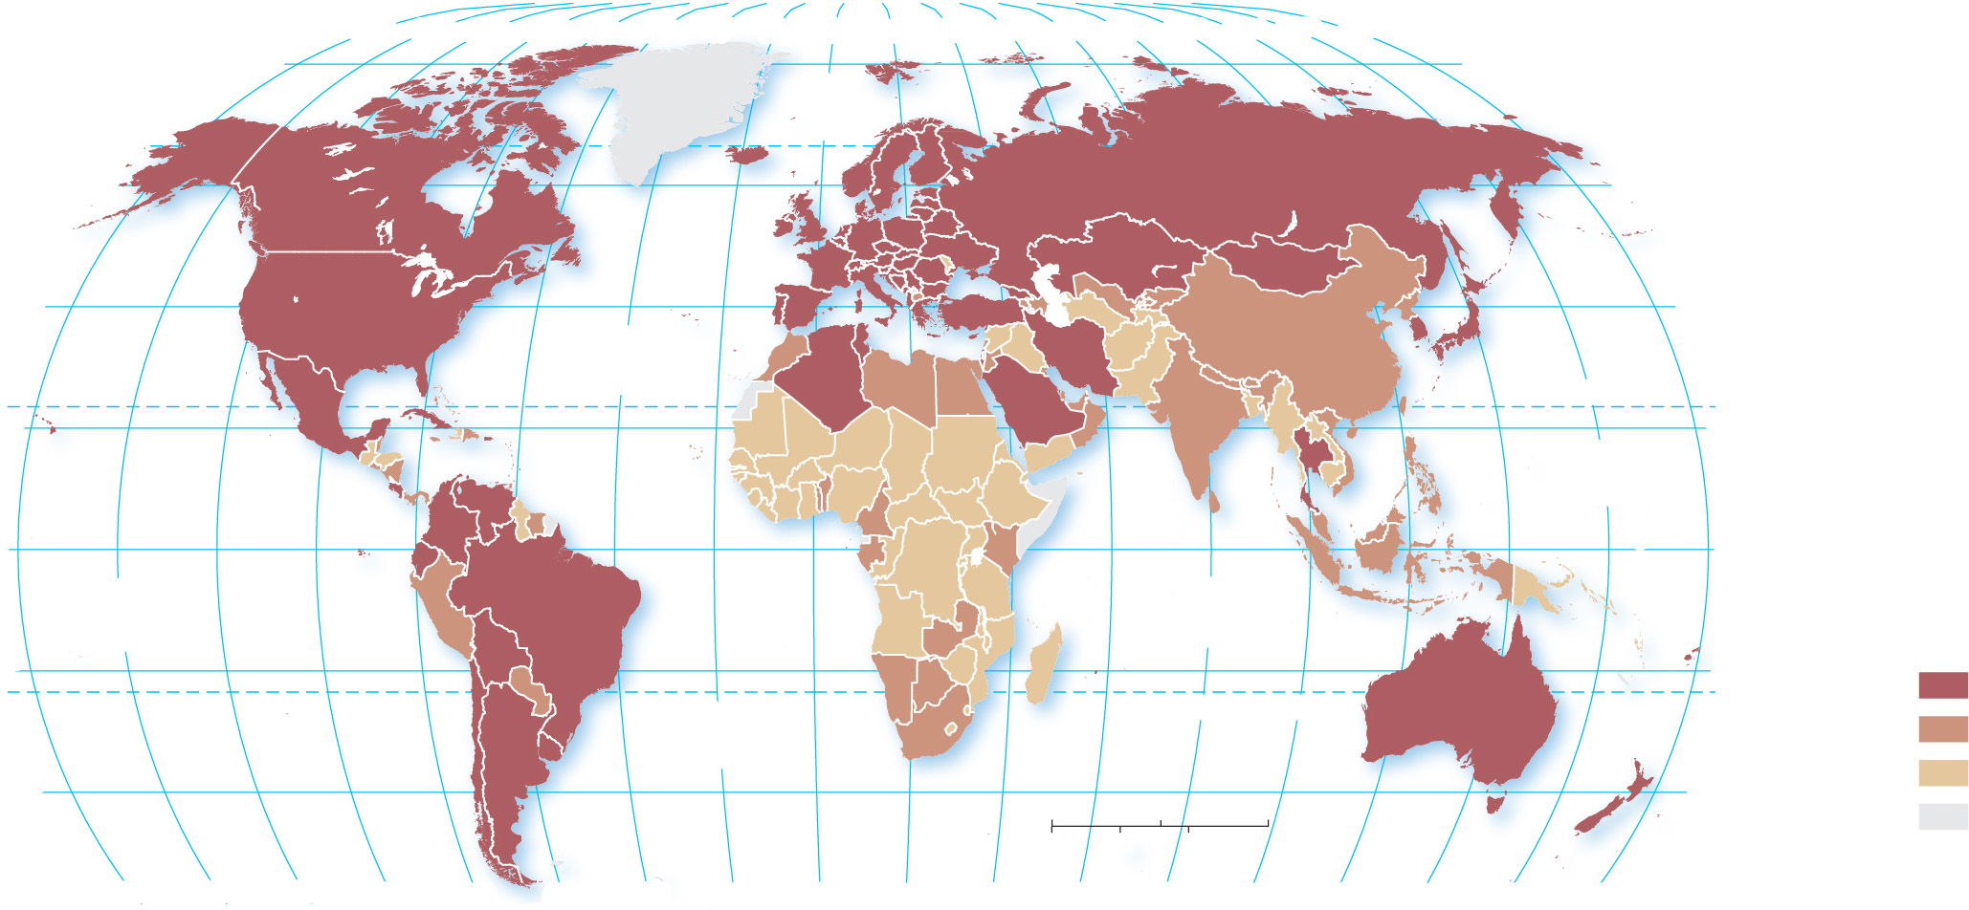
10.1.3 Access to Knowledge (3 of 5)
Figure 10-9: Expected years of schooling is the average number of years today’s 5-year-olds are expected to be in school.
80°
160°
140°
120°
100°
80°
60°
40°
20°
0°
20°
40°
60°
80°
100°
120°
140°
160°
180°
80°
ARCTIC
OCEAN
60°
60°
40°
ATLANTIC
OCEAN
40°
20°
TROPIC OF CANCER
20°
PACIFIC
OCEAN
0°
EQUATOR
0°
PACIFIC
OCEAN
INDIAN
OCEAN
Expected years
of schooling
20°
20°
14 and above
ATLANTIC
OCEAN
TROPIC OF CAPRICORN
12–13.9
40°
0
1,500
3,000 Miles
40°
below 12
0
1,500
3,000 Kilometers
no data
160°
140°
120°
100°
80°
60°
40°
20°
0°
20°
40°
60°
80°
100°
120°
140°
160°
180°

Slide 15
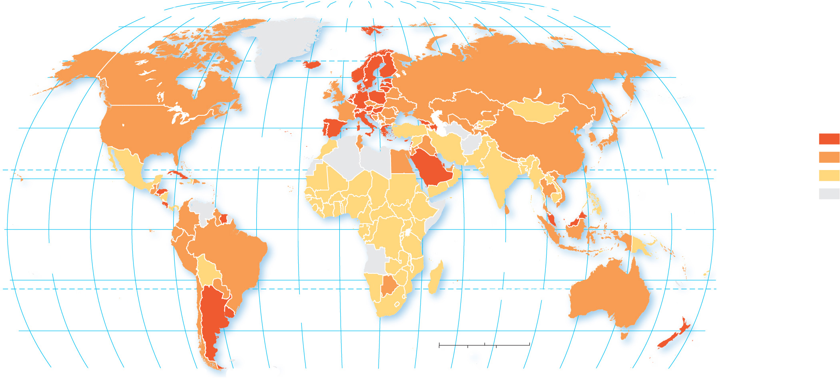
10.1.3 Access to Knowledge (4 of 5)
Figure 10-10: The pupil/teacher ratio is another measure of access to knowledge. A high ratio is often see as a level of underdevelopment, whereas a low ratio is better for education access.
80°
160°
140°
120°
100°
80°
60°
40°
20°
0°
20°
40°
60°
80°
100°
120°
140°
160°
180°
80°
ARCTIC
OCEAN
60°
60°
Expected years
of schooling
40°
ATLANTIC
OCEAN
40°
14 and above
TROPIC OF CANCER
12–13.9
20°
PACIFIC
OCEAN
20°
below 12
no data
0°
EQUATOR
0°
PACIFIC
OCEAN
INDIAN
OCEAN
20°
20°
ATLANTIC
OCEAN
TROPIC OF CAPRICORN
40°
0
1,500
3,000 Miles
40°
0
1,500
3,000 Kilometers
160°
140°
120°
100°
80°
60°
40°
20°
0°
20°
40°
60°
80°
100°
120°
140°
160°
180°

Slide 16
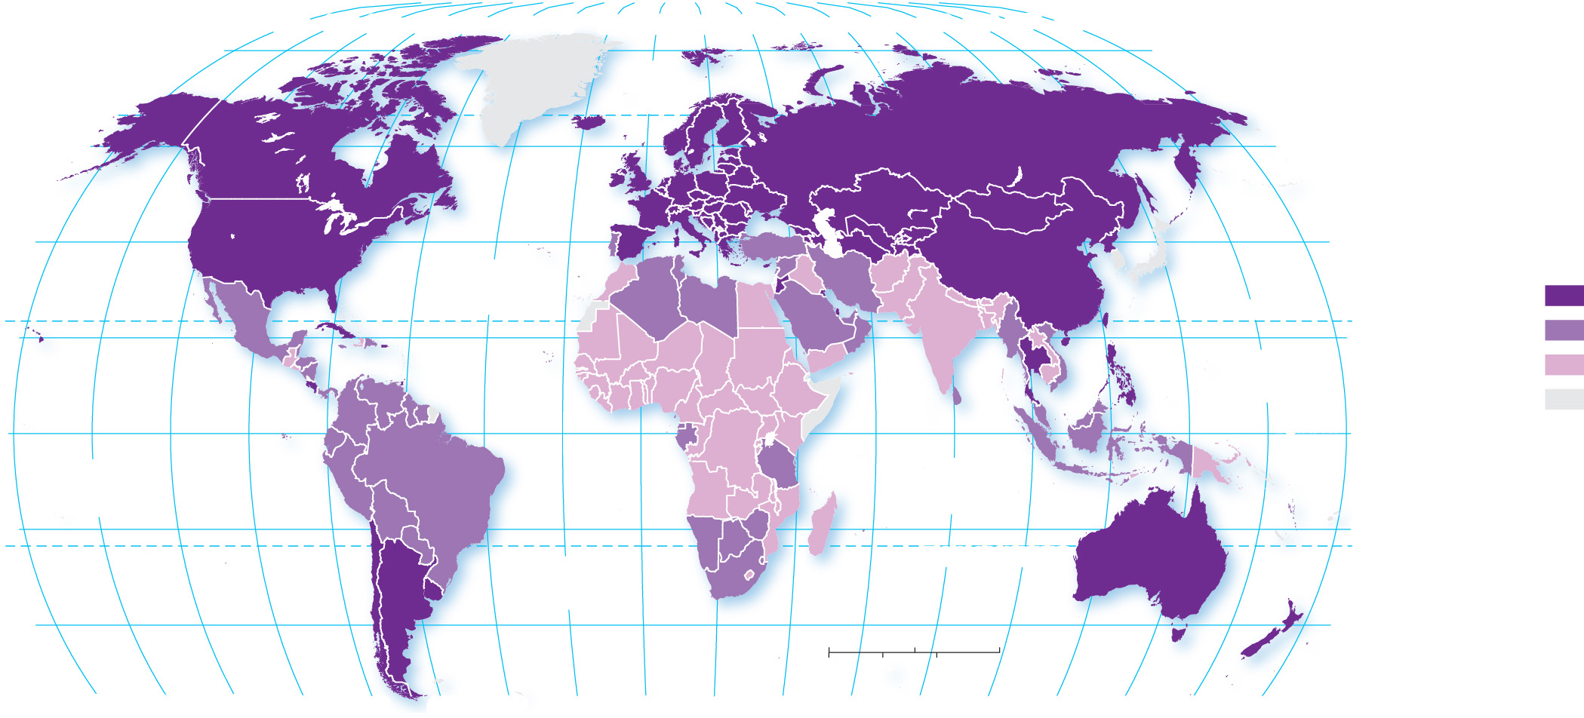
10.1.3 Access to Knowledge (5 of 5)
Figure 10-11: The literacy rate is another measure of access to knowledge. Literacy rates in the developed world are near 100%.
80°
160°
140°
120°
100°
80°
60°
40°
20°
0°
20°
40°
60°
80°
100°
120°
140°
160°
180°
80°
ARCTIC
OCEAN
60°
60°
40°
40°
Percent literate,
age 15 and older
ATLANTIC
OCEAN
96.0 and above
20°
TROPIC OF CANCER
20°
80.0–95.9
PACIFIC
OCEAN
below 80.0
EQUATOR
no data
0°
0°
PACIFIC
OCEAN
INDIAN
OCEAN
20°
20°
ATLANTIC
OCEAN
TROPIC OF CAPRICORN
40°
0
1,500
3,000 Miles
40°
0
1,500
3,000 Kilometers
160°
140°
120°
100°
80°
60°
40°
20°
0°
20°
40°
60°
80°
100°
120°
140°
160°
180°

Slide 17
10.1.4 Health and Welfare (1 of 5)
The U.N. has selected life expectancy at birth as the contributor to the H D I since it is one of the few measures which can be standardized
Other measures of wealth include:
access to consumer goods
motor vehicles per 1,000 persons

Slide 18
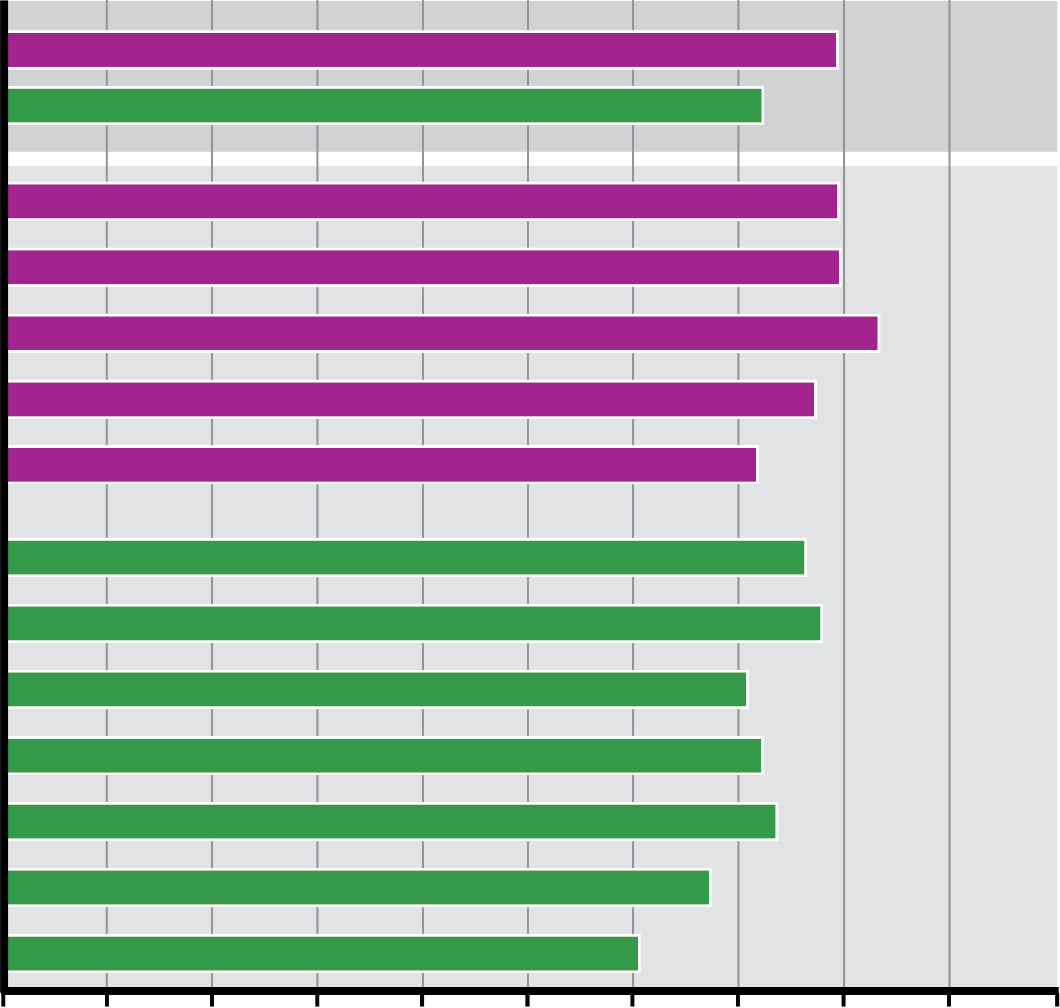
10.1.4 Health and Welfare (2 of 5)
Figure 10-12: Life expectancy at birth averages 79 in developed countries and 71 in developing countries.
Developed
Developing
North America
Europe
Japan & South Korea
South Pacific
Russia
Latin America
East Asia
Southeast Asia
Central Asia
Southwest Asia & North Africa
South Asia
Sub-Saharan Africa
0
10
20
30
40
50
60
70
80
90
100
Life expectancy at birth (years)

Slide 19
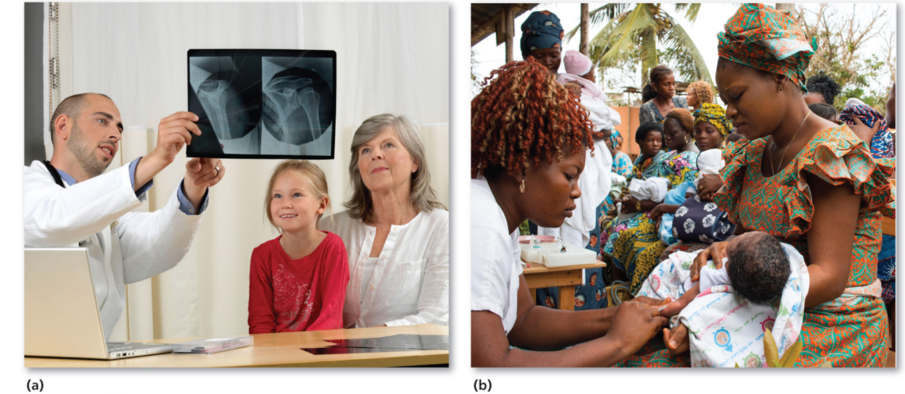
10.1.4 Health and Welfare (3 of 5)
Figures 10-13: Medical services and access to medical services vary greatly between the developed world (Sweden, at left) and the developing world (Togo, at right).

Slide 20
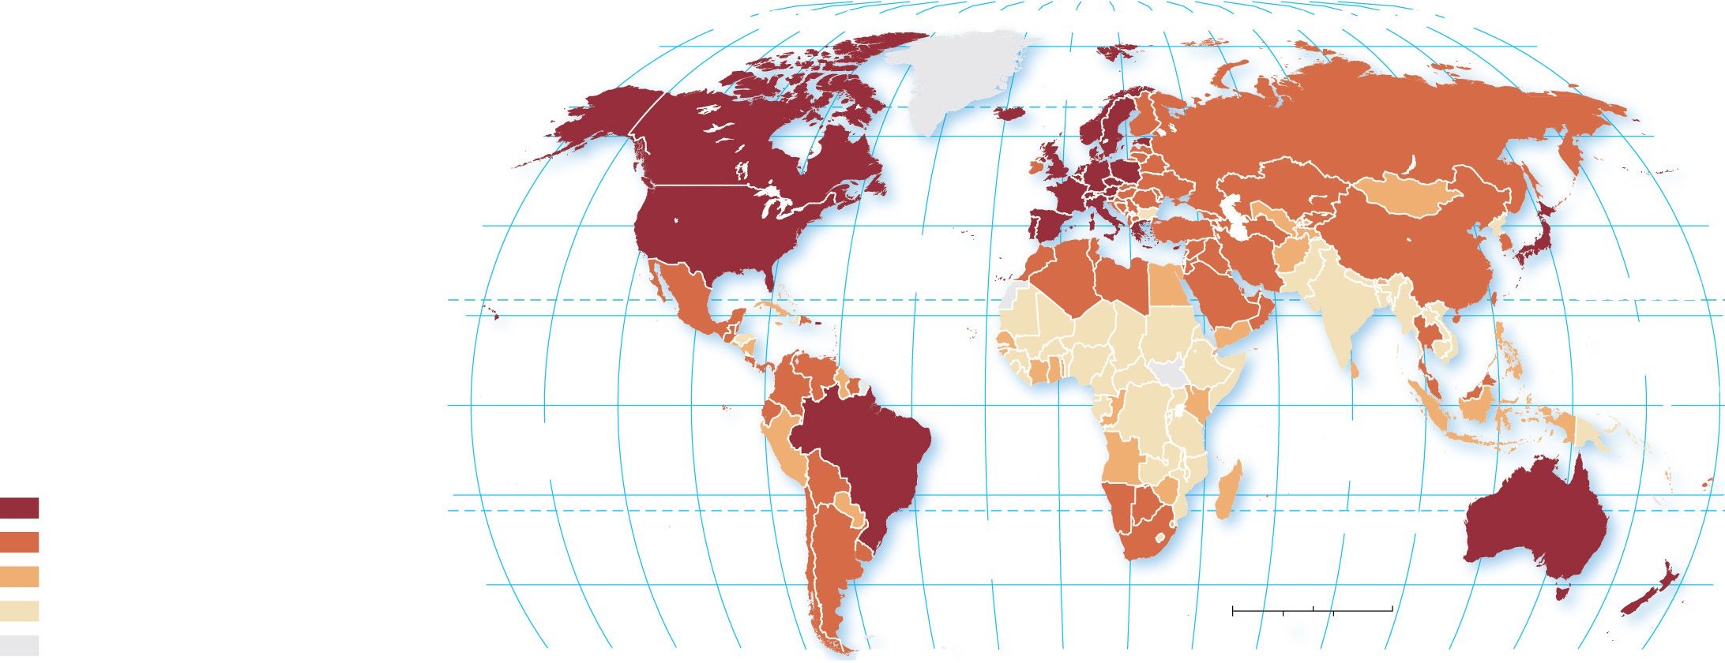
10.1.4 Health and Welfare (4 of 5)
Figure 10-14: The highest level of motor vehicle ownership is in North America and the lowest is in South Asia.
80°
160°
140°
120°
100°
80°
60°
40°
20°
0°
20°
40°
60°
80°
100°
120°
140°
160°
180°
80°
ARCTIC
OCEAN
60°
60°
40°
ATLANTIC
OCEAN
40°
20°
TROPIC OF CANCER
20°
PACIFIC
OCEAN
0°
EQUATOR
0°
Motor vehicles
per 1,000 persons
PACIFIC
OCEAN
INDIAN
OCEAN
500 and above
20°
20°
100–499
ATLANTIC
OCEAN
TROPIC OF CAPRICORN
25–99
40°
0
1,500
3,000 Miles
40°
below 25
0
1,500
3,000 Kilometers
no data
160°
140°
120°
100°
80°
60°
40°
20°
0°
20°
40°
60°
80°
100°
120°
140°
160°
180°

Slide 21
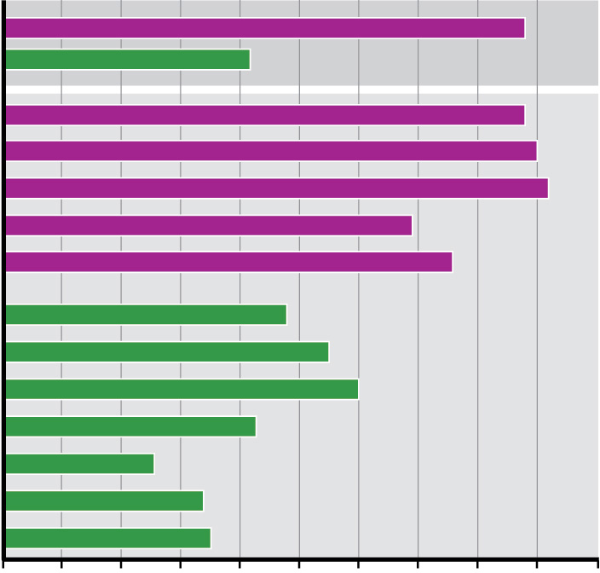
10.1.4 Health and Welfare (5 of 5)
Figure 10-15: Developed countries have much higher percentages of the population using the Internet than do developing countries.
Developed
Developing
North America
Europe
Japan & South Korea
South Pacific
Russia
Latin America
East Asia
Southeast Asia
Central Asia
Southwest Asia & North Africa
South Asia
Sub-Saharan Africa
0
10
20
30
40
50
60
70
80
90
100
Internet users (%)

Slide 22
Key Issue 2: Where Are Inequalities in Development Found?
10.2.1 Unequal and Uneven Development
10.2.2 Inequality Within Countries
10.2.3 Gender Inequality
10.2.4 Gender Empowerment and Employment
10.2.5 Reproductive Health

Slide 23
10.2.1 Unequal and Uneven Development (1 of 6)
The Inequality-adjusted Human Development Index (I H D I) modifies the H D I to account for inequality within a country. If the I H D I is lower than the H D I, the country has some inequality; the greater the difference in the two measures, the greater the inequality
In the world-systems theory, the developed countries form a core area, whereas developing countries occupy the periphery

Slide 24
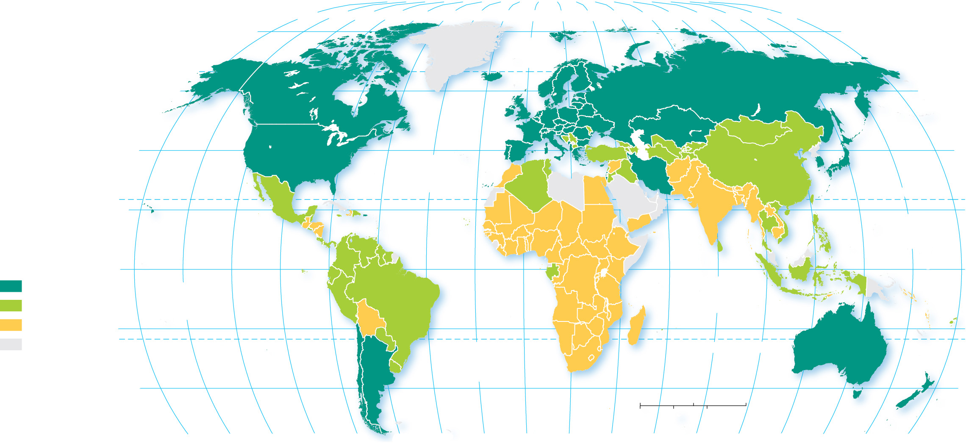
10.2.1 Unequal and Uneven Development (2 of 6)
Figure 10-16: The lower the score, the greater the inequality. Europe has the highest score, hence the least inequality. South Asia and sub-Saharan Africa have the lowest scores and therefore the greatest degree of inequality.
80°
160°
140°
120°
100°
80°
60°
40°
20°
0°
20°
40°
60°
80°
100°
120°
140°
160°
180°
80°
ARCTIC
OCEAN
60°
60°
40°
ATLANTIC
OCEAN
40°
20°
TROPIC OF CANCER
20°
PACIFIC
OCEAN
Inequality- adjusted HDI
0°
EQUATOR
0°
0.70 and above
PACIFIC
OCEAN
INDIAN
OCEAN
0.50–0.69
below 0.50
20°
20°
no data
ATLANTIC
OCEAN
TROPIC OF CAPRICORN
40°
0
1,500
3,000 Miles
40°
0
1,500
3,000 Kilometers
160°
140°
120°
100°
80°
60°
40°
20°
0°
20°
40°
60°
80°
100°
120°
140°
160°
180°

Slide 25
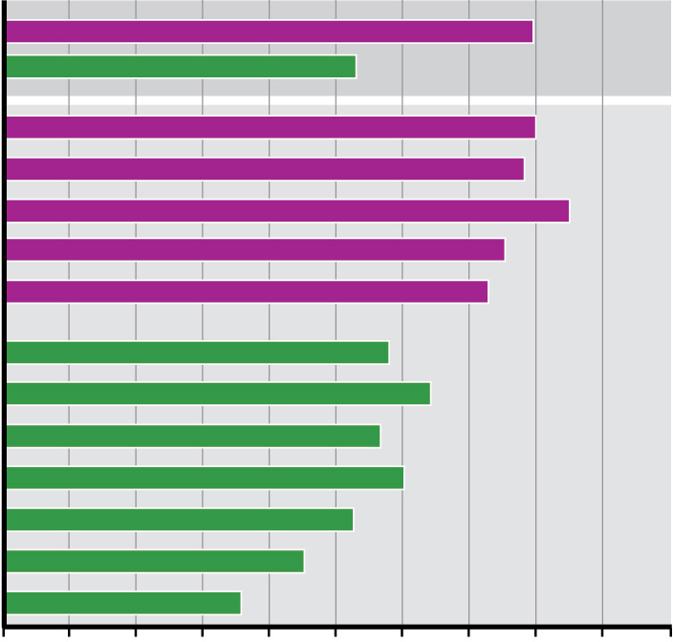
10.2.1 Unequal and Uneven Development (3 of 6)
Figure 10-17: South Asia and sub-Saharan Africa have the lowest scores and therefore the greatest degree of inequality.
Developed
Developing
North America
Europe
Japan & South Korea
South Pacific
Russia
Latin America
East Asia
Southeast Asia
Central Asia
Southwest Asia & North Africa
South Asia
Sub-Saharan Africa
0
0.1
0.2
0.3
0.4
0.5
0.6
0.7
0.8
0.9
1.0
Inequality-adjusted Human Development Index

Slide 26
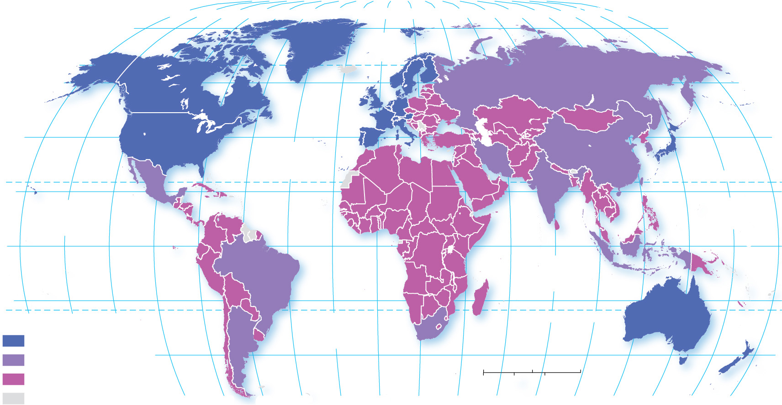
10.2.1 Unequal and Uneven Development (4 of 6)
Figure 10-18: In a world-systems perspective, North America and Europe form the developed core, and the developing countries form the periphery.
80°
160°
140°
120°
100°
80°
60°
40°
20°
0°
20°
40°
60°
80°
100°
120°
140°
160°
180°
80°
ARCTIC
OCEAN
60°
60°
40°
ATLANTIC
OCEAN
40°
TROPIC OF CANCER
20°
20°
PACIFIC
OCEAN
PACIFIC
OCEAN
0°
EQUATOR
0°
INDIAN
OCEAN
20°
20°
160°
140°
120°
ATLANTIC
OCEAN
TROPIC OF CAPRICORN
Core
Semi-periphery
40°
0
1,500
3,000 Miles
40°
Periphery
0
1,500
3,000 Kilometers
Other
100°
80°
60°
40°
20°
0°
20°
40°
60°
80°
100°
120°
140°
160°
180°

Slide 27
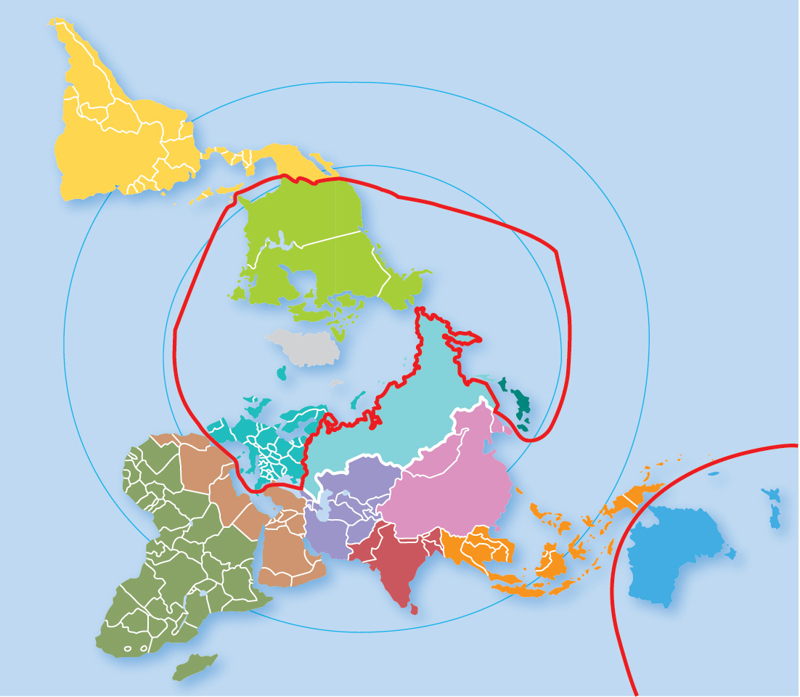
10.2.1 Unequal and Uneven Development (5 of 6)
Figure 10-19: The spatial relationship of the core and periphery is more apparent in a world map projection centered on the North Pole.
0°
LATIN
AMERICA
30°
NORTH
AMERICA
DEVELOPED
DEVELOPING
North
Pole
0°
30°
+
30°
0°
EUROPE
JAPAN
RUSSIA
EAST
ASIA
SOUTHWEST ASIA &
NORTH AFRICA
CENTRAL
ASIA
SUB-SAHARAN
AFRICA
SOUTH
ASIA
SOUTH
PACIFIC
SOUTHEAST
ASIA
DEVELOPED

Slide 28
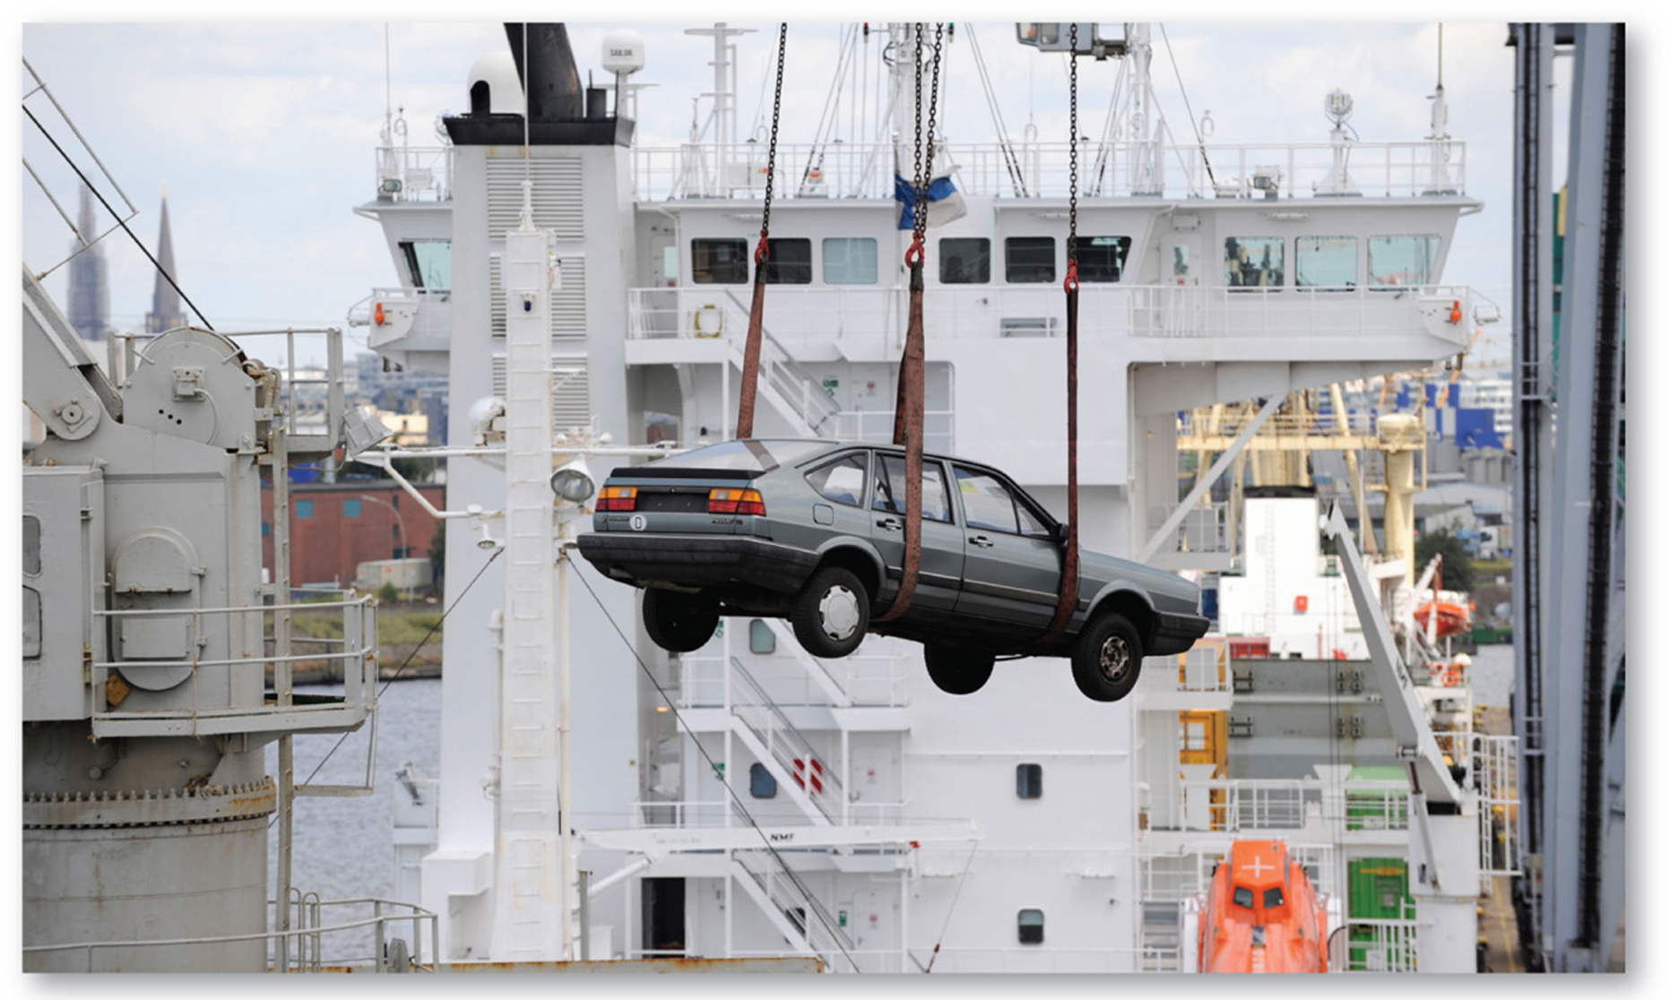
10.2.1 Unequal and Uneven Development (6 of 6)
Figure 10-20: Used cars are being exported from a core country (Germany) to a periphery country (Benin) illustrate the divide between wealthy core and poorer periphery.

Slide 29
10.2.2 Inequality Within Countries (1 of 7)
Inequality exists within regions of both developed and developing countries
Brazil—wealthy south and impoverished north
Turkey—wealthier western urban areas
United Kingdom—wealth concentrated around London
United States—northern/western states wealthier but gap with poorer southern states has closed in the last half-century

Slide 30
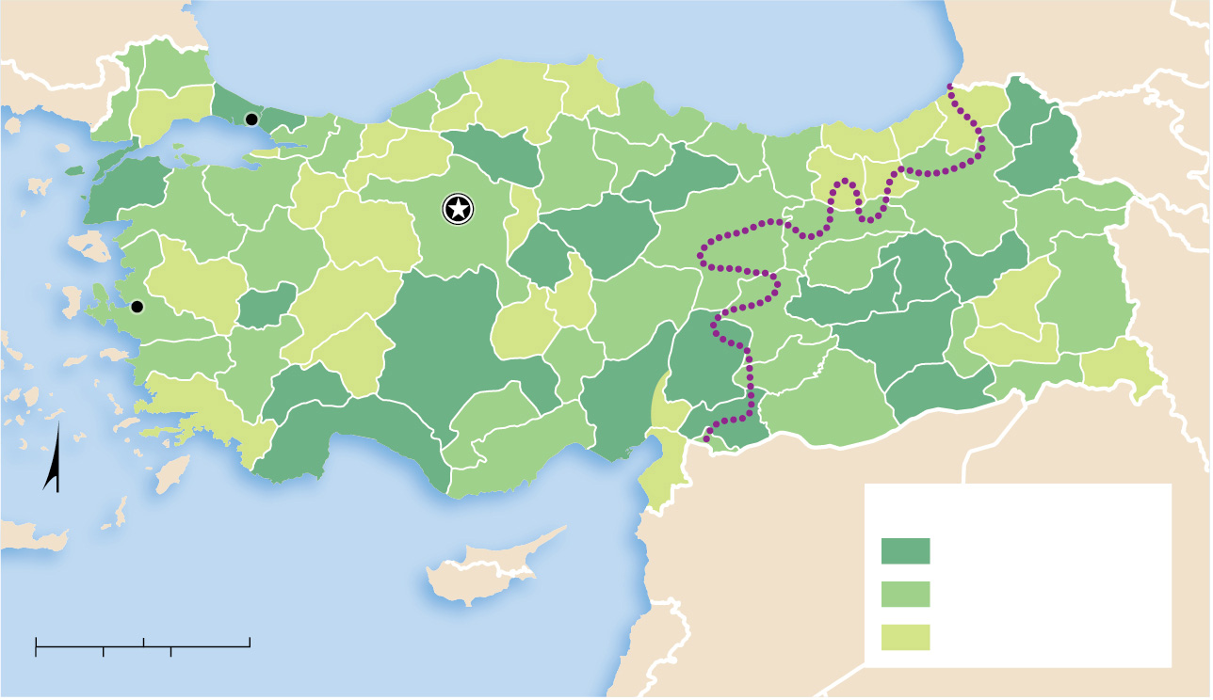
10.2.2 Inequality Within Countries (2 of 7)
Figure 10-21: Turkey’s wealthiest regions are around Istanbul.
BULGARIA
Black Sea
GEORGIA
GREECE
Istanbul
ARMENIA
Ankara
IRAN
Izmir
Kurdish dominance
IRAQ
N
GDP per capita in US$
Mediterranean Sea
SYRIA
above $10,000
CYPRUS
$7,000–$9,999
0
100
200 Miles
LEBANON
below $7,000
0
100
200 Kilometers

Slide 31
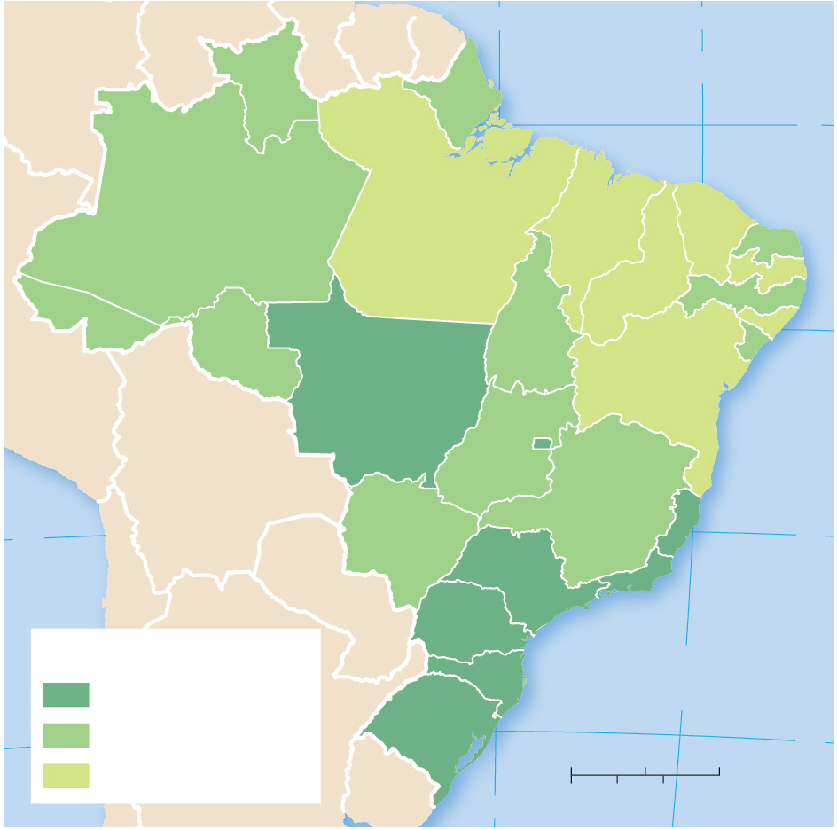
10.2.2 Inequality Within Countries (3 of 7)
Figure 10-22: Brazil’s wealth is concentrated in the south and east, especially along the coast.
50°
40°
RORAIMA
ATLANTIC OCEAN
AMAPÁ
EQUATOR
0°
RIO GRANDE
AMAZONAS
DO NORTE
PARÁ
MARANHÃO
CEARÁ
PIAUÍ
PARAÍBA
ACRE
PERNAMBUCO
TOCANTINS
ALAGOAS
RONDÔNIA
BAHIA
SERGIPE
MATO GROSSO
GOIÁS
DISTRITO
FEDERAL
20°
MATO GROSSO
MINAS GERAIS
ESPÍRITO SANTO
DO SUL
20°
SÃO PAULO
RIO DE
PARANÁ
JANEIRO
GDP per capita in US$
SANTA CATARINA
ATLANTIC
$10,000 and above
OCEAN
$5,000–$9,999
RIO GRANDE
DO SUL
0
250
500 Miles
30°
below $5,000
0
250
500 Kilometers
50°

Slide 32
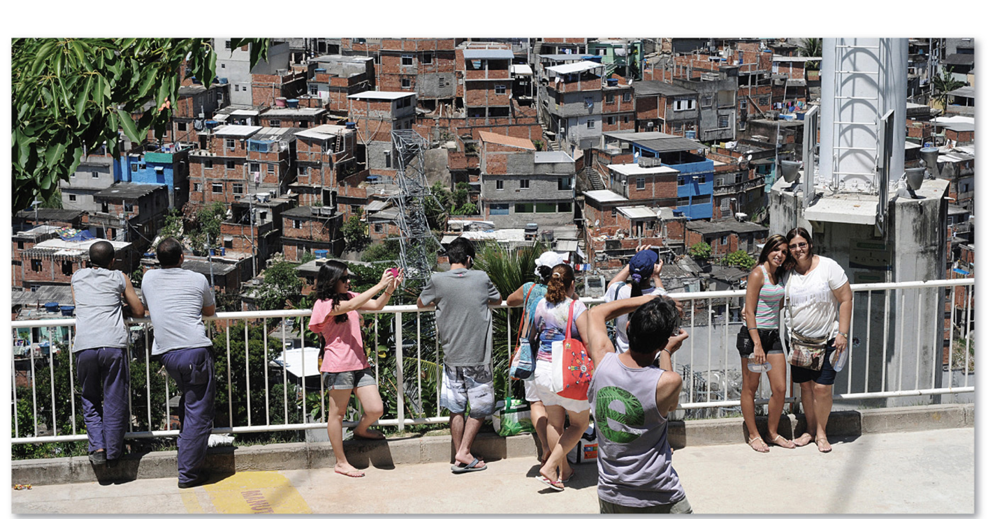
10.2.2 Inequality Within Countries (4 of 7)
Figure 10-23: The division of wealth is striking in Brazil. Tourists in Rio de Janeiro take photos with a background of slum housing (known in Brazil as favelas).

Slide 33
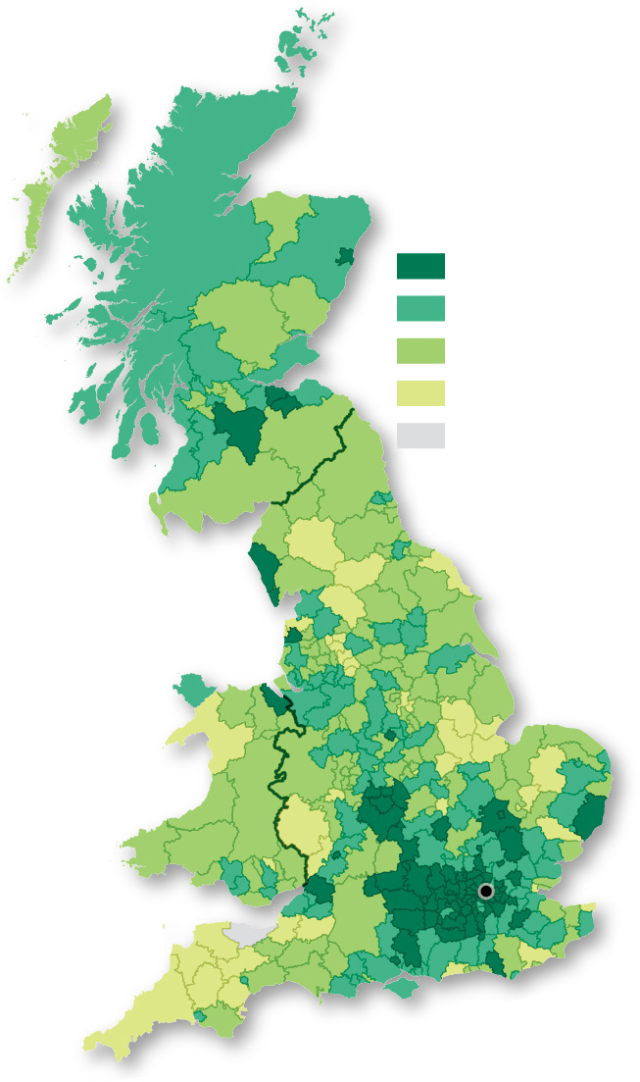
10.2.2 Inequality Within Countries (5 of 7)
Figure 10-24: Median household income is higher in the south, in particular around London, than in the north of the United Kingdom.
Gross annual income (British pounds)
SCOTLAND
28,600 and above
26,000–28,599
23,400–25,999
below 23,400
no data
WALES
ENGLAND
London

Slide 34
10.2.2 Inequality Within Countries (6 of 7)
Figure 10-25: In 1950, (a) southern states had much lower average incomes than the north and west. In 2015, (b) regional differences in income are lower.
Median income
as a percent of
national income
100 and above
80–99.9
below 80
(a) 1950
no data
(b) 2015

Slide 35
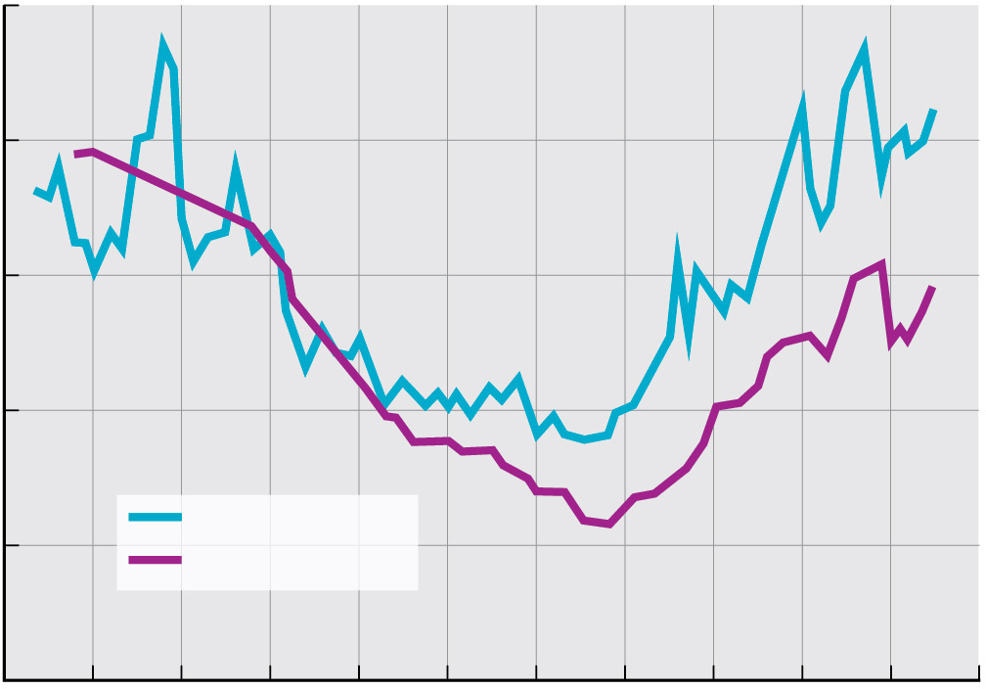
10.2.2 Inequality Within Countries (7 of 7)
Figure 10-27: The share of wealth held by the richest 1% has increased in the United States and United Kingdom since about 1980.
25
20
15
Percent (%)
15
5
United States
United Kingdom
0
1910
1920
1930
1940
1950
1960
1970
1980
1990
2000
2010
2020
Year

Slide 36
10.2.3 Gender Inequality (1 of 4)
The Gender Inequality Index (G I I) measures the gender gap in the level of achievement in three dimensions:
Reproductive health
Female empowerment
Female labor force participation
The Gender Development Index (G D I) measures the gender gap in the level of achievement for the three dimensions of the H D I: income, education, and life expectancy

Slide 37
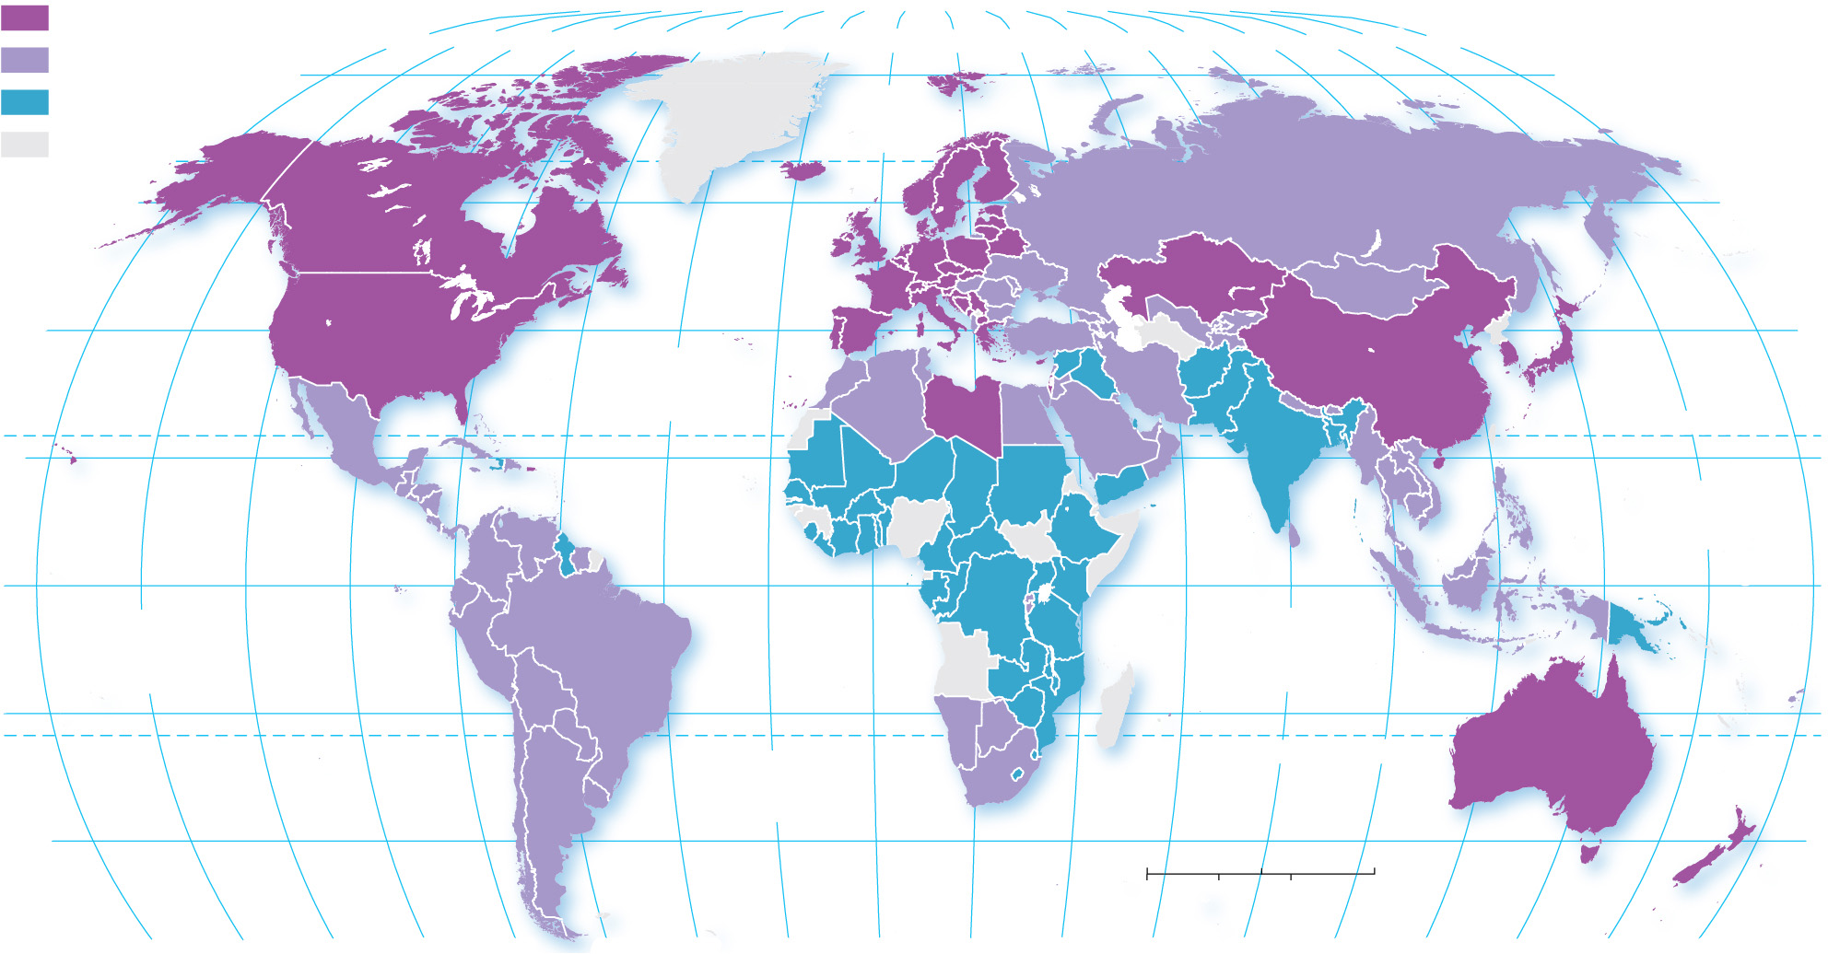
10.2.3 Gender Inequality (2 of 4)
Figure 10-28: The G I I is composed of measures of reproductive health, empowerment, and the labor market. Larger numbers indicate greater gender inequality.
Gender Inequality Index
below 0.20
160°
140°
120°
100°
80°
60°
40°
20°
0°
20°
40°
60°
80°
100°
120°
140°
160°
180°
0.20–0.49
80°
80°
0.50 and above
ARCTIC
OCEAN
no data
60°
60°
40°
ATLANTIC
OCEAN
40°
20°
TROPIC OF CANCER
20°
PACIFIC
OCEAN
0°
INDIAN
OCEAN
EQUATOR
0°
PACIFIC
OCEAN
20°
20°
ATLANTIC
OCEAN
TROPIC OF CAPRICORN
40°
0
1,500
3,000 Miles
40°
0
1,500
3,000 Kilometers
160°
140°
120°
100°
80°
60°
40°
20°
0°
20°
40°
60°
80°
100°
120°
140°
160°
180°

Slide 38
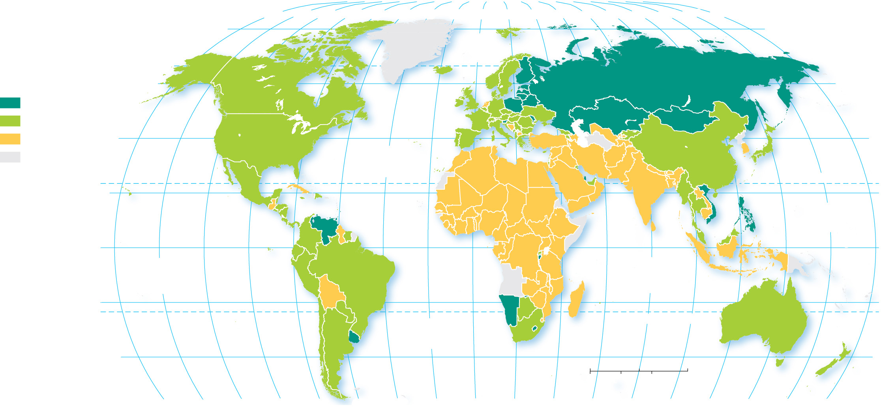
10.2.3 Gender Inequality (3 of 4)
Figure 10-30: The G D I is a measure of how unequal women are relative to men on the measures used in the H D I.
80°
160°
140°
120°
100°
80°
60°
40°
20°
0°
20°
40°
60°
80°
100°
120°
140°
160°
180°
80°
ARCTIC
OCEAN
Gender Development
Index
60°
60°
1.0 and above
0.95–0.99
below 0.95
40°
ATLANTIC
OCEAN
40°
no data
20°
TROPIC OF CANCER
20°
PACIFIC
OCEAN
0°
EQUATOR
0°
PACIFIC
OCEAN
INDIAN
OCEAN
20°
20°
ATLANTIC
OCEAN
TROPIC OF CAPRICORN
40°
0
1,500
3,000 Miles
40°
0
1,500
3,000 Kilometers
160°
140°
120°
100°
80°
60°
40°
20°
0°
20°
40°
60°
80°
100°
120°
140°
160°
180°

Slide 39
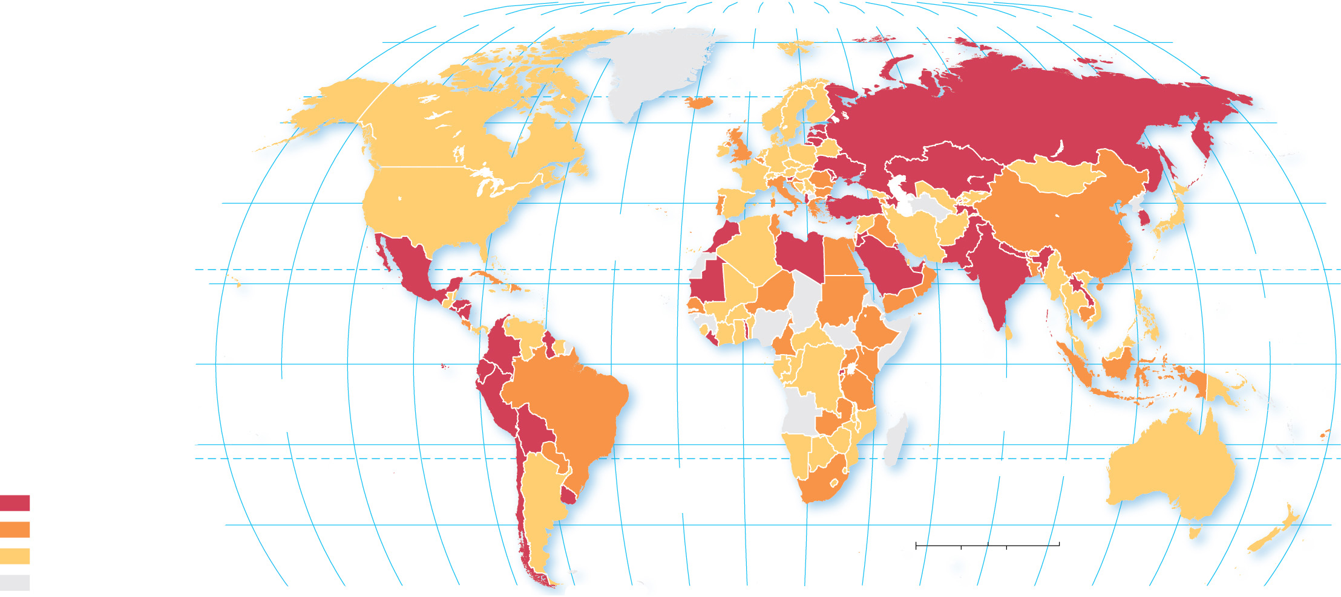
10.2.3 Gender Inequality (4 of 4)
Figure 10-31: Increased gender equality is a trend in most countries of the world.
80°
160°
140°
120°
100°
80°
60°
40°
20°
0°
20°
40°
60°
80°
100°
120°
140°
160°
180°
80°
ARCTIC
OCEAN
60°
60°
40°
ATLANTIC
OCEAN
40°
20°
TROPIC OF CANCER
20°
PACIFIC
OCEAN
0°
EQUATOR
0°
PACIFIC
OCEAN
INDIAN
OCEAN
Change in Gender
Inequality Index,
1990s–2015
20°
20°
ATLANTIC
OCEAN
TROPIC OF CAPRICORN
decrease 0.15 and above
decrease 0.10–0.14
40°
0
1,500
3,000 Miles
40°
decrease below 0.10 or increase
0
1,500
3,000 Kilometers
no data
160°
140°
120°
100°
80°
60°
40°
20°
0°
20°
40°
60°
80°
100°
120°
140°
160°
180°

Slide 40
10.2.4 Gender Empowerment and Employment (1 of 5)
The empowerment dimension of G I I is measured by two indicators—the percentage of seats held by women in the national legislature and the percentage of women who have completed some secondary school
The female labor force participation rate is the percentage of women holding full-time jobs outside the home. Women in developed countries are more likely than women in developing countries to hold full-time jobs outside the home

Slide 41
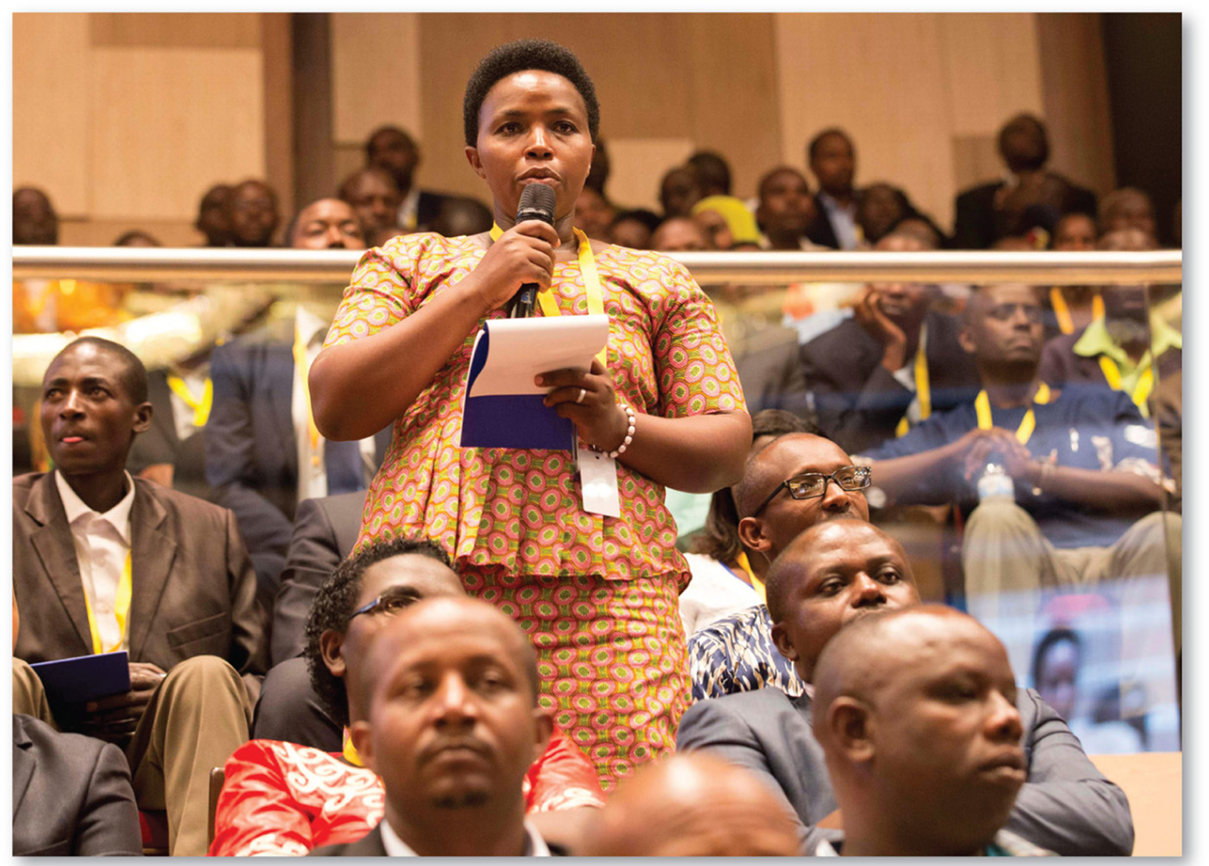
10.2.4 Gender Empowerment and Employment (2 of 5)
Figure 10-32: Rwanda has the highest percentage of women in the world serving in a national legislature.

Slide 42
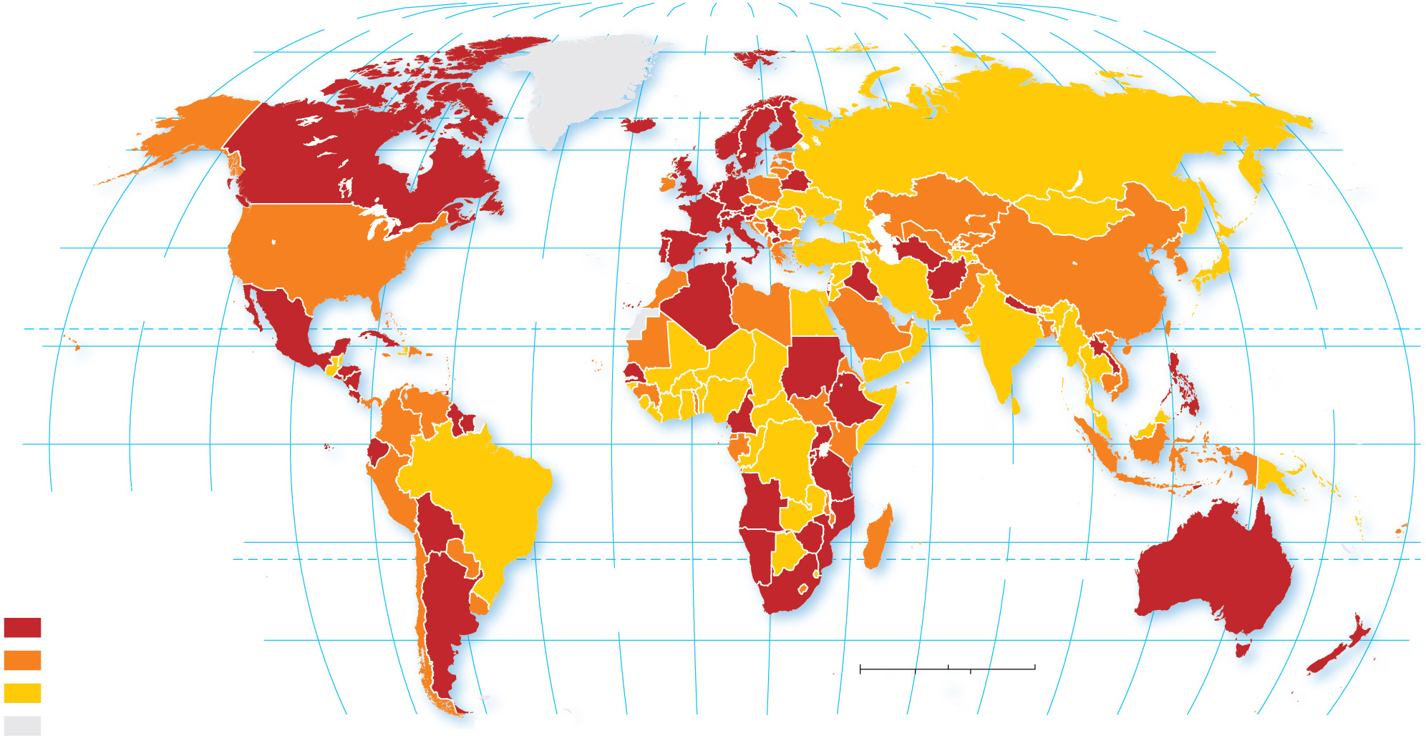
10.2.4 Gender Empowerment and Employment (3 of 5)
Figure 10-33: One measure of female empowerment is the percentage of seats held by women in a country’s national legislative body.
80°
160°
140°
120°
100°
80°
60°
40°
20°
0°
20°
40°
60°
80°
100°
120°
140°
160°
180°
80°
ARCTIC
OCEAN
60°
60°
40°
PACIFIC
OCEAN
ATLANTIC
OCEAN
40°
20°
TROPIC OF CANCER
20°
PACIFIC
OCEAN
0°
EQUATOR
0°
160°
140°
120°
INDIAN
OCEAN
Percent seats in
legislature held
by women
20°
20°
ATLANTIC
OCEAN
TROPIC OF CAPRICORN
25 and above
40°
40°
15–24
0
1,500
3,000 Miles
below 15
0
1,500
3,000 Kilometers
no data
100°
80°
60°
40°
20°
0°
20°
40°
60°
80°
100°
120°
140°
160°
180°

Slide 43
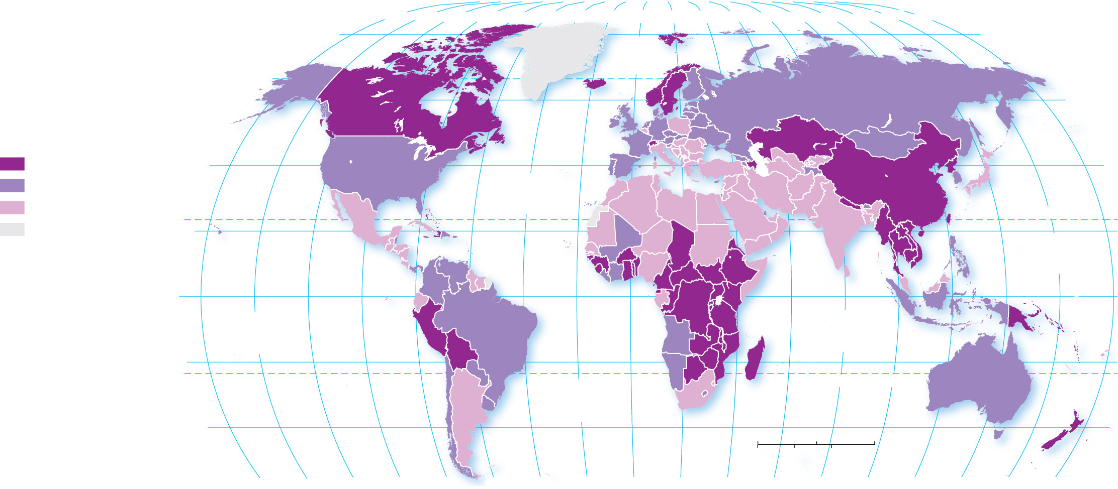
10.2.4 Gender Empowerment and Employment (4 of 5)
Figure 10-34: Female labor force participation as a percentage of male participation is a measure of gender inequality.
80°
160°
140°
120°
100°
80°
60°
40°
20°
0°
20°
40°
60°
80°
100°
120°
140°
160°
180°
80°
ARCTIC
OCEAN
60°
60°
Percent of women
in the labor force
60 and above
40°
ATLANTIC
OCEAN
40°
50–59
below 50
TROPIC OF CANCER
no data
20°
PACIFIC
OCEAN
20°
0°
EQUATOR
0°
PACIFIC
OCEAN
INDIAN
OCEAN
20°
20°
ATLANTIC
OCEAN
TROPIC OF CAPRICORN
40°
0
1,500
3,000 Miles
40°
0
1,500
3,000 Kilometers
160°
140°
120°
100°
80°
60°
40°
20°
0°
20°
40°
60°
80°
100°
120°
140°
160°
180°

Slide 44
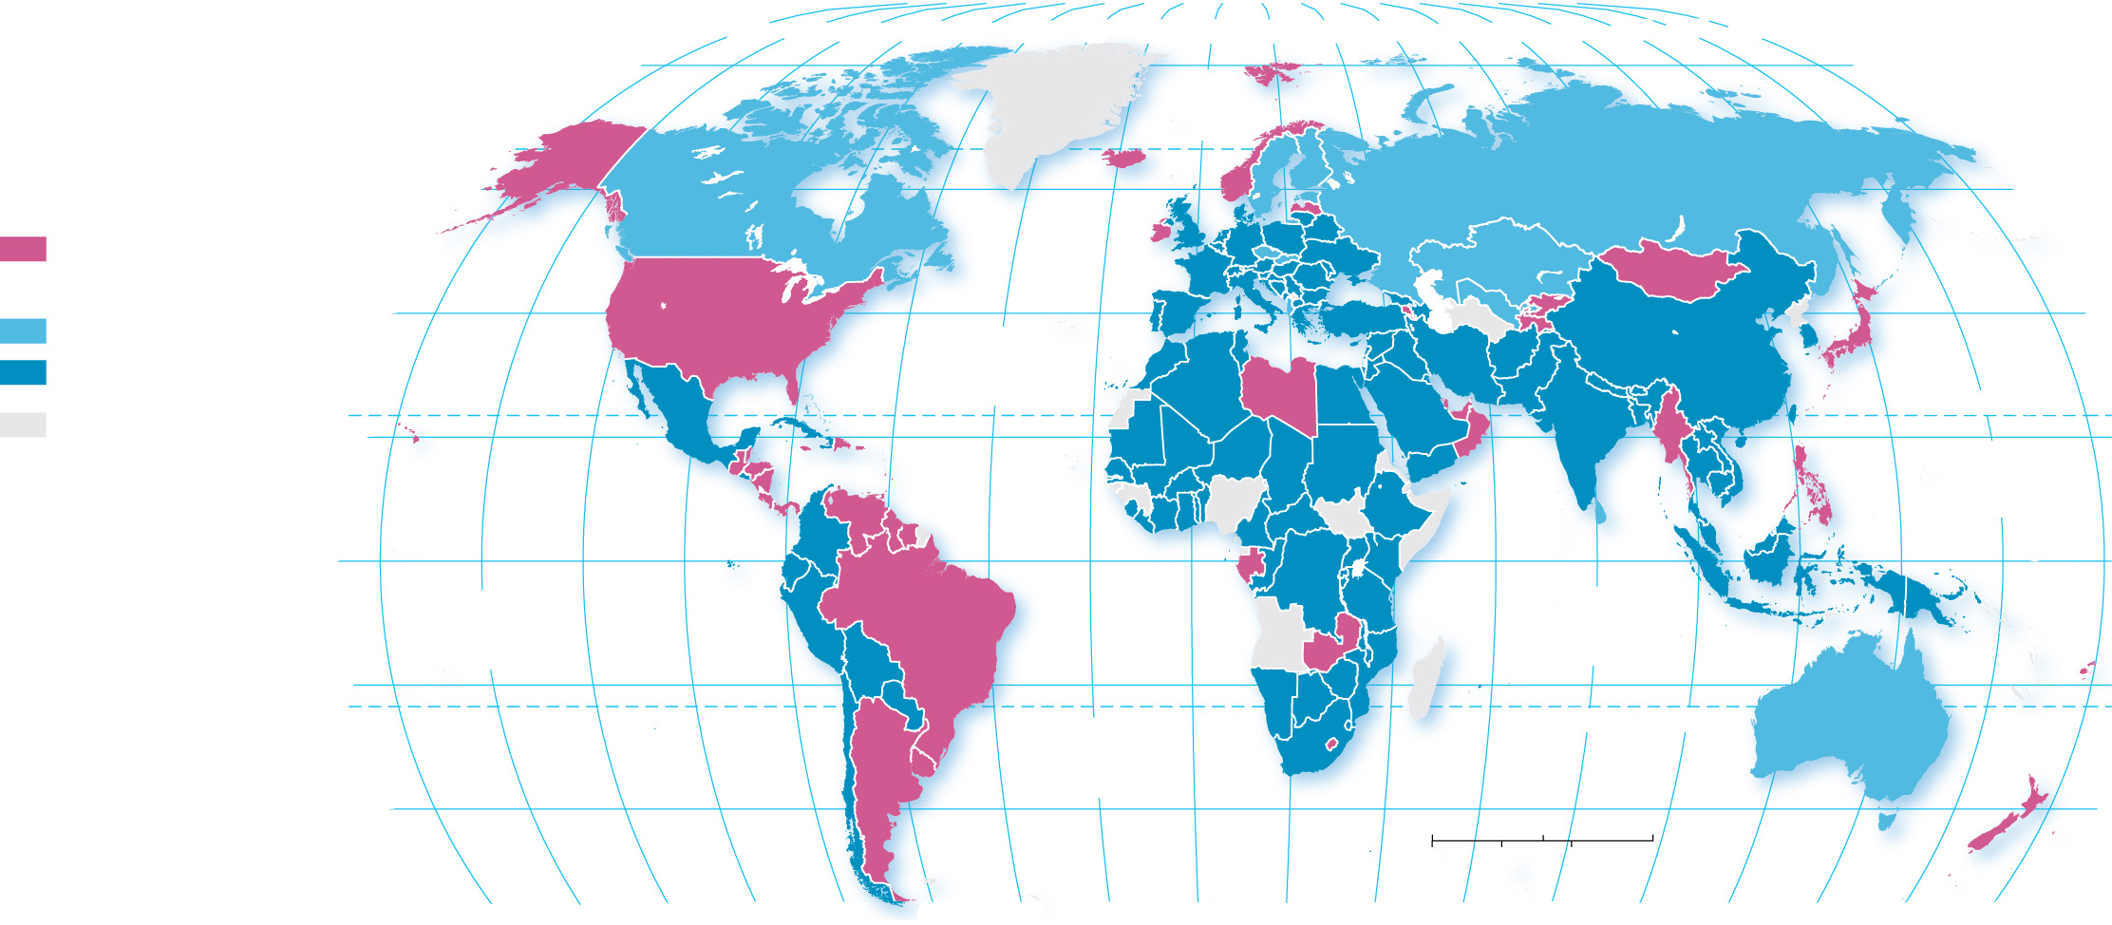
10.2.4 Gender Empowerment and Employment (5 of 5)
Figure 10-35: Another measure of female empowerment is the ratio of girls to boys in secondary school. Countries in lavender have more girls than boys enrolled.
80°
160°
140°
120°
100°
80°
60°
40°
20°
0°
20°
40°
60°
80°
100°
120°
140°
160°
180°
80°
ARCTIC
OCEAN
Percent with some
secondary school education
60°
60°
More females than males
More males than females
40°
40°
0–4.9% more males
ATLANTIC
OCEAN
at least 5% more males
TROPIC OF CANCER
no data
20°
PACIFIC
OCEAN
20°
0°
EQUATOR
0°
PACIFIC
OCEAN
INDIAN
OCEAN
20°
20°
ATLANTIC
OCEAN
TROPIC OF CAPRICORN
40°
0
1,500
3,000 Miles
40°
0
1,500
3,000 Kilometers
160°
140°
120°
100°
80°
60°
40°
20°
0°
20°
40°
60°
80°
100°
120°
140°
160°
180°

Slide 45
10.2.5 Reproductive Health (1 of 6)
The reproductive health dimension of the G I I is based on two indicators: adolescent fertility rate and maternal mortality rate
The adolescent fertility rate is the number of births per 1,000 women ages 15 to 19
The maternal mortality rate is the number of women who die giving birth per 100,000 live births

Slide 46
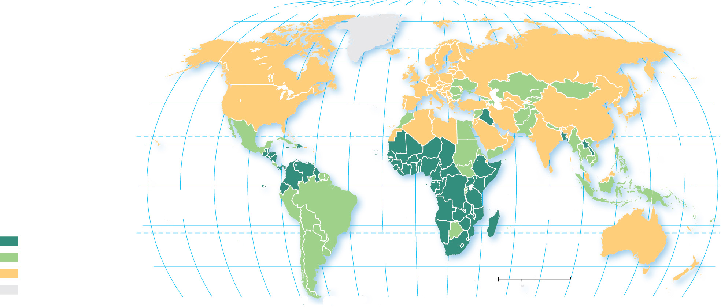
10.2.5 Reproductive Health (2 of 6)
Figure 10-36: The adolescent fertility (births per 1,000 women aged 15 to 19) rate is included in the G I I.
80°
160°
140°
120°
100°
80°
60°
40°
20°
0°
20°
40°
60°
80°
100°
120°
140°
160°
180°
80°
ARCTIC
OCEAN
60°
60°
40°
ATLANTIC
OCEAN
40°
TROPIC OF CANCER
20°
20°
PACIFIC
OCEAN
0°
EQUATOR
0°
PACIFIC
OCEAN
INDIAN
OCEAN
Adolescent fertility
rate per 1,000
20°
20°
70 and above
ATLANTIC
OCEAN
TROPIC OF CAPRICORN
30–69
40°
40°
below 30
0
1,500
3,000 Miles
no data
0
1,500
3,000 Kilometers
160°
140°
120°
100°
80°
60°
40°
20°
0°
20°
40°
60°
80°
100°
120°
140°
160°
180°

Slide 47
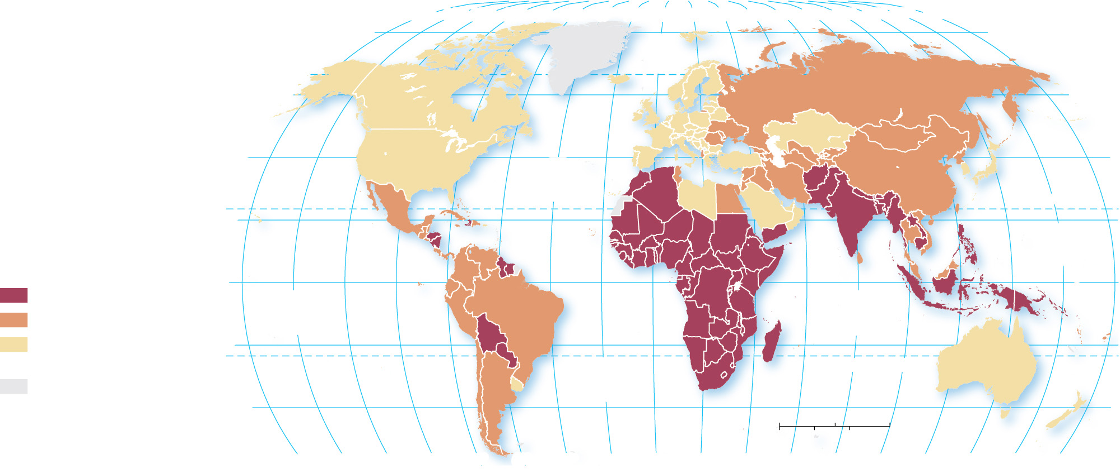
10.2.5 Reproductive Health (3 of 6)
Figure 10-37: The maternal mortality rate is the number of deaths of mothers in childbirth per 100,000 live births.
80°
160°
140°
120°
100°
80°
60°
40°
20°
0°
20°
40°
60°
80°
100°
120°
140°
160°
180°
80°
ARCTIC
OCEAN
60°
60°
40°
ATLANTIC
OCEAN
40°
Maternal Mortality Rate
(deaths of mothers in
childbirth per 100,000
live births)
20°
TROPIC OF CANCER
20°
PACIFIC
OCEAN
decrease 100 and above
0°
EQUATOR
0°
decrease 20–99
PACIFIC
OCEAN
INDIAN
OCEAN
decrease below 20
or increase
20°
20°
no data
ATLANTIC
OCEAN
TROPIC OF CAPRICORN
40°
0
1,500
3,000 Miles
40°
0
1,500
3,000 Kilometers
160°
140°
120°
100°
80°
60°
40°
20°
0°
20°
40°
60°
80°
100°
120°
140°
160°
180°

Slide 48
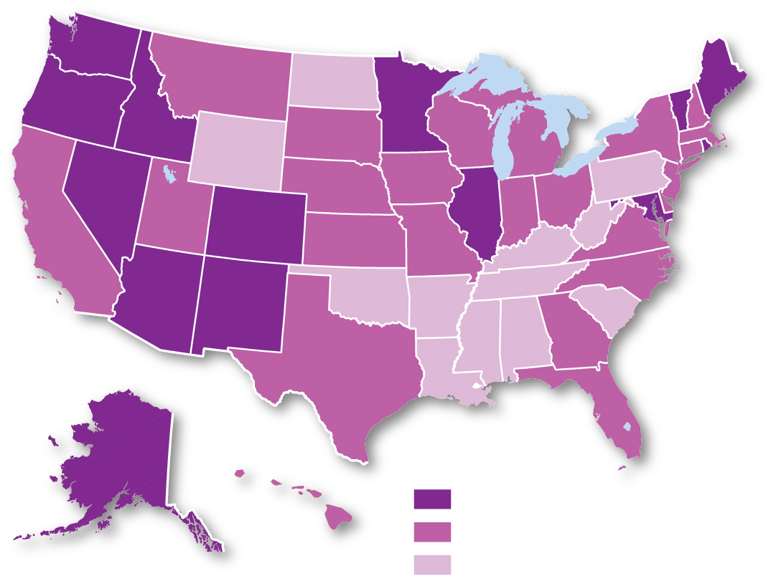
10.2.5 Reproductive Health (4 of 6)
Figure 10-38: There is a higher percentage of women in state legislatures in western and northern states than in southern states.
Percent women
in state legislature
30 and above
20–29
below 20

Slide 49
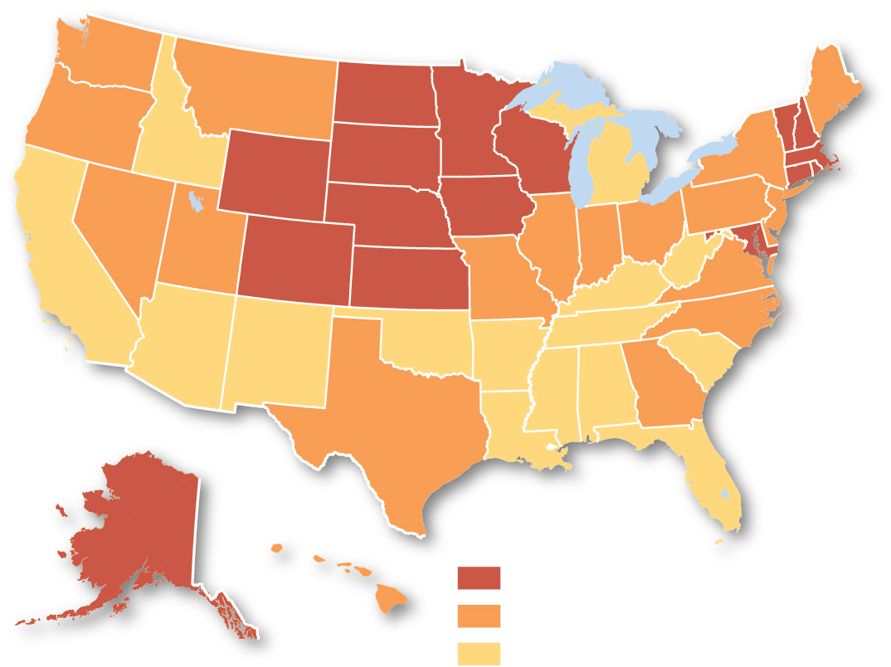
10.2.5 Reproductive Health (5 of 6)
Figure 10-39: The highest percentage of women in working full-time outside of the home is found in northern states.
Percent female labor
force participation
62 and above
58–61.9
below 58

Slide 50
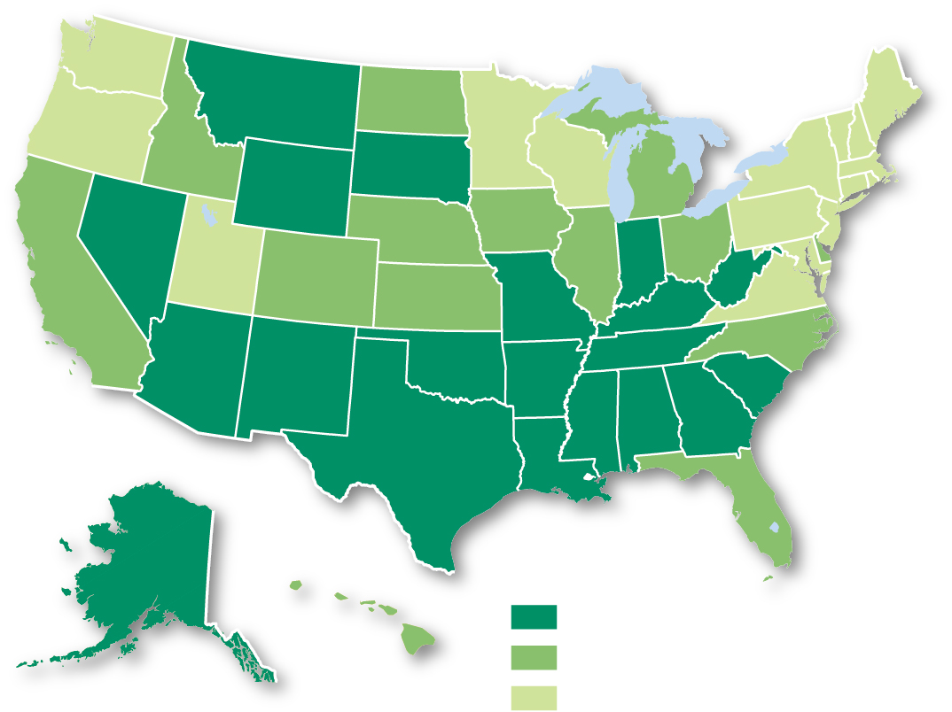
10.2.5 Reproductive Health (6 of 6)
Figure 10-40: The highest teenage birth rates are found in southern states.
Births per 1,000
females, ages 15–19
22 and above
17–21.9
below 17

Slide 51
Key Issue 3: Why Do Countries Face Challenges to Development?
10.3.1 Two Paths to Development
10.3.2 World Trade
10.3.3 Financing Development
10.3.4 Structural Adjustment

Slide 52
10.3.1 Two Paths to Development (1 of 5)
There are two paths to development: the self-sufficiency path and the international trade path
The self-sufficiency model encourages domestic production, discourages foreign ownership of businesses and resources, and protects their businesses from international competition
The international trade model encourages countries to open themselves to foreign investment and international markets

Slide 53
10.3.1 Two Paths to Development (2 of 5)
The self-sufficiency model requires:
import limits (tariffs)
isolating domestic businesses from international competition
equal investment across all sectors and regions of the domestic economy
India is an example of a country which formerly embraced the self-sufficiency model

Slide 54
10.3.1 Two Paths to Development (3 of 5)
The international trade model requires a country to identify assets and concentrate resources on specializations. Examples include the Four Asian Dragons (Taiwan, Singapore, South Korea, and Hong Kong)
Rostow’s model of international trade:
Traditional society
Preconditions for takeoff
Takeoff
Drive to maturity
Age of mass consumption

Slide 55
10.3.1 Two Paths to Development (4 of 5)
To promote the international trade model, countries representing 97% of world trade established the World Trade Organization (W T O) in 1995. The W T O works to reduce barriers to international trade in two principal ways: the reduction of restrictions on trade and enforcing trade agreements. Critics cite the W T O compromises the sovereignty of individual countries because it can order changes in taxes and laws that it considers unfair trading practices

Slide 56
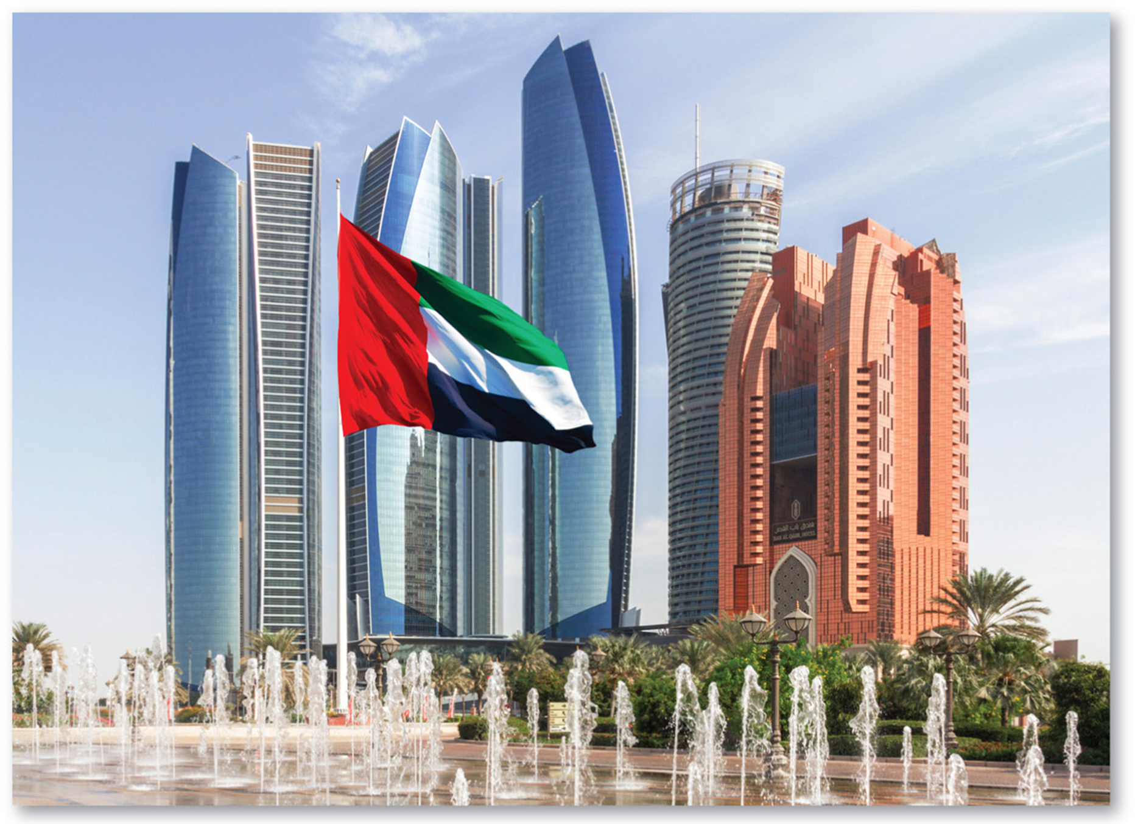
10.3.1 Two Paths to Development (5 of 5)
Figure 10-42: Dubai, United Arab Emirates (U A E). The U A E has used revenue from the sale of oil to develop a city of modern high-rises.

Slide 57
10.3.2 World Trade (1 of 6)
International Trade Triumphs
Developing nations joined the success of developed nations
Developing nations were able to generate funds through the sale of their raw materials
The international trade model requires industries remain competitive and innovative
Shortcomings of Self-Sufficiency
Inefficient industries
Lack of competitiveness and innovation
Corruption and oversized bureaucracies
The creation of a black market

Slide 58
10.3.2 World Trade (2 of 6)
India is an example of a country which abandoned the self-sufficiency model for the international trade model by
Allowing foreign companies to operate within India with limited interference
Import tariffs were reduced or eliminated
Monopolies in industries such as communications were eliminated

Slide 59
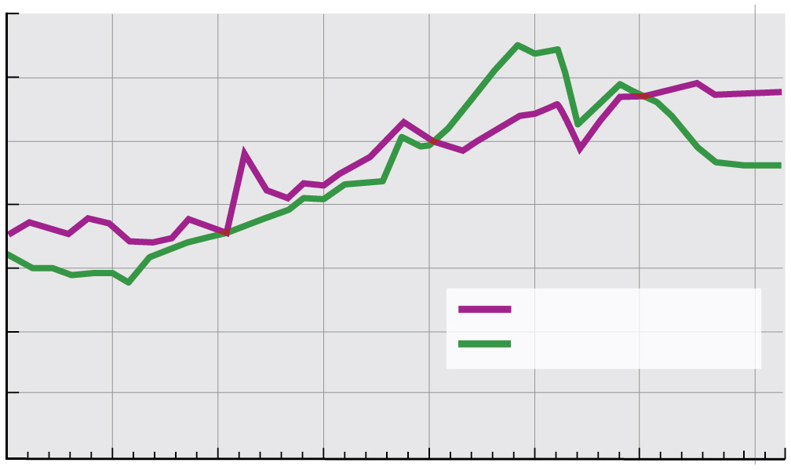
10.3.2 World Trade (3 of 6)
Figure 10-43: Both developed and developing countries are increasingly reliant on trade as a contributor to G D P.
35
30
25
20
Trade as % of GDP
15
Developed countries
10
Developing countries
5
0
1980
1985
1990
1995
2000
2005
2010
2017
Year

Slide 60
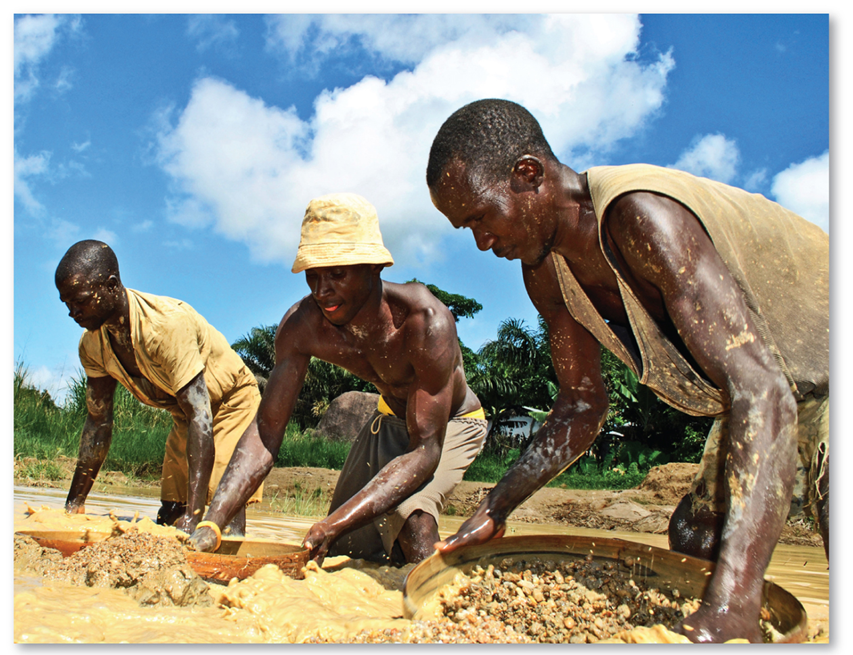
10.3.2 World Trade (4 of 6)
Figure 10-44: Illegal diamond mining examines the darker aspects of international trade.

Slide 61
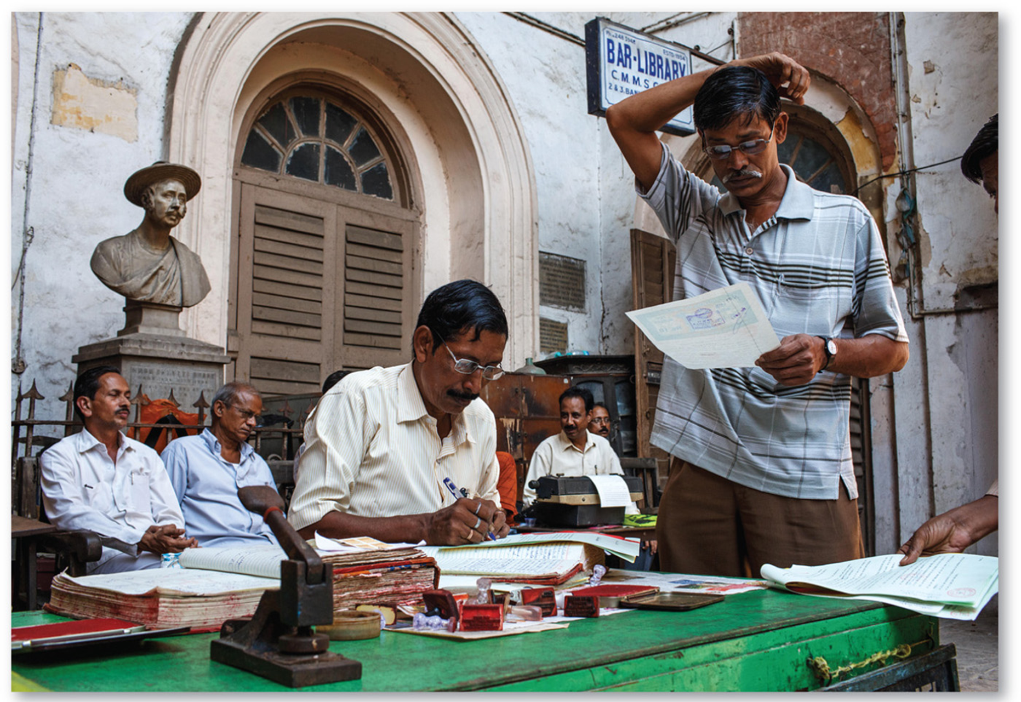
10.3.2 World Trade (5 of 6)
Figure 10-45: Under self-sufficiency in India, imports were limited, and the government regulated domestic industries.

Slide 62
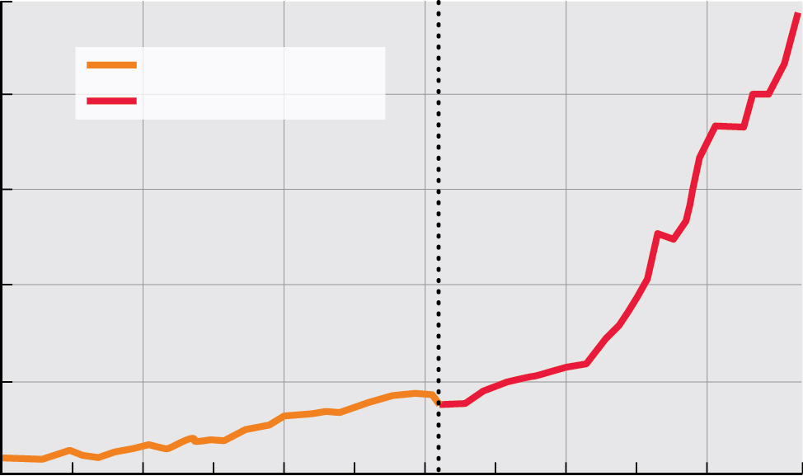
10.3.2 World Trade (6 of 6)
Figure 10-46: India’s G D P growth under self-sufficiency was stagnant but grew dramatically once the international trade model was adopted.
2000
Self-sufficiency
1600
International trade
1200
India’s GDP per capita (U.S. dollars)
800
400
0
1960
1965
1970
1975
1980
1985
1990
1995
2000
2005
2010
2017
Year

Slide 63
10.3.3 Financing Development (1 of 7)
Developing countries lack money for development, so they obtain finances from developed countries. Finance comes from two primary sources: foreign direct investment (F D I) by transnational corporations and loans from banks and international organizations such as the International Monetary Fund (I M F) and the World Bank

Slide 64
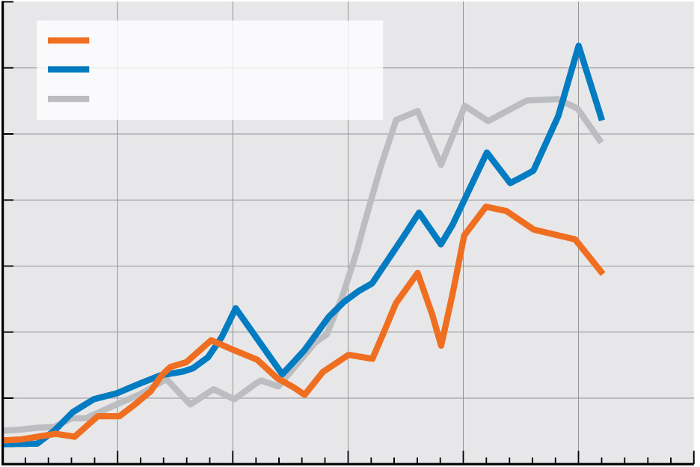
10.3.3 Financing Development (2 of 7)
Figure 10-47: Foreign direct investment in East Asia and Latin America has grown faster than other developing regions.
350
350
Latin America
300
300
East Asia
All other developing regions
250
250
200
200
Million dollars
150
150
100
100
50
50
0
0
1990
1995
2000
2005
2010
2015
2020
Year

Slide 65
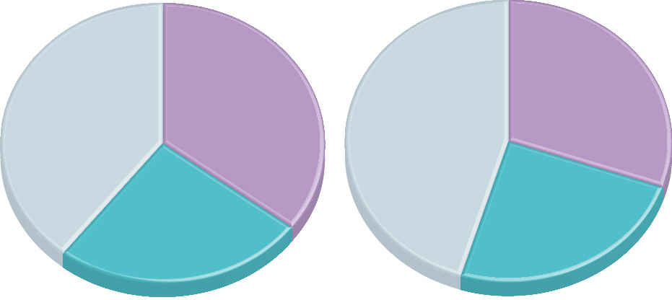
10.3.3 Financing Development (3 of 7)
Figure 10-48: Most foreign direct investment is out of and into developed countries in North America and Europe.
35.5%
30.5%
39.4%
45.2%
Europe
Europe
Rest of World
Rest of World
25.1%
24.3%
North
America
North
America
(a) Sources of FDI
(b) Destinations of FDI

Slide 66
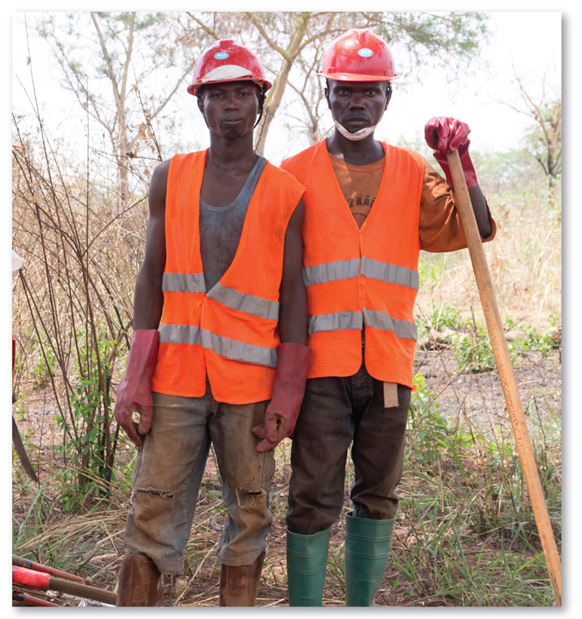
10.3.3 Financing Development (4 of 7)
Figure 10-49: A World Bank-funded road construction project in the Central African Republic.

Slide 67
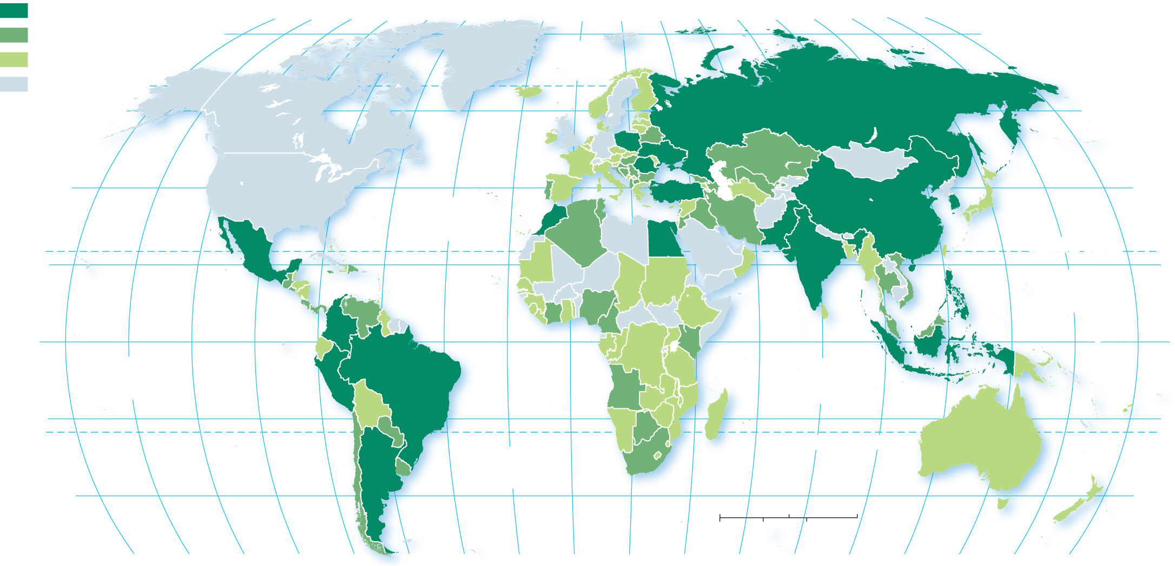
10.3.3 Financing Development (5 of 7)
Figure 10-50: The World Bank loans the most to countries in Asia and Latin America.
World Bank loans in US$
$10 billion and above
160°
140°
120°
100°
80°
60°
40°
20°
0°
20°
40°
60°
80°
100°
120°
140°
160°
180°
$1 billion–$9.9 billion
80°
ARCTIC
OCEAN
80°
below $1 billion
no loans
60°
60°
40°
ATLANTIC
OCEAN
40°
20°
TROPIC OF CANCER
20°
PACIFIC
OCEAN
0°
PACIFIC
OCEAN
EQUATOR
0°
INDIAN
OCEAN
20°
20°
ATLANTIC
OCEAN
TROPIC OF CAPRICORN
40°
0
1,500
3,000 Miles
40°
0
1,500
3,000 Kilometers
160°
140°
120°
100°
80°
60°
40°
20°
0°
20°
40°
60°
80°
100°
120°
140°
160°
180°

Slide 68
10.3.3 Financing Development (6 of 7)
An alternative source of loans is known as microfinance, which is the provision of small loans and other financial services to individuals and small businesses in developing countries that are unable to obtain loans from commercial banks
The Grameen Bank in Bangladesh is a prime example of microfinance. Grameen specializes in making loans to women, who make up three-fourths of the borrowers

Slide 69
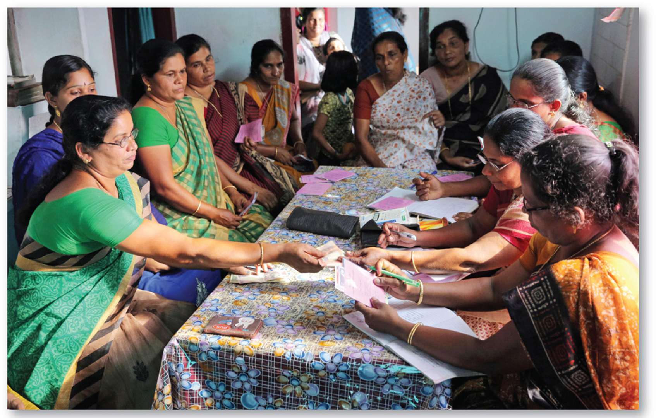
10.3.3 Financing Development (7 of 7)
Figure 10-51: The Peermade Development Society, Kerala, India, makes microloans to women trying to start small businesses.

Slide 70
10.3.4 Structural Adjustment (1 of 4)
The World Bank itself has judged half the projects it has funded in Africa to be failures. Common reasons include the following:
Projects don’t function as intended because of faulty engineering
Recipient nations squander or spend aid on armaments, or the aid is stolen through graft and corruption
New infrastructure does not attract other investments

Slide 71
10.3.4 Structural Adjustment (2 of 4)
Loan debt and repayment can entail a stimulus strategy or an austerity strategy. The stimulus strategy entails government spending to stimulate economy, whereas the austerity strategy requires spending be cut dramatically
The I M F or World Bank may impose a structural adjustment program on a developing nation, leading to cuts in key government spending on education and health, and producing higher unemployment

Slide 72
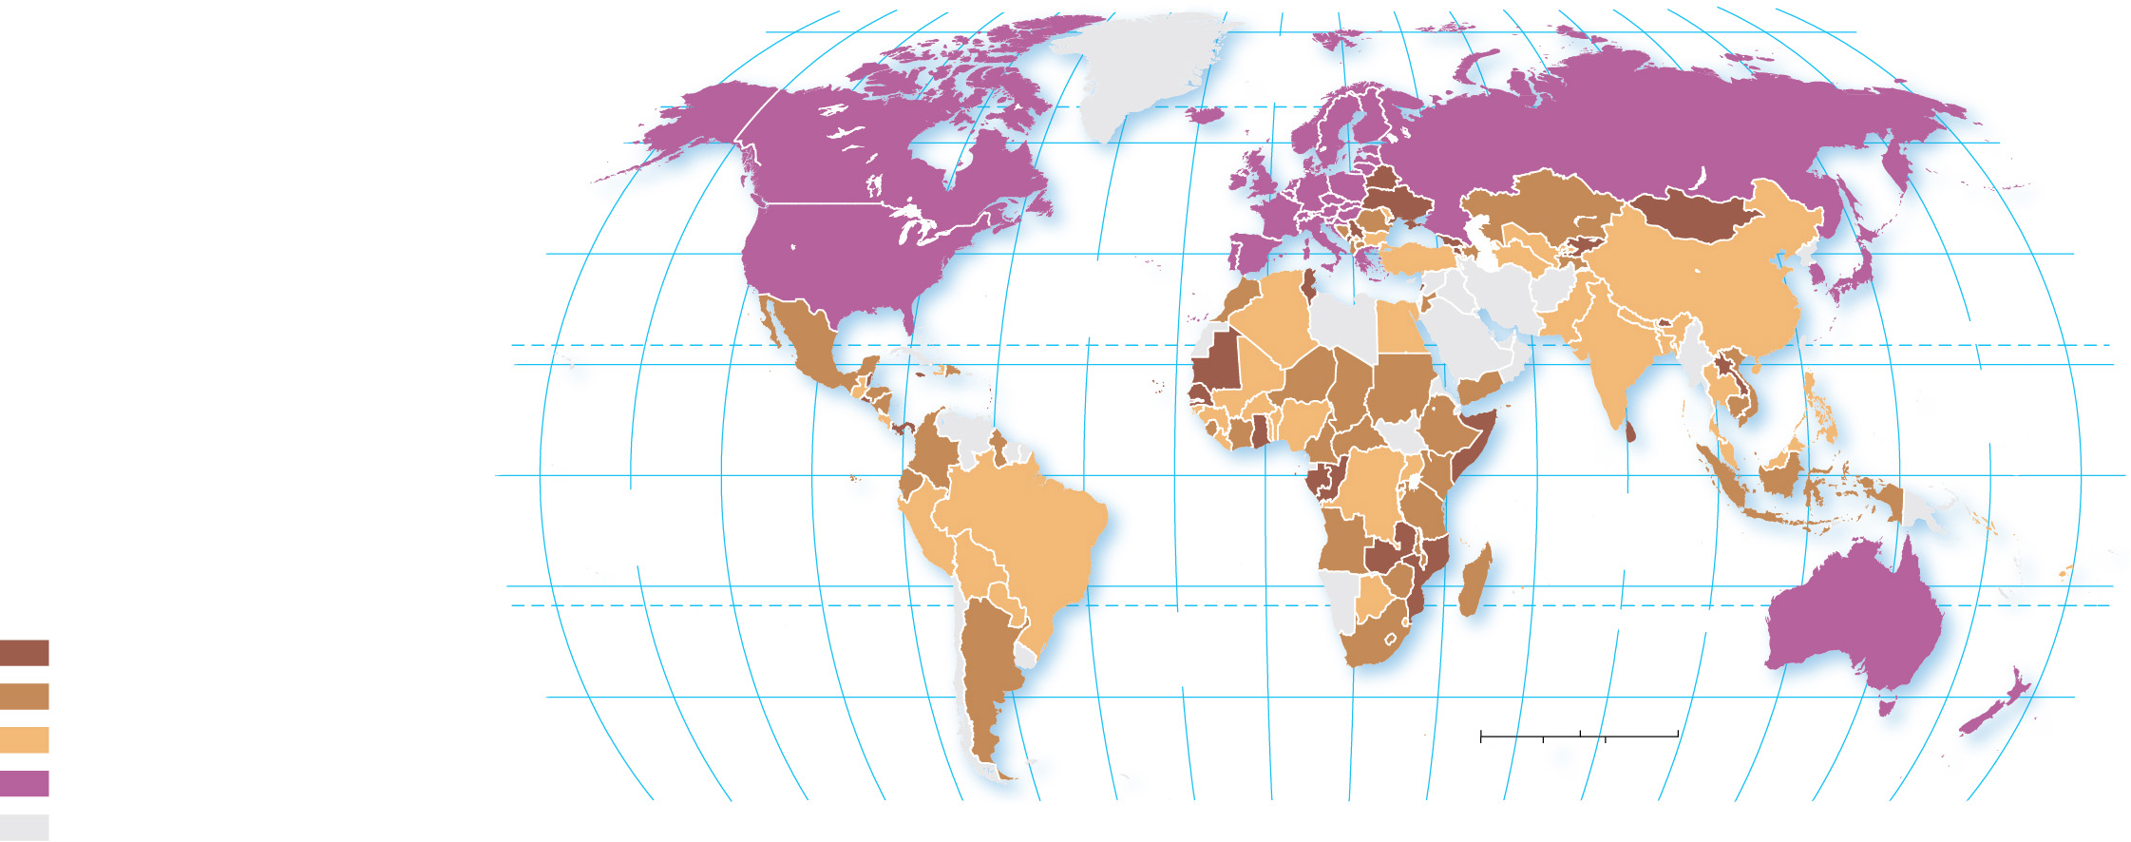
10.3.4 Structural Adjustment (3 of 4)
Figure 10-52: International borrowing leads to more debt than countries can repay.
80°
160°
140°
120°
100°
80°
60°
40°
20°
0°
20°
40°
60°
80°
100°
120°
140°
160°
180°
80°
ARCTIC
OCEAN
60°
60°
40°
ATLANTIC
OCEAN
40°
20°
TROPIC OF CANCER
20°
PACIFIC
OCEAN
0°
PACIFIC
OCEAN
EQUATOR
0°
INDIAN
OCEAN
Debt as percentage
of GNI
20°
20°
35 and above
ATLANTIC
OCEAN
TROPIC OF CAPRICORN
20–34.9
40°
0
1,500
3,000 Miles
40°
below 20
0
1,500
3,000 Kilometers
developed country
160°
140°
120°
100°
80°
60°
40°
20°
0°
20°
40°
60°
80°
100°
120°
140°
160°
180°
no data

Slide 73
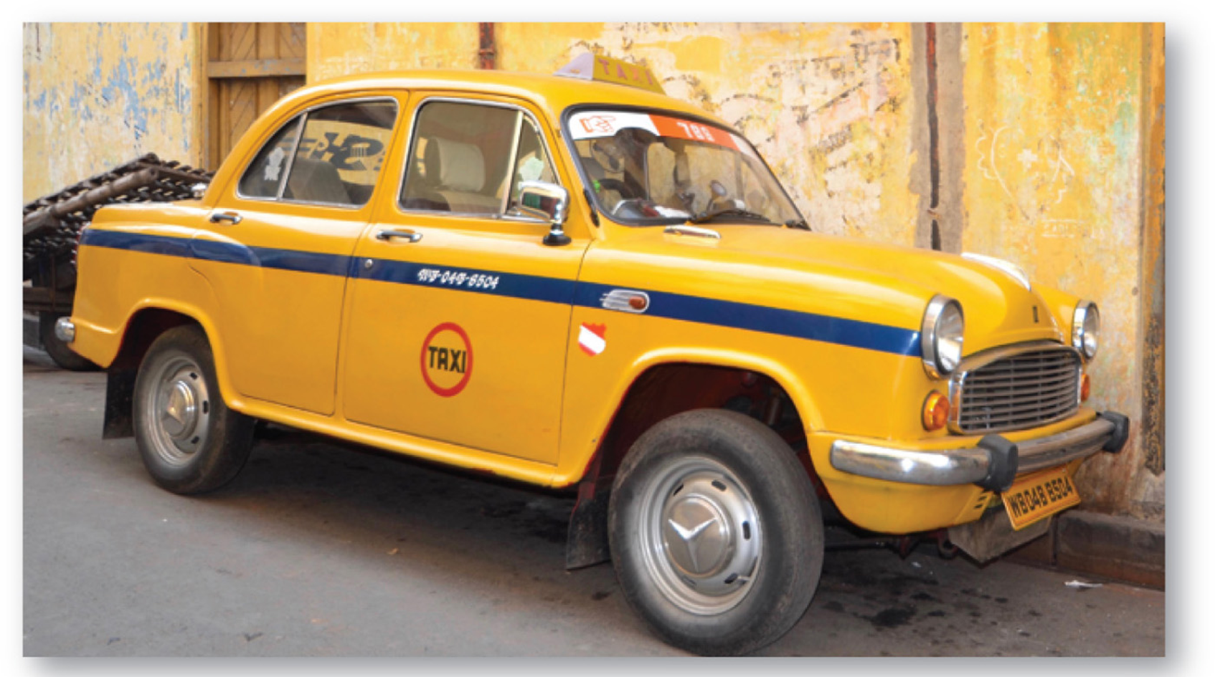
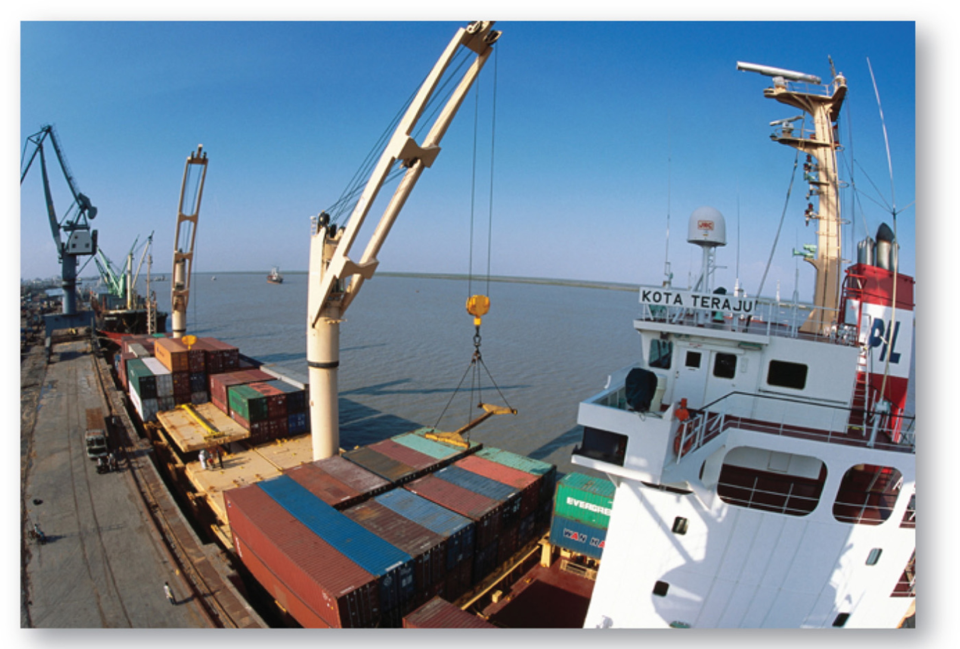
10.3.4 Structural Adjustment (4 of 4)
Figures 10-53 and 10-54: Globalization has compelled many countries to re-examine their commitment to the international trade model.

Slide 74
Key Issue 4: Why Are Countries Able to Make Progress in Development?
10.4.1 Measuring Progress
10.4.2 Fair Trade

Slide 75
10.4.1 Measuring Progress (1 of 8)
A summary of the progress made in the H D I and its components since 1980:
G N I per capita—G N I per capita has increased much more rapidly in developed countries
Education—Mean years of education have increased by around the same number in developed and developing countries
Life expectancy—Life expectancy has increased by around the same number of years in developed and developing countries
H D I—The gap in H D I between developed countries and developing countries has narrowed

Slide 76
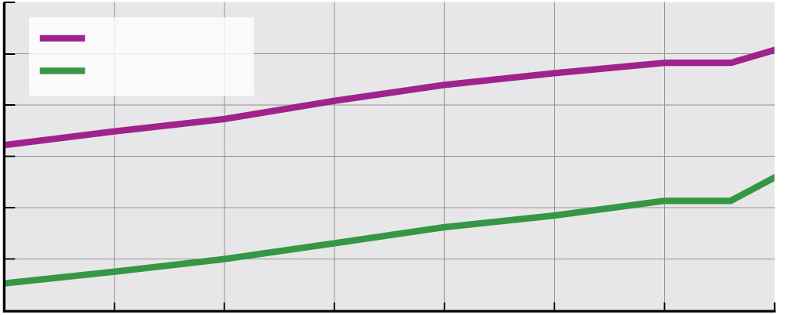
10.4.1 Measuring Progress (2 of 8)
Figure 10-55: Education in developed and developing countries has had a nearly parallel trend.
14.0
12.0
Developed
Developing
10.0
8.0
Mean years of education
6.0
4.0
2.0
1980
1985
1990
1995
2000
2005
2010
2015
Year

Slide 77
10.4.1 Measuring Progress (3 of 8)
Figure 10-56: Life expectancy in developing countries has been increasing more rapidly.
80
75
70
65
Life expectancy (years)
60
55
Developed
50
Developing
45
40
1955
1965
1975
1985
1995
2005
2015
Year

Slide 78
10.4.1 Measuring Progress (4 of 8)
Figure 10-57: H D I in developed and developing countries has had a nearly parallel trend.
1.000
0.900
0.800
0.700
HDI change
Developed
0.600
Developing
0.500
0.400
0.300
1980
1985
1990
1995
2000
2005
2010
2015
Year

Slide 79
10.4.1 Measuring Progress (5 of 8)
Figure 10-58: The changing circle size shows the increase in H D I from 1980 to 2015.
Russia
Europe
Japan & South Korea
North America
Southwest Asia
& North Africa
HDI index
Developed regions
East Asia
1.0
2015
Southeast Asia
0.8
1980
Central Asia
0.6
Developing regions
0.4
2015
Latin America
Sub-Saharan
Africa
South Asia
0.2
0.0
1980
Very high developed
High developing
Medium developing
Low developing
South Pacific

Slide 80
10.4.1 Measuring Progress (6 of 8)
Table 10-1: The United Nations has listed 17 sustainable development goals to achieve by 2030.
Goal | Comment
End poverty in all its forms everywhere. | Poverty was cut in half between 1990 and 2010, but in 2018, 766 million people lived in extreme poverty, which the World Bank defines as earning less than $1.90 per day.
End hunger, achieve food security and improved nutrition, and promote sustainable agriculture. | The U.N. estimated 803 million people were undernourished in 2018. It wants to double agricultural productivity by 2030.
Ensure healthy lives and promote well-being for all at all ages. | Progress has been made in reducing infant mortality and maternal mortality, but the U.N. hopes to reduce these rates further by 2030.
Ensure inclusive and quality education for all and promote lifelong learning | The U.N. wants to ensure that all children attend school; 61 million children of primary school age do not attend school, more than half of whom are in sub-Saharan Africa.
Achieve gender equality and empower all women and girls. | Gender inequalities have been reduced but persist in all regions, as discussed in Key Issue 2.

Slide 81
10.4.1 Measuring Progress (7 of 8)
Table 10-1: [Continued]
Goal | Comment
Ensure access to water and sanitation for all. | 884 million people lack access to drinking water, and 2.3 billion lack access to toilets or latrines.
Ensure access to affordable, reliable, sustainable, and modern energy for all. | One in five people lack access to electricity, and fossil fuels are the principal contributor to climate change.
Promote inclusive and sustainable economic growth, employment, and decent work for all. | The U.N. wants an increase in GDP per capita in developing countries of at least 7 percent per year.
Build resilient infrastructure, promote sustainable industrialization, and foster innovation. | In addition to electricity and sanitation issues cited in earlier goals, the U.N. also estimates that 1.5 billion people lack access to reliable phones.
Reduce inequality within and among countries. | Income inequality has increased since 1990 within and between countries.
Make cities inclusive, safe, resilient, and sustainable. | Rapid urbanization has put pressure on water, sewerage, and health; 828 million people live in what the U.N. defines as slums.

Slide 82
10.4.1 Measuring Progress (8 of 8)
Table 10-1: [Continued]
Goal | Comment
Ensure sustainable consumption and production patterns. | The U.N. estimates that one-third of food rots or spoils because of poor transportation or harvesting methods.
Take urgent action to combat climate change and its impacts. | It is not too late to reverse the recent sharp increase in carbon dioxide emissions that is producing climate change.
Conserve and sustainably use the oceans, seas, and marine resources. | Progress has been made in water quality, but overfishing is a problem.
Sustainably manage forests, combat desertification, halt and reverse land degradation, and halt biodiversity loss. | Drought, desertification, and deforestation are negatively impacting agriculture and biodiversity.
Promote just, peaceful, and inclusive societies. | The U.N. estimates that corruption, bribery, theft, and tax evasion costs developing countries $1.26 trillion annually.
Revitalize the global partnership for sustainable development. | Overall aid has increased from developed countries to developing countries.

Slide 83
10.4.2 Fair Trade (1 of 2)
Fair trade is international trade that provides greater equity to workers and small businesses in developing countries
Fair trade practices ensure producers get a greater share of the price of their goods, protect the rights of workers to receive fair wages and humane treatment, and allow for consumers to connect more directly with the producers. The elimination of middlemen is key to ensuring fair trade practices

Slide 84
10.4.2 Fair Trade (2 of 2)
Figure 10-59: Indian garment workers in a fair trade garment factory.

Slide 85
Copyright
This work is protected by United States copyright laws and is provided solely for the use of instructors in teaching their courses and assessing student learning. Dissemination or sale of any part of this work (including on the World Wide Web) will destroy the integrity of the work and is not permitted. The work and materials from it should never be made available to students except by instructors using the accompanying text in their classes. All recipients of this work are expected to abide by these restrictions and to honor the intended pedagogical purposes and the needs of other instructors who rely on these materials.

