Slide 1
The Cultural Landscape: An Introduction to Human Geography
Thirteenth Edition
Chapter 13 Lecture
Urban Patterns
Copyright © 2020 Pearson Education, Inc. All Rights Reserved
Notes:
If this PowerPoint presentation contains mathematical equations, you may need to check that your computer has the following installed:
1) MathType Plugin
2) Math Player (free versions available)
3) NVDA Reader (free versions available)

Slide 2
Urban Patterns: Key Issues
13.1 Why Are Cities Challenging to Define?
13.2 Where Are People Distributed in Urban Areas?
13.3 Why Do Urban Areas Expand?
13.4 Why Might Cities Be More Sustainable?

Slide 3
Key Issue 1: Why Are Downtowns Distinctive?
13.1.1 Cities and Geography
13.1.2 The Central Business District
13.1.3 Competing for Space in C B Ds

Slide 4
13.1.1 Cities and Geography (1 of 5)
A central city is an urban settlement that has been legally incorporated into an independent, self-governing unit known as a municipality
An urban area consists of a central city and its surrounding built-up suburbs. The U.S. census recognizes two types of urban areas:
An urbanized area is an urban area with at least 50,000 inhabitants
An urban cluster is an urban area with between 2,500 and 50,000 inhabitants

Slide 5
13.1.1 Cities and Geography (2 of 5)
Metropolitan Statistical Area (M S A) is an urbanized area of >50,000, contains the country of the urbanized area and adjacent counties with high population density
Micropolitan Statistical Area (μS A) is similar to M S A, but the central city has 10,000–50,000 people
A core-based statistical area (C B S A) is any one M S A or μS A
A combined statistical area (C S A) is contiguous C B S As tied together by commuting patterns

Slide 6
13.1.1 Cities and Geography (3 of 5)
A megalopolis is a collection of adjacent or overlapping metropolitan areas that merge into a continuous urban region. The northeast corridor of the United States (Boston-New York-Philadelphia-Baltimore-Washington D C) is an example. The Tokaido corridor of Japan (Tokyo-Yokohama-Nagoya) is another example

Slide 7
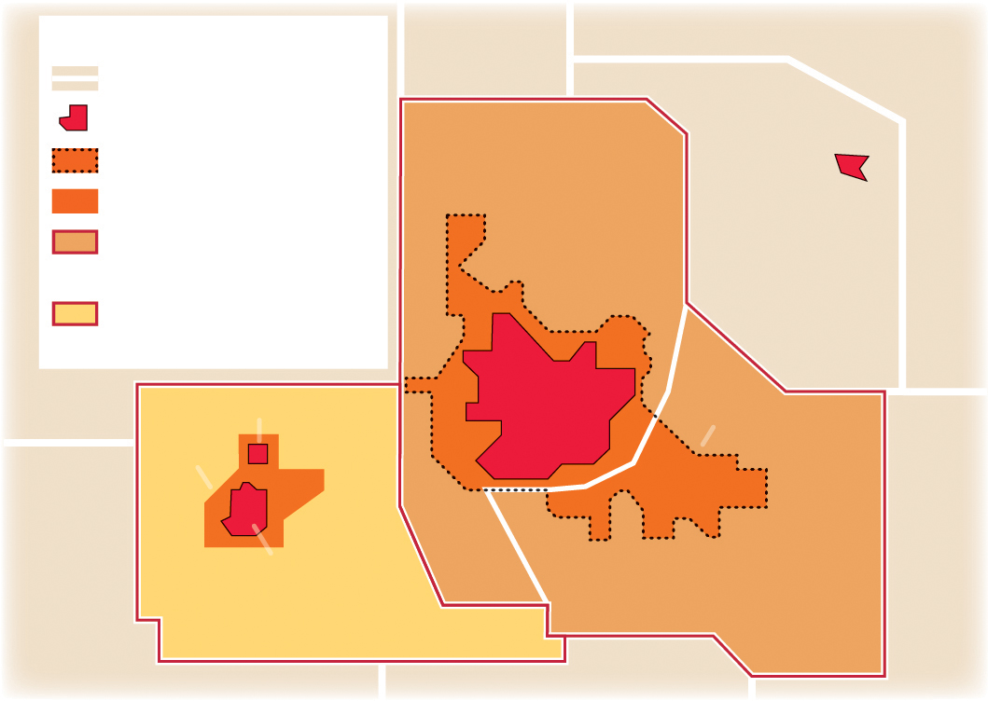
13.1.1 Cities and Geography (4 of 5)
Figure 13-1: The U.S. Census defines urban areas depending on the size and number of municipalities and their interaction.
Urban definitions
County
Municipality
Municipality D
Urbanized Area (UZA)
Urban Cluster
County C
Metropolitan Statistical
Area (MSA)
County B
Micropolitan Statistical
Area (µSA)
Municipality B
Municipality A
Urban
Cluster
Urbanized Area
County A
Municipality C
Metropolitan Statistical Area
County D
Micropolitan Statistical Area

Slide 8
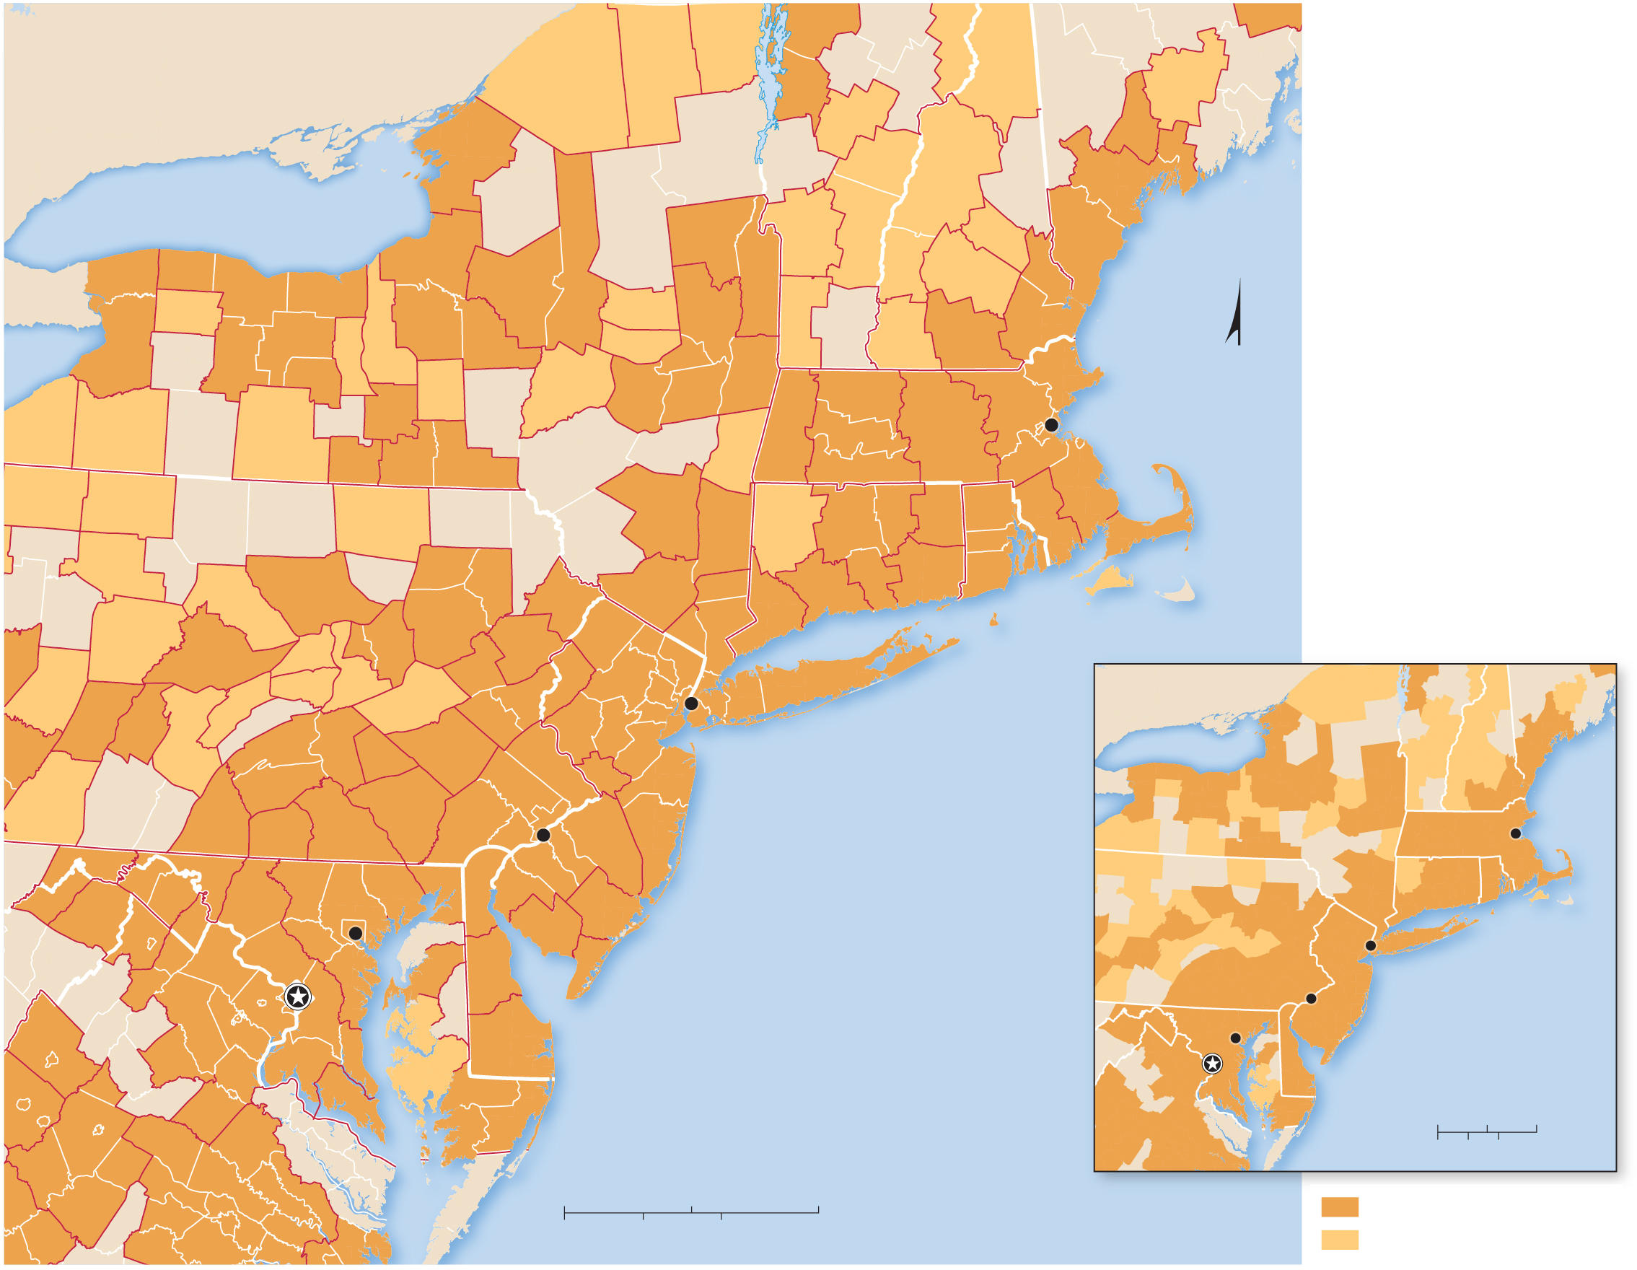
13.1.1 Cities and Geography (5 of 5)
Figure 13-2: A long stretch of contiguous urbanization stretches from Boston to Washington.
Malone
Plattsburgh
Burlington-
South
Burlington
Berlin
CANADA
Ogdensburg-
Massena
Barre
Augusta-
Waterville
Watertown-
Fort Drum
Lewiston-
Auburn
Lake Ontario
Rutland
Claremont-
Lebanon
Laconia
Portland-
South Portland-
Biddeford
Utica-
Rome
GlensFalls
Concord
Buffalo-
Niagara
Falls
Batavia
Rochester
Seneca
Falls
Syracuse
Gloversville
Bennington
Manchester-
Nashua
Auburn
Oneonta
Amsterdam
Albany-
Schenectady-
Troy
Keene
Boston-
Cambridge-
Quincy
N
Jamestown-
Dunkirk-
Fredonia
Olean
Ithaca
Cortland
Hudson
Springfield
Boston
Corning
Elmira
Binghamton
Pittsfield
Worcester
Warren
Bradford
Sayre
Kingston
Torrington
Hartford-
W. Hartford
E. Hartford
Providence-
New Bedford-
Fall River
St. Marys
Poughkeepsie-
Newburgh-
Middletown
New Haven-
Milford
Norwich-
New
London
Barnstable Town
Lock
Haven
Williamsport
Scranton-
Wilkes-Barre
Bridgeport-
Stamford-
Norwalk
Vineyard
Haven
DuBois
State
College
Lewisburg
Bloomsburg-
Berwick
East
Stroudsburg
Indiana
Johnstown
Lewistown
Selinsgrove
Sunbury
Allentown-
Bethlehem
Easton
New York
CANADA
ME
Altoona
Harrisburg-
Carlisle
Pottsville
Reading
New York-Northern New Jersey-
Long Island
Lake Ontario
VT
Huntingdon
Lebanon
Trenton-
Ewing
NY
NH
Somerset
Gettysburg
York-
Hanover
Lancaster
Philadelphia-
Camden-
Wilmington
Philadelphia
MA
Boston
Cumberland
Chambersburg
Hagerstown-
Martinsburg
Baltimore-
Towson
Atlantic City-
Hammonton
CT
RI
Winchester
Baltimore
Vineland-
Millville-
Bridgeton
Ocean
City
PA
NJ
New York
Washington-
Arlington-
Alexandria
Washington,
D.C.
Dover
Philadelphia
Harrisonburg
Easton
ATLANTIC
OCEAN
WV
Baltimore
MD
DE
ATLANTIC
OCEAN
Staunton-
Waynesboro
Lexington
Park
Cambridge
Salisbury
Washington,
D.C.
VA
0
50
100 Miles
Charlottesville
0
50
100 Kilometers
Richmond
0
50
100 Miles
Metropolitan statistical area
Lynchburg
Virginia Beach-
Norfolk-Newport News
0
50
100 Kilometers
Micropolitan statistical area

Slide 9
13.1.2 The Central Business District (1 of 3)
C B D, or central business district, is the most central place in a city, with a high concentration of public services, business services, and consumer services
Department stores with high threshold and range used to locate in the C B D but have relocated to suburban locations
Specialty stores with high ranges prefer to locate in the C B D
Retail-serving C B D workers are also found in the C B D

Slide 10
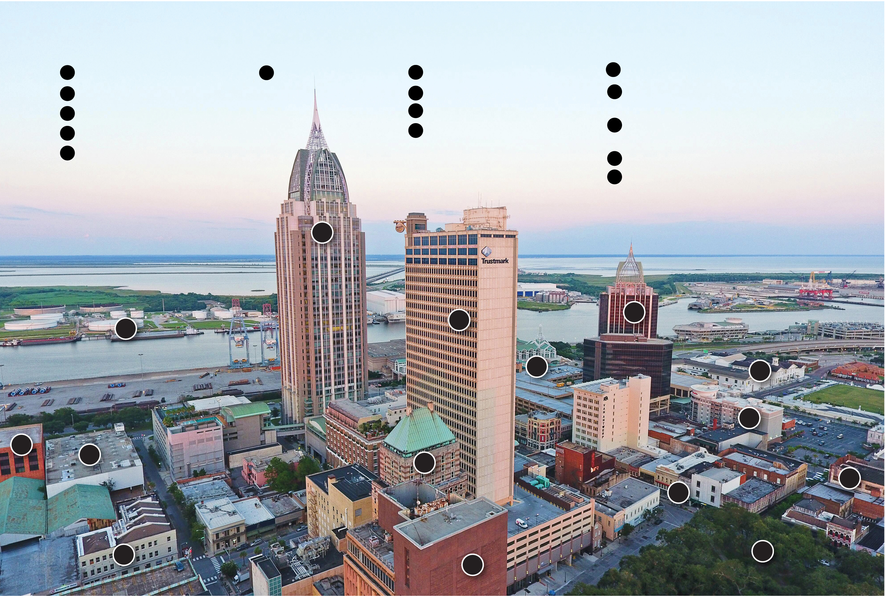
13.1.2 The Central Business District (2 of 3)
Figure 13-3: The Mobile, Alabama C B D contains a high concentration of public, business, and consumer services. Tall buildings demonstrate the value of locating near the center.
BUSINESS SERVICES
RESIDENTIAL
PUBLIC SERVICES
CONSUMER SERVICES
1
Norton Lilly International
3
Staples-Pake
4
Port of Mobile
2
YMCA
5
RSA Battle House Tower
9
Mobile Convention Center
10
Renaissance Mobile Riverview
Plaza
6
Regions Bank Building
12
History Museum of Mobile
11
Dauphin Street Bars &
Restaurants
7
Trustmark
14
Bienville Square
8
Wells Fargo Bank
13
Hampton Inn
15
Former Gayfers Department Store
5
4
7
10
9
12
13
1
2
6
11
15
3
8
14

Slide 11
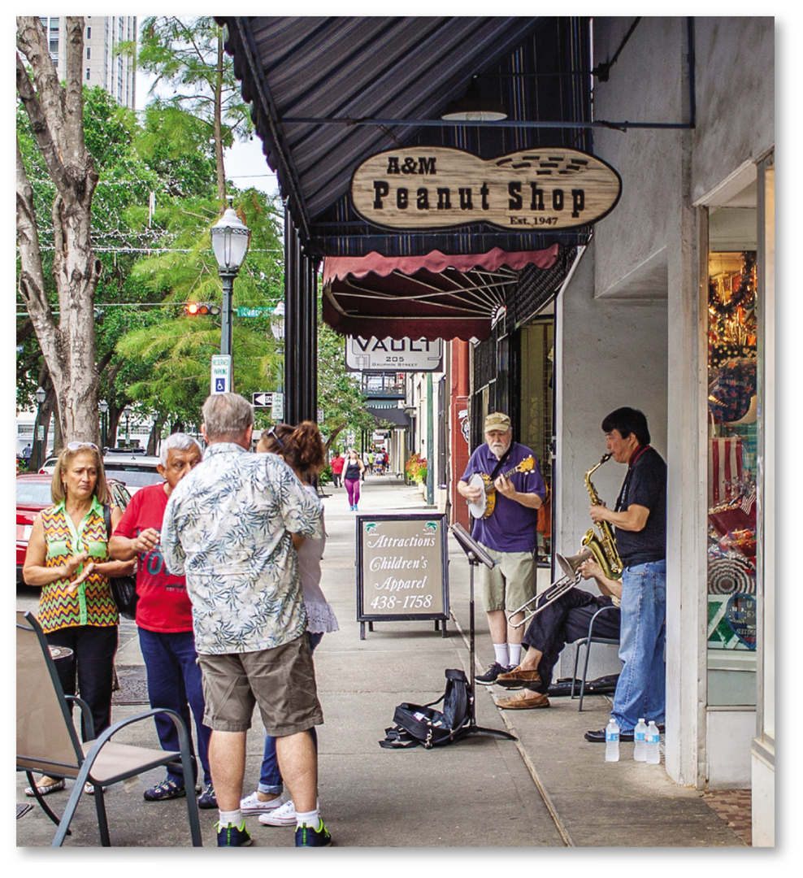
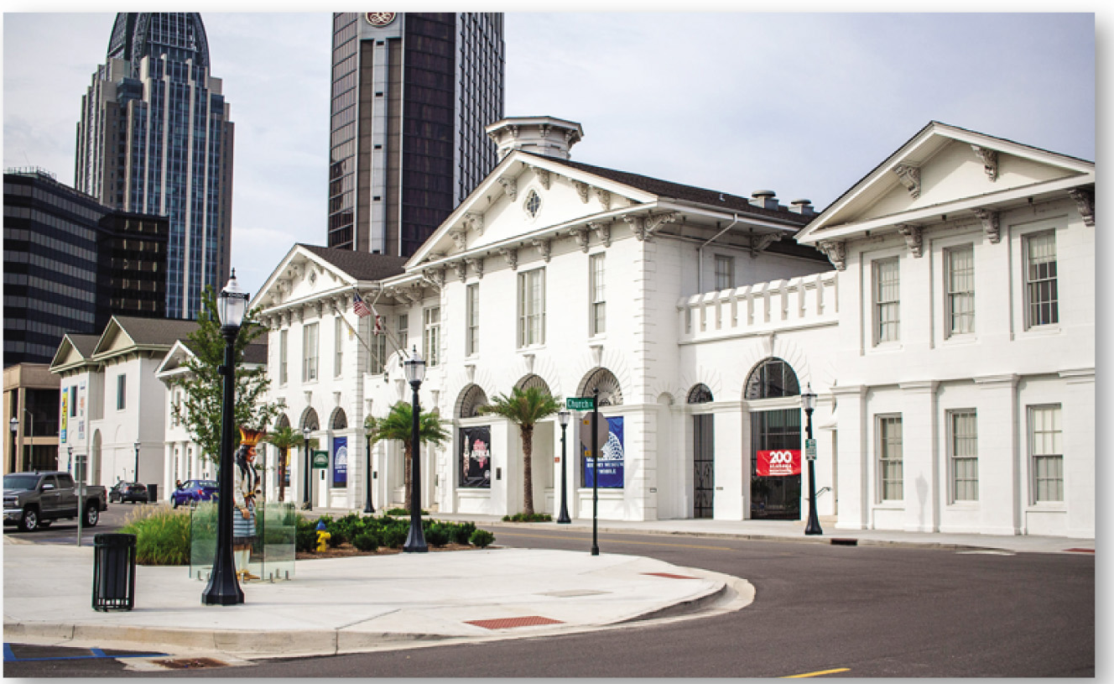
13.1.2 The Central Business District (3 of 3)
Figures 13-4 and 13-5: The C B D features office buildings for public services (left) as well as consumer retail (right) with high thresholds and ranges.

Slide 12
13.1.3 Competing for Space in C B Ds (1 of 4)
A C B D’s accessibility produces extreme competition for the limited available land. As a result, land values are very high in the C B D
Vertical development maximizes space through the construction of underground spaces and skyscrapers
Manufacturing is excluded from the C B D
Loft-style apartments for young people and childless couples are common for workers in the C B D

Slide 13
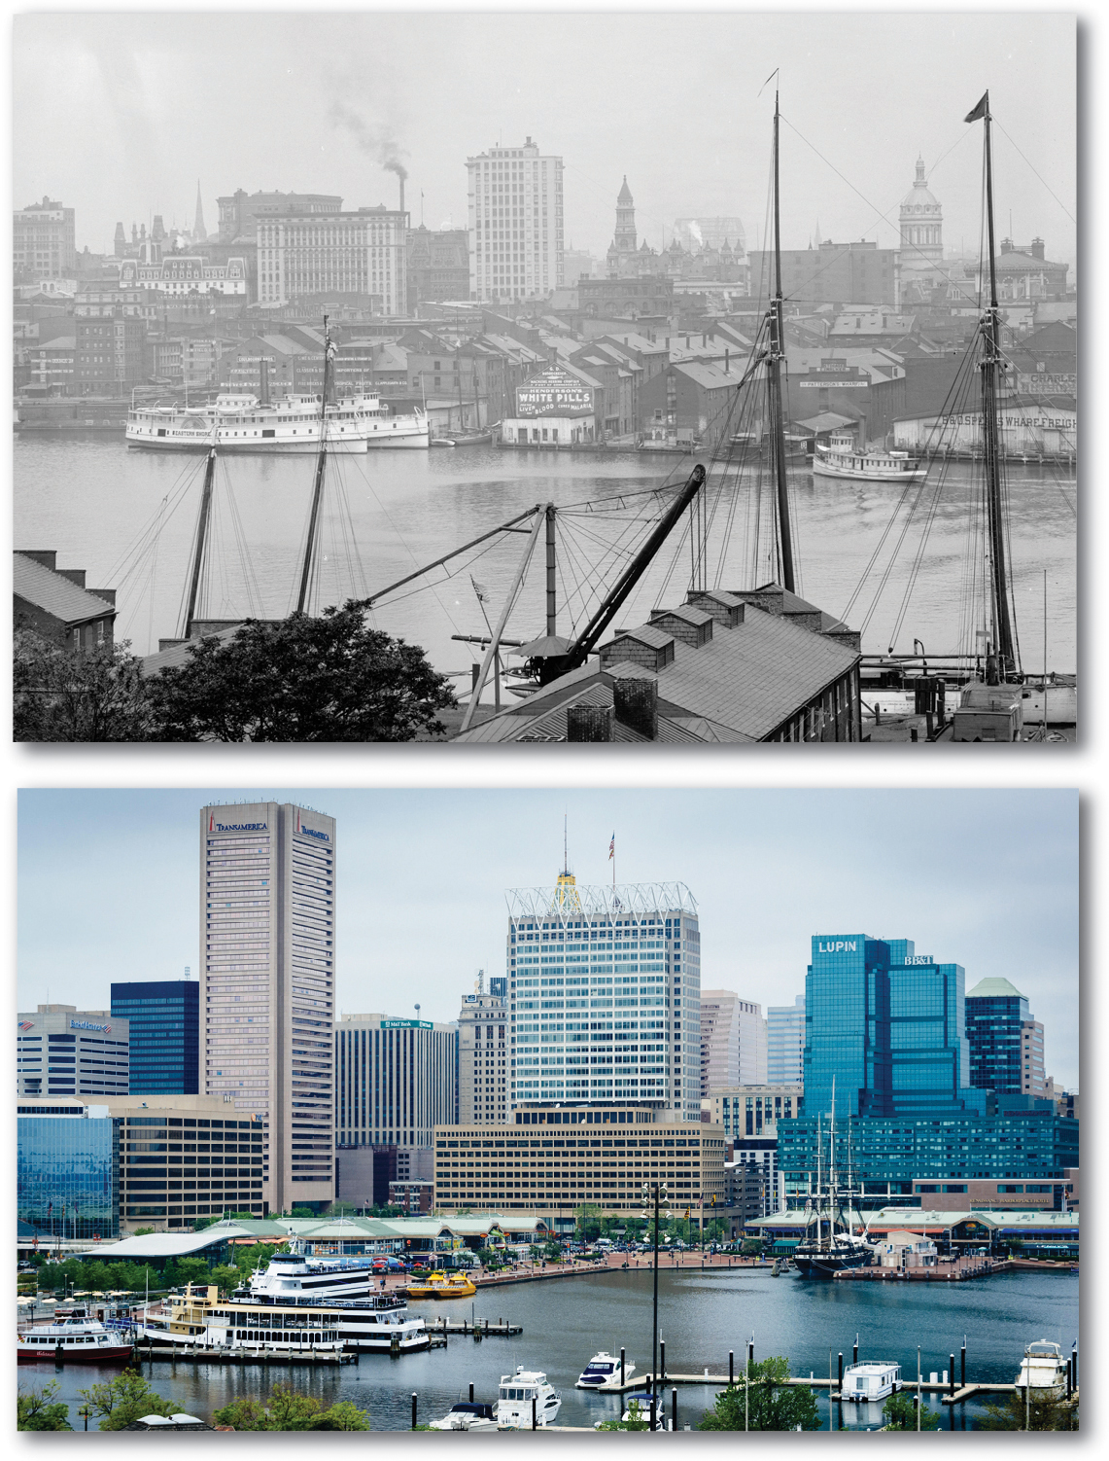
13.1.3 Competing for Space in C B Ds (2 of 4)
Figure 13-6: The Inner Harbor of Baltimore has changed from1903, when industry was the principal land use (a) to recent years (b) where shops, restaurants, marinas, the National Aquarium, and other consumer services have replaced industry.
(a)
(b)

Slide 14
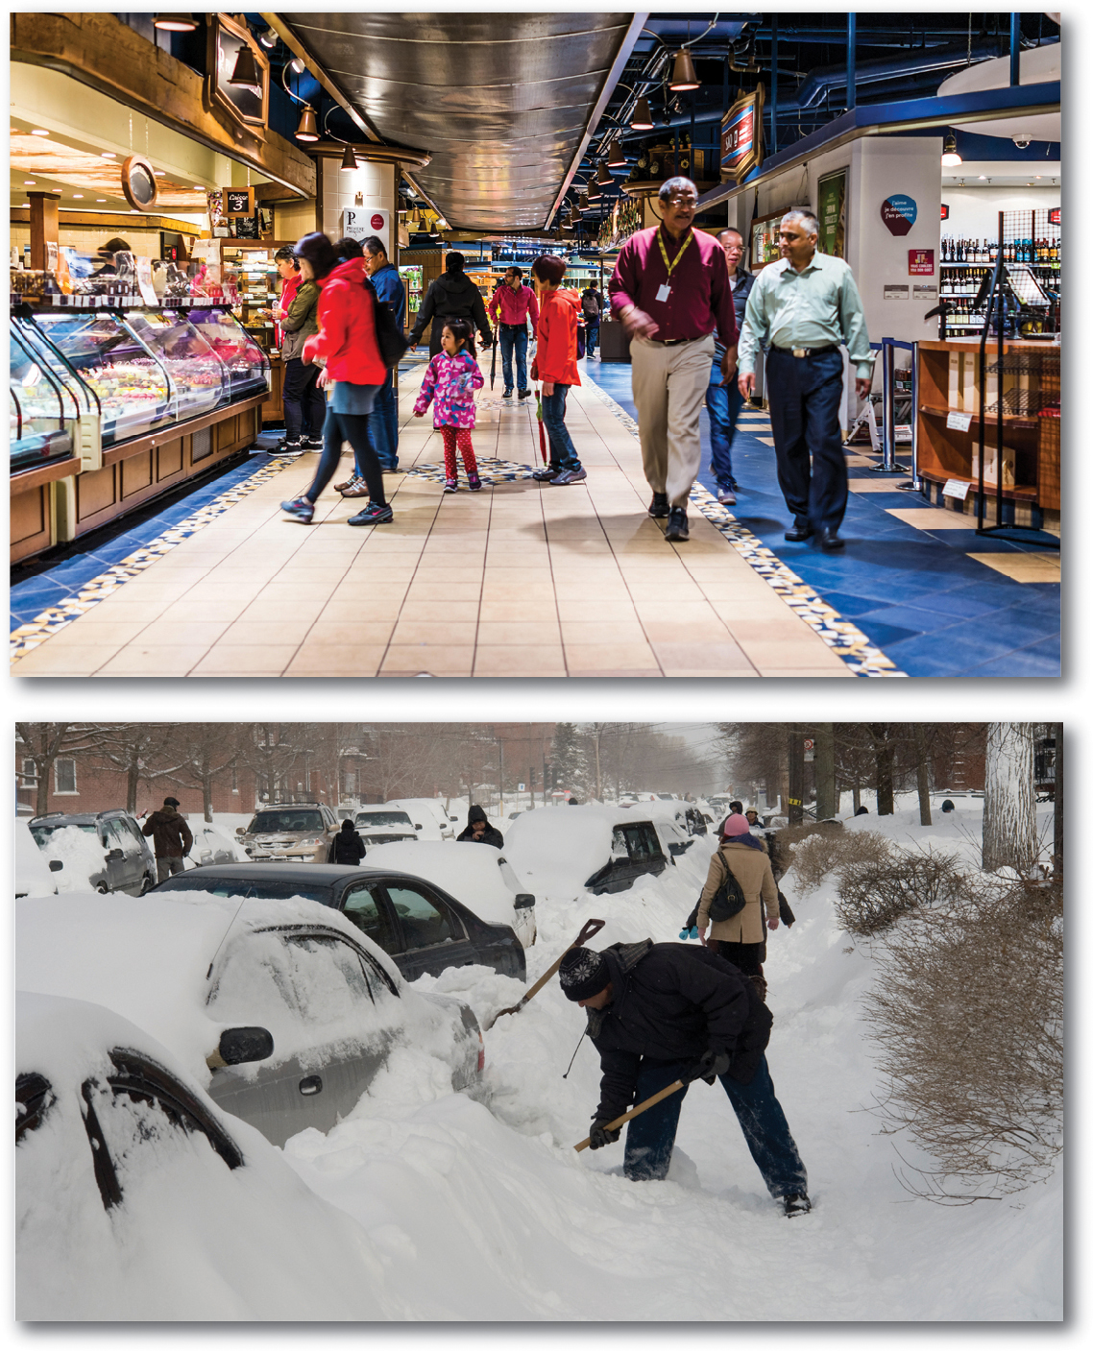
13.1.3 Competing for Space in C B Ds (3 of 4)
Figure 13-7: Montréal, Canada’s Underground City (a) maximizes the use of land in the city center and allows shoppers to avoid winter weather (b).
(a)
(b)

Slide 15
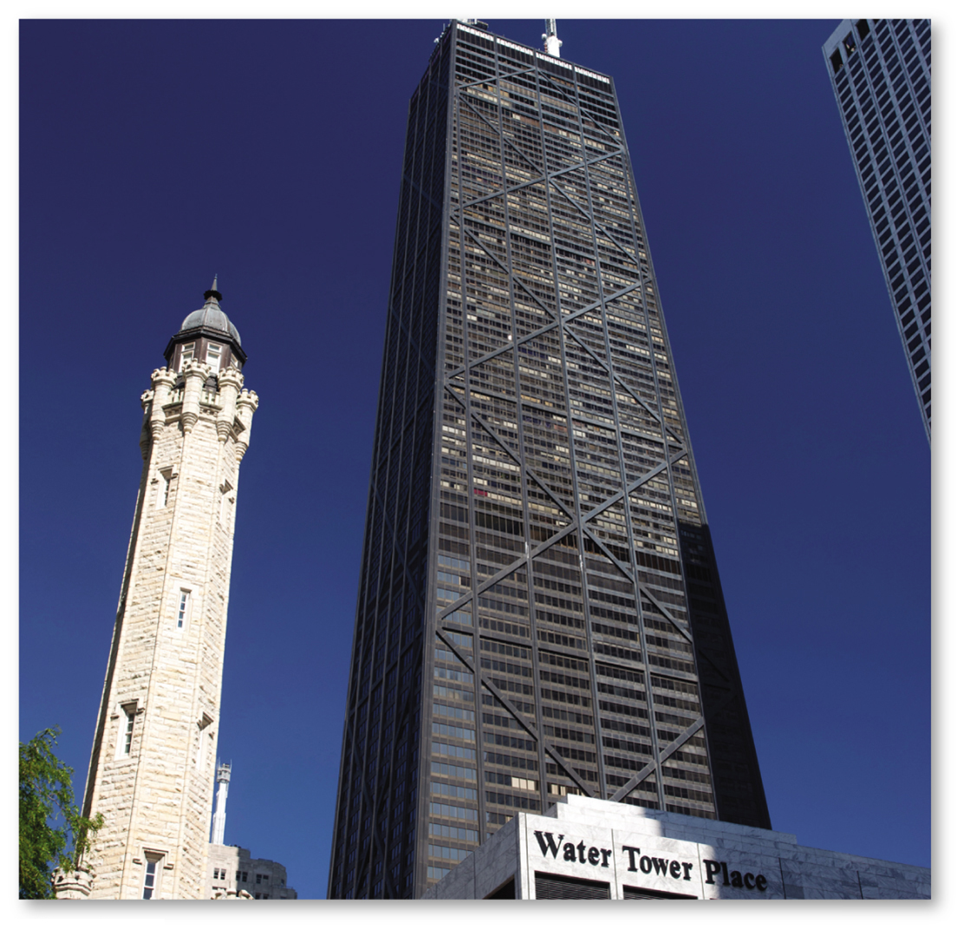
13.1.3 Competing for Space in C B Ds (4 of 4)
Figure 13-8: The John Hancock Center and neighboring buildings have commercial services on the lowest floors, offices on middle floors, and apartments and commercial activities again on the topmost floors.

Slide 16
Key Issue 2: Where Are People Distributed in Urban Areas?
13.2.1 Models of Urban Structure
13.2.2 Applying the Models in North America
13.2.3 Structure of European Cities
13.2.4 Premodern Cities in Developing Countries
13.2.5 Applying the Models in Developing Countries
13.2.6 Changing Urban Structure of Mexico City

Slide 17
13.2.1 Models of Urban Structure (1 of 6)
Three models help explain where different types of people tend to live in an urban area:
Concentric zone model—a city grows outward from a central area in a series of concentric rings
Sector model—a city develops in a series of sectors where certain areas are better for various activities
Multiple nuclei model—a city includes a C B D as well as other nodes around which activities occur

Slide 18
13.2.1 Models of Urban Structure (2 of 6)
A fourth model is the galactic (peripheral) model where an urban area consists of an inner city surrounded by large suburban residential and service nodes or nuclei tied together by a beltway or ring road. The galactic model is a variation of the multinuclei model

Slide 19
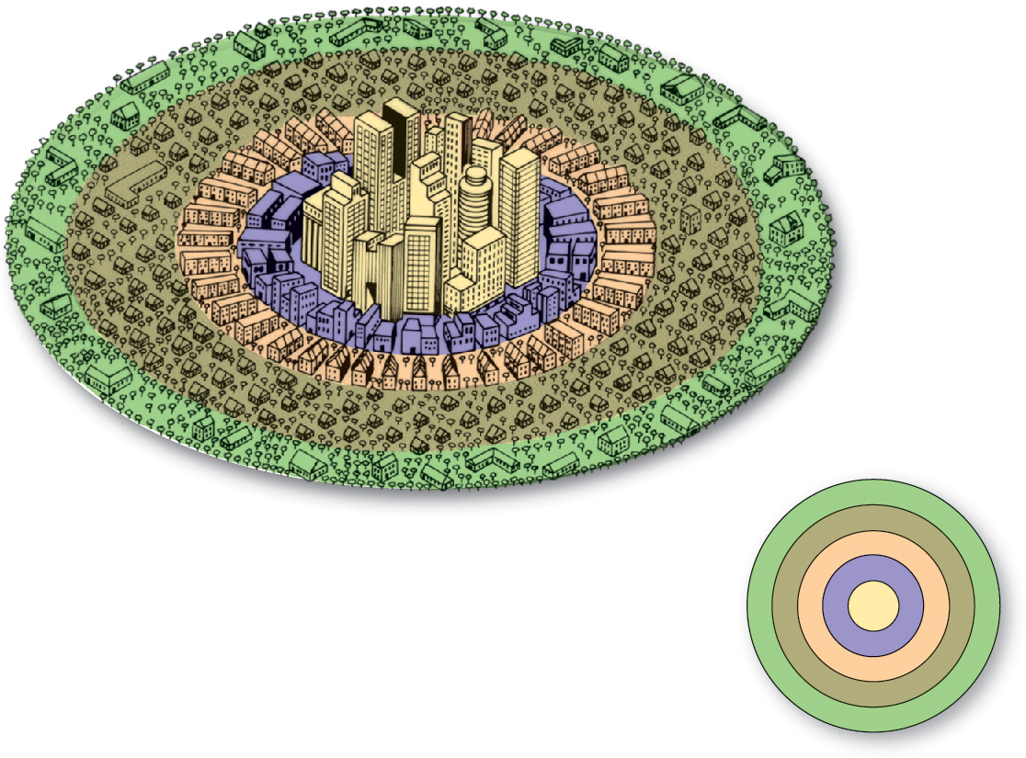
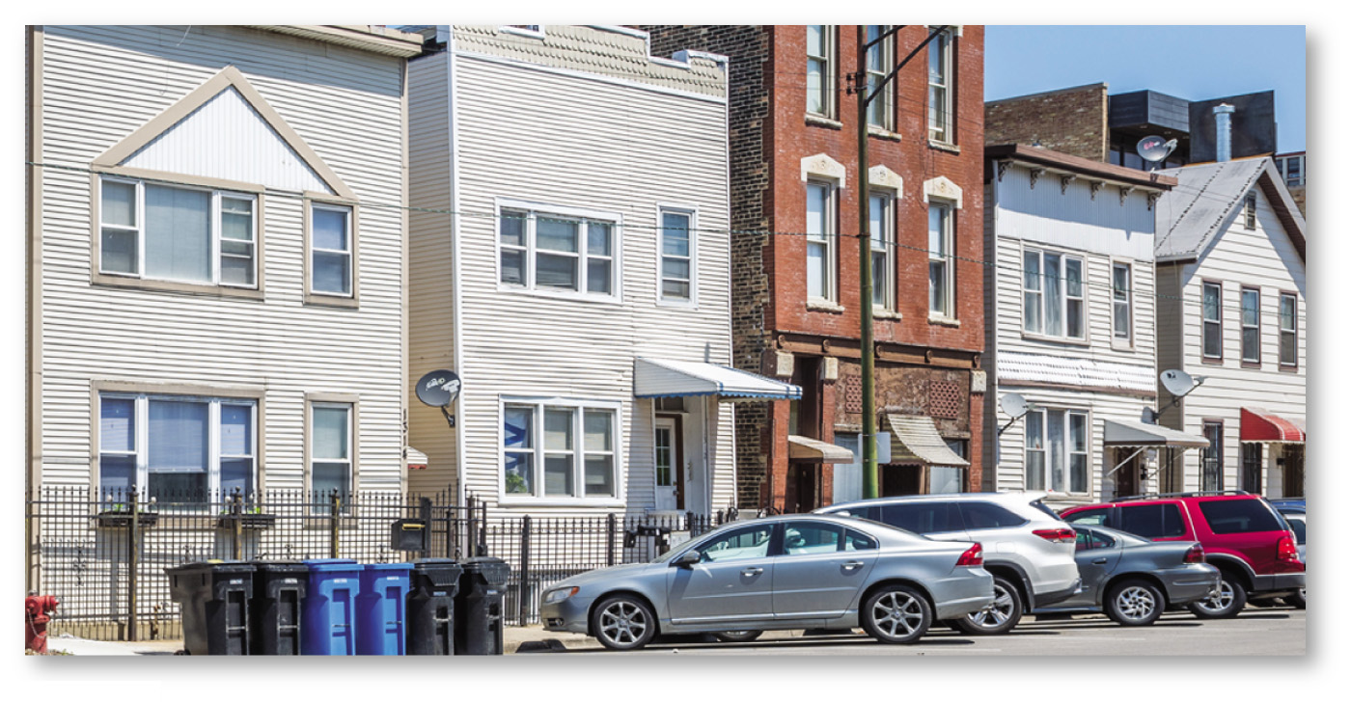
13.2.1 Models of Urban Structure (3 of 6)
Figures 13-9 and 13-10: The concentric zone model (left) shows the city as a series of concentric rings of different activities like working-class homes in Chicago (right).
1
Central business district
1
2
3
4
5
2
Zone of transition
3
Zone of independent workers' homes
4
Zone of better residences
5
Commuter's zone

Slide 20
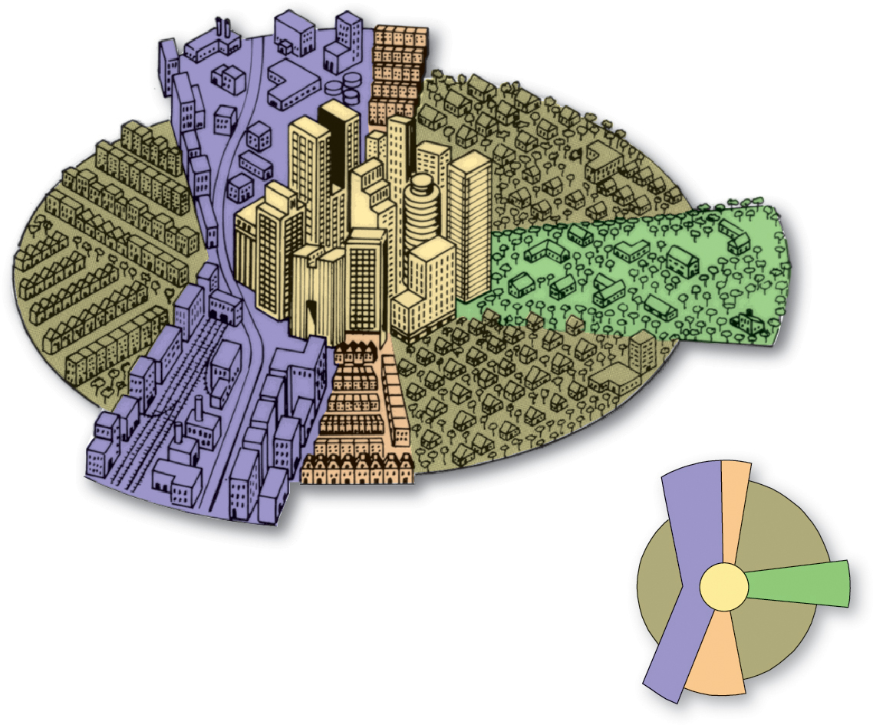
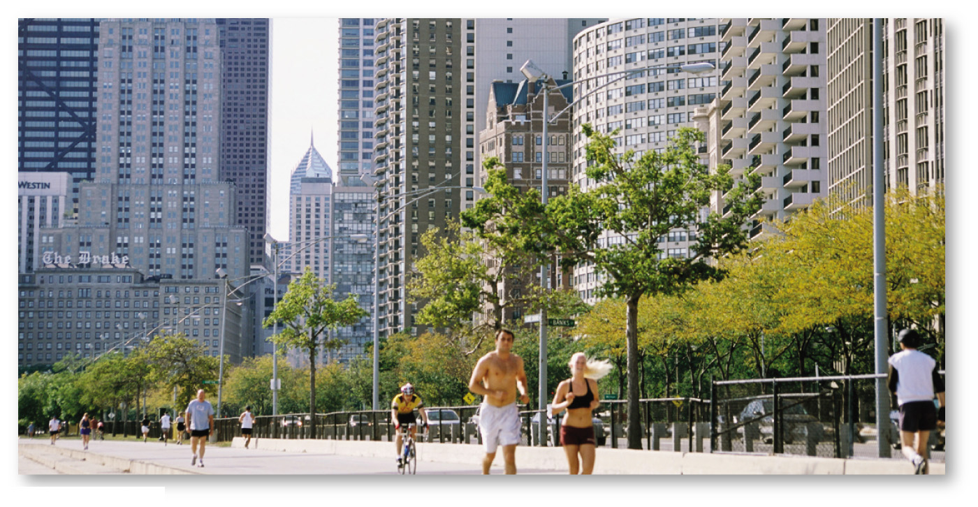
13.2.1 Models of Urban Structure (4 of 6)
Figures 13-11 and 13-12: The sector model (left) shows the city developing with wedges or corridors radiating from the C B D, as seen in Chicago’s strip of high-class residential housing (right).
2
3
4
1
Central business district
4
1
5
2
Transportation and industry
2
4
3
Low-class residential
3
4
Middle-class residential
5
High-class residential

Slide 21
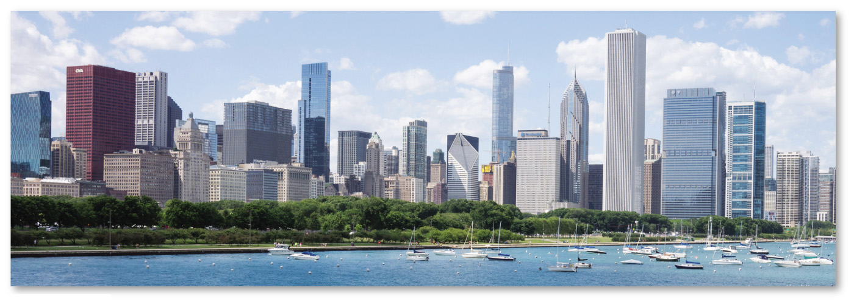
13.2.1 Models of Urban Structure (5 of 6)
Figure 13-13: A major city like Chicago will have a well-defined C B D.

Slide 22
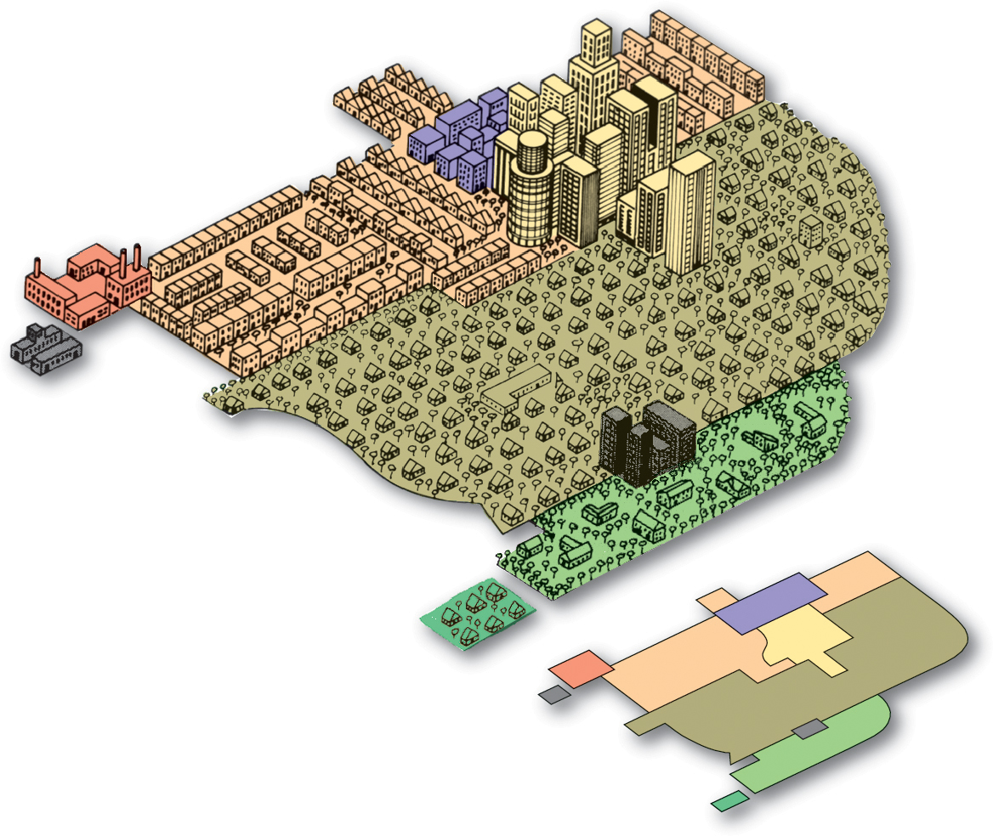
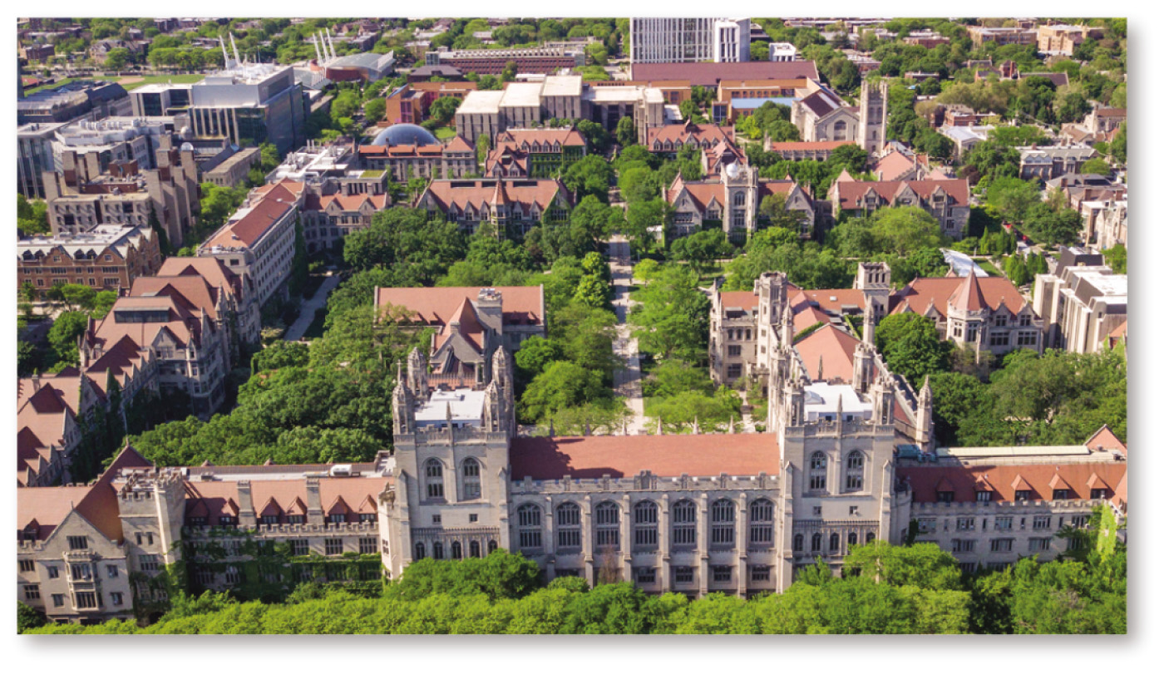
13.2.1 Models of Urban Structure (6 of 6)
Figures 13-14 and 13-15: The multiple nuclei model (left) displays different activities in different nodes, like the University of Chicago (right) serving as a center of services for students.
2
3
6
3
1
1
Central business district
9
4
7
2
Wholesale, light manufacturing
5
3
Low-class residential
8
4
Medium-class residential
5
High-class residential
6
Heavy manufacturing
7
Outlying business district
8
Residential suburb
9
Industrial suburb

Slide 23
13.2.2 Applying the Models in North America (1 of 6)
The study of where people of varying living standards, ethnic background, and lifestyle live within an urban area is social area analysis
Urban areas in the United States are divided into census tracts that each contain approximately 5,000 residents and correspond, where possible, to neighborhood boundaries

Slide 24
13.2.2 Applying the Models in North America (2 of 6)
The concentric zone model suggests that households in older homes are much more likely to live in an inner ring and the household in a newer house in an outer ring
The sector model suggests that the household with a more modest income is unlikely to live in the same sector of the city as the household with the higher income
The nuclei model suggests people with the same ethnic or racial background are likely to live near each other

Slide 25
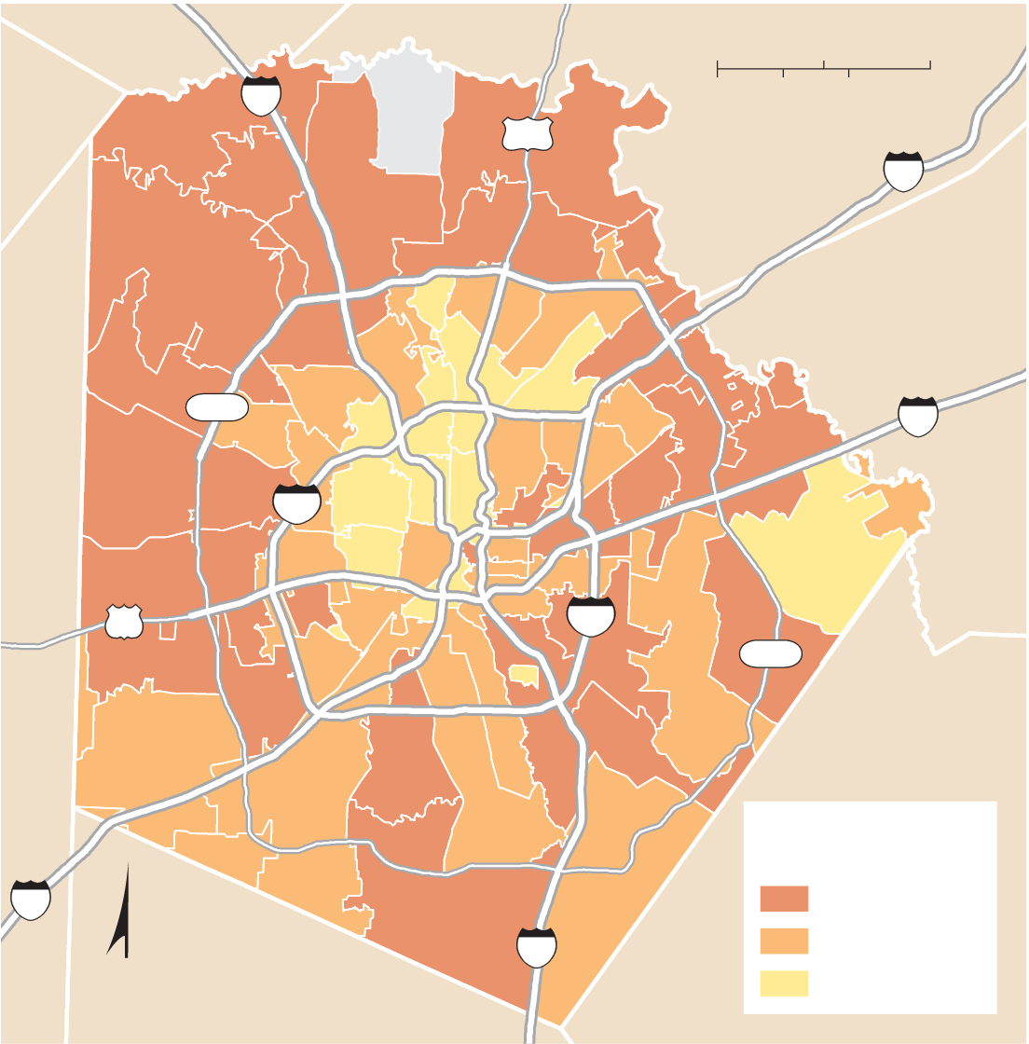
13.2.2 Applying the Models in North America (3 of 6)
Figure 13-18: Examining the age of housing in San Antonio reveals a concentric pattern.
0
5
10 Miles
10
0
5
10 Kilometers
281
35
Helotes
Universal
City
1604
Live Oak
10
Leon
Valley
Alamo Hgts.
Windcrest
Converse
Terrell
Hills
Schertz
410
Kirby
90
San Antonio
410
1604
Percent housing
built 2005 or later
35
10 and above
N
37
4–10
below 4

Slide 26
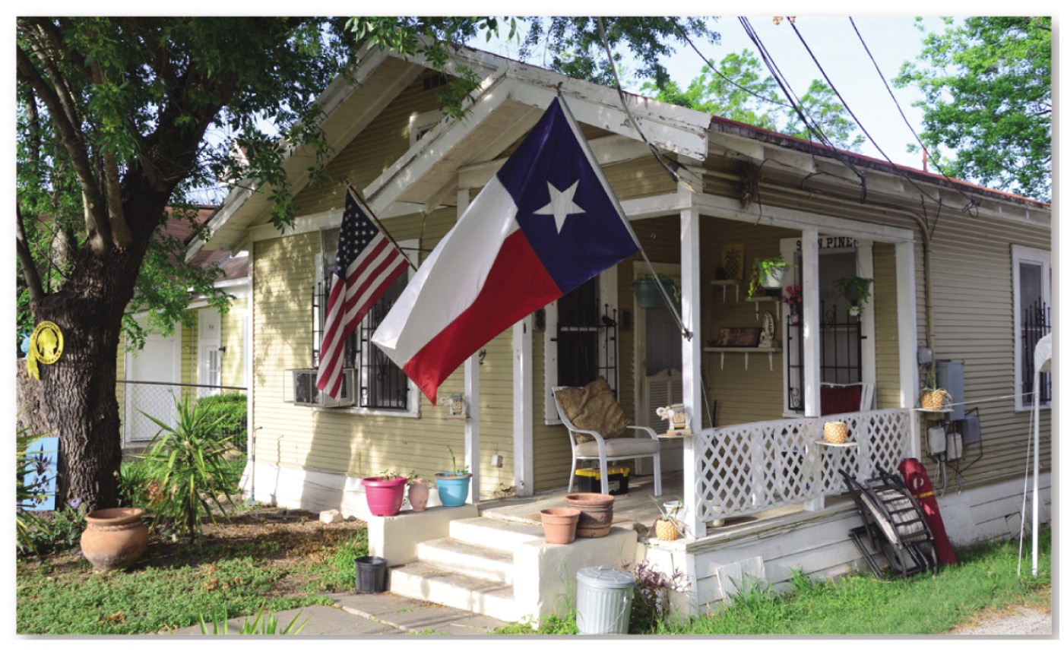
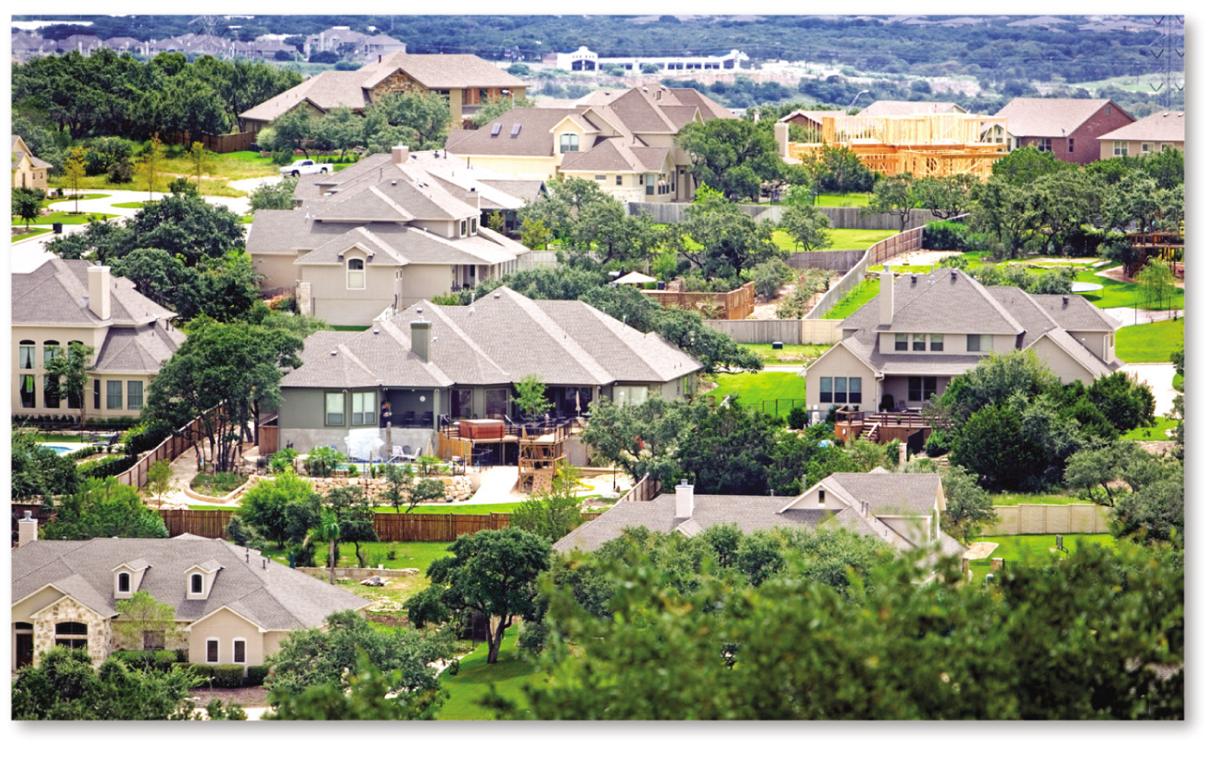
13.2.2 Applying the Models in North America (4 of 6)
Figures 13-19 and 13.20: Older housing is found in an inner ring (left), while newer housing is found in an outer ring.

Slide 27
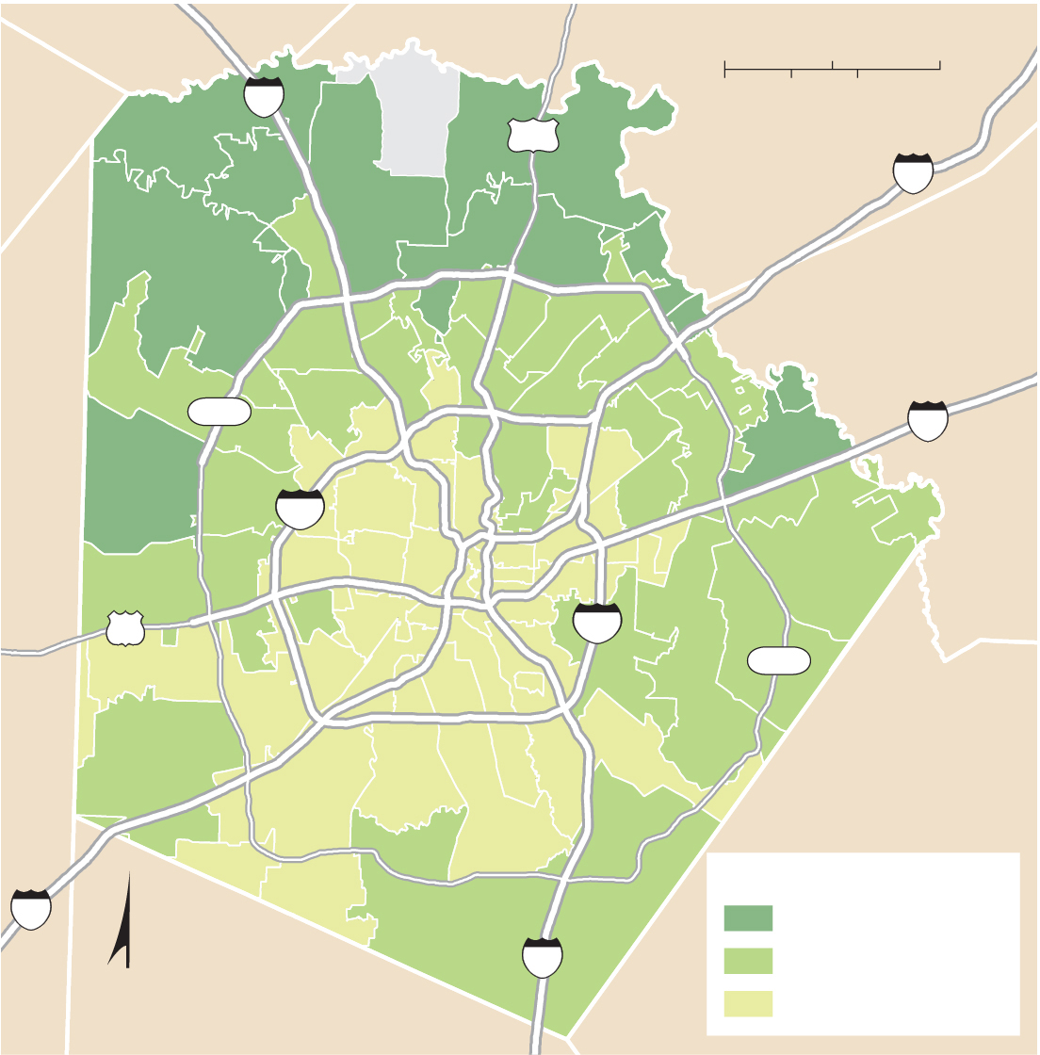
13.2.2 Applying the Models in North America (5 of 6)
Figure 13-21: Examining the median income in San Antonio reveals a sector pattern.
0
5
10 Miles
10
0
5
10 Kilometers
281
35
Helotes
Universal
City
1604
Live Oak
10
Leon
Valley
Alamo Hgts.
Windcrest
Converse
Terrell
Hills
Schertz
410
Kirby
90
San Antonio
410
1604
35
Household income
$90,000 and above
N
37
$50,000–$90,000
below $50,000

Slide 28
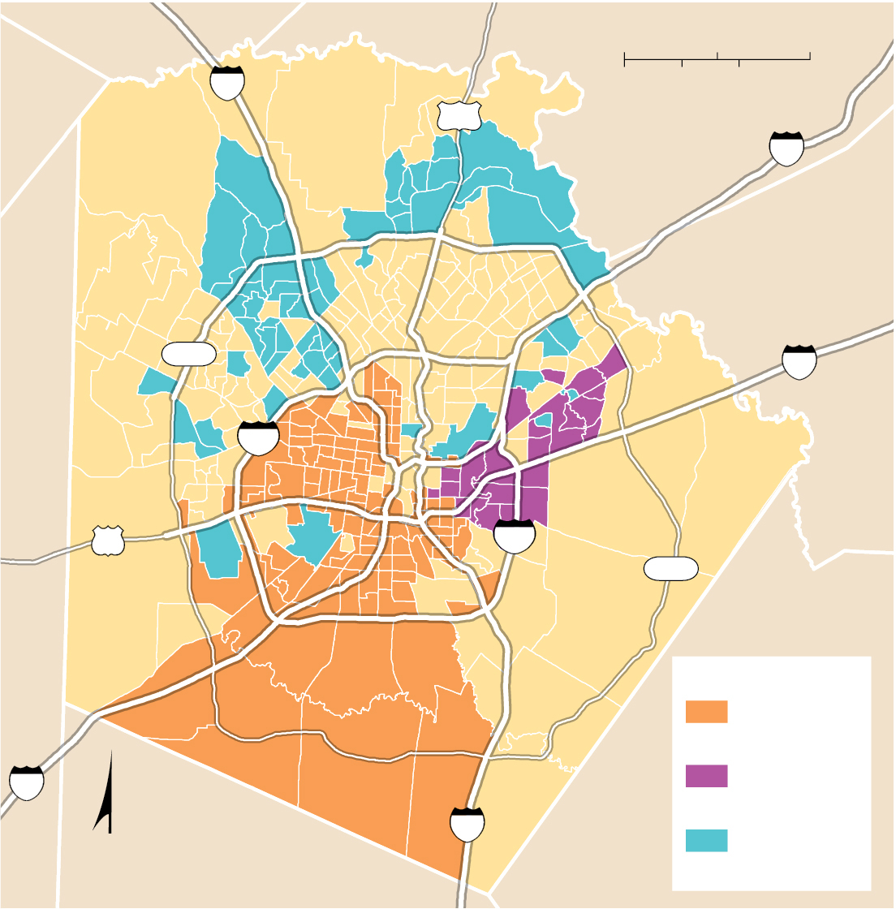
13.2.2 Applying the Models in North America (6 of 6)
Figure 13-23: Examining the distribution of ethnicities in San Antonio reveals multiple nuclei.
0
5
10 Miles
10
0
5
10 Kilometers
281
35
Helotes
Universal
City
1604
Live Oak
10
Leon
Valley
Alamo Hgts.
Windcrest
Converse
Terrell
Hills
Schertz
410
Kirby
90
San Antonio
410
1604
Ethnic clusters
Hispanic
(75% or more)
35
Black
(25% or more)
N
37
Asian
(5% or more)

Slide 29
13.2.3 Structure of European Cities (1 of 6)
European urban patterns differ from the United States
The C B D will have high-density residential areas. It will also feature consumer services directed to a residential population
Public services will be found within the C B D, often parks laid out centuries ago
The historic core will be preserved and skyscrapers will be absent
Higher income residencies will be in the center, lower incomes on the periphery

Slide 30
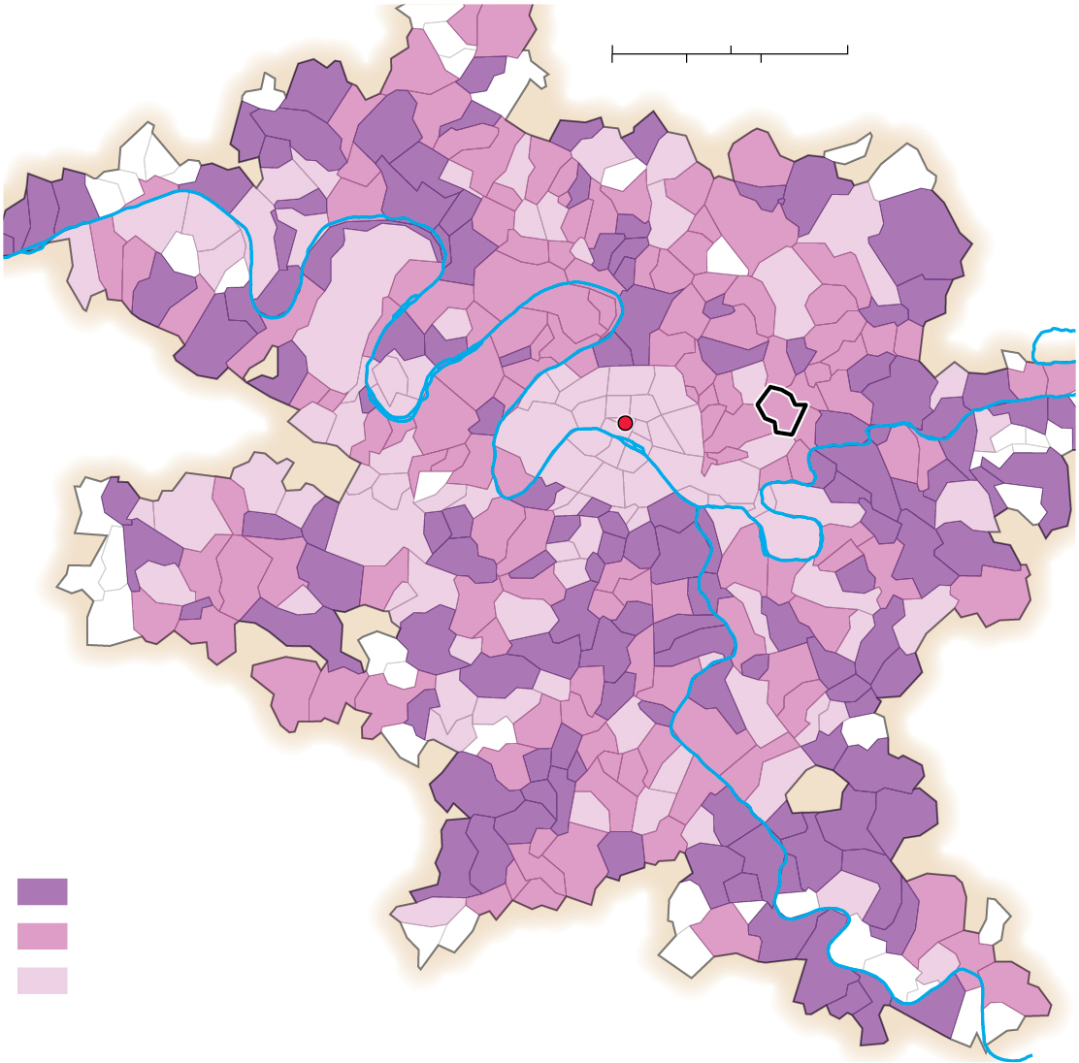
13.2.3 Structure of European Cities (2 of 6)
Figure 13-24: The oldest housing is in the inner ring, in the area around the Louvre Museum, the former royal palace near the historic center of Paris.
0
5
10 Miles
0
5
10 Kilometers
Seine
Louvre
Rosny-sous-Bois
Marne
Paris
Seine
Percent of housing
built 2001–2010
10 and above
5–9
below 5

Slide 31
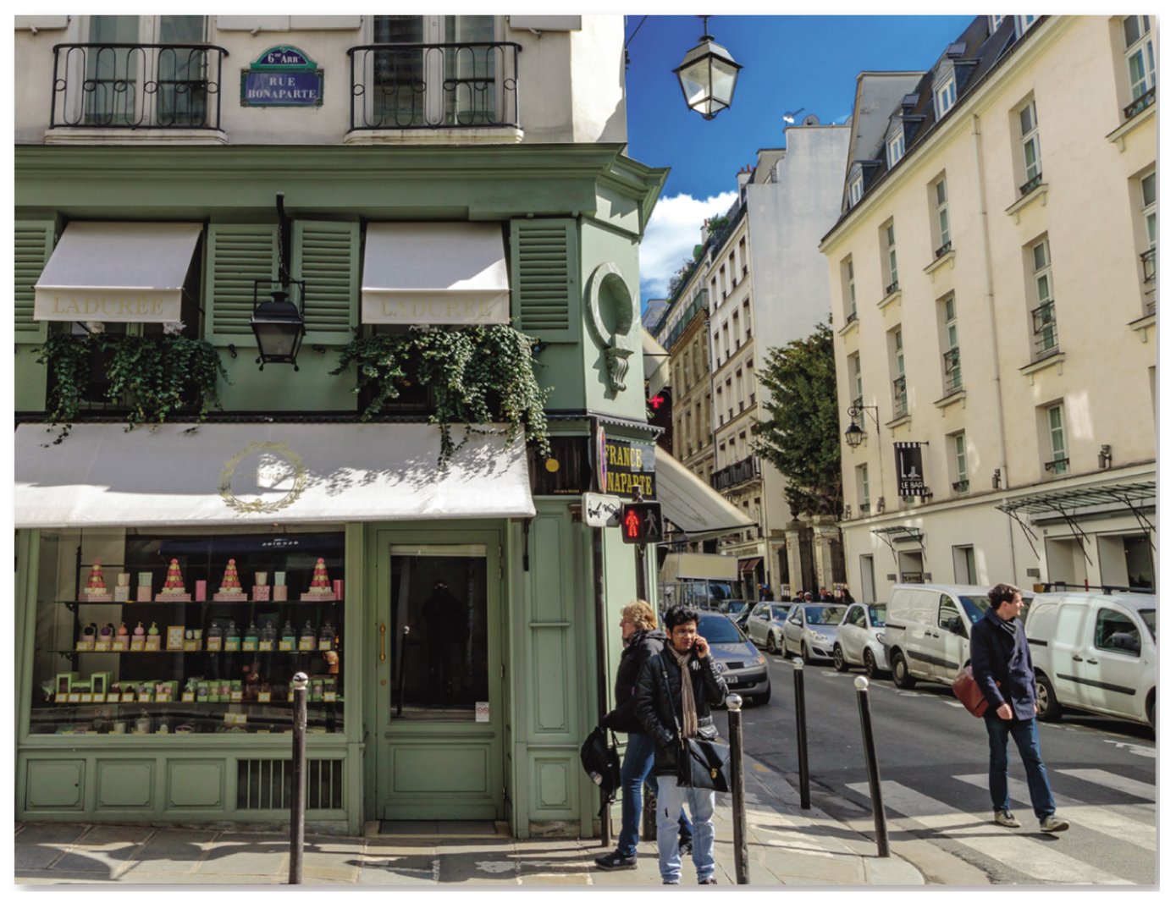
13.2.3 Structure of European Cities (3 of 6)
Figure 13-25: Older housing situated above shops in an inner-city Paris neighborhood immediately across the River Seine from the Louvre.

Slide 32
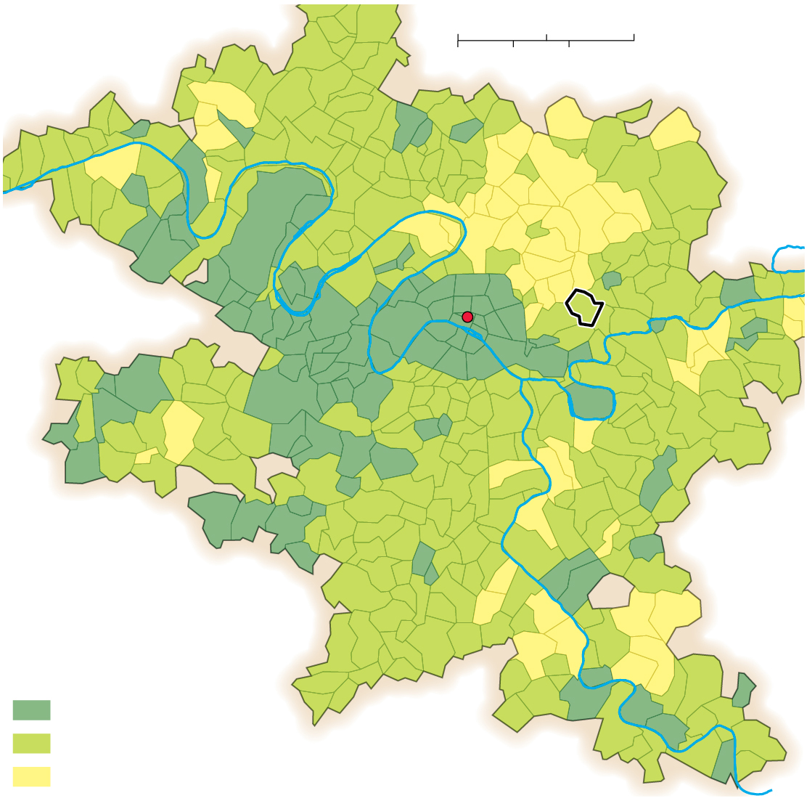
13.2.3 Structure of European Cities (4 of 6)
Figure 13-26: Household income in Paris follows a sector model. The southwest is the highest-income sector, and the northeast is the lowest-income sector.
0
5
10 Miles
0
5
10 Kilometers
Seine
Louvre
Rosny-sous-Bois
Marne
Paris
Seine
Monthly household
income (Euros)
1,800 and above
1,000– 1,799
below 10

Slide 33
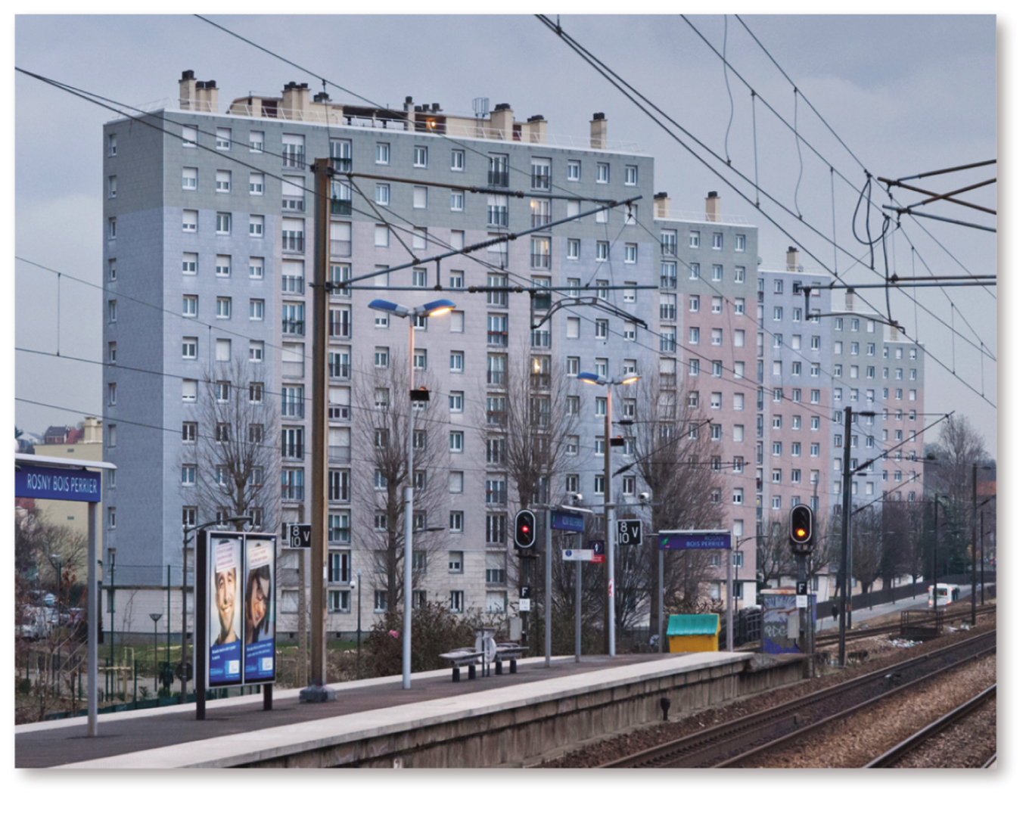
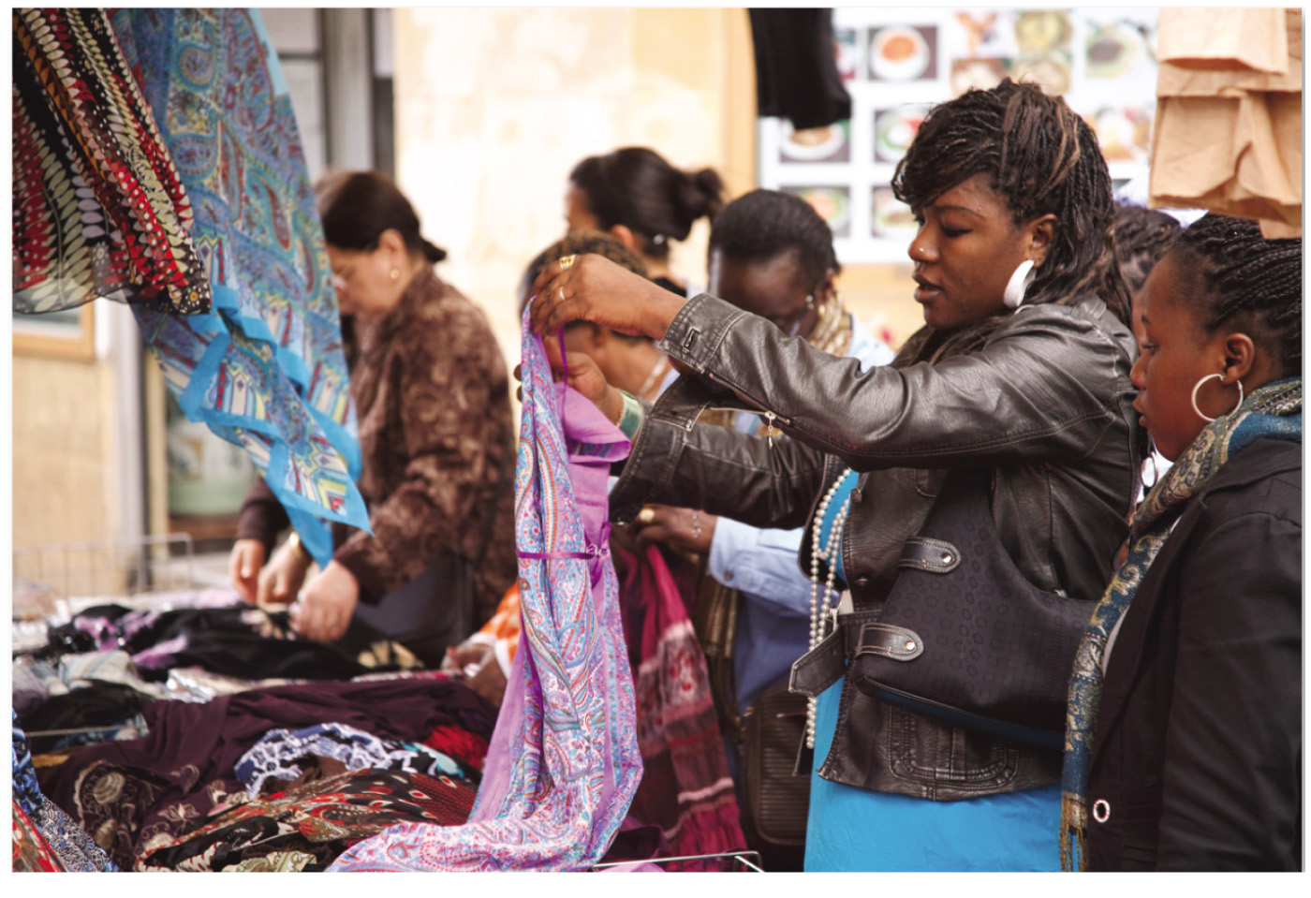
13.2.3 Structure of European Cities (5 of 6)
Figures 13-27 and 13-29: Rosny-sous-Bois is a suburb located in the northeastern low-income sector (left) with high-rise apartment blocks. Many immigrants to the Paris area from Africa live in suburbs to the northeast and southeast (right).

Slide 34
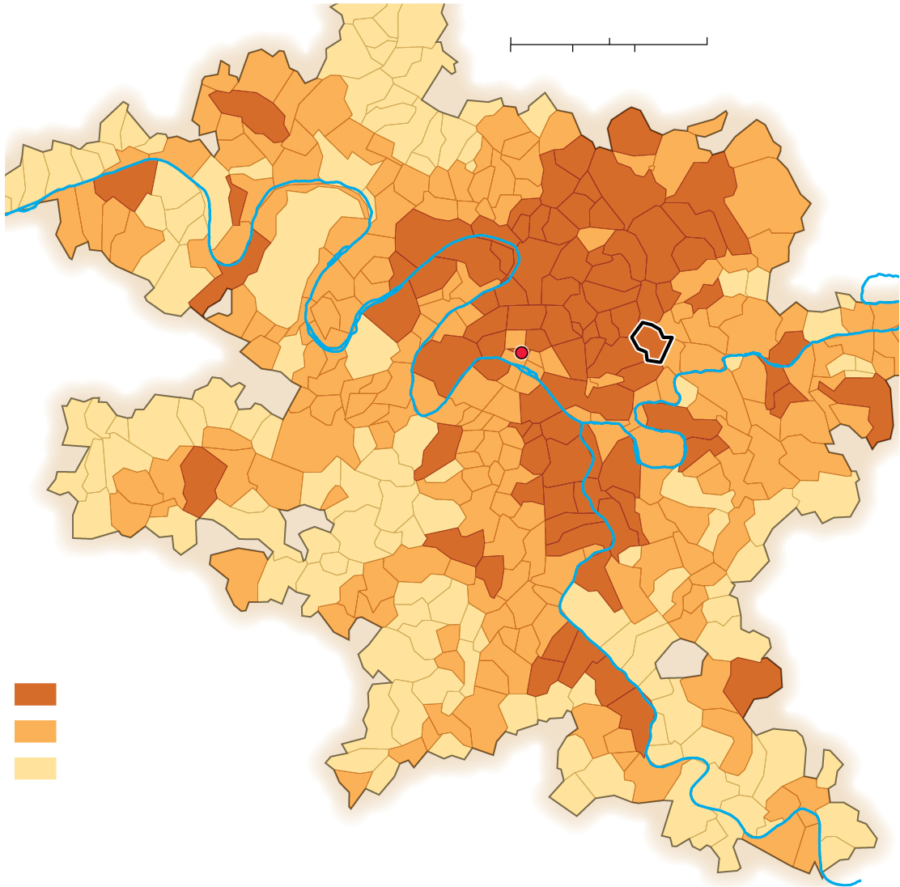
13.2.3 Structure of European Cities (6 of 6)
Figure 13-28: Immigrant neighborhoods in Paris follow a multiple nuclei model.
0
5
10 Miles
0
5
10 Kilometers
Seine
Louvre
Rosny-sous-Bois
Marne
Paris
Percent immigrants,
2017
Seine
20 and above
10–19
below 10

Slide 35
13.2.4 Premodern Cities in Developing Countries (1 of 5)
The ancient and medieval structure of cities in the developing world was influenced by the cultural values of the peoples living there
European colonialization resulted in the imposition of standardized plans for cities, often by building a new city next to the existing one. In other cases, the Europeans demolished the precolonial city and built atop its ruins

Slide 36
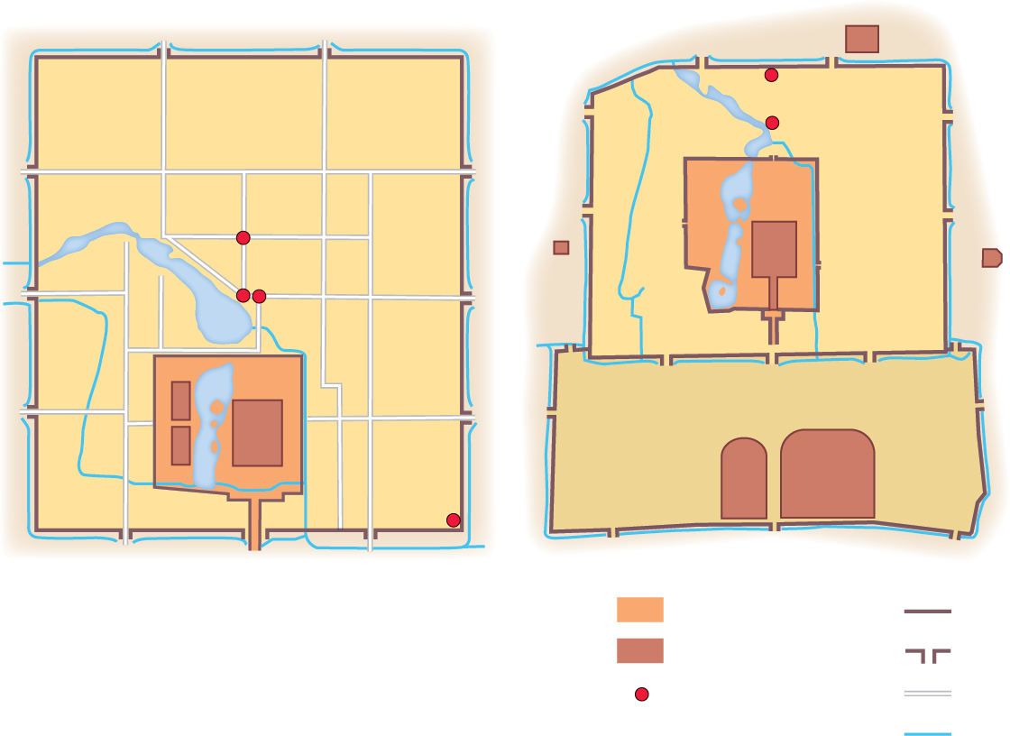
13.2.4 Premodern Cities in Developing Countries (2 of 5)
Figure 13-30: Dadu during the Yuan Dynasty (left) and Beijing during the Ming Dynasty (right).
(a)
(b)
Temple
of Earth
Bell Tower
Drum Tower
INNER
CITY
Bell Tower
Forbidden
City
Drum
Tower
Temple
of Moon
Temple
of Sun
Central Tower
Xingsheng
Palace
Palace
OUTER CITY
Longfu
Palace
Temple of
Agriculture
Temple of
Heaven
Observatory
Imperial City
Wall
Important building
Gate
Place of interest
Street
Canal

Slide 37
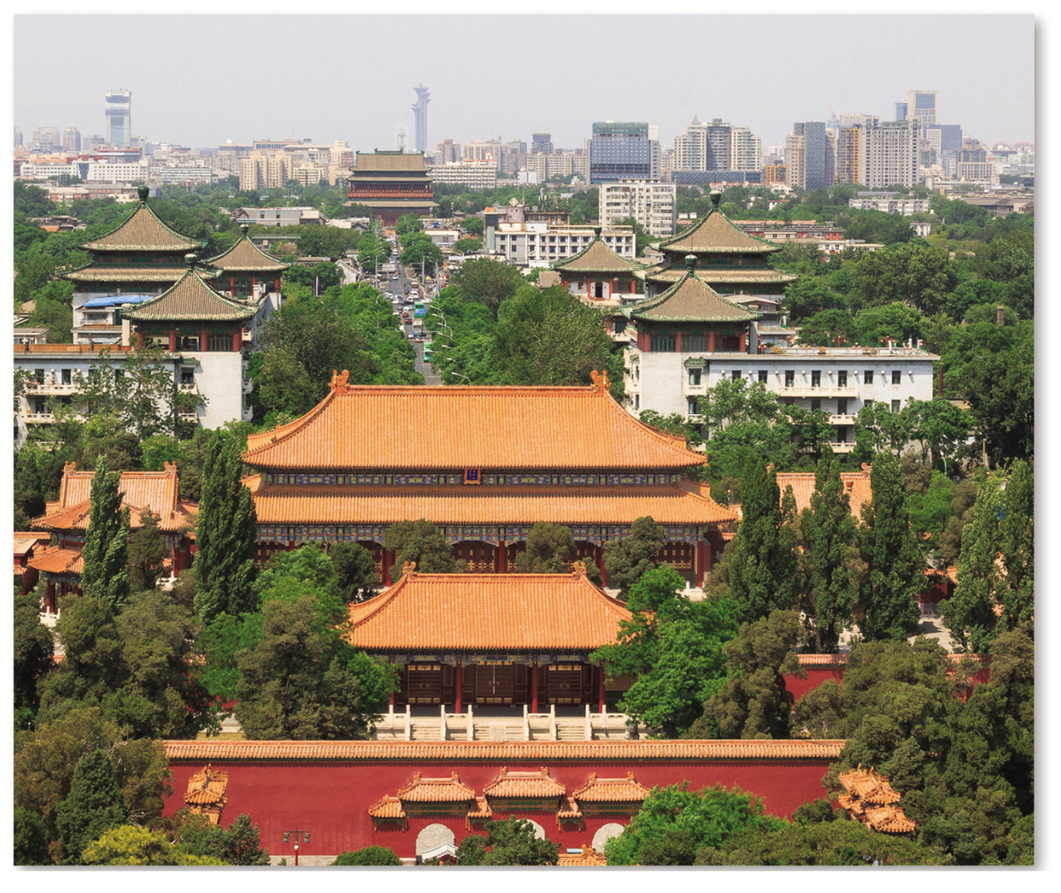
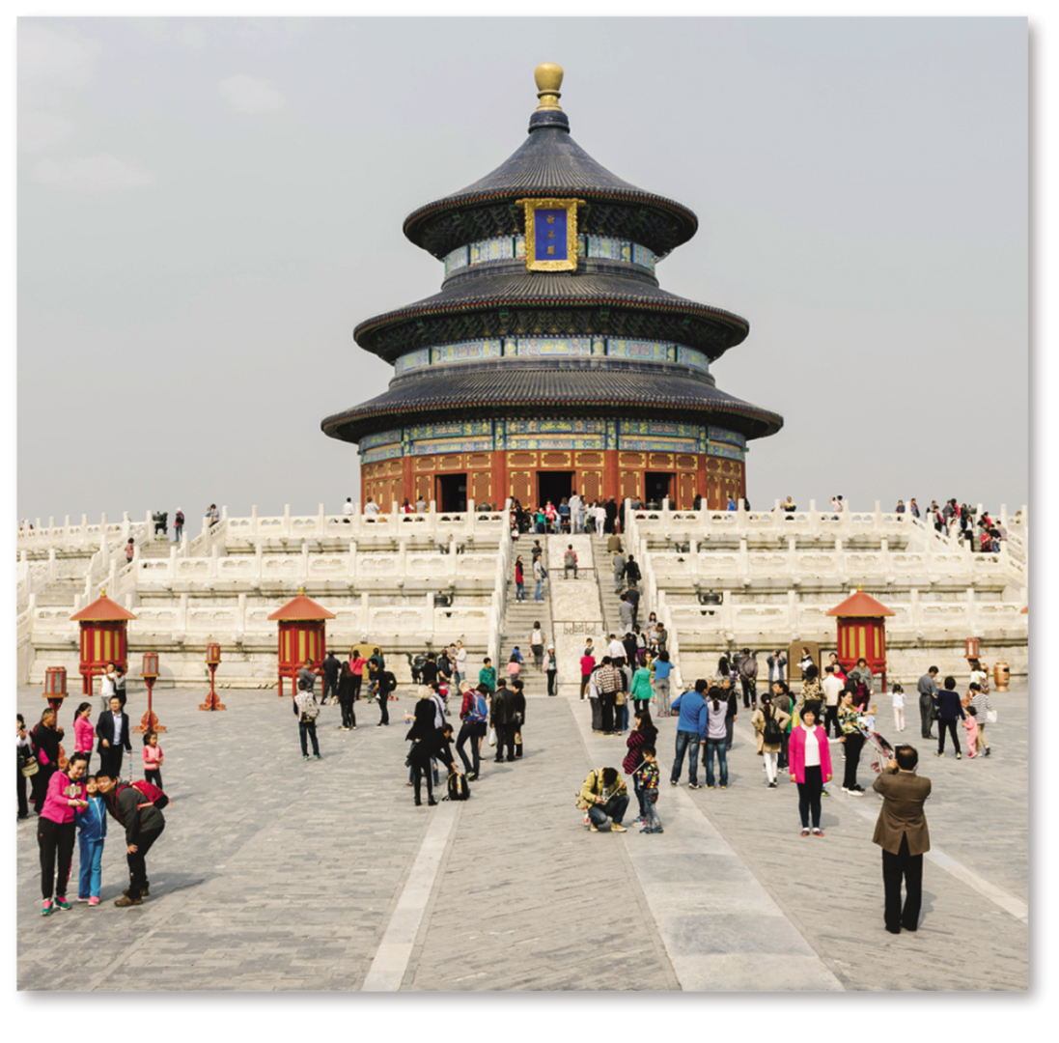
13.2.4 Premodern Cities in Developing Countries (3 of 5)
Figures 13-31 and 13-32: The Drum Tower (left) was the center of Dadu, the city that became Beijing. The Temple of Heaven (right) was built in the outer city of Beijing in the 1400s.

Slide 38
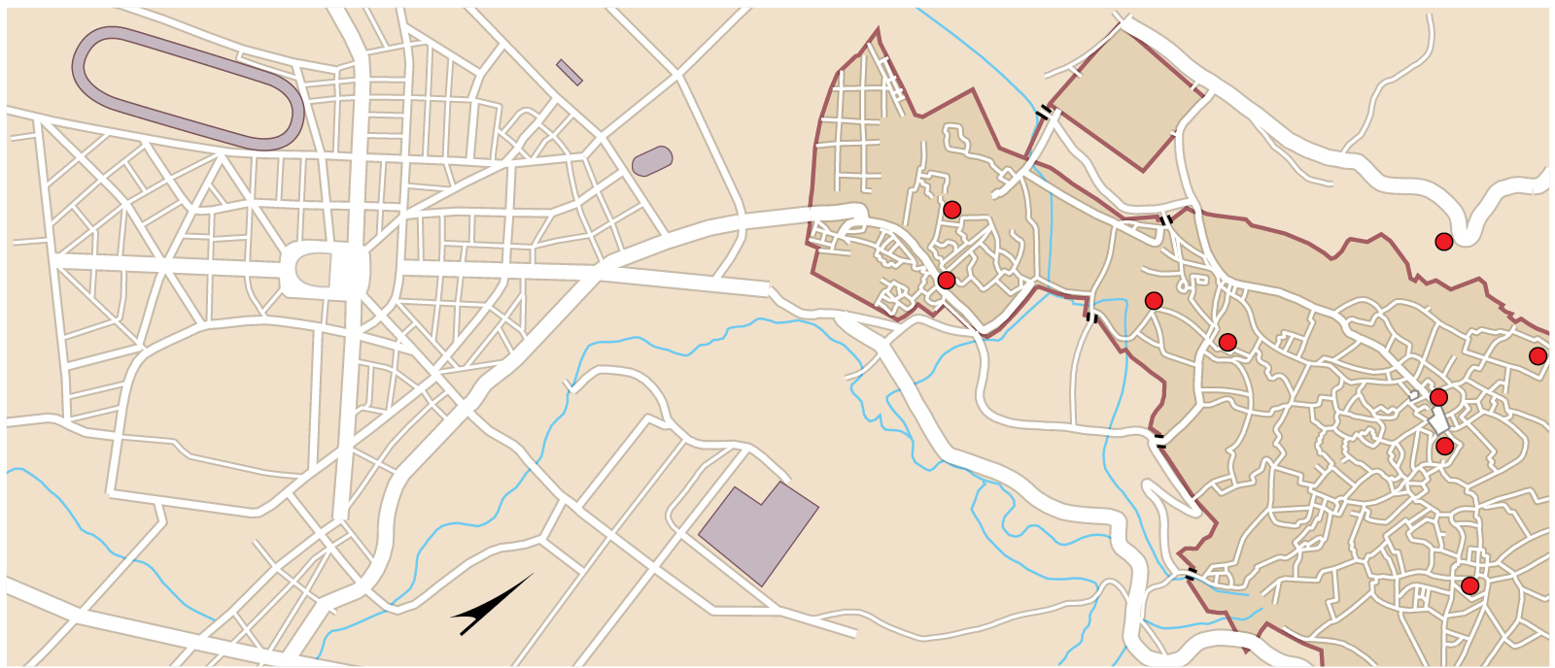
13.2.4 Premodern Cities in Developing Countries (4 of 5)
Figure 13-33: The precolonial town to the east (Medinah on the map) had narrow irregularly arranged streets and numerous mosques. The French colonial administration laid out an entirely new district in the west (New Town on the map), with geometrically arranged streets and squares.
Station
Wall
Bab Segma
Gate
Race Course
Kasbah
Cherarda
Panoramic Road
Avenue de Meknes
Royal
Palace
Bab Boujloud
Gate
Stadium
Merinide
Tombs
Great
Mosque
Dar Beide
Palace
Wall
Avenue Hassan II
Bab Riafa
Gate
Batha
Palace
Jamaï
Palace
New
Town
Wall
Nejjarine
Fountain
Tour
Bab El Hadid
Gate
Medinah
Karaouine
Mosque
de
Fés
Hospital
Avenue Ibn
El Khatib Rue Chefchaquen
Bab Jdid
Gate
Andalousian
Mosque
N

Slide 39
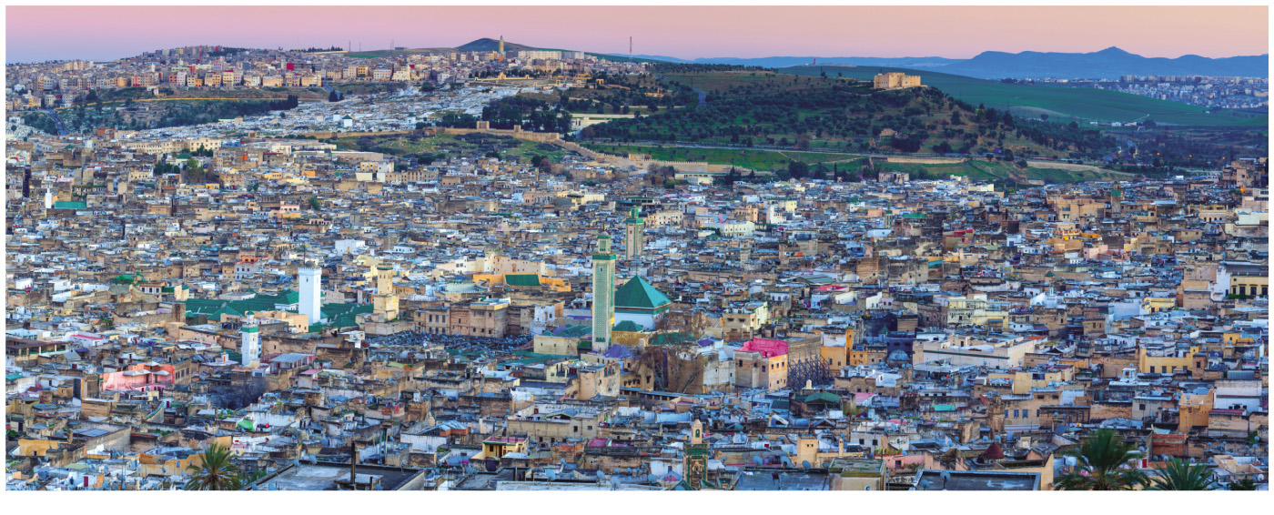
13.2.4 Premodern Cities in Developing Countries (5 of 5)
Figure 13-34: Looking west, the Medinah (Old Town) is in the foreground, and the French built New Town is in the background. A portion of the wall that encircles the Medinah is visible between the Old Town and New Town.

Slide 40
13.2.5 Applying the Models in Developing Countries (1 of 8)
The concentric zone model has been applied most frequently to cities in developing countries. The inner rings house higher-income people, the outer rings are informal settlements
The sector model reveals wealthy people push out from the center in a well-defined elite residential sector
The multiple nuclei model shows a complex mix of ethnic groups residing in different zones, such as in Southeast Asia

Slide 41
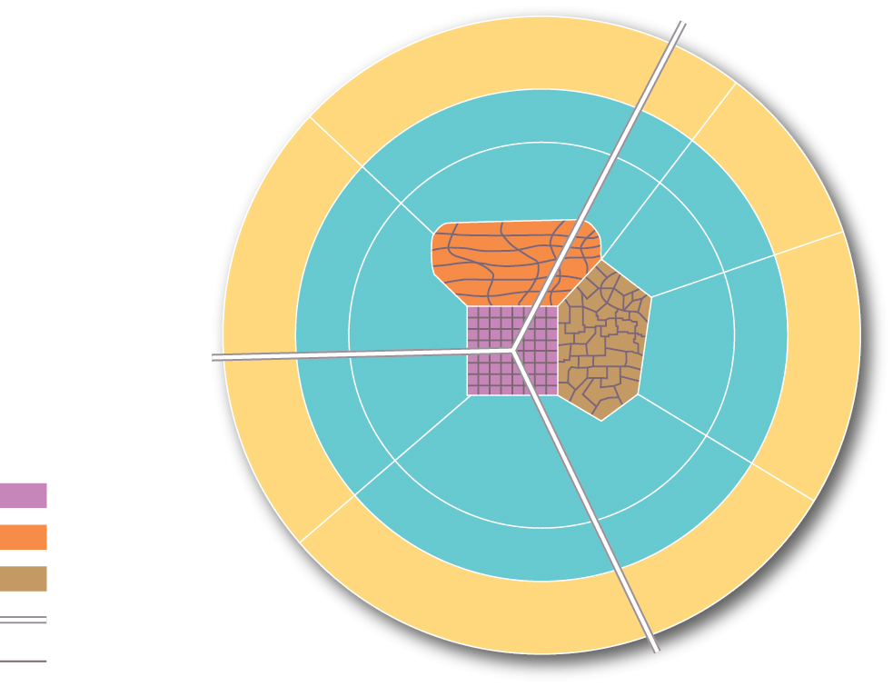
13.2.5 Applying the Models in Developing Countries (2 of 8)
Figure 13-35: Models of urban structure have been adapted to fit different developing countries.
Ethnic neighborhoods
Informal satellite townships
Ethnic and mixed
neighborhoods
Mining and manufacturing zone
Informal satellite townships
Colonial CBD
Traditional CBD
Market zone
Major road
Local street

Slide 42
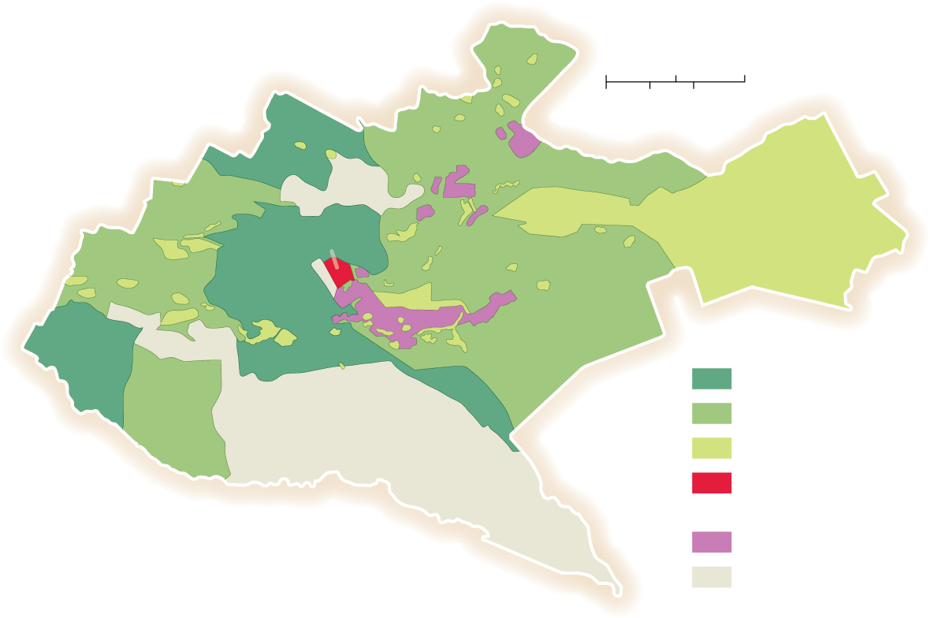
13.2.5 Applying the Models in Developing Countries (3 of 8)
Figure 13-36: Higher-income people in Nairobi are more likely to live in an inner ring, whereas low-income people are in outer rings.
0
2
4 Miles
0
2
4 Kilometers
CBD
Nairobi
High income
Middle income
Low income
Central business
district
Industrial district
Nairobi National Park

Slide 43
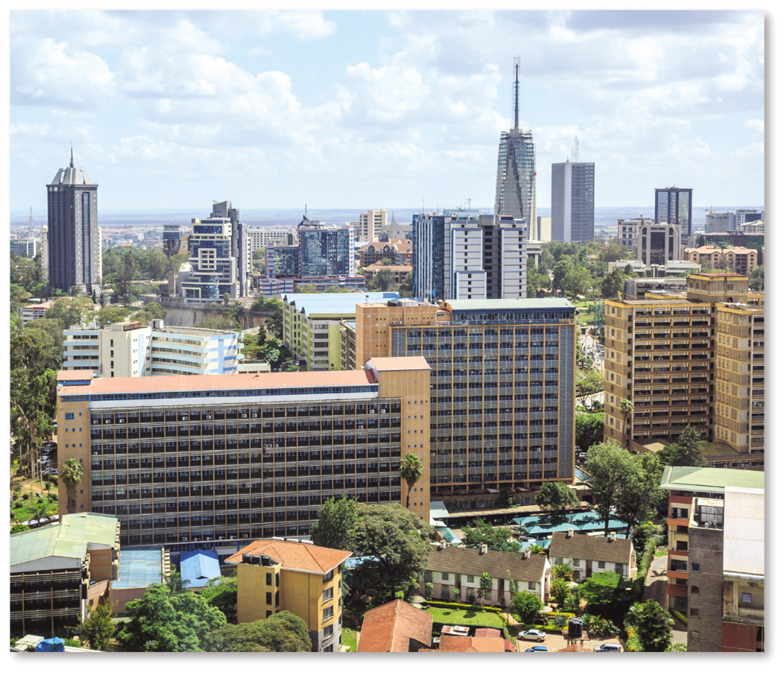
13.2.5 Applying the Models in Developing Countries (4 of 8)
Figure 13-37: Higher-income people live in the high-rises, which are closer to the center.

Slide 44
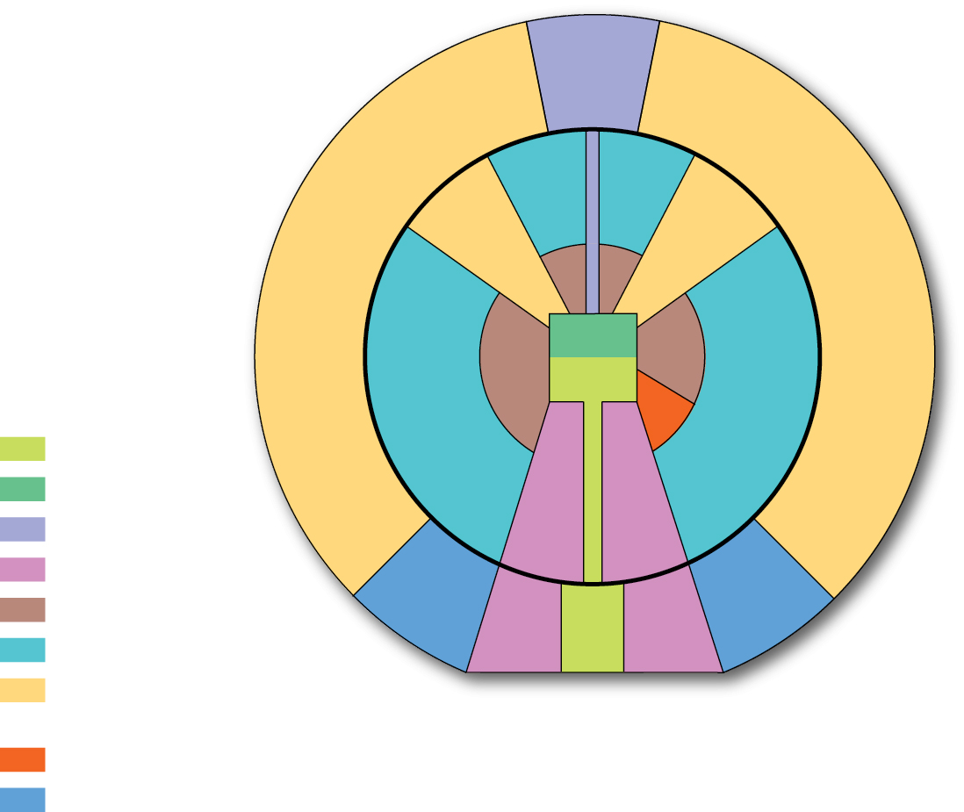
13.2.5 Applying the Models in Developing Countries (5 of 8)
Figure 13-38: The sector model is often applied to Latin American cities.
Industrial
park
Disamenity
Disamenity
Periférico
Market
Periférico
CBD
Commercial
Market
Spine
Industrial
Elite residential sector
Zone of maturity
Mall
Zone of increasing density
Zone of peripheral
squatter settlements
Gentrification
Middle-class residential

Slide 45
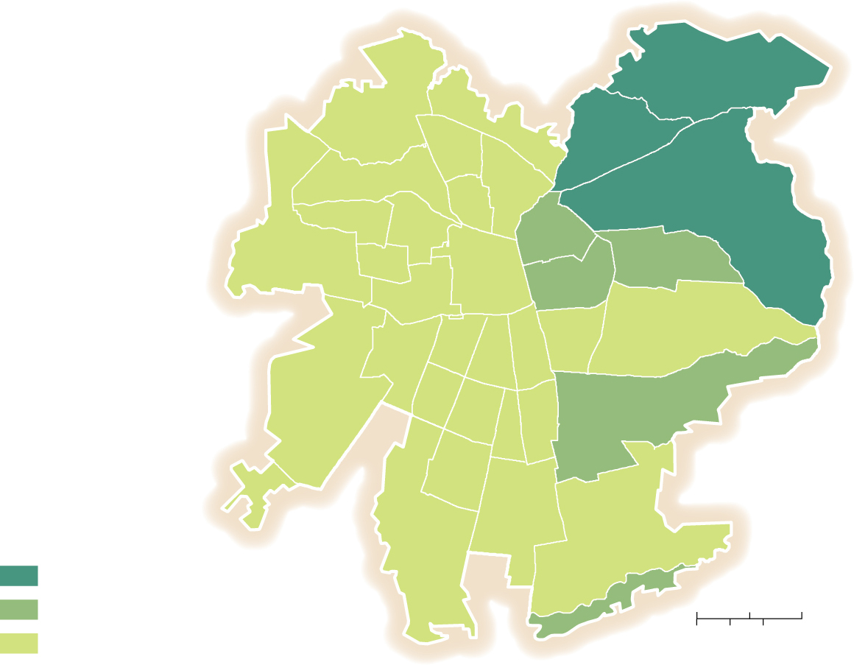
13.2.5 Applying the Models in Developing Countries (6 of 8)
Figure 13-39: Santiago’s development follows a sector model. High-income people live in a sector to the northeast.
Santiago
Percent of residents
who are high-income
40 and above
10–39
0
2
4 Miles
below 10
0
2
4 Kilometers

Slide 46
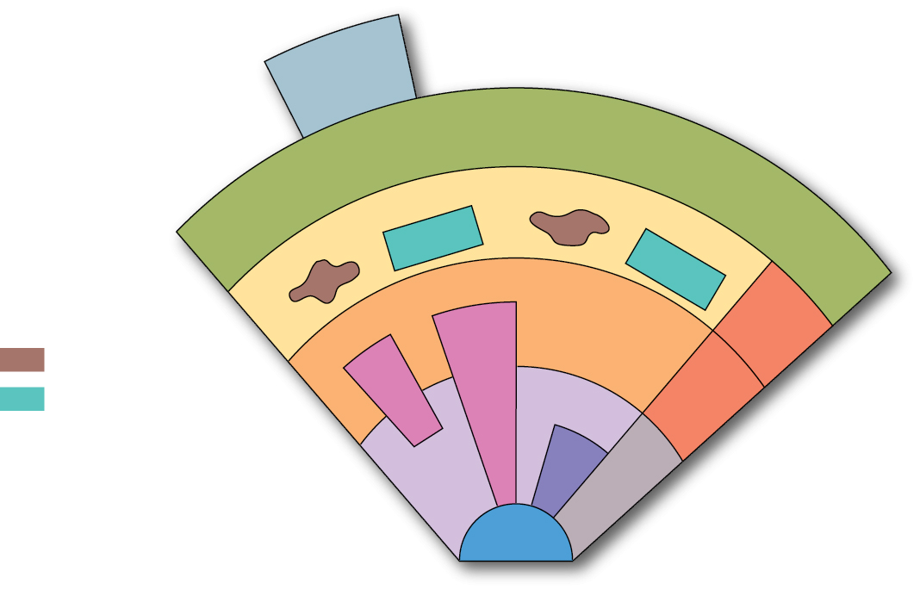
13.2.5 Applying the Models in Developing Countries (7 of 8)
Figure 13-40: The Southeast Asian city displays the multiple nuclei model with different immigrant ethnic groups residing in different nodes in the city.
New
industrial
estate
Market gardening zone
Zone of new suburbs and squatter areas
Middle-density residential zone
Squatter areas
New
high-class
residential
Suburbs
High-class
residential
Alien commercial
zone
Government zone
Mixed land use zone
Western commercial zone

Slide 47
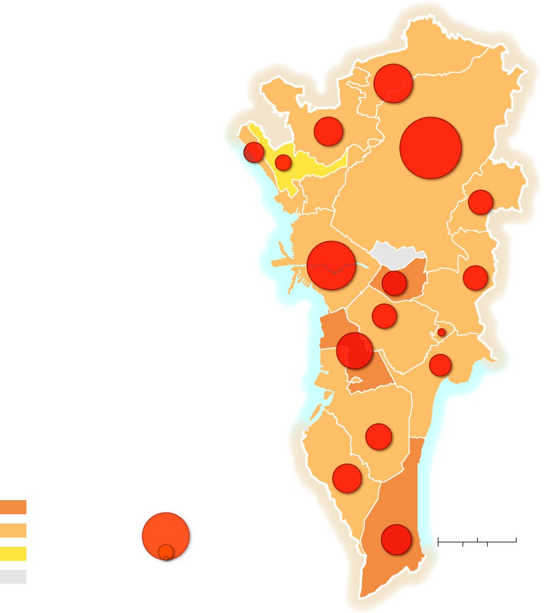
13.2.5 Applying the Models in Developing Countries (8 of 8)
Figure 13-41: Most informal settlements in Manila, the Philippines, are located in outer districts.
Caloocan
Valenzuela
Navotas
Malabon
Marikina
Caloocan
Quezon City
Manila
San
Juan
Pasig
Pasay
Mandaluyong
Manila
Bay
Makati
Pateros
Taguig
Parañaque
Percent informal
settlements per
district
Number of informal
settlements per
district
Las
Piñas
Laguna
de Bay
40 and above
100,000
Muntinlupa
20–39
10,000
0
2
4 Miles
below 20
1,000
0
2
4 Kilometers
no data

Slide 48
13.2.6 Changing Urban Structure in Mexico City (1 of 6)
Mexico City provides an example of a city in a developing country that has passed through three stages of development
Pre-colonial Tenochtitlán was built on an island in Lake Texcoco
The Spanish demolished the Aztec city and rebuilt in the Spanish colonial model
Since independence: rapid growth from 500,000 people in 1900 to 21 million today

Slide 49
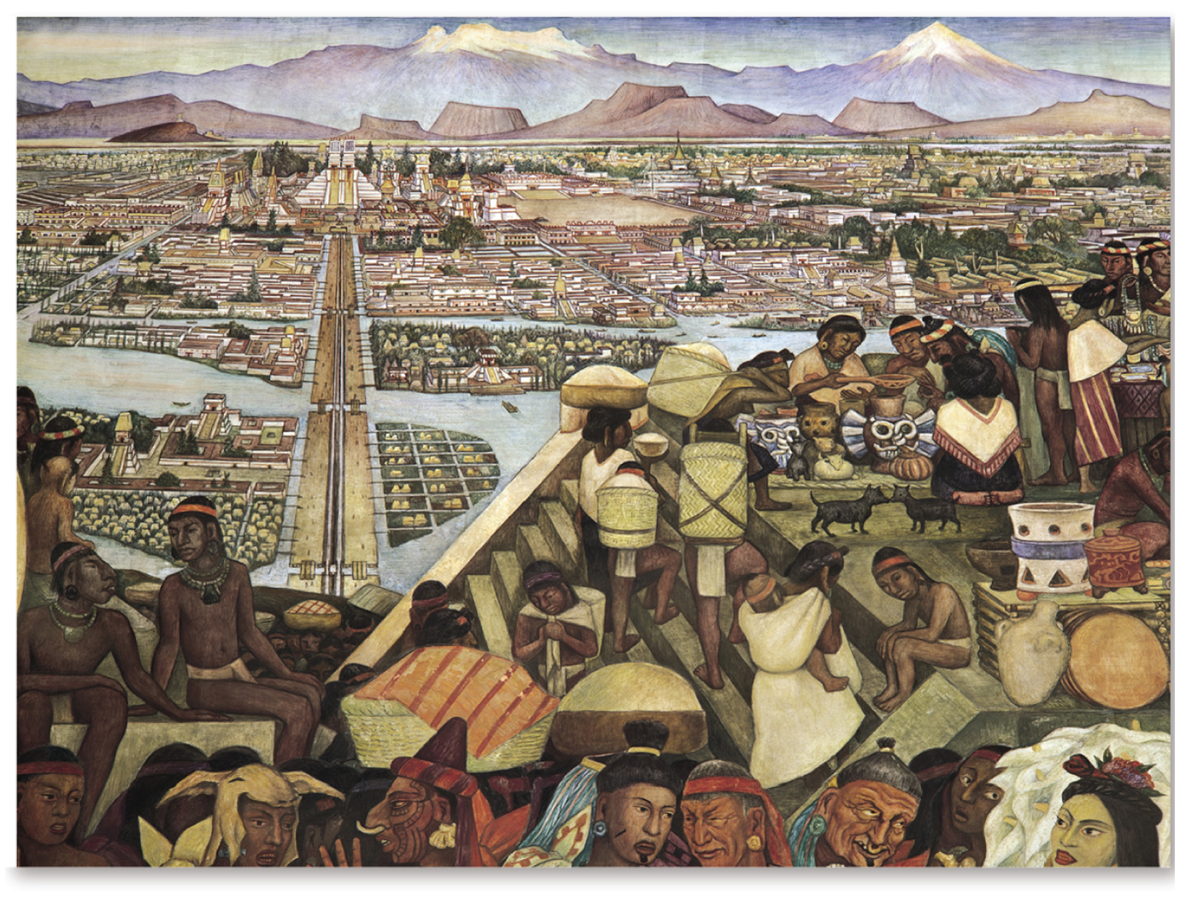
13.2.6 Changing Urban Structure in Mexico City (2 of 6)
Figure 13-42: The site of Tenochtitlán was an island in a lake and marsh.

Slide 50
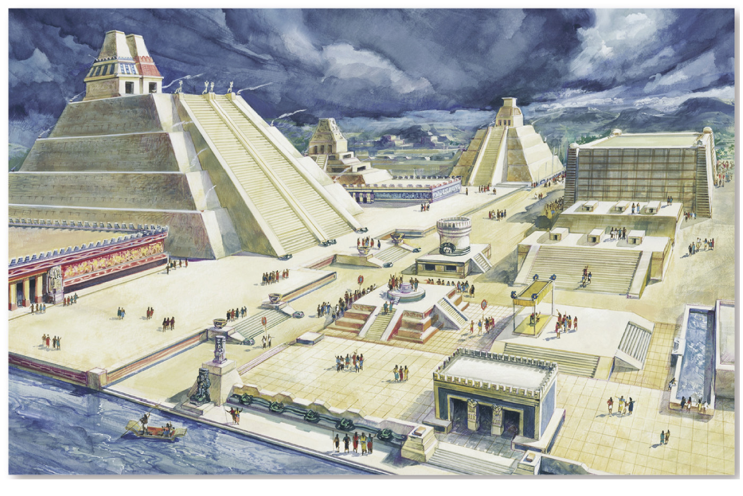
13.2.6 Changing Urban Structure in Mexico City (3 of 6)
Figure 13-43: The center of Tenochtitlán held the Templo Mayor and shrines.

Slide 51
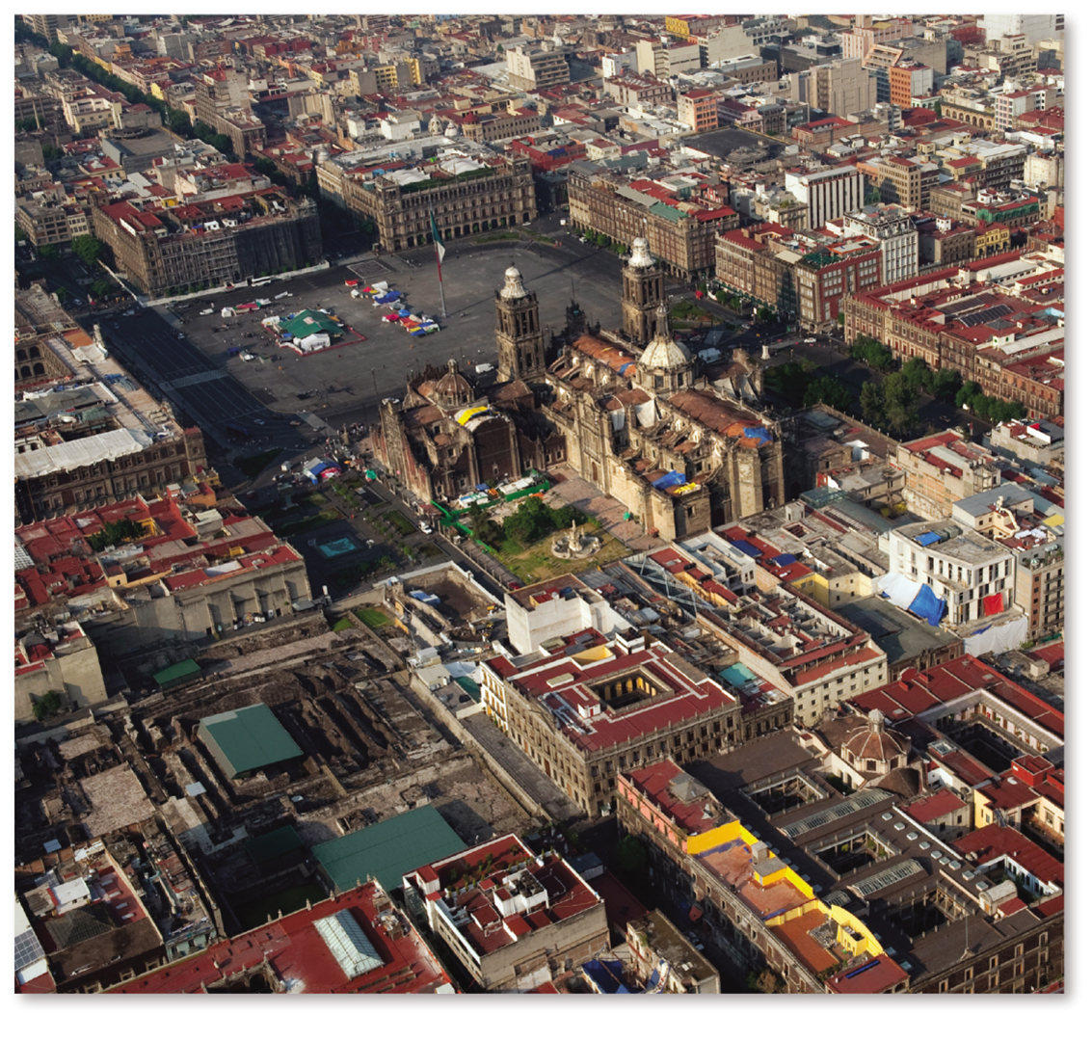
13.2.6 Changing Urban Structure in Mexico City (4 of 6)
Figure 13-44: The center of colonial Mexico City was the main square (Zocalo), located near the site of the demolished Templo Mayor.

Slide 52
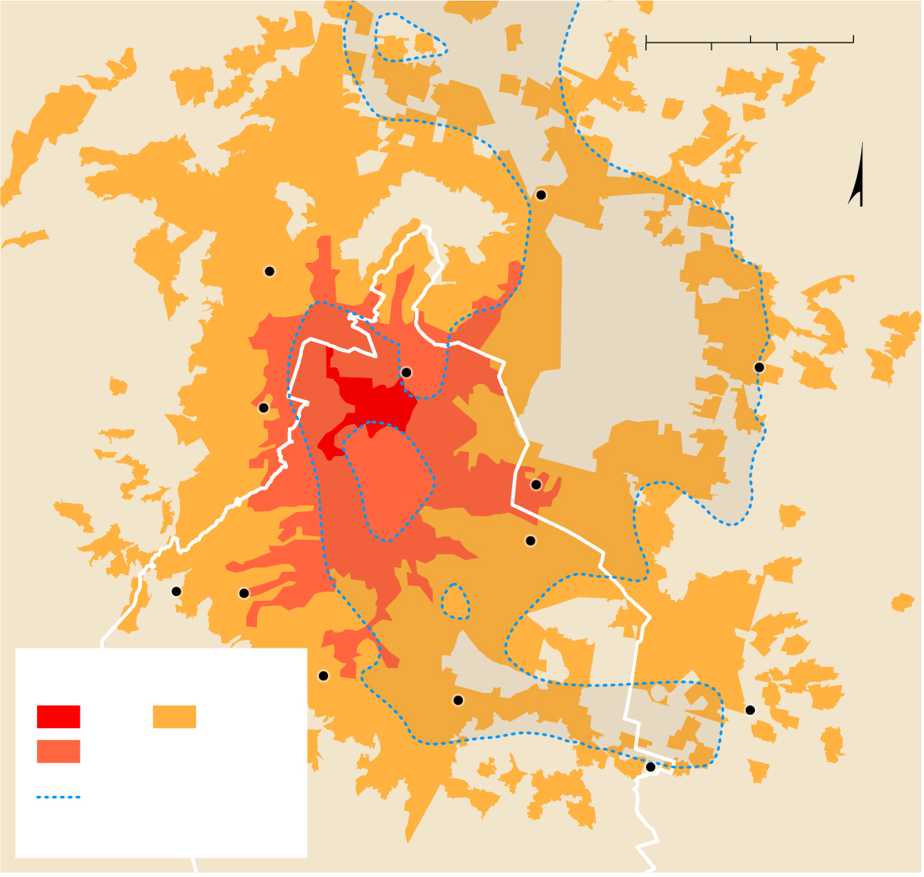
13.2.6 Changing Urban Structure in Mexico City (5 of 6)
Figure 13-45: The land area of Mexico City expanded dramatically in the twentieth century. Most of Lake Texcoco was covered by development.
State of
Mexico
0
5
10 Miles
0
5
10 Kilometers
Xalostoc
N
Tlalnepantla
Vallejo
Texcoco
Naucalpan
Mexico City
Nezahualcóyotl
Santa
Fe
Iztapalapa
Cuajimalpa
Extent of Mexico City
Tlalpan
Xochimilco
Valle de Chalco
1910
2000
1960
Mexico
City
Mixquic
Lake Texcoco during
Aztec Empire
State of
Mexico

Slide 53
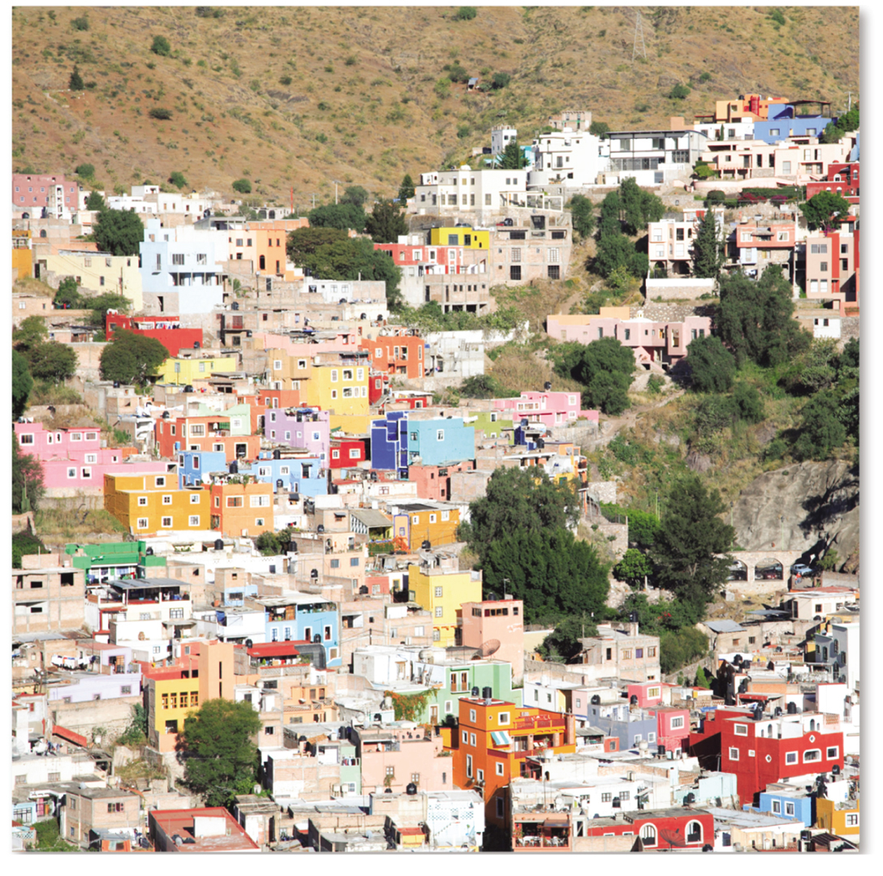
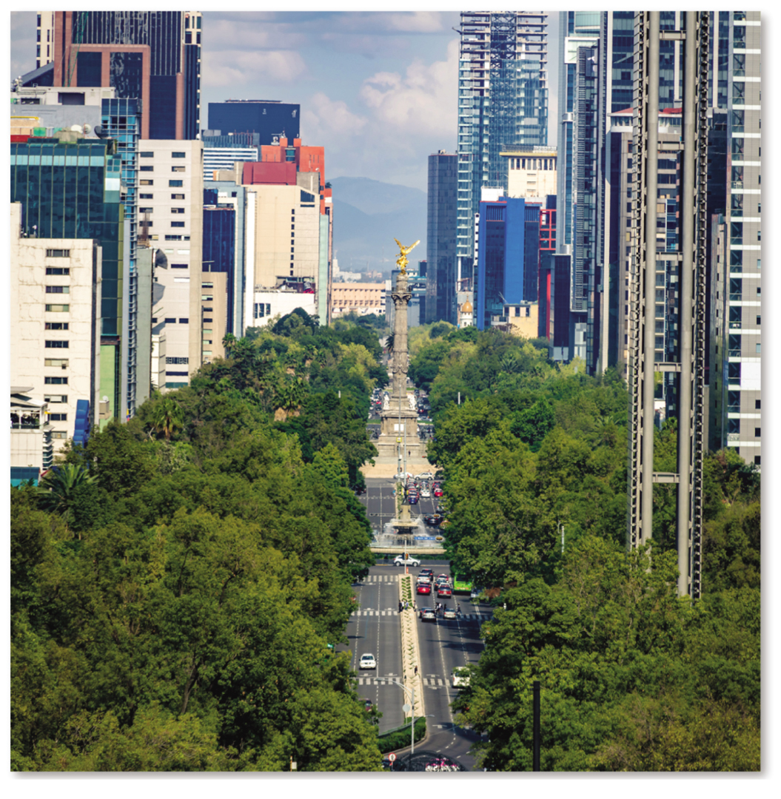
13.2.6 Changing Urban Structure in Mexico City (6 of 6)
Figures 13-46 and 13-47: Mexico City’s informal settlements are in an outer ring (left). The Paseo de la Reforma represents a wealthy sector extending out from the city center (right).

Slide 54
Key Issue 3: Why Do Urban Areas Expand?
13.3.1 Origin and Growth of Suburbs
13.3.2 Suburban Sprawl
13.3.3 Suburban Segregation
13.3.4 Reliance on Motor Vehicles
13.3.5 Legacy of Public Transport

Slide 55
13.3.1 Origin and Growth of Suburbs (1 of 4)
A suburb is a residential or commercial area situated within an urban area but outside the central city
Annexation is the process of legally adding land area to a city. Annexation was once popular, but now it is common for peripheral areas to organize their own municipalities rather than pay taxes to a city for municipal services
Local government fragmentation makes it difficult to solve urban problems (e.g., traffic)

Slide 56
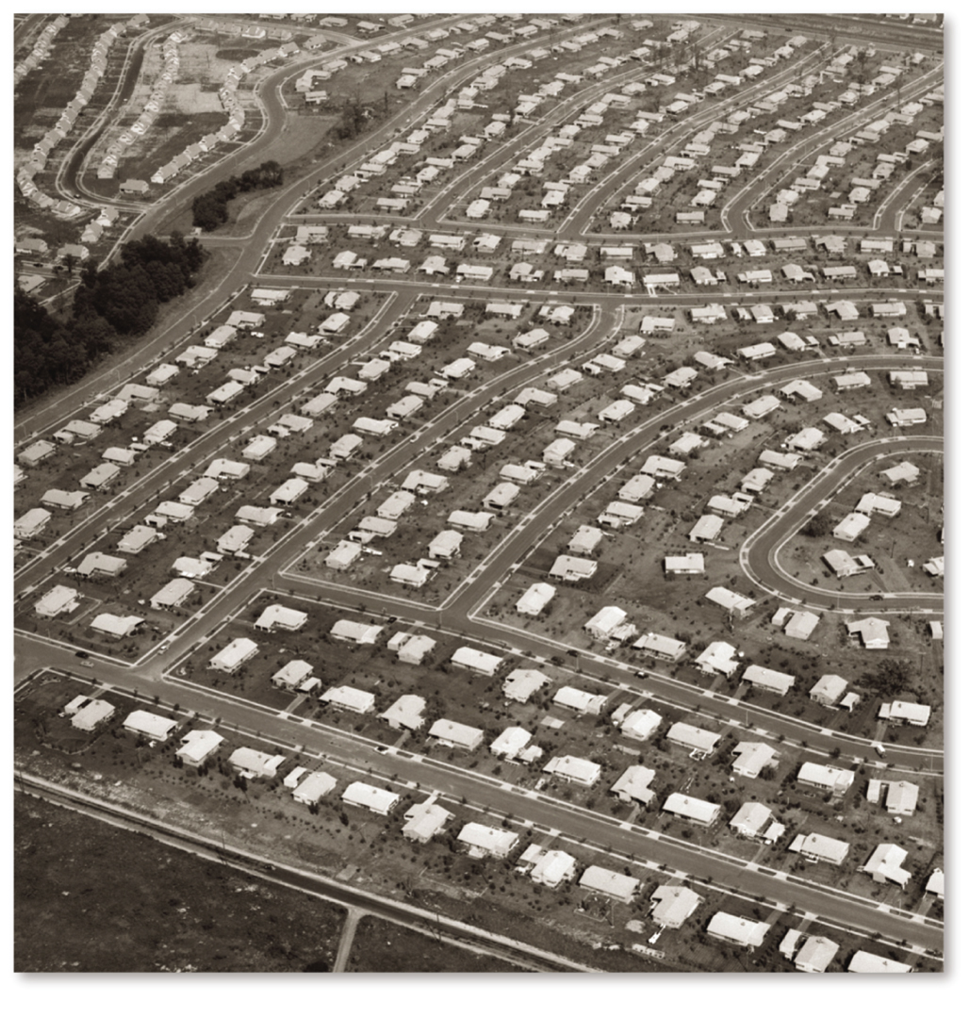
13.3.1 Origin and Growth of Suburbs (2 of 4)
Figure 13-48: Suburban growth accelerated after
with the widespread use of the automobile.

Slide 57
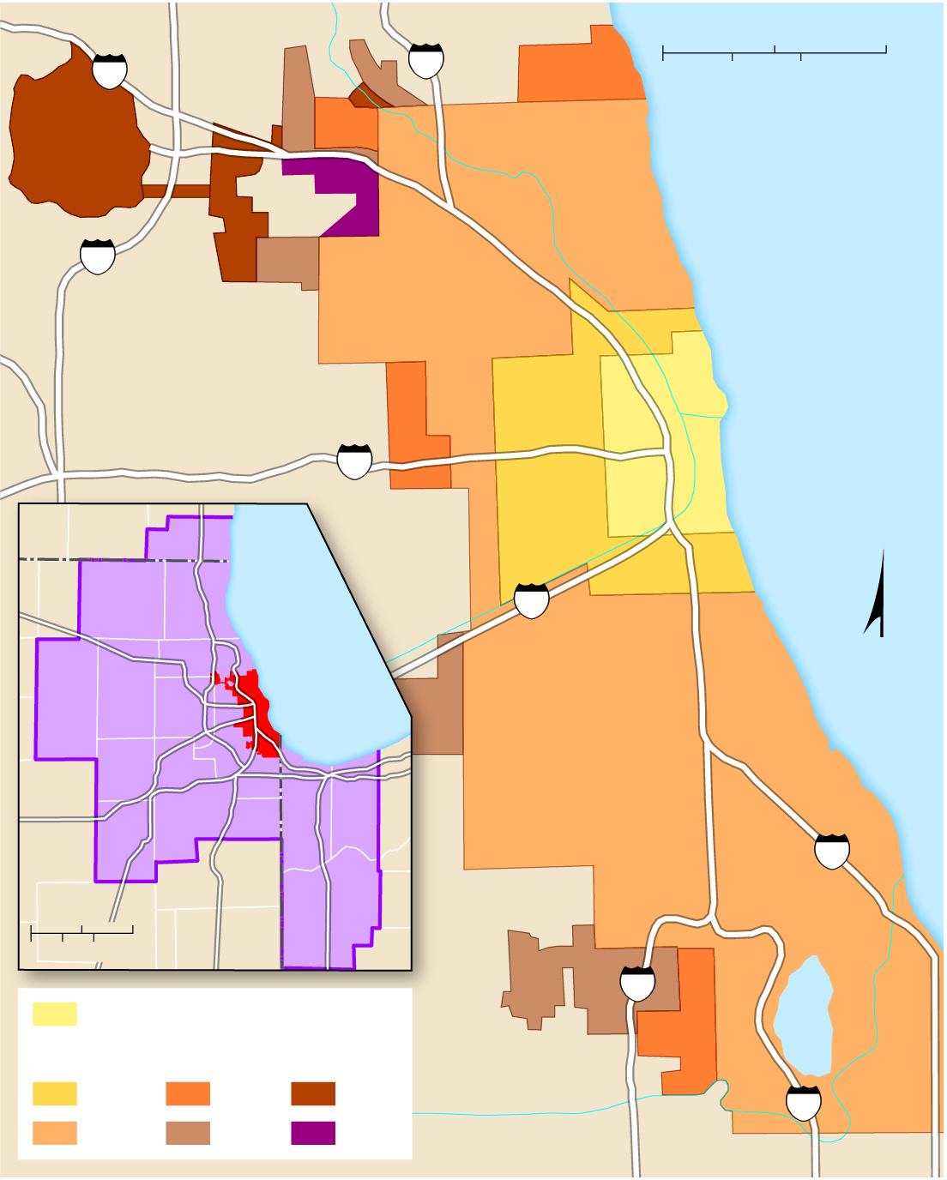
13.3.1 Origin and Growth of Suburbs (3 of 4)
Figure 13-49: Chicago’s annexation of surrounding areas was rapid in the 1800s, but slowed in the 1900s.
94
0
2.5
5 Miles
90
0
2.5
5 Kilometers
294
Lake
Michigan
290
Chicago
WI
ILLINOIS
Lake
Michigan
55
Chicago
MSA
N
Chicago
IN
90
City limits,1837
57
Lake
Calumet
Annexed by
1870
1900
1960
94
1890
1930
1990

Slide 58
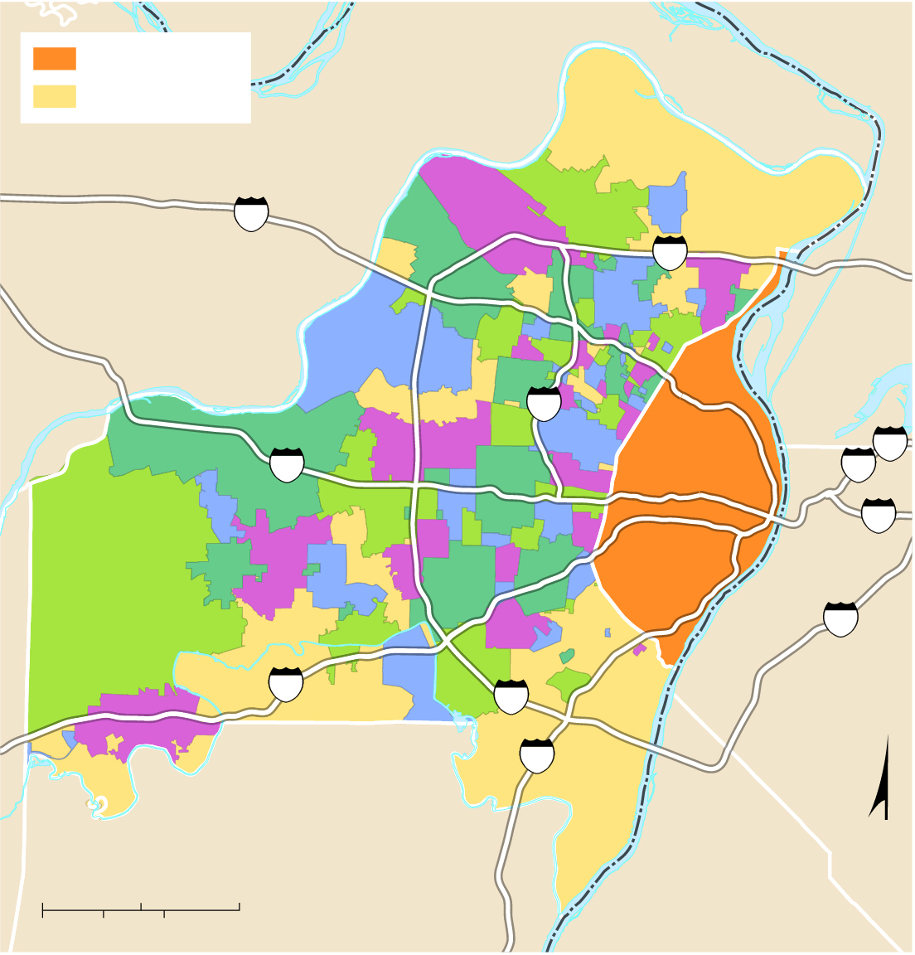
13.3.1 Origin and Growth of Suburbs (4 of 4)
Figure 13-51: Instead of the possibility of being annexed by St. Louis, many residents of St. Louis County have incorporated their own municipalities.
City of St. Louis
ILLINOIS
unincorporated
ST. CHARLES CO.
MISSOURI
70
Missouri R.
270
MADISON CO.
170
64
St. Louis
70
55
ST. LOUIS CO.
64
Mississippi R.
255
44
ST. CLAIR CO.
270
JEFFERSON CO.
55
N
0
5
10 Miles
MONROE CO.
0
5
10 Kilometers

Slide 59
13.3.2 Suburban Sprawl (1 of 5)
Sprawl is the development of low-density suburbs in locations not contiguous to the existing built-up area. Sprawl causes more costs to extend roads and utilities and the loss of agricultural land
The density change in an urban area is called the density gradient where the number of houses per unit of land diminishes as distance from the center city increases
Legislation to limit suburban growth and preserve farmland is called smart growth

Slide 60
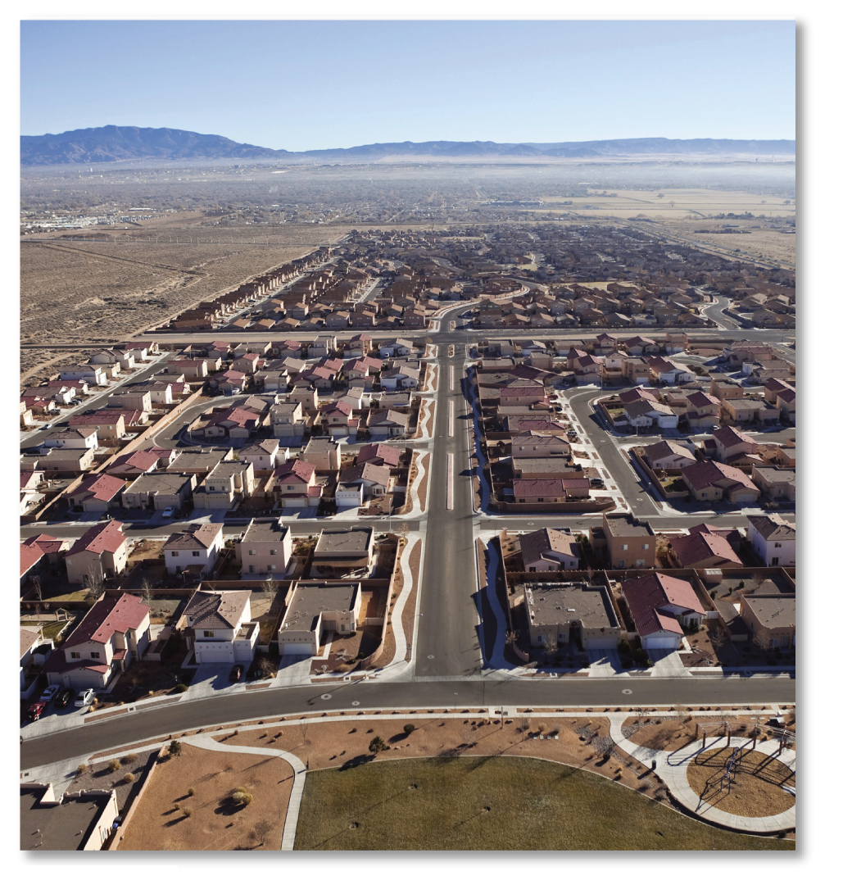
13.3.2 Suburban Sprawl (2 of 5)
Figure 13-52: Modern suburban sprawl results in higher costs to connect distant roads and utilities as well as the loss of farmland.

Slide 61
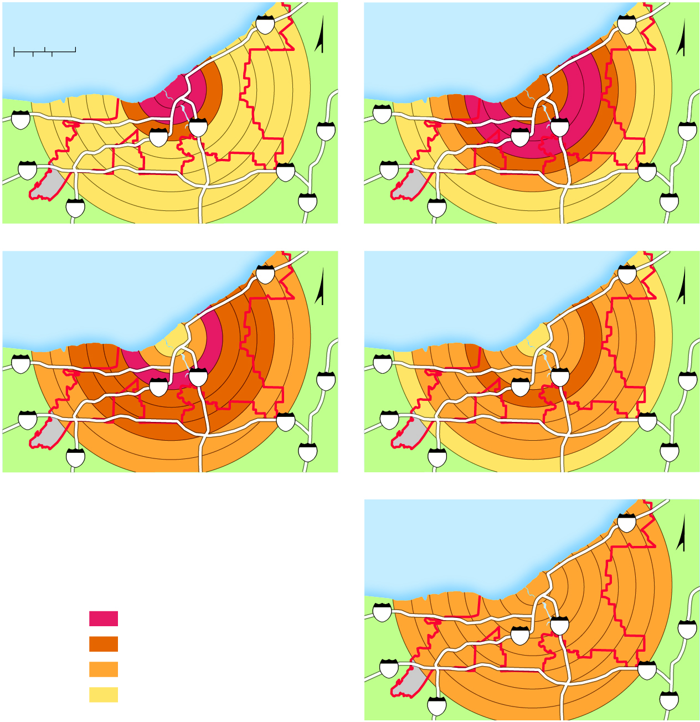
13.3.2 Suburban Sprawl (3 of 5)
Figure 13-53: In 1900, Cleveland had a strong density gradient, with high densities at the center and low densities farther out. Suburbanization flattened that density gradient.
1900
90
1930
90
0
2
4 Miles
Lake Erie
N
Lake Erie
N
0
2
4 Kilometers
Cleveland
Cleveland
90
71
77
271
90
71
77
271
480
480
480
480
71
271
71
271
1960
90
1990
90
Lake Erie
N
Lake Erie
N
Cleveland
Cleveland
90
71
77
271
90
71
77
271
480
480
480
480
71
271
71
271
2010
90
Lake Erie
N
Persons per sq. mile
Cleveland
15,000 and above
90
71
77
271
10,000–14,999
5,000–9,999
480
480
below 5,000
71
271

Slide 62
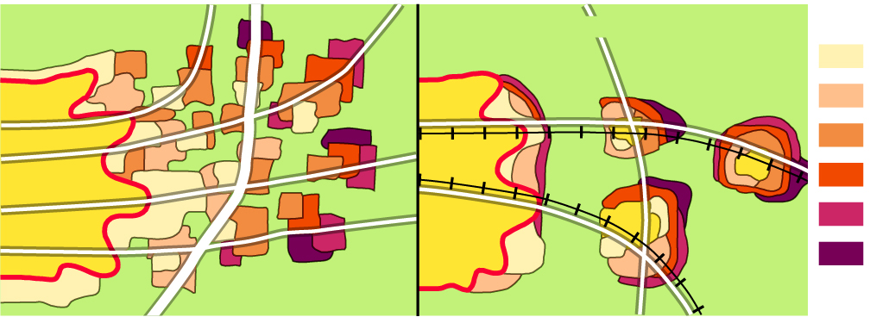
13.3.2 Suburban Sprawl (4 of 5)
Figure 13-54: Land use planning in the U.K. directs new development to be contiguous with existing urbanization (right), as opposed to the fragmentation in the United States (left).
UNITED STATES
UNITED KINGDOM
Developed
Farms
1950s
1960s
1970s
City
1980s
City
1990s
Beltway
Farms
2000s
Farms

Slide 63
13.3.2 Suburban Sprawl (5 of 5)
Figures 13-56 and 13-57: New developments in Portland must take place inside of the growth boundary (left). Image of Portland (right).
Portland city boundary
5
Vancouver
Urban Growth Boundary
WASHINGTON
already urban
205
Camas
Willamette R.
Columbia R.
Hillsboro
CBD
84
Forest
Grove
Portland
Troutdale
Beaverton
Gresham
Tigard
Milwaukie
Lake Oswego
OREGON
Tualatin
Gladstone
Sherwood
205
Oregon
City
Newberg
Wilsonville
N
Canby
0
5
10 Miles
5
0
5
10 Kilometers

Slide 64
13.3.3 Suburban Segregation (1 of 4)
Many suburbs display two forms of segregation:
Residential segregation is where housing is built for people of a single social class, with others excluded by virtue of the cost, size, or location of the housing, often by the use of zoning ordinances. Segregation by race and ethnicity also persists in some suburbs
Commercial segregation is where residents are separated from commercial and manufacturing activities that are confined to compact, distinct areas

Slide 65
13.3.3 Suburban Segregation (2 of 4)
Figure 13-58: Zoning ordinances are often used to create suburbs that segregate by income since poor people cannot afford to purchase the large single-family homes which occupy the large lots.

Slide 66
13.3.3 Suburban Segregation (3 of 4)
Figure 13-59: The Village of Indian Hill has a mean household income around $250,000, much higher than neighboring suburbs. The village is 92% white, 6% Asian American, 2% Hispanic, and 1% African-American.
Fairfield
West Chester
75
71
275
Forest Park
Springdale
Sharonville
Loveland
Wyoming
Blue
Ash
Montgomery
North
College Hill
126
Reading
Silverton
Madeira
Indian Hill
74
75
St. Bernard
Norwood
Milford
Cincinnati
71
Dayton
275
Ohio R.
Covington
471
Forestville
75
Household income
above $150,000
$100,000–$149,999
$75,000–$99,999
below $75,000

Slide 67
13.3.3 Suburban Segregation (4 of 4)
Figures 13-60 and 13-61: The malls surround Columbus (left) near the beltway. Retail has followed wealthy residents to the suburbs, like these in Columbus, Ohio (right).
750
23
Mall size
(million
square feet)
745
315
Polaris
Fashion
Place
257
71
15
10
3
5
2
270
33
The Shops at
Worthington Place
161
161
The Mall at
Tuttle Crossing
23
Northland Mall
(demolished)
33
3
Easton
Town
Center
62
270
315
71
23
Northland Mall
(demolished)
70
670
16
Columbus
317
270
40
70
33
40
Westland Mall
(demolished)
3
70
104
Eastland
Mall
N
62
270
23
0
2
4 Kilometers
4 Miles
104
317
33
0
2
71

Slide 68
13.3.4 Reliance on Motor Vehicles (1 of 3)
There have been five epochs of U.S. urban areas resulting from changing transportation systems:
Sail-Wagon Epoch (1790–1830)
Iron Horse Epoch (1830–1870)
Steel Rail Epoch (1870–1920)
Auto-Air-Amenity Epoch (1920–1970)
Satellite-Electronic-Jet Propulsion Epoch (1970–present)
Most Americans today prefer to use automobiles in lieu of public transportation

Slide 69
13.3.4 Reliance on Motor Vehicles (2 of 3)
Figure 13-62: The timeline of the five major urban transportation epochs in the United States.
1800
1850
1900
1950
2000
SAIL-WAGON EPOCH
(1790–1830)
IRON HORSE EPOCH
(1830–1870)
STEEL RAIL EPOCH
(1870–1920)
AUTO-AIR-AMENITY
EPOCH (1920–1970)
SATELLITE-ELECTRONIC-
JET PROPULSION (1970–?)
Urban areas were clustered
along the Atlantic Coast.
Communication was
primarily by wind-powered
ships plying up and down
the Atlantic Coast.
Steam-powered railroads
provided transport from
outlying areas into cities.
Canals connected newly
founded inland cities with
existing urban centers on
the East Coast.
Long-haul rail lines
connected urban areas
around the country.
Travel time between
cities was greatly
reduced.
The gasoline engine
made it possible for motor
vehicles to become the
dominant transport within
and between urban areas.
Gasoline-powered airplanes
facilitated travel between
distant urban centers.
The current era is
characterized by the
ability to communicate
electronically, as well as to
control transport systems
electronically.

Slide 70
13.3.4 Reliance on Motor Vehicles (3 of 3)
Figure 13-65: Boston’s Central Artery freeway (left) was demolished and replaced with an underground freeway and the Rose Kennedy Greenway (right).
(a)
(b)

Slide 71
13.3.5 Legacy of Public Transport (1 of 3)
Public transportation is more commonplace in Europe than in the United States, but it has made a recent comeback, and in certain cities (e.g., New York, Chicago) its use has remained heavy due to the challenges of driving (congestion, parking)
Public transport in the United States is used primarily for commuting by workers into and out of the C B D, whereas in Europe, its use is more widespread

Slide 72
13.3.5 Legacy of Public Transport (2 of 3)
Figures 13-66 and 13-67: Munich, Germany, is typical of many public transport-oriented cities in developed countries (left). Shown here (right) are its underground rail (a), elevated rail (b), and tram (c) systems.
S1
U6
S8
Munich’s
U-Bahn line
openings
S2
U2
1970s
1980s
1990s
since 2000
U3
U1
U8
S-Bahn
U7
stop
U4
S3
S2
S4
U5
U2
S8
U4
U8
S1
S4
S6
S6
U6
U7
U3
U1
U5
S7
S3
S7

Slide 73
13.3.5 Legacy of Public Transport (3 of 3)
Figure 13-68: Public transport is heavily used in several major cities, especially in the northeast and in California.
Seattle
Portland
Minneapolis-
St. Paul
Buffalo
Boston
Milwaukee
Detroit
Cleveland
New York
Salt Lake City
Chicago
Pittsburgh
Philadelphia
Sacramento
Baltimore
San Francisco
Denver
Cincinnati
Washington, D.C.
San Jose
St. Louis
Las Vegas
Riverside-San Bernardino
Charlotte
Total transit trips
via rail, bus, or other
Los Angeles
Phoenix
Atlanta
San Diego
Dallas-
Ft. Worth
New York
Tucson
4.2 billion
Austin
New Orleans
Orlando
350,000,000
Houston
Tampa-
St. Petersburg
100,000,000
Honolulu
San Antonio
Miami
35,000,000
Rail available
No rail

Slide 74
Key Issue 4: Why Might Cities Be More Sustainable?
13.4.1 The City Challenged
13.4.2 The City Renewed
13.4.3 Controlling Vehicles
13.4.4 Impacts of Near-Future Changes in Vehicles

Slide 75
13.4.1 The City Challenged (1 of 2)
The underclass is a group prevented from participating in the material benefits of society because of a host of social and economic challenges which include:
inadequate job skills
lack of transportation
homelessness
drugs and crime
inadequate municipal services (police, fire, health)

Slide 76
13.4.1 The City Challenged (2 of 2)
Figure 13-69: People line up for free food in Cincinnati’s Over-the-Rhine neighborhood.

Slide 77
13.4.2 The City Renewed (1 of 6)
The process of converting an urban neighborhood from a low-income, renter-occupied area to a middle-class, owner-occupied area is called gentrification
Gentrification allows for a deteriorated inner-city to be revitalized but at the expense of lower income people who are sometimes forced to move out because the rents become too high for them

Slide 78
13.4.2 The City Renewed (2 of 6)
Public housing is government-owned housing rented to low-income people. These often were high-rise apartments in the United States and became centers of crime, drug-use because too many low-income families were concentrated into a high-density environment
Public housing projects across the United States have been demolished in recent years and replace with single-family homes

Slide 79
13.4.2 The City Renewed (3 of 6)
Figure 13-71: Gentrification in the Over-the-Rhine neighborhood in Cincinnati (before, top and after, bottom): Critics of gentrification argue that the community becomes too expensive and pushes out poor residents.

Slide 80
13.4.2 The City Renewed (4 of 6)
Figure 13-72: Many U.S. cities have redeveloped consumer services like retail and leisure services in their C B Ds, like the Reading Terminal building in Philadelphia.

Slide 81
13.4.2 The City Renewed (5 of 6)
Figure 13-73: One of the most notorious high-rise public housing projects, Pruitt-Igoe in St. Louis, was constructed during the 950s and demolished during the 1970s.

Slide 82
13.4.2 The City Renewed (6 of 6)
Figure 13-74: A notorious high-rise public housing project in Chicago called Cabrini Green was located in a gentrifying neighborhood. The project has been demolished and replaced with new housing for middle-class families.

Slide 83
13.4.3 Controlling Vehicles (1 of 5)
Demand to use congested roads is being reduced in a number of ways:
Congestion charges
Tolls which increase during high-use periods
Permits
Bans
Vehicle sharing services (e.g., Uber)
Autonomous vehicles are changing the landscape. There are multiple levels of autonomous vehicles, ranging from assisted driving to driverless

Slide 84
13.4.3 Controlling Vehicles (2 of 5)
Figure 13-75: In London, motorists must pay a congestion charge of up to £11.50 ($15) to drive into the central area between 7 a.m. and 6 p.m. Monday through Friday.

Slide 85
13.4.3 Controlling Vehicles (3 of 5)
Figure 13-76: A main street in Haarlem, the Netherlands, is closed to vehicles so pedestrians can walk freely.

Slide 86
13.4.3 Controlling Vehicles (4 of 5)
Figure 13-77: A driverless bus in Paris.

Slide 87
13.4.3 Controlling Vehicles (5 of 5)
Figure 13-78: Fully automated vehicle. No driver attention is required, but the vehicle has a steering wheel and floor pedals that someone in the vehicle could operate in an emergency.

Slide 88
13.4.4 Impacts of Near-Future Changes in Vehicles (1 of 7)
Cities will be transformed by changes in motor vehicles. The key changes in the car of the near future are:
Power source—more vehicles will be powered by electricity instead of petroleum
Ownership—more vehicles will be shared rather than owned by single individuals
Autonomy—more vehicles will operate with little or no effort by a driver

Slide 89
13.4.4 Impacts of Near-Future Changes in Vehicles (2 of 7)
The world can reduce pollution and fossil fuel dependency in the future. The strategy with three key elements are:
a sharp decrease in the use of the three fossil fuels
an increase in the use of renewable energy
carbon capture and storage (C C S) which involves capturing waste C O ₂, and transporting it to a storage site where it will not enter the atmosphere

Slide 90
13.4.4 Impacts of Near-Future Changes in Vehicles (3 of 7)
Figure 13-79: U.S. fuel efficiency standards have increased dramatically since the 1980s.
40
35
Cars
Trucks
30
Miles per gallon
25
20
15
1980
1985
1990
1995
2000
2005
2010
2015
2020
Year

Slide 91
13.4.4 Impacts of Near-Future Changes in Vehicles (4 of 7)
Figure 13-80: Global companies have innovative ways in which to use batteries discarded from electric cars.
Chevrolet
Data center
Michigan
Nissan / Eaton /
Mobility House
Energy storage
Amsterdam
BMW
Energy storage farm
Leipzig, Germany
Nissan / Sumitomo
Street lighting
Naime, Japan
Renault
Renewable storage
Porto Santo Island
Renault /
Connected Energy
EV charging
Belgium
EVgo
EV charging
California
Nissan / Sumitomo
Large-scale
power storage
Japan
Renault
Backup power
for elevators
Paris
Florida Power & Light
Grid management
Florida
EcarACCU
Solar energy storage
Cameroon
Eaton
Energy storage
South Africa
BYD
Energy storage
Shenzhen, China

Slide 92
13.4.4 Impacts of Near-Future Changes in Vehicles (5 of 7)
Figure 13-81: The United Nations target for the U.S. carbon dioxide emissions, by source: Most reductions are forecast through reducing the use of fossil fuels.
19.7
31.5
23.4
(a) 2010 target (quad BTUs)
2.4
1.3
2.9
6.6
3.8
12.0
6.7
15.8
7.2
9.6
(b) 2050 target (quad BTUs)
Renewables
Natural gas with CCS
Nuclear
Petroleum
Biomass
Coal
Natural gas
Coal with CCS

Slide 93
13.4.4 Impacts of Near-Future Changes in Vehicles (6 of 7)
Figure 13-82: East Asia, especially China, is responsible for the largest share of the world’s C O₂ emissions (left), but North America generates higher percentages of C O₂ emissions than their share of the world’s population (right).
(a) Percent of world CO₂ emissions
(b) Percent of world population
3
4
8
5
5
16
10
1
5
14
4
8
14
7
21
3
1
8
33
5
25
North America
Southeast Asia
Europe
Central Asia
South Pacific
Southwest Asia
and North Africa
Russia
East Asia
Sub-Saharan Africa
South Asia
Latin America

Slide 94
13.4.4 Impacts of Near-Future Changes in Vehicles (7 of 7)
Figure 13-83: Electricity generation source by U.S. state: Electric cars are less polluting when powered by energy generated from lower carbon-emitting sources.
MI
NY
OH
PA
CA
IL
NC
TX
GA
FL
6.6%
1.7%
3.0%
Major electricity source
(at least 40%)
7.3%
Natural gas
Wind
19.3%
34.9%
Coal
Geothermal
Nuclear
none above 40%
Source of electricity in
the United States, 2018
27.2%
Hydroelectric
Electric vehicles
with lower emissions
than hybrids
Solar

Slide 95
Copyright
This work is protected by United States copyright laws and is provided solely for the use of instructors in teaching their courses and assessing student learning. Dissemination or sale of any part of this work (including on the World Wide Web) will destroy the integrity of the work and is not permitted. The work and materials from it should never be made available to students except by instructors using the accompanying text in their classes. All recipients of this work are expected to abide by these restrictions and to honor the intended pedagogical purposes and the needs of other instructors who rely on these materials.

