Slide 1
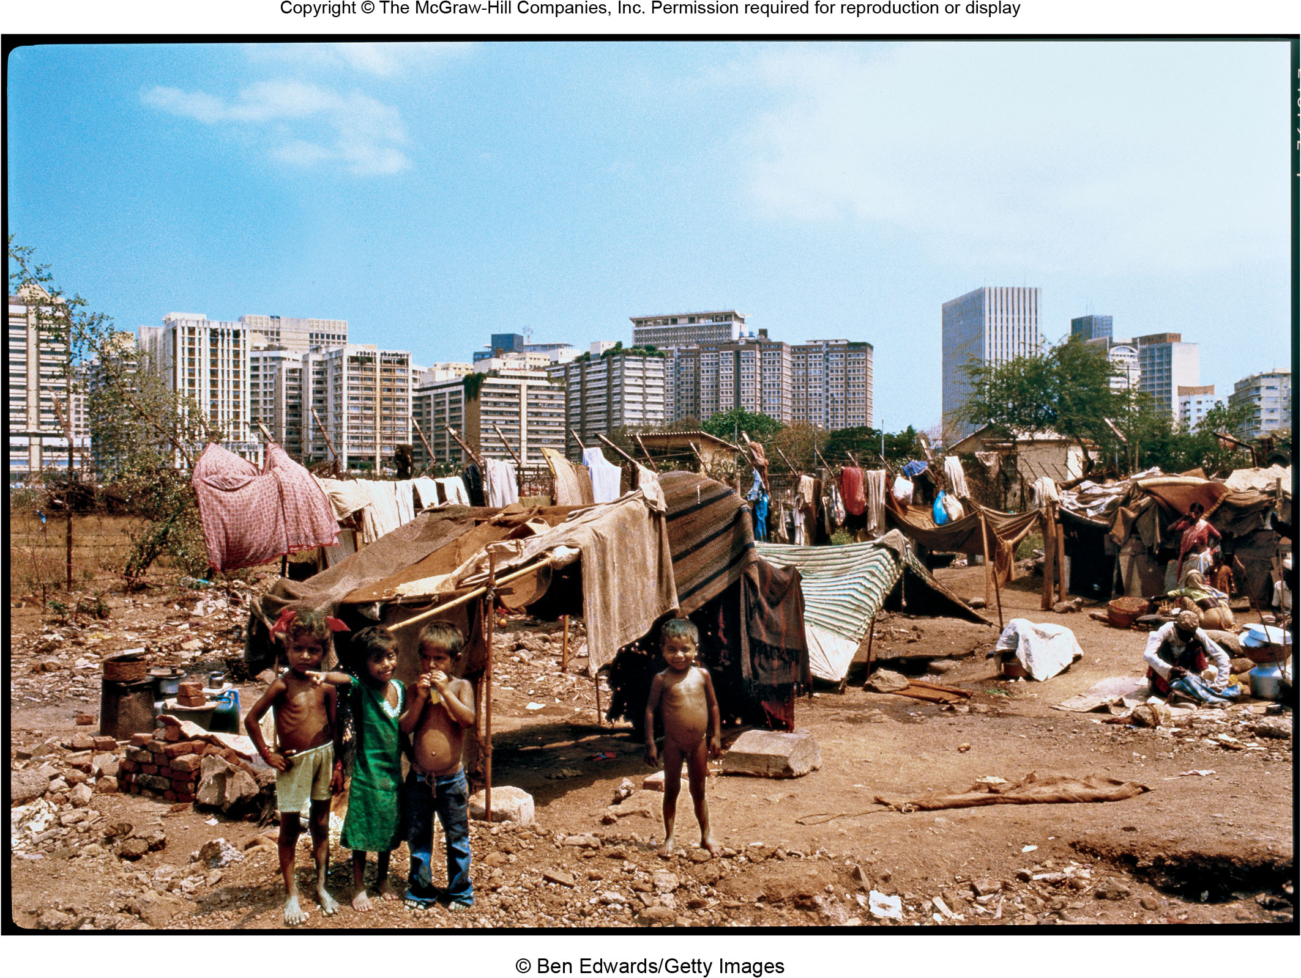
Chapter 18 LECTURE OUTLINE Development & Geography
Human Geography by Malinowski & Kaplan

Slide 2
Chapter 18 Modules
18A Meanings of Development and Development Disparities Today
18B Modernization and Economic Development
18C World Systems Perspective on Development
18D Profiles of Development: The Bottom Billion
18E Possible Solutions to the Development Crisis
18F Export-Led Approaches to Development
18G Structuralist and Sustainable Development Models

Slide 3
18A: Meanings of Development and Development Disparities Today 1
World development focuses on raising the living standards of the poorest countries and reducing disparities among countries
Poor countries are often referred to as the Third World, less developed countries, or the developing world
Rich countries are often referred to as the First World, developed countries, or more developed countries

Slide 4
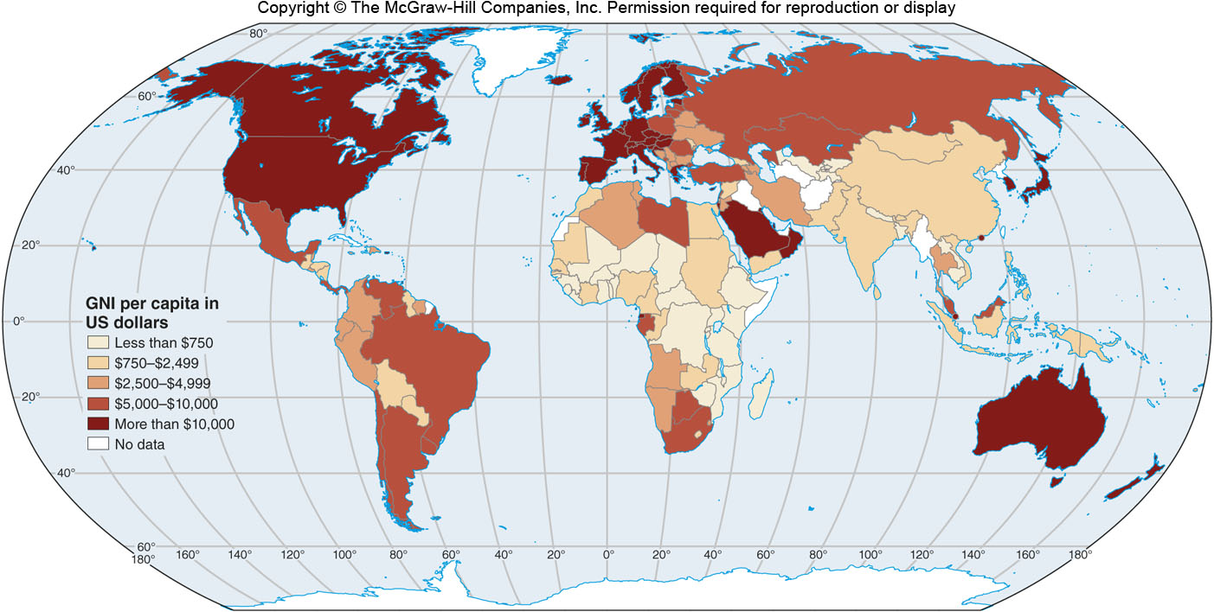
GNI per Capita
Figure 18A.1

Slide 5
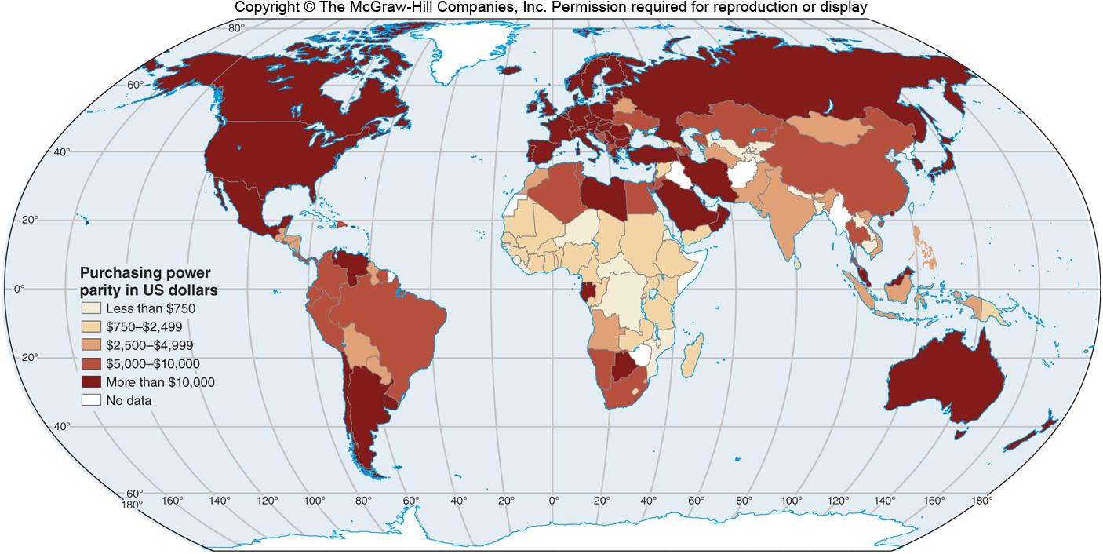
Purchasing Power Parity
Figure 18A.2

Slide 6
18A: Meanings of Development and Development Disparities Today 2
Human Development Index (HDI)
A measure of development that includes measures of income, education, and health (life expectancy)

Slide 7
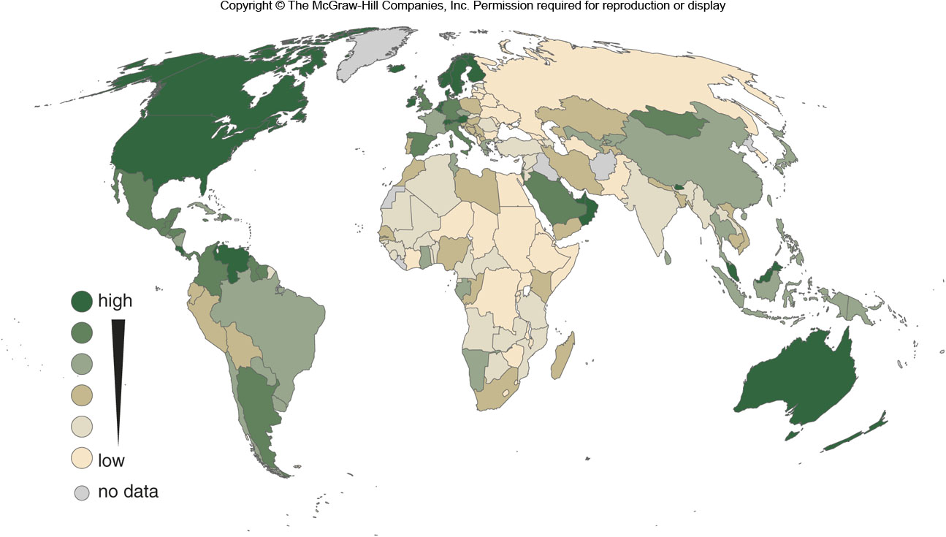
Subjective Well-Being
Figure 18A.4

Slide 8
18B: Modernization & Economic Development 2
Two views on development disparities
Underdevelopment is a function of progress
Underdevelopment is intrinsic to a global economic structure that began with colonialism and persists with neocolonialism
Modernization Theory
For countries to develop, they need to adopt elements of Western society, including values
Neoliberalism

Slide 9
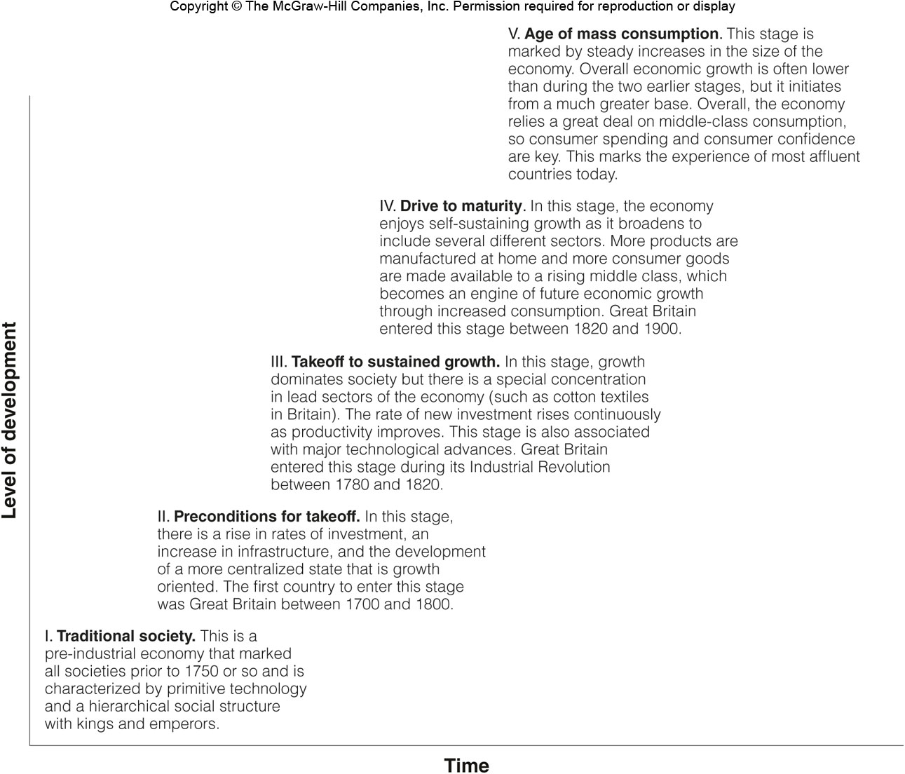
Rostow’s Model
Figure 18B.2

Slide 10
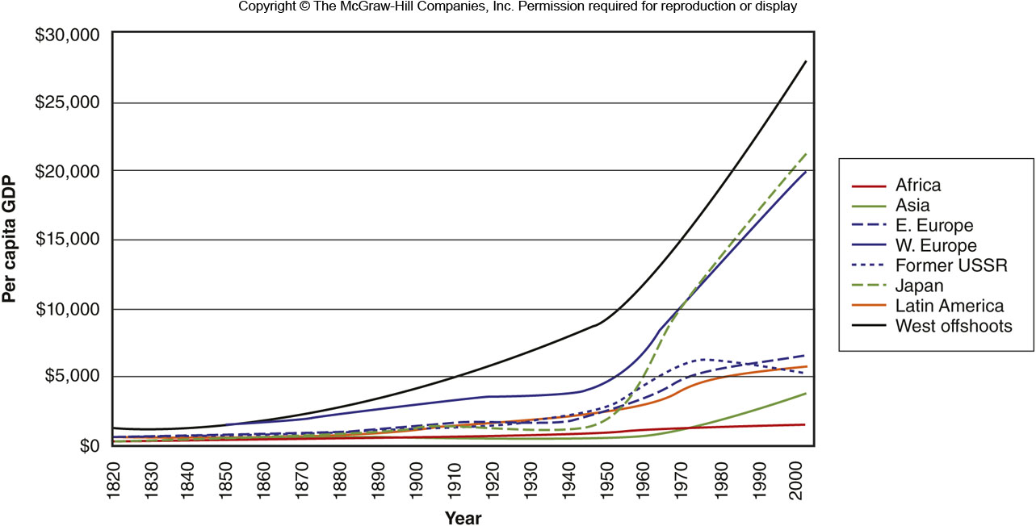
GDP per Capita over Time
Figure 18B.3

Slide 11
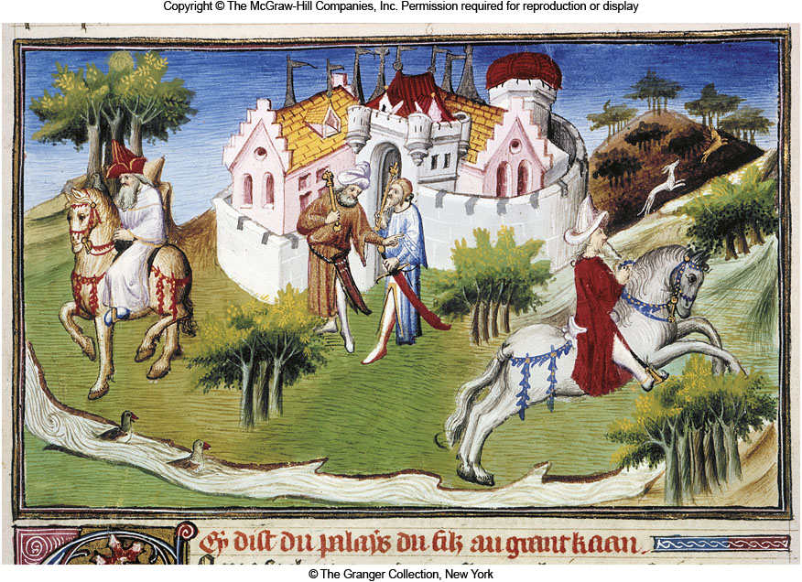
18B: Modernization & Economic Development 2
Jeffrey Sachs viewed development as a process of overcoming a series of development traps

Slide 12
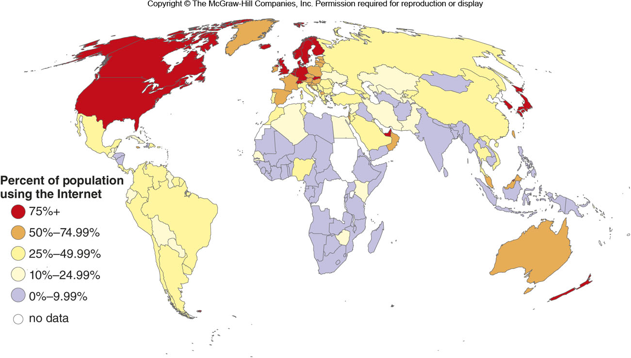
% Using the Internet
Figure 18B.5

Slide 13
18C: World Systems Perspective on Development
A lot of modernization theory is based on a Western model and assumes that each country develops on its own
The world systems perspective views the economic system as a whole

Slide 14
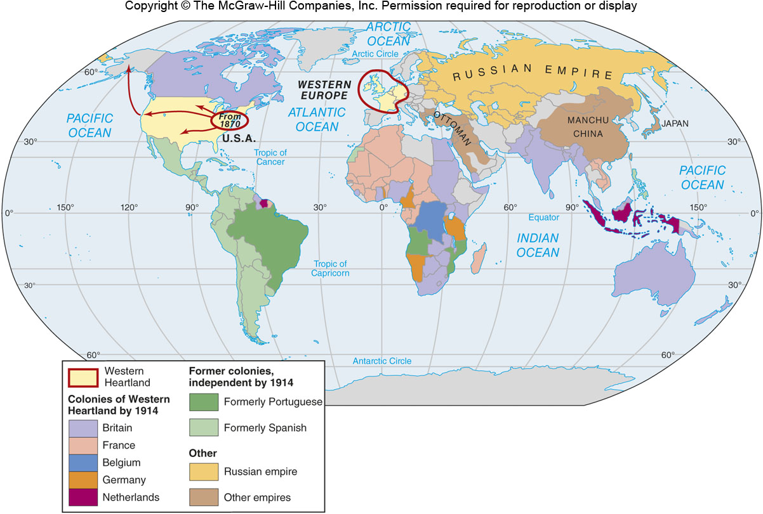
European Colonies
Figure 18C.1

Slide 15
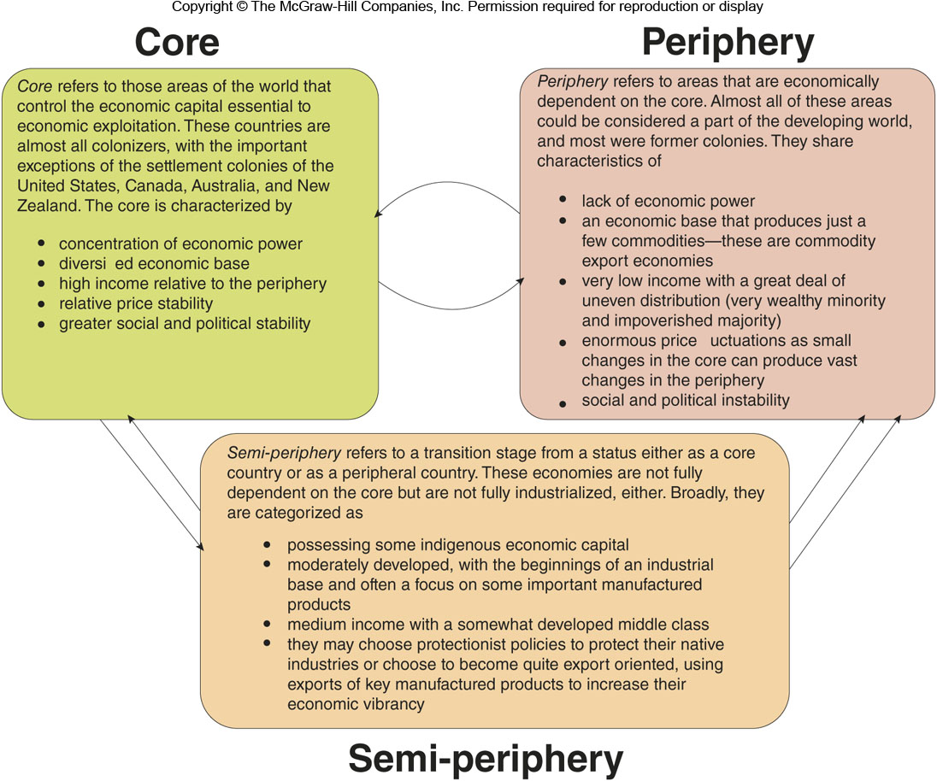
Core-Periphery Relationships
Figure 18C.5

Slide 16
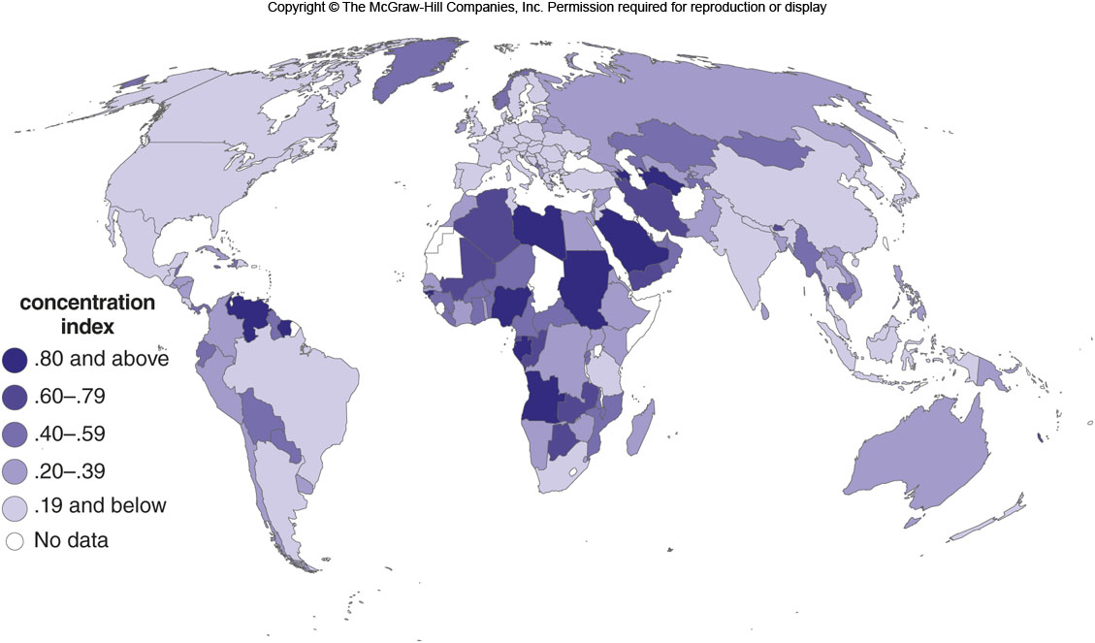
Commodity Export Economies
Figure 18C.6

Slide 17
18D: Profiles of Development: The Bottom Billion
According Collier, there now exists a 3-way stratification of the world’s population
The Fortunate Billion
(Affluent Societies)
The Majority
(Developing Societies)
The Bottom Billion
(Stagnant Economies)

Slide 18
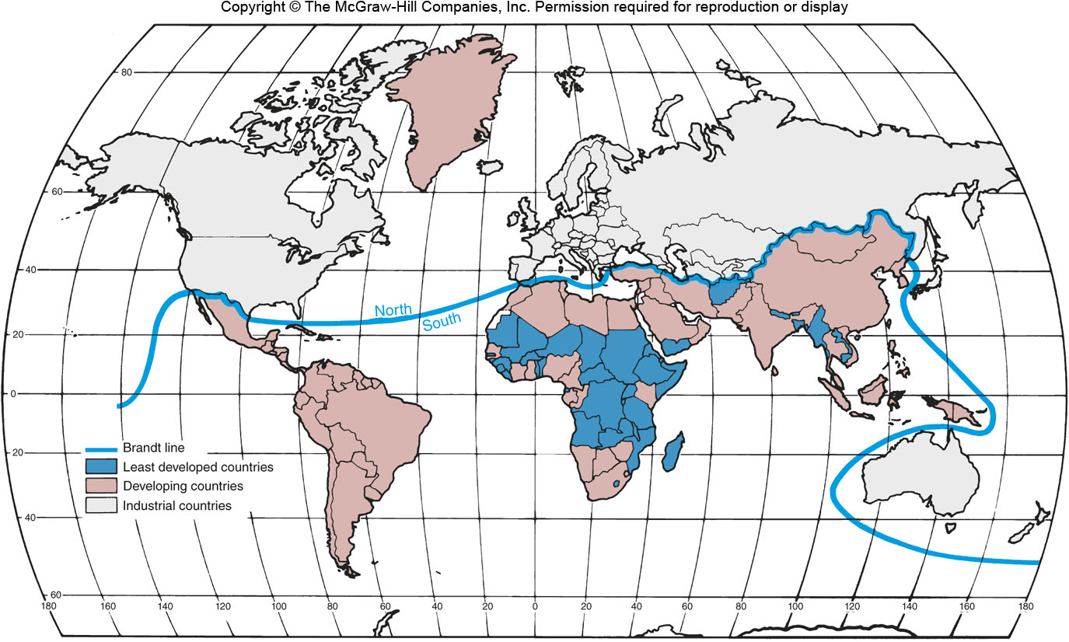
The Undeveloped World
Figure 18D.1

Slide 19
18D: Profiles of Development: The Bottom Billion
According Collier, there now exists a 3-way stratification of the world’s population
The Fortunate Billion
(Affluent Societies)
The Majority
(Developing Societies)
The Bottom Billion
(Stagnant Economies)

Slide 20
18E: Possible Solutions to the Development Crisis
One possible solution is to accelerate economic growth by way of industrialization, but to do so requires a large portion of a country’s economy
To overcome this, countries may begin by manufacturing lower value-added products, such as textiles, before attempting higher value-added products, such as electronics

Slide 21
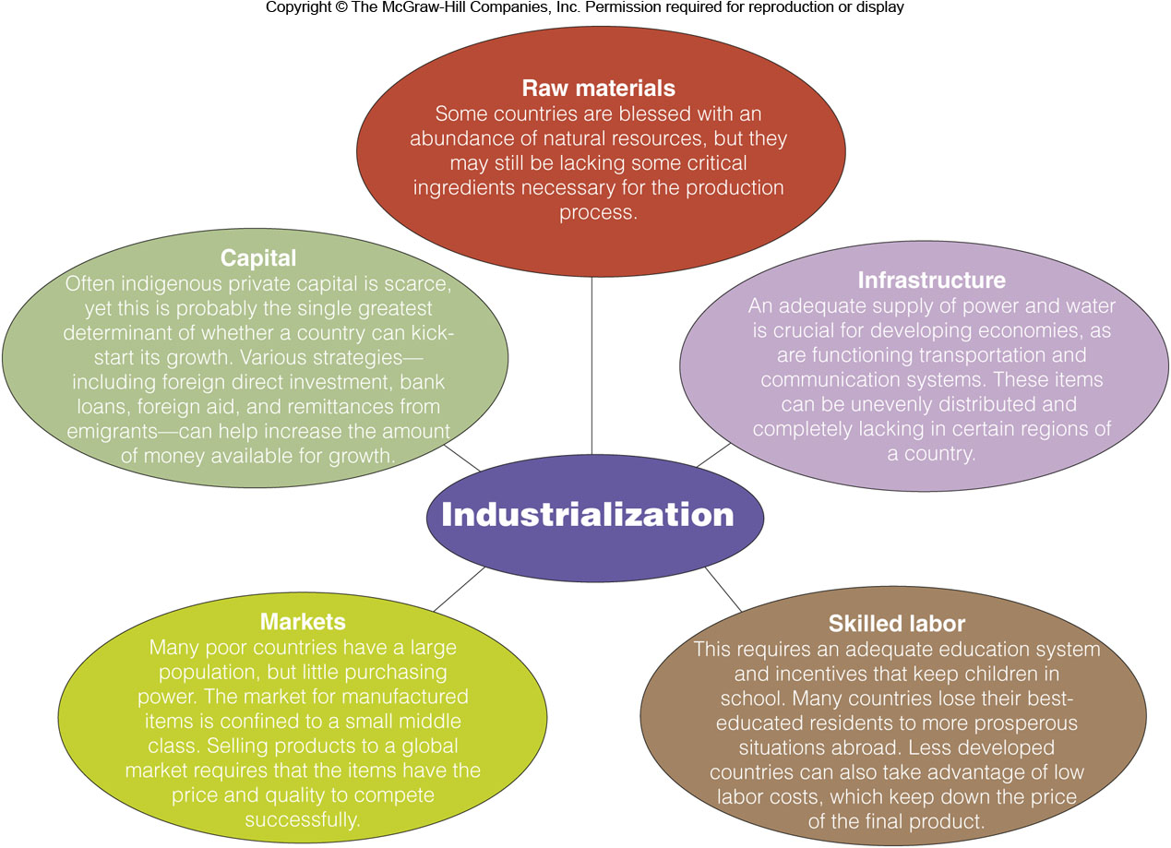
Factors Needed for Industrialization
Figure 18E.1

Slide 22
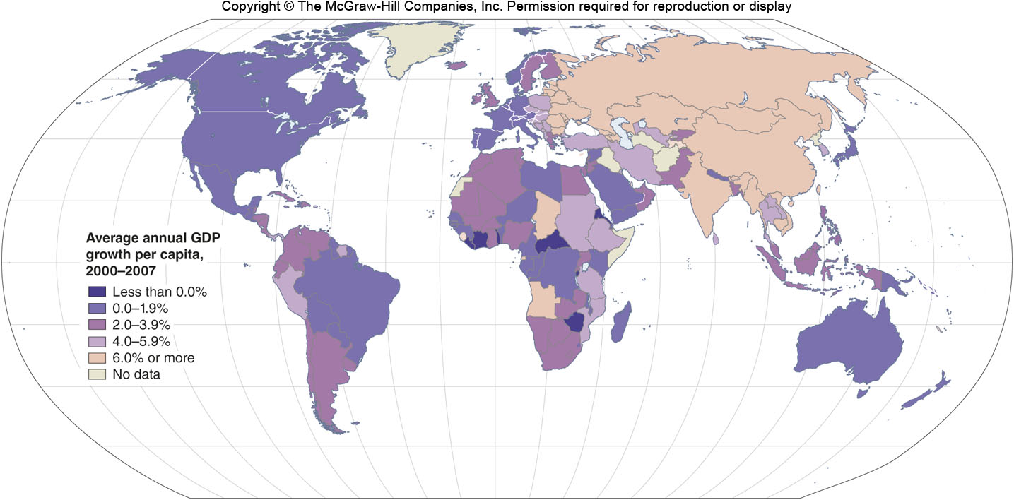
Average Annual GDP Growth per Capita, 2000-2007
Figure 18E.2

Slide 23
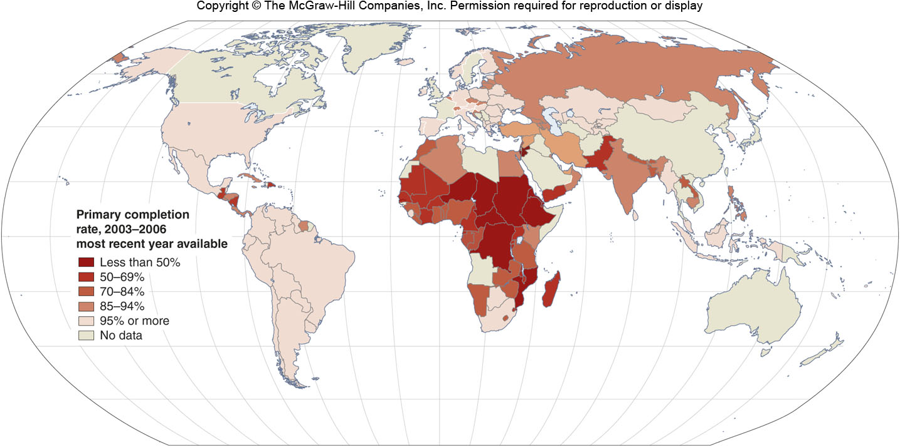
Primary School Completion Rate, 2003-2006
Figure 18E.3

Slide 24
18F: Export-Led Approaches to Development
A view that production of goods for export, sometimes aided by the government, is the key to economic development
The Tiger economies of East Asia successfully employed this strategy
China’s exports may be about 40% of its economy

Slide 25
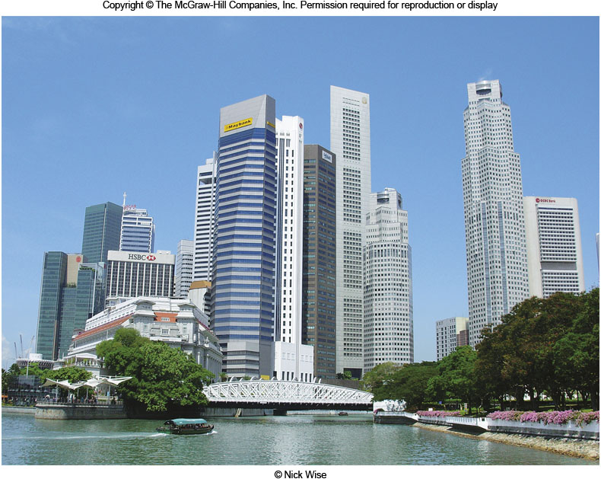
Asian Incomes Relative to the U.S.
Figure 18F.3

Slide 26
18G: Structuralist & Sustainable Development Models
Many approaches to development can be said to fit into the structuralist school of development
Sees government interaction as key
Can be full government control or partial
Import substitution strategies are common
Sustainable development seeks a more even distribution of wealth and protection of the environment

