Slide 1
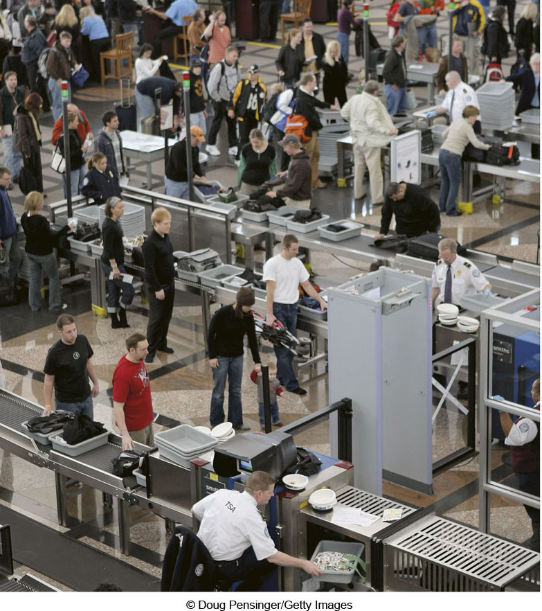
Chapter 5 LECTURE OUTLINE MIGRATION FLOWS
Human Geography by Malinowski & Kaplan

Slide 2
Chapter 5 Modules
5A Migration versus Movement
5B Types of Migration
5C Human Trafficking
5D Refugees
5E Why Do People Migrate?
5F Consequences of Migration
5G Migration History of the United States

Slide 3
5A: Migration versus Movement 1
Migration
A permanent relocation of one’s place of residence & usually long-distance
Can be international or internal
Cyclical Movement
When people move back & forth between two places or among a few locations

Slide 4
5A: Migration versus Movement 2
Periodic Movement
Similar to cyclical movement but longer in duration
Example: guest workers allowed to work in a country for a limited amount of time

Slide 5
5B: Types of Migration 1
Primitive Migration
Hunter / Gatherers
Mass Migration (aka Group Migration)
Involves a large # of people, such as colonialism
Free Migration
Deciding to migrate without coercion, support, or compulsion
Restricted Migration
Migration today is limited by laws, quotas, etc.

Slide 6
5B: Types of Migration 2
Impelled & Forced Migration
Trail of Tears
Japanese-American internment camps
Nazi resettlement
Slavery
Rural-to-Urban Migration

Slide 7
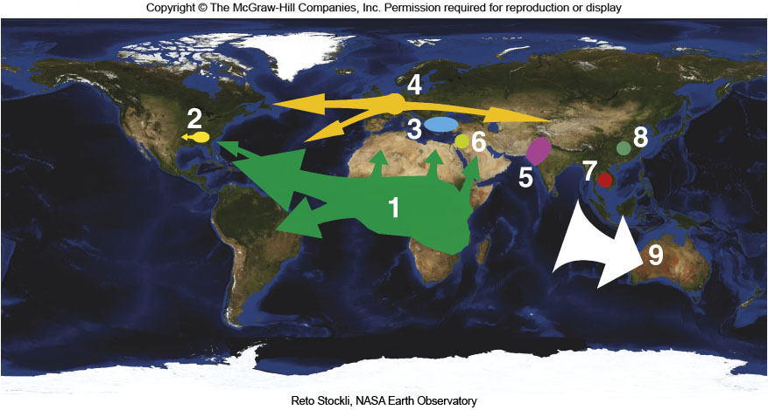
Major World Migrations
Figure 5B.2

Slide 8
Measuring Migration
Gross Migration
The total # of people that leave & enter a country
Net Migration
The difference between the # of people who leave & the # of people who enter
Out-Migration
The total # of people who leave a country
In-Migration
The total # of people who arrive in a country

Slide 9
5C: Human Trafficking
The recruitment, transportation, transfer, harboring or receipt of persons by threat or use of force
600,000 – 800,000 per year
“People Smuggling” is the shipping of people to circumvent immigration laws
Child Soldiers
~ 300,000 children

Slide 10
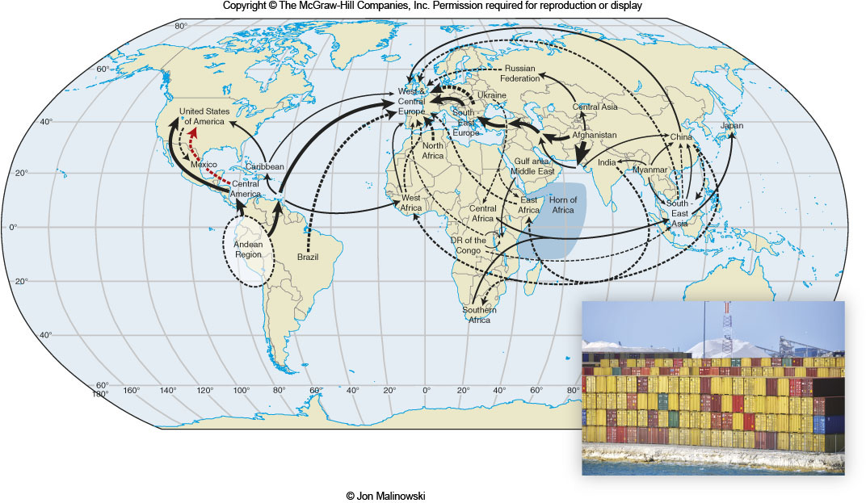
People Smuggling
Figure 5C.1

Slide 11
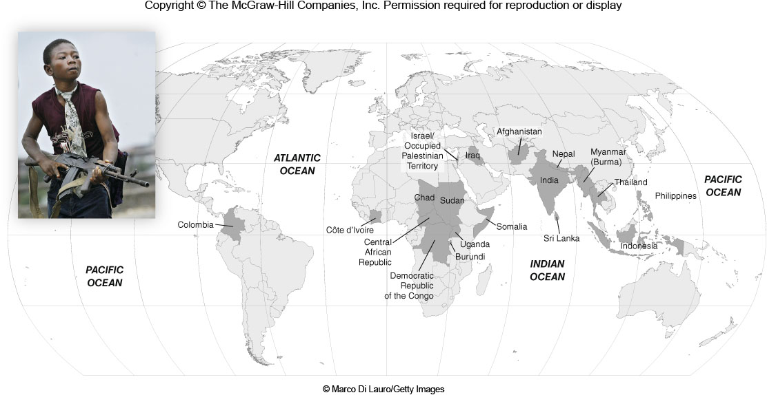
Child Soldiers
Figure 5C.3

Slide 12
5D: Refugees
A person living outside of his or her own country who cannot return home because of fear of injury or persecution.
12 million people worldwide are refugees or seeking asylum
Internally Displaced Persons
A person displaced in his or her own country
About 24 million people worldwide
Repatriation
The process of moving refugees back into their home country

Slide 13
5E: Why do People Migrate? 1
Ravenstein’s Laws
More people migrate a short distance than a long distance
There is a flow of migrants from remote areas to less remote areas and finally to the cities.
Step Migration
Flows of migration also create small counterflows.
Long-distance migrants are more likely to be heading to a major city.
Urban residents are less likely to migrate than are people who live in the country.
Women migrate more than men, but they tend to migrate shorter distances. Ravenstein believed that long-distance migrants were more apt to be men.

Slide 14
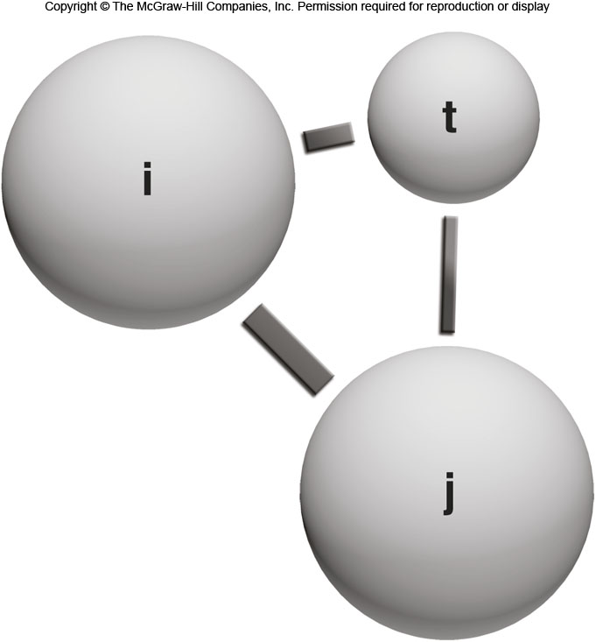
5E: Why do People Migrate? 2
Distance Decay
As the distance between two places increases, the volume of interaction between these places decreases
Also known as Zipf’s Law
Gravity Model
Postulates that the interaction between two cities is a function of each city’s population and the distance between them

Slide 15
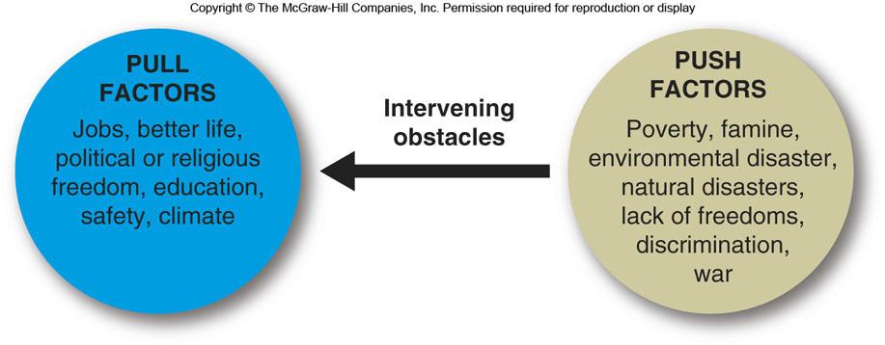
5E: Why do People Migrate? 3
Push-Pull Model
Everett Lee, 1966
Intervening obstacles may affect a migrant’s decision

Slide 16
5E: Why do People Migrate? 4
Intervening Opportunities
While migrating from A to B, migrants may become aware of other opportunities
Life Cycle Factors
Migrants move at significant times in their lives
Factor Mobility Model
Argues that migrants move from low- to high-wage areas
Human Capital Model
People move for both economics and for personal reasons

Slide 17
5F: Consequences of Migration
Demographic Consequences
Migration can change the size, age composition, and ethnic composition of a population
Economic Consequences
Positive or negative
Do migrants help or hurt a country?
Social Consequences
Can lead to cultural assimilation or cultural conflict

Slide 18
5G: Migration History of the U.S.
Colonial Period
1600 – American Revolution
Mostly Northern Europeans & African Slaves
1st Wave of European Immigration
1800 – 1880
Western & Northern Europeans
2nd Wave of European Immigration
1880 – 1921
Hundreds of thousands per year

Slide 19
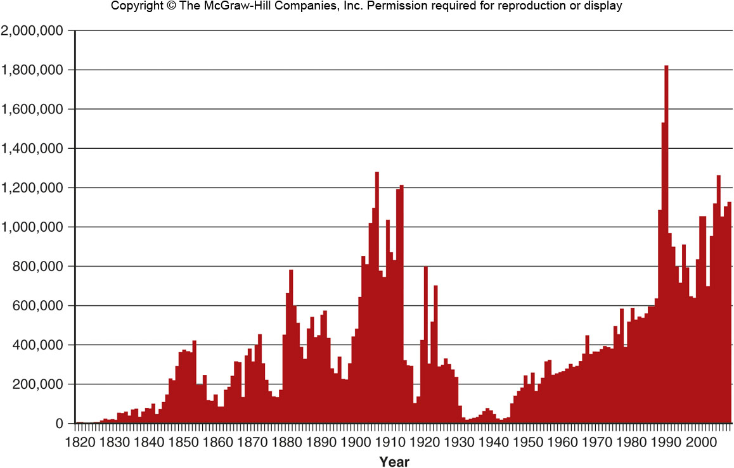
U.S. Immigration by Year
Figure 5G.1

Slide 20
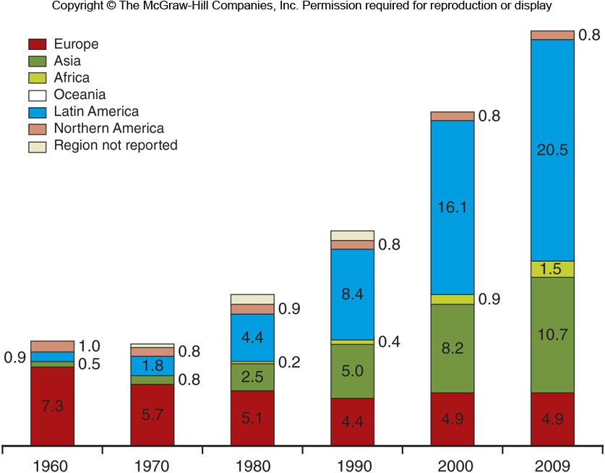
U.S. Immigration Region
Figure 5G.4

