Slide 1
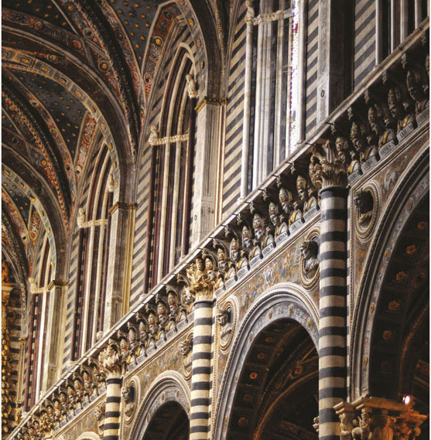
Chapter 8 LECTURE OUTLINE The Geography of RELIGION
Photo © Jon Malinowski.
All rights reserved. Used with permission.
Human Geography by Malinowski & Kaplan

Slide 2
Chapter 8 Modules
8A Classifying Religions
8B Major World Religions
8C Hinduism
8D Buddhism
8E Judaism
8F Christianity
8G The Spread and Distribution of Christianity
8H Islam
8I Other Large Religious Groups
8J Landscapes of Religion

Slide 3
8A: Classifying Religions
Religion
A cultural system of beliefs, traditions, and practices often centered around the worship of a deity or deities
Universalizing religions
Religions that seek to convert nonbelievers
Examples: Christianity, Islam
Ethnic religions
A religion closely associated with a particular ethnic group
Examples: Judaism, Hinduism

Slide 4
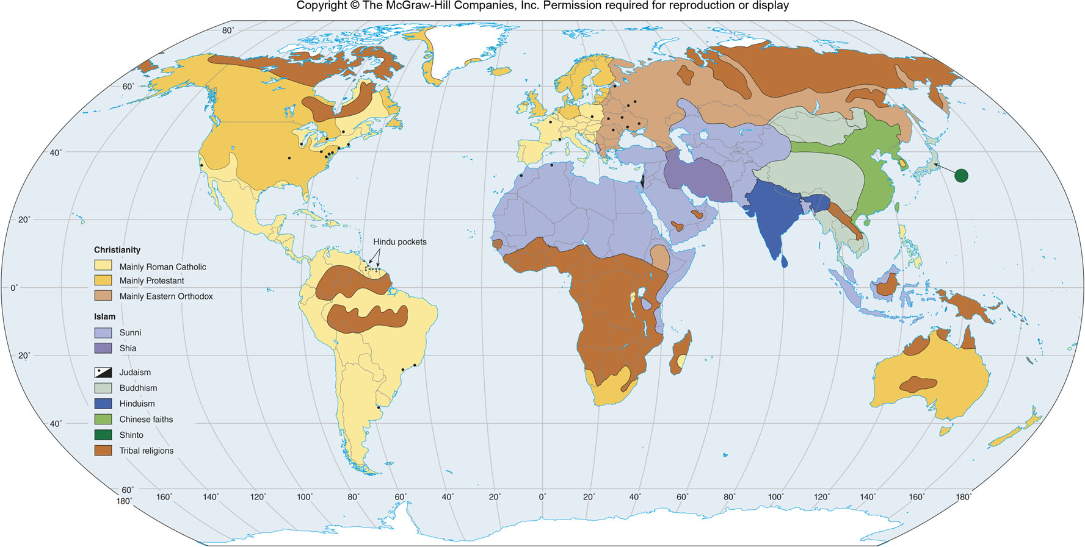
World Religions
Figure 8B.1

Slide 5
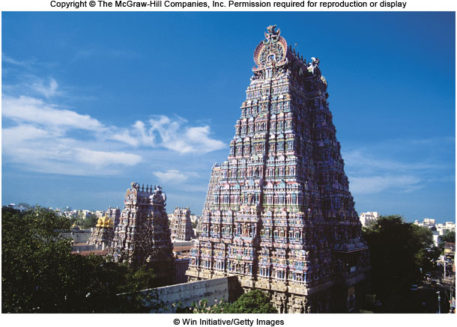
8C: Hinduism
At least 4,000-5,000 years old
Geographically concentrated in India and British colonial areas
1 million Hindus in the United States

Slide 6
8C: Hindu Beliefs
Dharma
One’s duties or obligations in life
Basis of the caste system
Karma
Every action has consequences
Can affect your next life
Reincarnation
A person’s soul goes through cycles of death and rebirth
When an organism dies, the soul passes to another life form
The cycle can be broken (moksha)

Slide 7
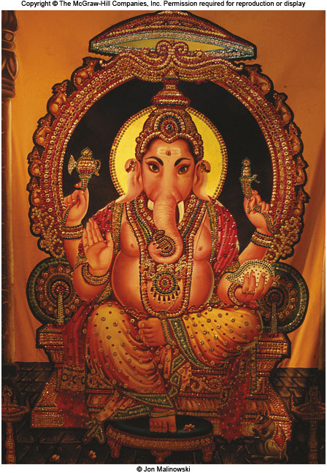
8C: Hindu Worship
Polytheistic
Millions of gods and goddesses
Vishnu & Shiva have large sects
The Vedas
Holy books
Worship is more individual than communal
Ganesh

Slide 8
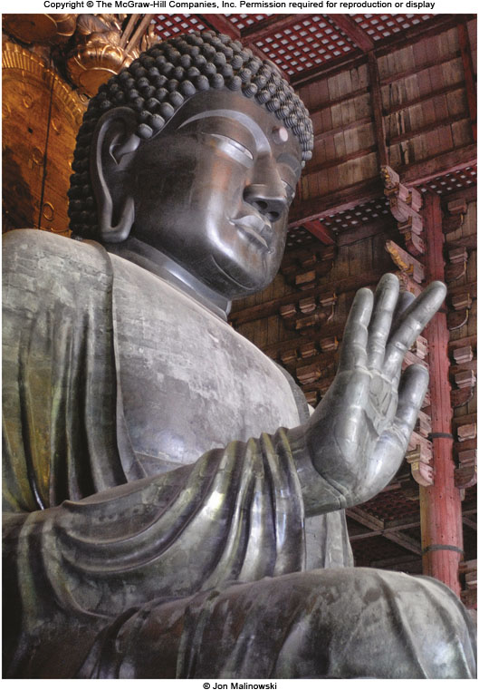
8D: Buddhism 1
Based on the teachings of Siddhartha in the 5th-6th century BCE
Buddhists believe that all living things are reborn, but the cycle can be broken
Four Noble Truths
Life is suffering
Suffering is caused by desire and craving
Suffering can be ended
Desire can be eliminated through the Eightfold Path

Slide 9
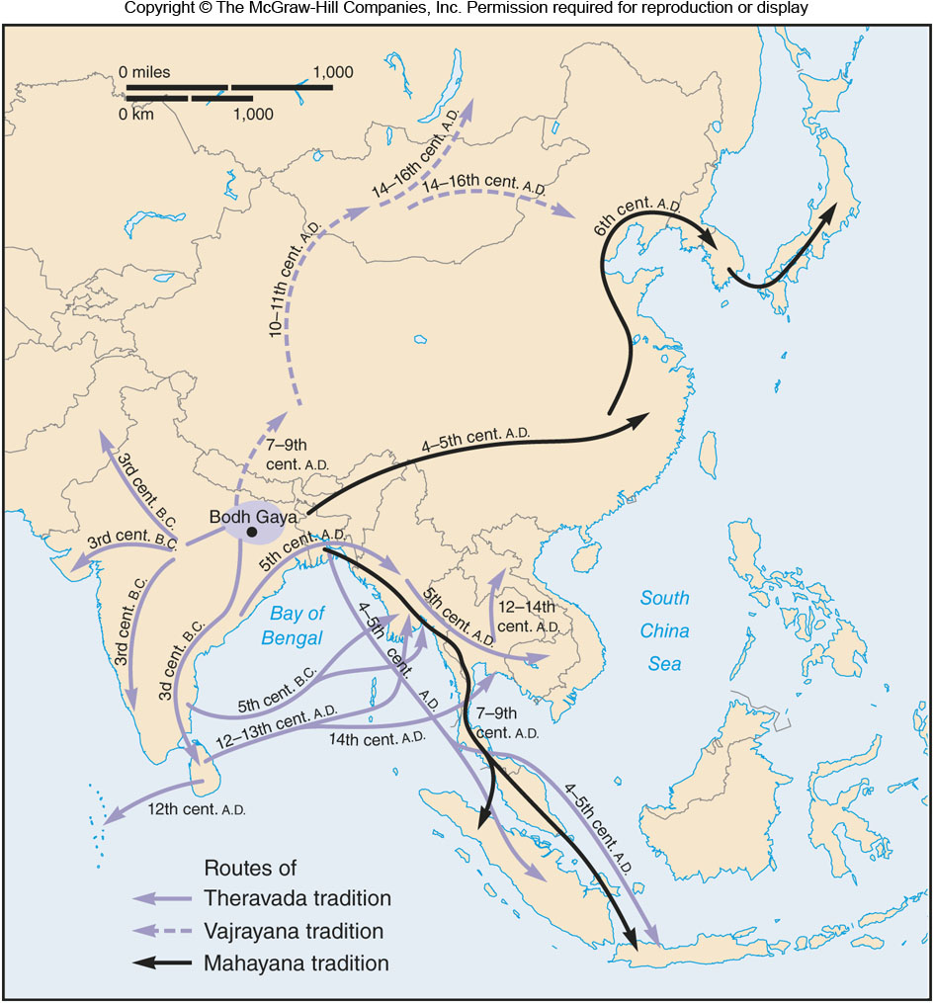
8D: Buddhism 2
After Buddha’s death, his teachings were passed down and eventually written down in the Pali Canon
Over time, Buddhism spread into 3 main forms
Theravada
Southeast Asia
Mahayana
China, East Asia, Southeast Asia
Vajrayana
Tibet & Mongolia

Slide 10
8E: Judaism 1
Small but influential faith
Ethnic religion
Believe themselves to be the chosen people of God
Expelled from what is now Israel by the Romans
The Diaspora
Jewish populations settled throughout the Middle East, North Africa, and southern Europe

Slide 11
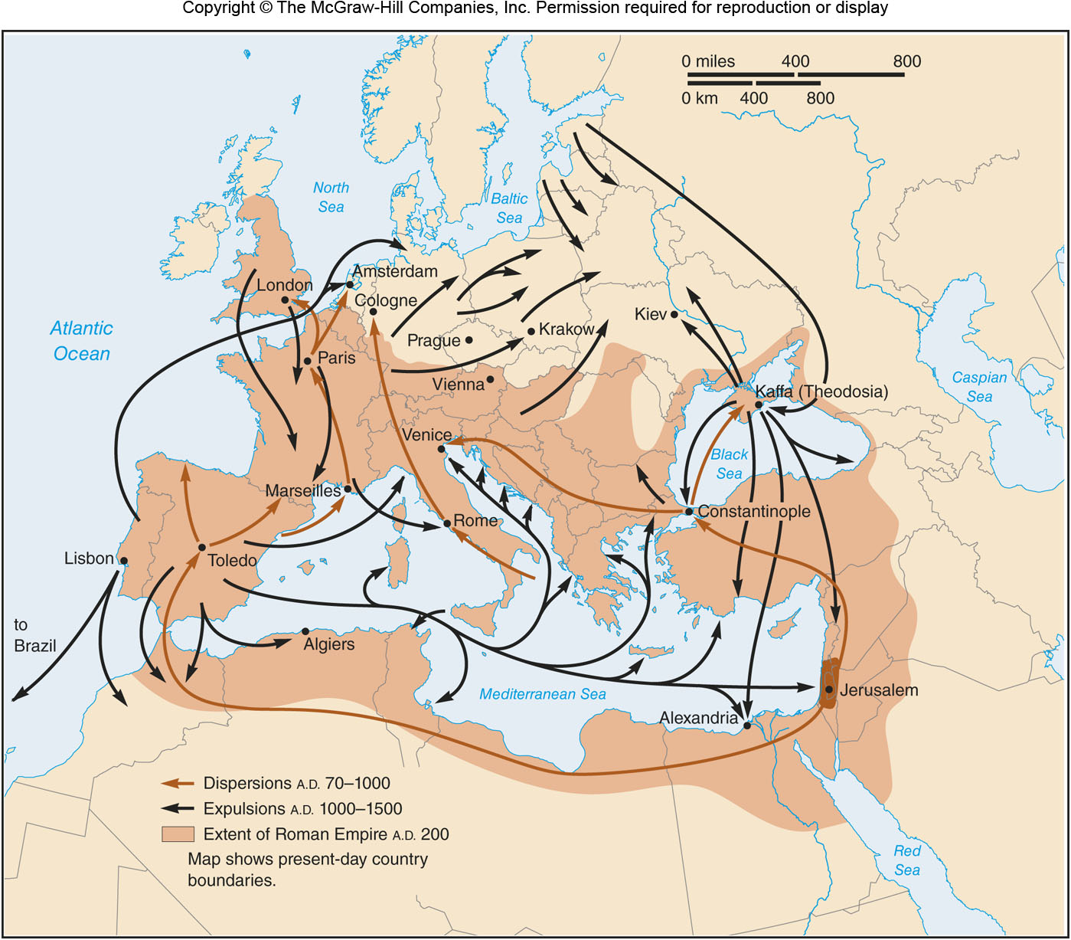
The Diaspora
Figure 8E.1

Slide 12
8E: Judaism 2
Worship in synagogues or temples
Believe God gave humans his law through the Torah
Sabbath is Friday night and Saturday
Numerous annual holidays
Observant Jews are required to keep a kosher diet

Slide 13
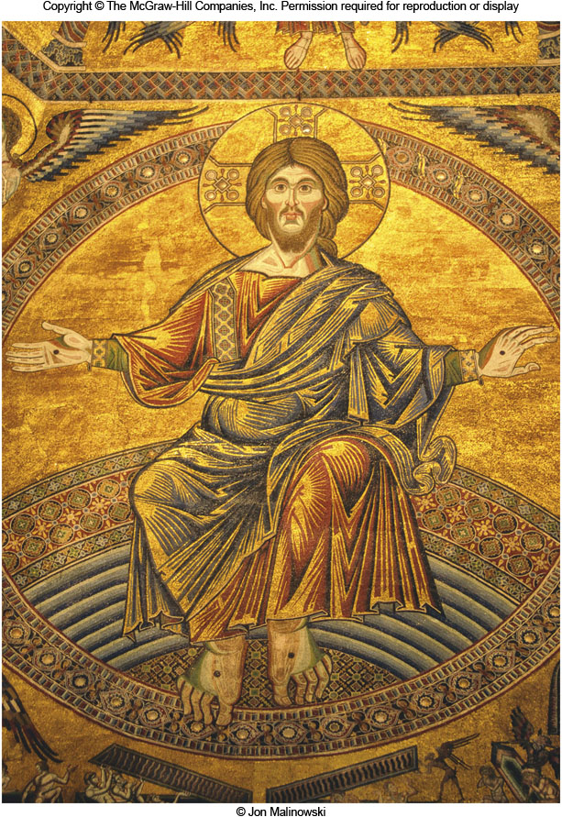
8F: Christianity 1
Over 2 billion adherents
Rooted in the Jewish tradition
Believe that Jesus is the Messiah
Christ is Greek for anointed one
Wide variety in ways that Christians worship
Sabbath is Sunday

Slide 14
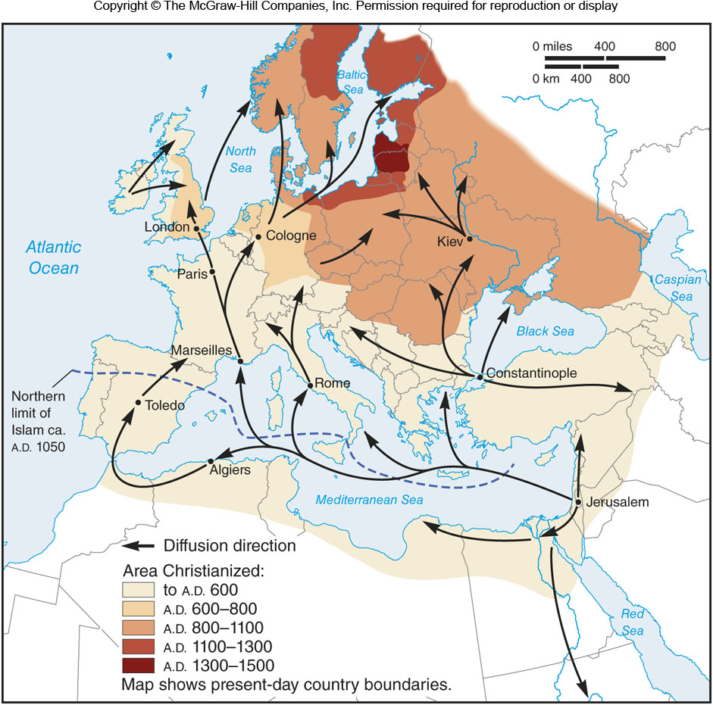
The Spread of Christianity in Europe
Figure 8G.1

Slide 15
8H: Islam 1
Younger than the other major world religion
Origins in the 6th-7th century C.E. and the Prophet Muhammad
The Islamic calendar begins with the Hijra in 622 C.E.
Primary source of Muslim belief is the Qur'an, which Muslims believe contain the actual words of God revealed to Muhammad
Disagreements over succession after Muhammad’s death led to the split between Sunnis and Shi’ites

Slide 16
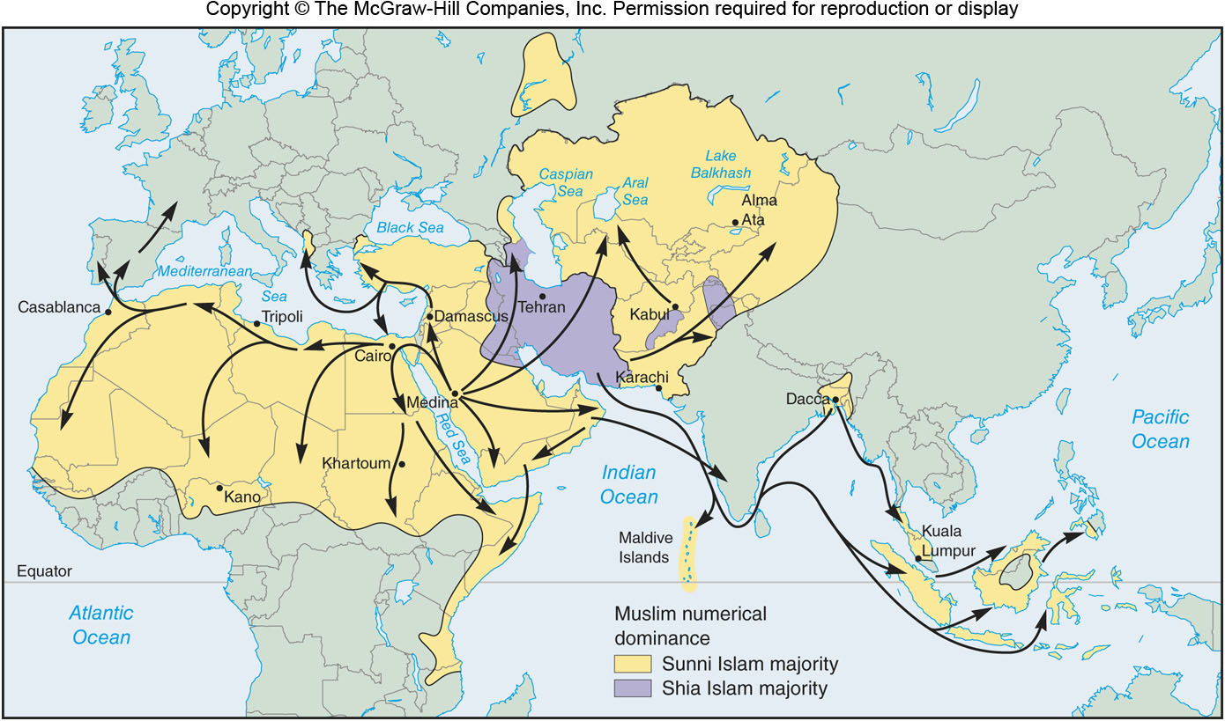
Diffusion of Islam
Figure 8H.3

Slide 17
8H: Islam 2
Five Pillars of Islam
A confession of faith, known as the Shahadah. It is, simply, “There is no god but God, and Muhammad is His Prophet.”
Prayer. Muslims are expected to pray five times a day. During prayer, Muslims face in the direction of Mecca, no matter where they are in the world.
Charity. Muslims, except the poor, are expected to give one-fortieth of their income and possessions to the poor each year.
Observance of the holy month of Ramadan. During Ramadan, Muslims fast during the day and only take food or drink in moderation at night.
Pilgrimage, or the Hajj. Every able-bodied Muslim who can afford the journey is expected to make a pilgrimage to Mecca once during his or her lifetime.

Slide 18
8I: Other Large Religious Groups 1
Chinese folk religions
Confucianism
Began in the 5th-6th centuries B.C.E.
Emphasizes proper relationships in society
Taoism
Mystical and esoteric
Focused on morality, self-restraint, & humility
African Traditional Religion
A catch-all term for dozens of traditions
Animistic
Emphasis is on maintaining order in society

Slide 19
8I: Other Large Religious Groups 2
Sikhism
Founded by Guru Nanak in the 15th century in what is now Punjab in India/Pakistan
Rejected key ideas of Hinduism and Islam, the key religions in the area
About 20 millions adherents worldwide
Jainism
Developed as a reaction to Hinduism in the 6th century B.C.E.
Goal is to eliminate sources of bad karma

Slide 20
8I: Other Large Religious Groups 3
Baha'i
Founded in the 19th century in what is now Iran & Iraq
Universalizing. Seeks to unite all the peoples of the world
About 6 millions adherents
Shinto
Ancient, ethnic, religion of Japan
Animistic
Most Japanese will engage in both Shinto and Buddhist religious activities

Slide 21
8J: Landscapes of Religion 1
Unique buildings
Churches, mosques, temples, etc.
Some cities are organized around religious buildings
Religions also have internal geographies, like dioceses in the Catholic Church
Cemeteries, religious schools, monuments, etc.
Pilgrimage sites
Sacred vs. profane landscapes

Slide 22
8J: Landscapes of Religion 2
Types of Sacred Places (after Jackson & Henrie):
Historical sites
Western Wall (Judaism)
Karbala, Iraq (Shi’ite Muslims)
Homelands
Chaco Canyon, New Mexico was home to Puebloan Indians
Mystico-Religious Sites
Places where the religion feels that a deity came into contact with humans
Dome of the Rock (Muslims)
Bodhi Tree (Buddhists)

