Slide 1
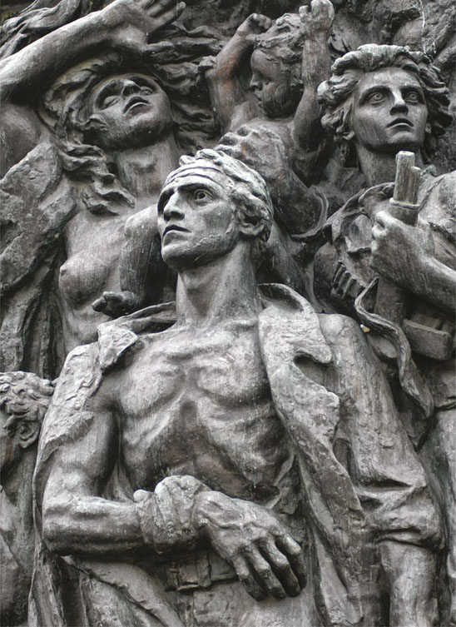
Chapter 9 LECTURE OUTLINE race, ethnicity, & gender
Photo © Jon Malinowski.
All rights reserved. Used with permission.
Human Geography by Malinowski & Kaplan

Slide 2
Chapter 9 Modules
9A What is Ethnicity?
9B The Life of an Ethnic Group
9C The Geography of Ethnicity
9D Ethnicity in the United States
9E Ethnic Provinces
9F Gender and Geography
9G The Global Geography of Gender

Slide 3
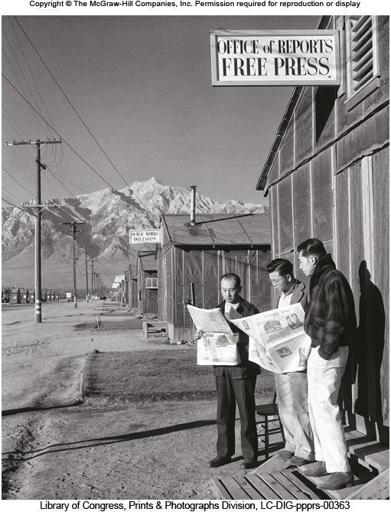
9B: The Life of an Ethnic Group 1
Emergent Ethnicity
The creation of an ethnic identity
Resurgent Ethnicity
An ethnic identity that has faded and then reemerges

Slide 4
9B: The Life of an Ethnic Group 2
Acculturation
The process of learning to operate in a new culture
Assimilation
The adoption of a new culture and the abandonment of aspects of the original culture
Cultural assimilation
Immigrant has adopted enough culture traits to be a functioning member of a new culture
Functional assimilation
The fusion of an ethnic group with the majority society

Slide 5
9C: The Geography of Ethnicity 1
Ethnic Neighborhood
Areas within cities that have concentrated populations of a particular ethnic group
Ghetto
Originally, an Italian term for areas of cities where Jews were forced to live
More broadly, poor urban neighborhoods where minorities are concentrated
Ethnoburb
A suburban area with a strong ethnic concentration

Slide 6
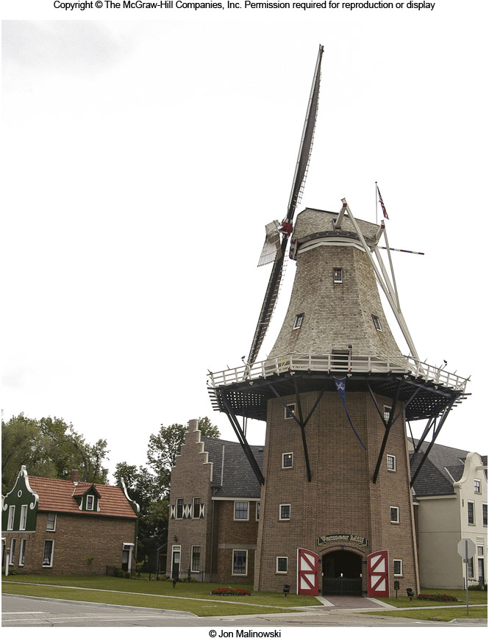
9C: The Geography of Ethnicity 2
Ethnic Island
Areas of ethnic concentration in rural or non-urban areas
Sometimes formed through cluster migration

Slide 7
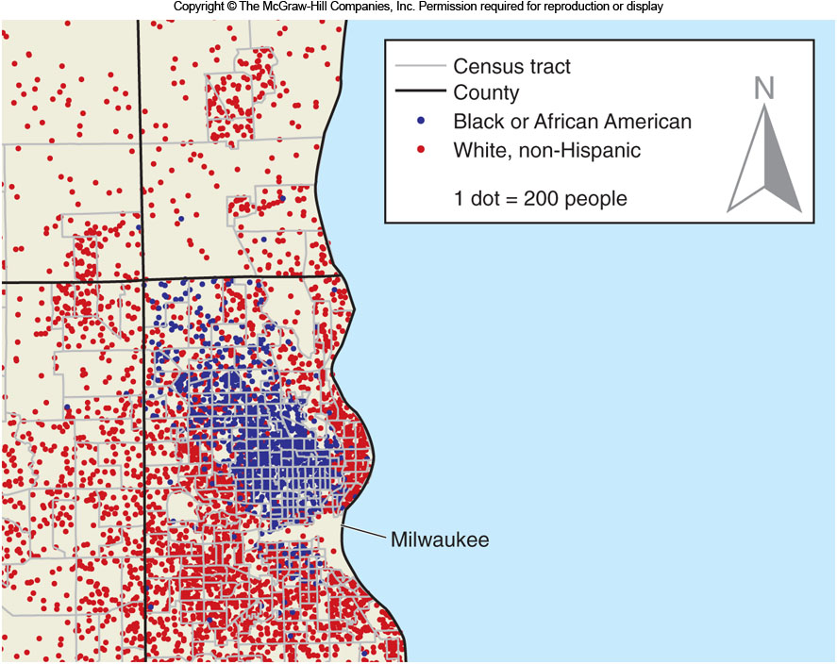
9C: Segregation
The separation between social or ethnic groups
Index of Dissimilarity
A common measure of segregation

Slide 8
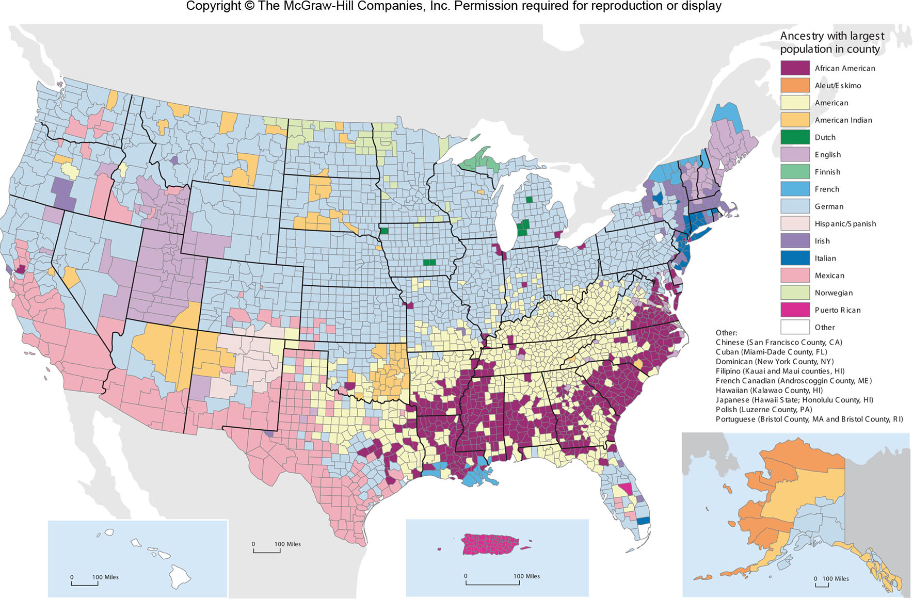
Ancestral Groups in the U.S.
Figure 9D.1

Slide 9
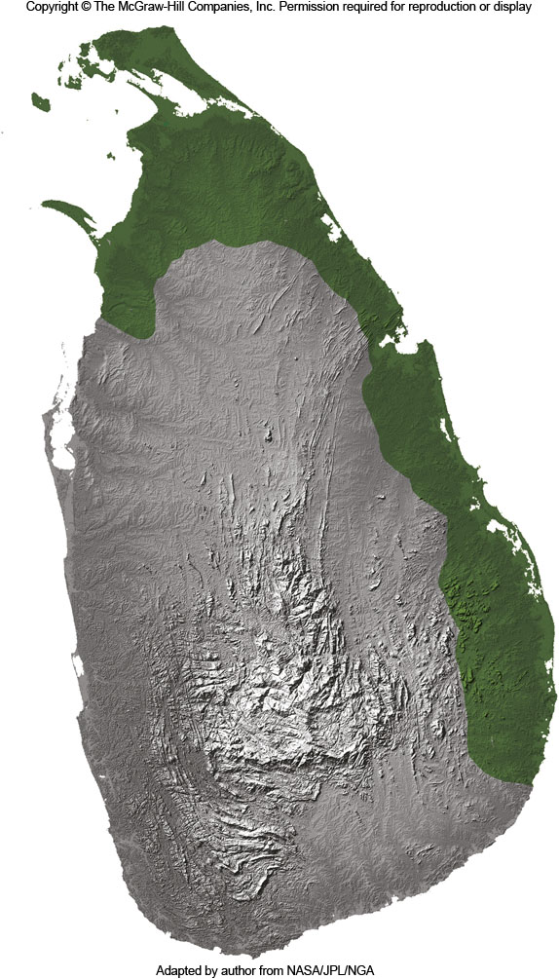
9E: Ethnic Provinces
Large areas associated with a particular ethnic group
Examples: Quebec, the Southwestern U.S.
Often related with political conflict
West Papua in Indonesia
Tamil areas of Sri Lanka

Slide 10
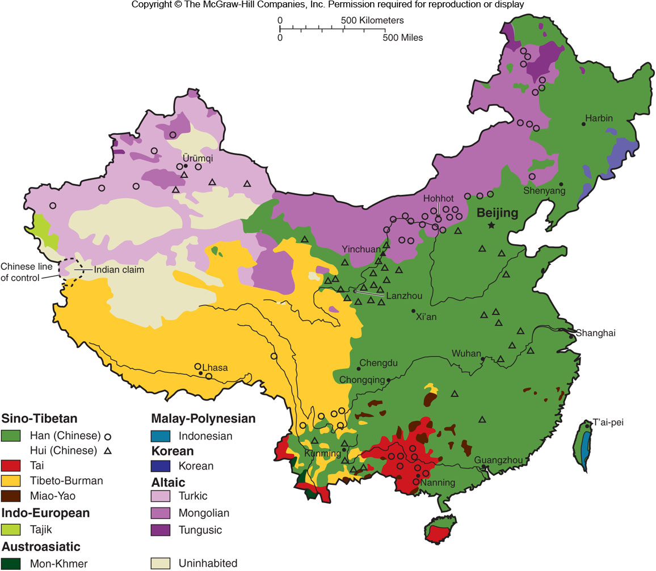
Ethnolinguistic Regions of China
Figure 9E.2

Slide 11
9F: Gender & Geography
Feminist Geography
Focuses on gender roles & how gender affects the way we interact with the world
Gender
Societal norms & behaviors that are expected of males or females
What spaces are considered male, female, and gender neutral in our society?

Slide 12
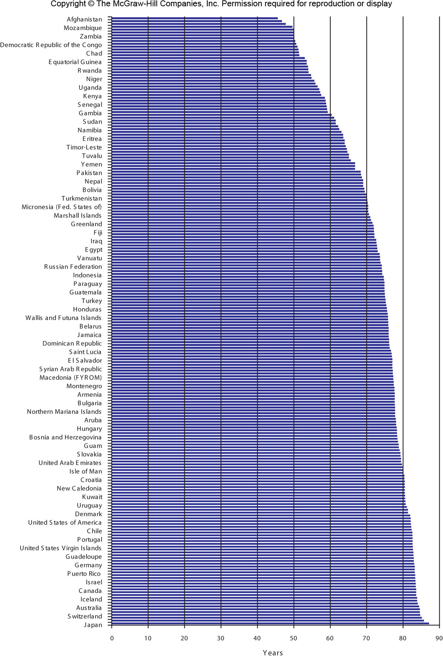
Female Life Expectancy
Figure 9G.1

Slide 13
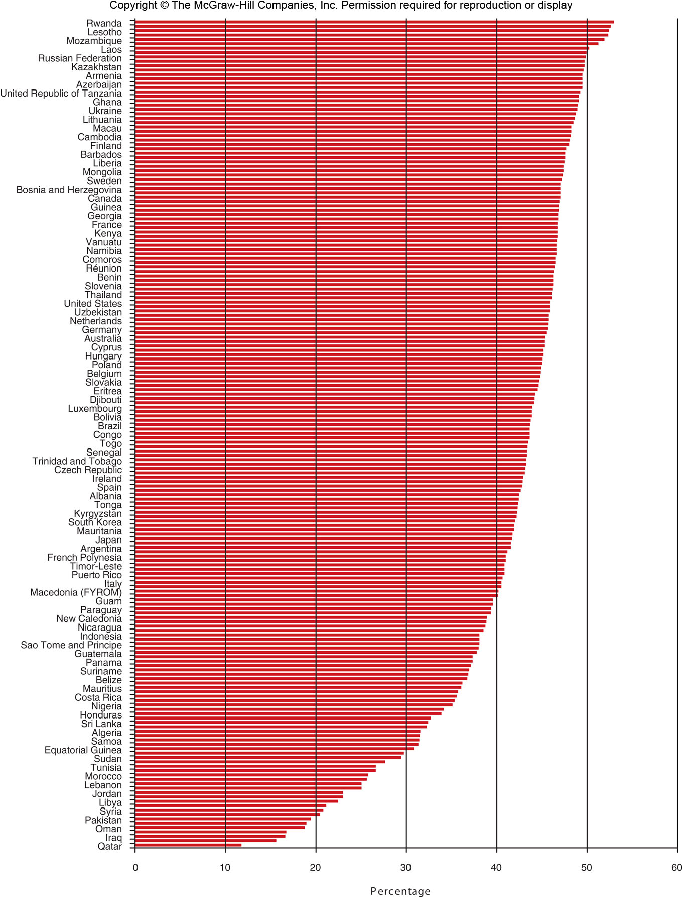
Share of Women in
the Adult Labor Force
Figure 9G.2

