Slide 1
Chapter 18
States and Societies of Sub-Saharan Africa

Slide 2
Effects of Early African Migrations
Bantu-speaking peoples settle south of equator
Agriculture, herding spreads with Bantu migrations
Iron metallurgy

Slide 3
Cultivation of Bananas
Domesticated in southeast Asia
Malay sailors colonize Madagascar, 300-500 C.E.
Introduce bananas, yams, chickens
Well-adapted to African climate
Food supply increases with this key crop

Slide 4
Population Growth

Slide 5
Kin-Based Societies
Stateless, segmented societies
No elaborate hierarchies, bureaucracies
Average population of village: one hundred
Ruled by elders
Network of villages resolve disputes in ad hoc manner
Higher government authorities rare

Slide 6
Chiefdoms
Population pressures after 1000 C.E. increase competition, disputes
Small chiefdoms appear, overrule kin-based groups
Small kingdoms form
Ife, Benin

Slide 7
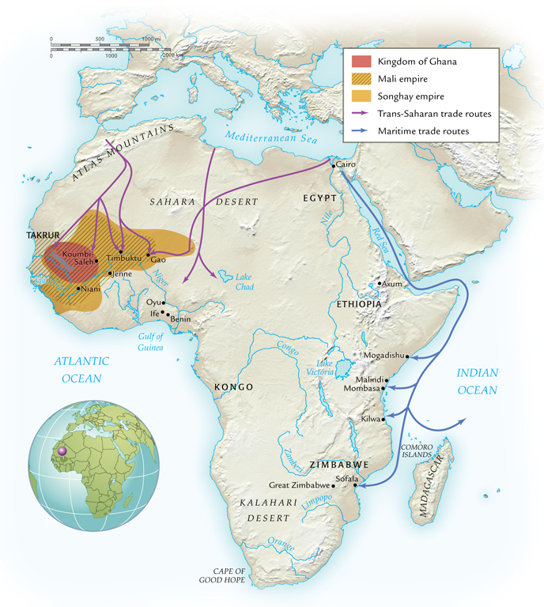
Kingdoms, Empires, and City-States of Sub-Saharan Africa, 800-1500 C.E.

Slide 8
Kingdom of Kongo
Basin of the Congo (Zaire) river
Conglomeration of several village alliances
Participated actively in trade networks
Most centralized rule of the early Bantu kingdoms
Royal currency: cowries
Ruled fourteenth to seventeenth century, until undermined by Portuguese slave traders

Slide 9
Islamic Kingdoms and Empires
Islam spreads to west Africa
Trans-Saharan caravans
Coastal east Africa through maritime trade
Profound influence after eighth century

Slide 10
Trans-Saharan Trade and Islamic States in West Africa
Desiccation of Sahara begins ca. 5000 B.C.E.
Introduction of Arabian camels revolutionizes trade
70-90 days to cross Sahara
Arabs establish trading communities
Gao

Slide 11
The Kingdom of Ghana
Not related to modern State of Ghana
Developed fourth to fifth century C.E.
Protection against camel-driving raiders
Center of African gold trade
Imported from south to Ghana
Also sold ivory, slaves

Slide 12
Koumbi-Saleh
Capital of kingdom of Ghana
Principal trading center
High point ninth to twelfth century
Population 15,000-20,000
Military, cultural center

Slide 13
Islam in West Africa
Kings of Ghana convert, tenth century
Positive impact on trade, relations with north Africa
Synthesized Islam with local traditions
Nearby Takrur, aggressive missionaries

Slide 14
Sundiata (r. 1230-1255)
Empire of Mali extends over kingdom of Ghana
Neighboring kingdoms as well
Took greater advantage of trans-Saharan trade
Nominally Muslim, but did not force conversions

Slide 15
Mansa Musa (r. 1312-1337)
Grand-nephew of Sundiata
Fervent Muslim
Performed hajj in 1324-25
Constructed numerous mosques
Supported Muslim scholars
Empire declines after his rule

Slide 16
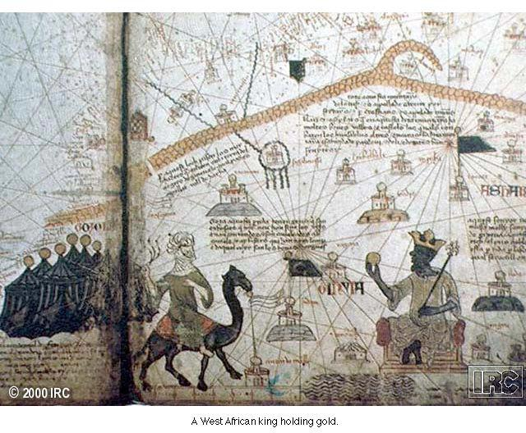
Mansa Musa

Slide 17
The Indian Ocean Trade and Islamic States in East Africa
East coast maritime trade weak until second century
Bantu peoples populate coast
Swahili (“coasters”) engage in trade with Arabs
Language a form of Bantu, influenced by Arabic
Tenth century, trade increases

Slide 18
The Swahili City-States
Great wealth, eleventh to twelfth century C.E.
Development of city-states
Architecture moved from wood/mud to coral, stone
Chinese silk, porcelain imported

Slide 19
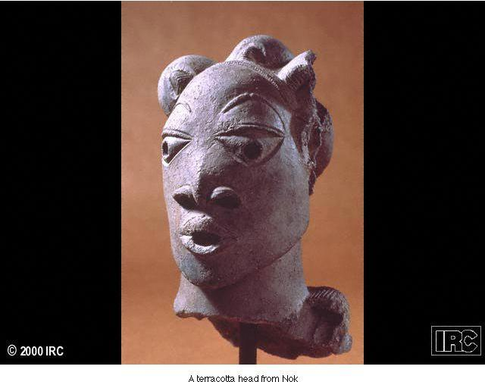
Nok Sculpture

Slide 20
Kilwa
City-state on east African coast
Fishing, limited trade, 800-1000 C.E.
Turn to agriculture, increased trade in pottery and stoneware
Major trading center by fourteenth century
Exporting over a ton of gold per year by fifteenth century C.E.

Slide 21
Zimbabwe
“Dwelling of the chief”
Stone complex called “Great Zimbabwe” built early thirteenth century C.E., capital
Population 18,000 in late fifteenth century
Managed trade between internal and coastal regions

Slide 22
Islam in East Africa
Ruling elites in east Africa accept Islam without forcing general population to convert
Often retained pagan religious traditions and practices
Islam serves as social glue with other merchants, states

Slide 23
Arabian Society and Cultural Development
Some kingdoms, empires, city-states with well-defined classes
Ruling elites
Merchant class
Peasant class
Other areas in sub-Saharan Africa continue to use traditional kin-based groups

Slide 24
Kinship Groups
Extended families, clans
Idea of private property less prevalent
Land held communally
Harvests distributed by elders

Slide 25
Sex and Gender Relations
Men work with specialized skills
Tanning, iron work
Heavy labor
Both sexes work in agriculture
Male rule more common, but some expanded roles for women
Merchants, some military activity
Islamic norms slow to penetrate African society

Slide 26
Age Grades
From early agricultural period, Sudan
Peer groups of single age cohort
Crosses lines of family and kinship

Slide 27
Slavery
Practiced since ancient times
Most slaves captives of war
Debtors
Suspected witches
Criminals
Used principally in agricultural labor
Slaves a form of personal wealth, social status

Slide 28
Slave Trading
Increased trans-Saharan and Indian Ocean trade stimulates slave trade, ninth century C.E.
Africa replaces eastern Europe as principal source of slaves
Creates internal African slave trade
More powerful states attack smaller kinship-based groups
10,000-20,000 slaves per year

Slide 29
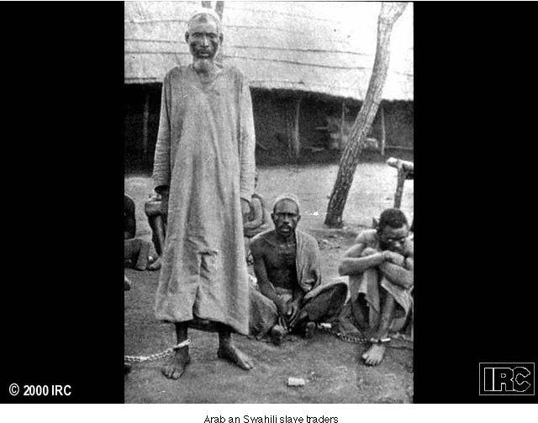
Arabian Swahili Slave Trade

Slide 30
The Zanj Revolt
Slaves from Swahili coast exported to work in Mesopotamia
Sugarcane plantations
Salt deposits
869 C.E., slave Ali bin Muhammad mounts revolt of 15,000 slaves
Captures Basra
Later crushed by Abbasids

Slide 31
African Religion
Great diversity of religious belief
Common element: single male creator god
Lesser deities associated with natural phenomena
Ancestor worship
Diviners
Religious specialists, principally men
Oracle reading, spells, other rituals
Limited emphasis on theology
Morality, balance of nature important

Slide 32
Early Christianity in North Africa
First century: popular in Egypt, north Africa
Initially weak in sub-Saharan Africa
The Christian Kingdom of Axum, fourth century C.E.
Ethiopia
Merchants, then kings convert
Bible translated into Ethiopian
Isolated during Islamic period, renaissance during twelfth century C.E.
Massive churches carved out of solid rock

Slide 33
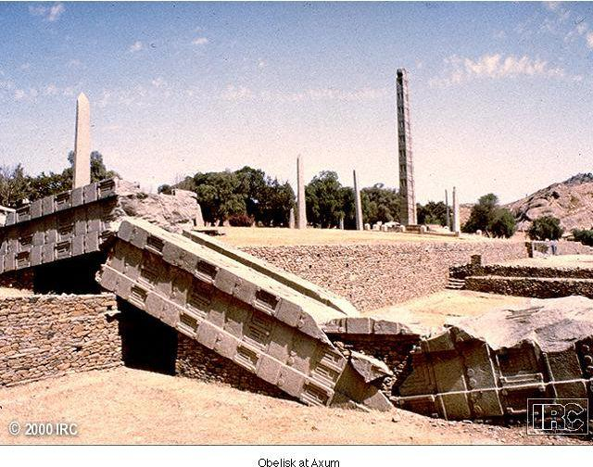
The Obelisk at Axum

Slide 34
Ethiopian Christianity
Isolation from other Christian areas until sixteenth century
Independent development
Strong African influence
Spirit world
amulets

