Slide 1
Chapter 23
The Transformation of Europe

Slide 2
The Protestant Reformation
Martin Luther (1483-1546) attacks Roman Catholic church practices, 1517
Indulgences: preferential pardons for charitable donors
Writes Ninety-Five Theses, rapidly reproduced with new printing technology
Excommunicated by Pope Leo X in 1520
1520s-1530s dissent spread throughout Germany and Switzerland

Slide 3
Roots of Reform
Church’s political involvement, wealth, power foster greed and corruption
Church faces criticism
Demand for more personal involvement with the divine

Slide 4
Martin Luther
Luther’s expanded critique
Closure of monasteries
Translations of Bible into vernacular
End of priestly authority, especially the pope
Return to biblical text for authority
German princes interested
Opportunities for assertion of local control
Support for reform spreads throughout Germany

Slide 5
Reform Outside Germany
Switzerland, Low Countries follow Germany
England: King Henry VIII (r. 1509-1547) has conflict with pope over requested divorce
England forms its own church by 1560
France: John Calvin (1509-1564) codifies Protestant teachings while in exile in Geneva
Scotland, Netherlands, Hungary also experience reform movements

Slide 6
The Catholic Reformation
Roman Catholic church reacts
Refining doctrine, missionary activities to Protestants, attempt to renew spiritual activity
Council of Trent (1545-1563), periodic meetings to discuss reform
Society of Jesus (Jesuits) founded by St. Ignatius Loyola (1491-1556)
Rigorous religious and secular education
Effective missionaries

Slide 7
Witch Hunts
Most prominent in regions of tension between Catholics and Protestants
Late fifteenth century development in belief in devil and human assistants
Sixteenth to seventeenth centuries approximately 110,000 people put on trial; 45,000 put to death
Vast majority females, usually single, widowed
Held accountable for crop failures, miscarriages, etc.
New England: 234 witches tried, 36 hung

Slide 8
Religious Wars
Protestants and Roman Catholics fight in France (1562-1598)
1588 Philip II of Spain attacks England to force return to Catholicism
English destroy Spanish ships by sending flaming unmanned ships into the fleet
Netherlands rebel against Spain, gain independence by 1610

Slide 9
The Thirty Years’ War (1618-1648)
Holy Roman emperor attempts to force Bohemians to return to Roman Catholic church
All of Europe becomes involved in conflict
Principal battleground: Germany
Political, economic issues involved
Approximately one-third of German population destroyed

Slide 10
The Consolidation of Sovereign States
Emperor Charles V (r. 1519-1556) attempts to revive Holy Roman Empire as strong center of Europe
Through marriage, political alliances
Ultimately fails
Protestant Reformation provides cover for local princes to assert greater independence
Foreign opposition from France, Ottoman empire
Unlike China, India, Ottoman empire, Europe does not develop as single empire, rather individual states
Charles V abdicates to monastery in Spain

Slide 11
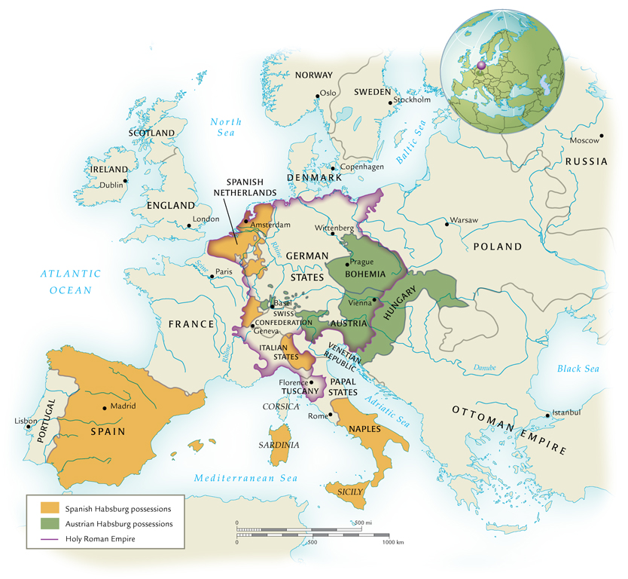
Sixteenth-Century Europe

Slide 12
The New Monarchs
Italy well-developed as economic power through trade, manufacturing, finance
Yet England, France, and Spain surge ahead in sixteenth century with innovative new tax revenues
England: Henry VIII
Fines and fees for royal services; confiscated monastic holdings
France: Louis XI, Francis I
New taxes on sales, salt trade

Slide 13
The Spanish Inquisition
Founded by Fernando and Isabel in 1478
Original task: search for secret practitioners of Judaism or Islam, later search for Protestants
Spread to Spanish holdings outside Iberian peninsula in western hemisphere
Imprisonment, executions
Intimidated nobles who might have considered Protestantism
Archbishop of Toledo imprisoned 1559-1576

Slide 14
Constitutional States
England and the Netherlands develop institutions of popular representation
England: constitutional monarchy
Netherlands: republic
English civil war, 1642-1649
Begins with opposition to royal taxes
Religious elements: Anglican church favors complex ritual, complex church hierarchy, opposed by Calvinist Puritans
King Charles I and parliamentary armies clash
King loses, is beheaded in 1649

Slide 15
The Glorious Revolution (1688-1689)
Puritans take over; becomes a dictatorship
Monarchy restored in 1660, fighting resumes
Resolution with bloodless coup called Glorious Revolution
King James II deposed, daughter Mary and husband William of Orange take throne
Shared governance between crown and parliament

Slide 16
The Dutch Republic
King Philip II of Spain attempts to suppress Calvinists in Netherlands, 1567
Large-scale rebellion follows; by 1581, Netherlands declares independence
Based on a representative parliamentary system

Slide 17
Absolute Monarchies
Theory of divine right of kings
French absolutism designed by Cardinal Richelieu (under King Louis XIII, 1624-1642)
Destroyed castles of nobles, crushed aristocratic conspiracies
Built bureaucracy to bolster royal power base
Ruthlessly attacked Calvinists

Slide 18
Louis XIV (the “Sun King,” 1643-1715)
L’état, c’est moi: “The State – that’s me.”
Magnificent palace at Versailles, 1670s, becomes his court
Largest building in Europe
1,400 fountains
25,000 fully grown trees transplanted
Power centered in court, important nobles pressured to maintain presence

Slide 19
Absolutism in Russia: The Romanov Dynasty (1613-1917)
Peter I (“the Great,” r. 1682-1725)
Worked to modernize Russia on western European model
Developed modern Russian army, reformed Russian government bureaucracy, demanded changes in fashion: beards forbidden
Built new capital at St. Petersburg
Catherine II (“the Great,” r. 1762-1796)
Huge military expansion
Partitions of Poland, 1772-1797
Social reforms at first, but end with Pugachev peasant rebellion (1773-1774)

Slide 20
The European States System
No imperial authority to mediate regional disputes
Peace of Westphalia (1648) after Thirty Years’ War
European states to be recognized as sovereign and equal
Religious, other domestic affairs protected
Warfare continues: opposition to French expansion, Seven Years’ War (1756-1763)
Balance of power tenuous
Innovations in military technology proceed rapidly

Slide 21
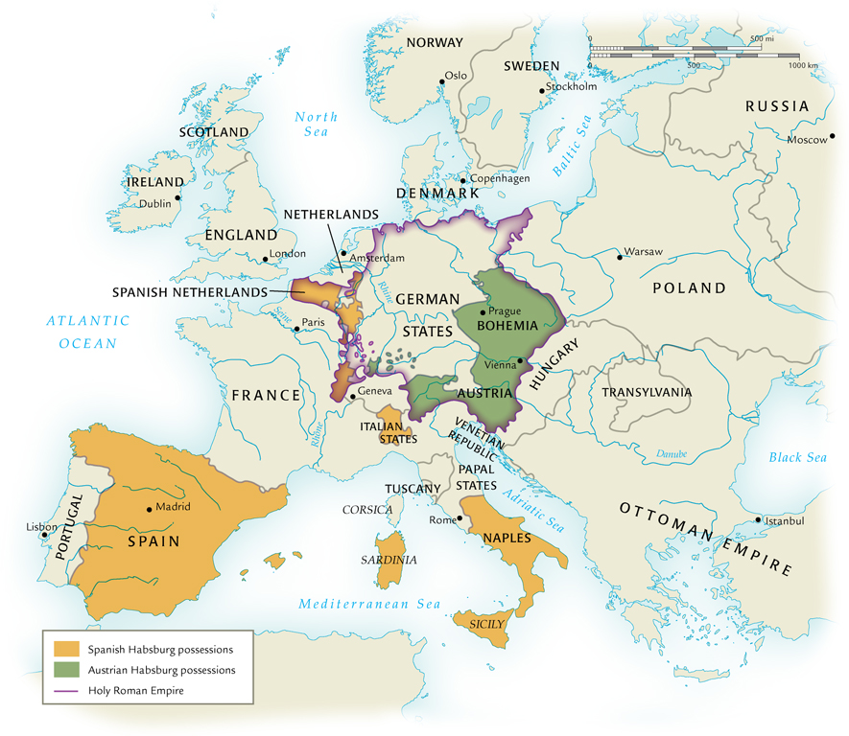
Europe After the Peace of Westphalia, 1648

Slide 22
Population Growth and Urbanization
Rapidly growing population due to Columbian exchange
Improved nutrition
Role of the potato (considered an aphrodisiac in sixteenth and seventeenth centuries)
Replaces bread as staple of diet
Better nutrition reduces susceptibility to plague
Epidemic disease becomes insignificant for overall population decline by mid-seventeenth century

Slide 23
Population Growth in Europe

Slide 24
Urbanization

Slide 25
Early Capitalism
Private parties offer goods and services on a free market
Own means of production
Private initiative, not government control
Supply and demand determines prices
Banks, stock exchanges develop in early modern period
Joint-stock companies (English East India Company, VOC)
Relationship with empire-building
Medieval guilds discarded in favor of “putting-out” system

Slide 26
Impact of Capitalism on the Social Order
Rural life
Improved access to manufactured goods
Increasing opportunities in urban centers begins depletion of the rural population
Inefficient institution of serfdom abandoned in western Europe, retained in Russia until nineteenth century
Nuclear families replace extended families
Gender changes as women enter income-earning work force

Slide 27
Capitalism and Morality
Adam Smith (1723-1790) argued that capitalism would ultimately improve society as a whole
But major social change increases poverty in some sectors
Rise in crime
Witch-hunting a possible consequence of capitalist tensions and gender roles

Slide 28
The Copernican Universe
Reconception of the Universe
Reliance on second-century Greek scholar Claudius Ptolemy of Alexandria
Motionless earth inside nine concentric spheres
Christians understand heaven as last sphere
Difficulty reconciling model with observed planetary movement
1543, Nicolaus Copernicus of Poland breaks theory
Notion of moving Earth challenges Christian doctrine

Slide 29
The Scientific Revolution
Johannes Kepler (Germany, 1571-1630) and Galileo Galilei (Italy, 1564-1642) reinforce Copernican model
Isaac Newton (1642-1727) revolutionizes study of physics
Rigorous challenge to church doctrines

Slide 30
Women and Science
William Harvey (1578-1657) “scientifically” proves innate female inferiority
Émilie du Châtelet (1701-1749)
French mathematician and physicist
Translated Newton’s Principia Mathematica

Slide 31
The Enlightenment
Trend away from Aristotelian philosophy and church doctrine in favor of rational thought and scientific analysis
John Locke (England, 1632-1704), Baron de Montesquieu (France, 1689-1755) attempt to discover natural laws of politics
Center of Enlightenment: France, philosophes
Voltaire (1694-1778), caustic attacks on Roman Catholic church: écrasez l’infame, “crush the damned thing”
Deism increasingly popular

Slide 32
The Theory of Progress
Assumption that Enlightenment thought would ultimately lead to human harmony, material wealth
Decline in authority of traditional organized religion

