Slide 1
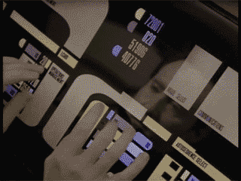
Lesson 3: Introduction to Internet Technology

Slide 2
Lesson 3 Objectives
Define networks
Define the Internet
Identify Internet connection methods
Define Internet protocols
Define the Domain Name System (DNS)
Define cloud computing

Slide 3
Overview of Networks
Network – two or more computers linked together so they can communicate, share resources and exchange information
Networks allow users to:
Access shared programs and data
Transfer data from one computer to another
Share peripheral devices such as printers
Share storage devices to store data for backup
Use programs to communicate with other users
Access the Internet

Slide 4
The Client/Server Model
Client/server model – a network structure in which individual computers and devices interact with one another through a central server, to which they are all connected
Client – an individual computer connected to a network
Server – a computer that manages network resources
Node – an individual computer or other device connected to a network

Slide 5
LANs and WANs
Local area network (LAN) – a group of computers connected within a confined geographic area
The organization owns all network components
Wide area network (WAN) – two or more connected LANs that span a wide geographic area
The organization typically leases some of the components needed to transmit data, such as high-speed telephone lines or wireless transmission equipment

Slide 6
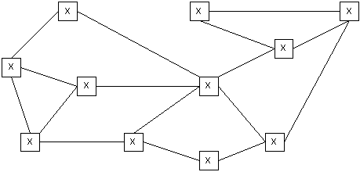
Overview of the Internet
Internet – a vast network of LANs and WANs that electronically connects millions of people worldwide
The Internet was formed in 1969 by ARPA, whose network, ARPANET, featured multiple servers and connections

Slide 7
The World Wide Web
World Wide Web – a set of software programs that enables users to access resources on the Internet via hypertext documents, or Web pages
Web page – a document created in HTML containing hypertext links that, when clicked, enable users to access a different location or document
Web site – a collection of related Web pages
Web browser – a software application that enables users to easily access, view and navigate Web pages on the Internet

Slide 8
How the Internet Works
Network protocols and packets:
Protocol – an agreed-upon format for transmitting data between two devices
Packet – a fixed piece of information sent across a network
Every computer connected to the Internet uses Transmission Control Protocol / Internet Protocol (TCP/IP)
TCP/IP – software that makes Internet communication possible

Slide 9
How the Internet Works (cont’d)
Computers access information from the Internet as follows:
You request data from an Internet server
The request is divided into packets
The packets are routed from your LAN to the Internet backbone
The packets are routed from the Internet backbone to the destination server
The destination server sends the requested information using the same process

Slide 10
Connecting to the Internet
Six elements are required to connect to the Internet:
Computer
Operating system
TCP/IP
Client software
Internet connection (direct through an ISP)
Internet address

Slide 11
Internet Service Providers (ISPs)
Internet Service Provider (ISP) – an organization that provides access to the Internet
Most ISPs charge a flat monthly rate
Some basic-service ISPs offer Internet connectivity for free
ISPs offer dial-up or direct Internet connections

Slide 12
Dial-up and Direct Internet Connections
Dial-up Internet connections:
Standard telephone lines and analog modem
Integrated Services Digital Network (ISDN) line and an ISDN modem
Direct Internet connections:
High-speed data links, including fiber-optic
Wireless connections, including 802.11 standards and satellite
T and E carriers, including fractional T and E lines
LAN connections
Cable modems
Digital Subscriber Line (DSL)
4G mobile hotspot

Slide 13
Internet Protocols
Internet Protocol version 4 (IPv4) – supports 32-bit dotted quad IP address format
Most widely used version of IP
Approximately 4 billion possible IP addresses
Internet Protocol version 6 (IPv6) – supports 128-bit hexadecimal address format
Also known as Internet Protocol Next Generation (IPng)
Included as part of IP support in many products
Approximately 340 undecillion (340 times 10³⁶) possible IP addresses

Slide 14
Internet Protocols (cont’d)
Remote access protocols:
Point-to-Point Protocol (PPP) – allows a computer to connect to the Internet over a phone line
Point-to-Point Protocol over Ethernet (PPPoE) – implements PPP over Ethernet (Ethernet is a LAN network standard that allows computers in a network to communicate)
PPPoE connects an entire network to the Internet

Slide 15
Internet Protocols (cont’d)
Hypertext Transfer Protocol (HTTP) – used to transfer Web pages from a Web server to a Web client (Web browser)
Hypertext Transfer Protocol Secure (HTTPS) – used to access a secure Web server
File Transfer Protocol (FTP) – used to transfer files between computers on the Internet

Slide 16
Internet Protocols (cont’d)
Electronic mail (e-mail) protocols:
Simple Mail Transfer Protocol (SMTP) – used to transfer e-mail messages to others with an outgoing mail server
Post Office Protocol (POP) – used to receive e-mail from an incoming mail server
Forces you to download e-mail messages before reading and managing them
Current version is POP3
Internet Message Access Protocol (IMAP) – used to receive e-mail from an incoming mail server
Allows you to manage e-mail messages while they reside on the server
Current version is IMAP4

Slide 17
Internet Protocols (cont’d)
Network News Transfer Protocol (NNTP) – used by news servers to exchange newsgroup articles
Newsgroup – a group of messages about a particular subject that is posted to a central Internet site (news server) and redistributed through Usenet
Usenet – a public-access worldwide network

Slide 18
Domain Name System (DNS)
Domain Name System (DNS) – resolves IP addresses into easily recognizable names
For example:
72.44.192.233 = www.CIWcertified.com
Domain name and IP address refer to the same Web server

Slide 19
Typical Domain Name
www.CIWcertified.com
Server (host) name
Registered company domain name
Domain category (top-level domain)

Slide 20
Domain Name Syntax
Domain names are read right to left, signifying general, then specific locations
For example, www.CIWcertified.com can be interpreted as follows:
com – commercial site
CIWcertified – registered company domain name
www – Web server name at company

Slide 21
Top-Level Domains
com – commercial or company sites
edu – educational institutions, typically universities
org – organizations; originally clubs, associations and non-profit groups; currently, various types of organizations
mil – U.S. military
gov – U.S. civilian government
net – network sites, including ISPs
int – international organizations (rarely used)

Slide 22
Domain Name Servers and Virtual and Shared Domains
Domain name server – a server on the Internet that resolves domain names into IP addresses
Reverse DNS – the process of resolving IP addresses into domain names
Virtual domain – a hosting service that allows a company to host its domain name on a third-party ISP server
Shared domain – a hosting service that allows multiple entities to share portions of the same domain name

Slide 23
Cloud Computing
Cloud computing – a paradigm in which users access software and services remotely over the Internet
Crowdsourcing – outsourcing a task to an undefined group of people or community to obtain and analyze large amounts of data
Cloud computing characteristics:
Reliance on only a Web browser to access services
No browser preference
No operating system preference

Slide 24
Cloud Computing (cont'd)
Software as a Service (SaaS) – another name for cloud computing
Grid computing – a cluster of multiple, remote systems that are used to create a single solution
Advantages to cloud computing:
Flexibility
Scalability
Cost reduction
Problems with cloud computing:
Connectivity
Speed
Lockout

Slide 25
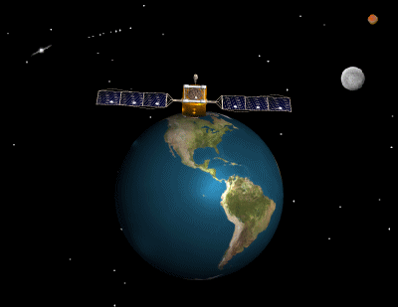
Lesson 3 Summary
Define networks
Define the Internet
Identify Internet connection methods
Define Internet protocols
Define the Domain Name System (DNS)
Define cloud computing

