Slide 1
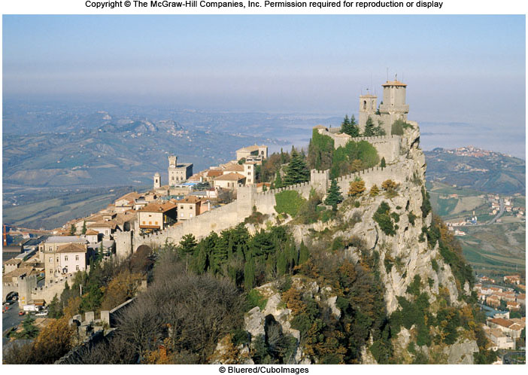
Chapter 10 LECTURE OUTLINE A World of nations & states
Human Geography by Malinowski & Kaplan

Slide 2
Chapter 10 Modules
10A Sovereignty, Legitimacy, & Territoriality
10B History of Political Forms
10C History of States
10D Variations in Modern States
10E Four Markers of a Nation
10F The Relationship between Nations and States
10G Nationalism as an Ideology and Force in Statecraft
10H Boundaries and Borderlands
10I Geopolitics and the Global Order

Slide 3
10A: Sovereignty, Legitimacy, & Territoriality of Political Units 1
Political Unit
Organizational entities at several different spatial scales that aid the study of political geography. The most important of these is the country, or state.
Sovereignty
Indicates that a state has complete control over a defined area
Legitimacy
Defines whether a government has the standing or right to rule a state’s people or territory

Slide 4
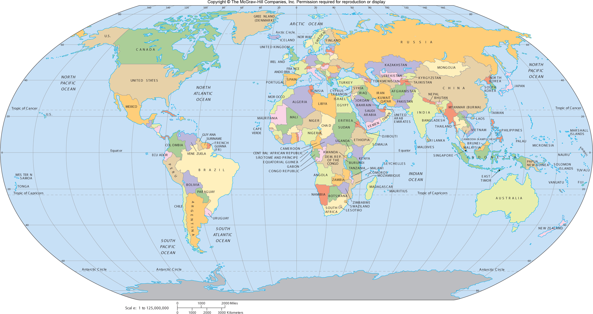
States of the World
Figure 10A.1

Slide 5
10B: History of Political Forms
Tribal Groups or Chiefdoms
Often had no rigidly defined boundaries
Feudal Systems
City-States
Empires
Metropole: dominant part of the empire
Colonies: subordinate parts of an empire

Slide 6
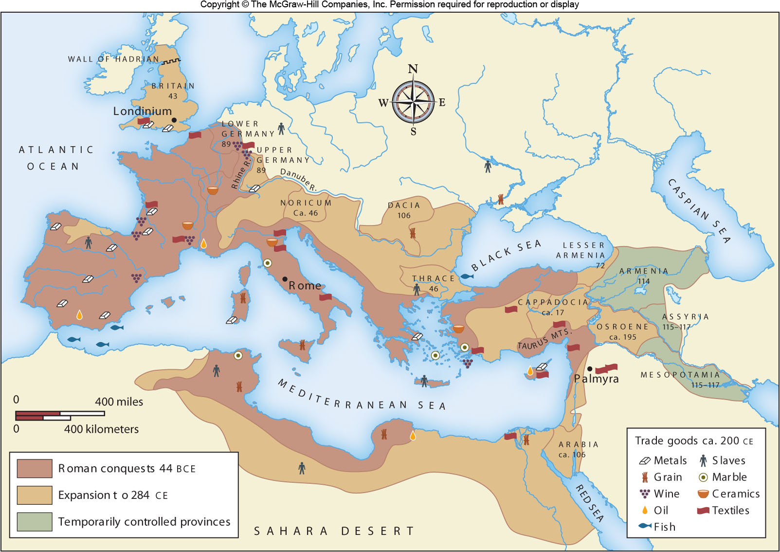
The Roman Empire
Figure 10B.3

Slide 7
10C: History of States
The Modern State System stems from:
The Westphalian state system
Treaty of Westphalia, 1648
Clearly bounded, sovereign territories
The growth of nationalism & the nation-state
Europe’s impact on the rest of the world
Decolonization in the past two centuries

Slide 8
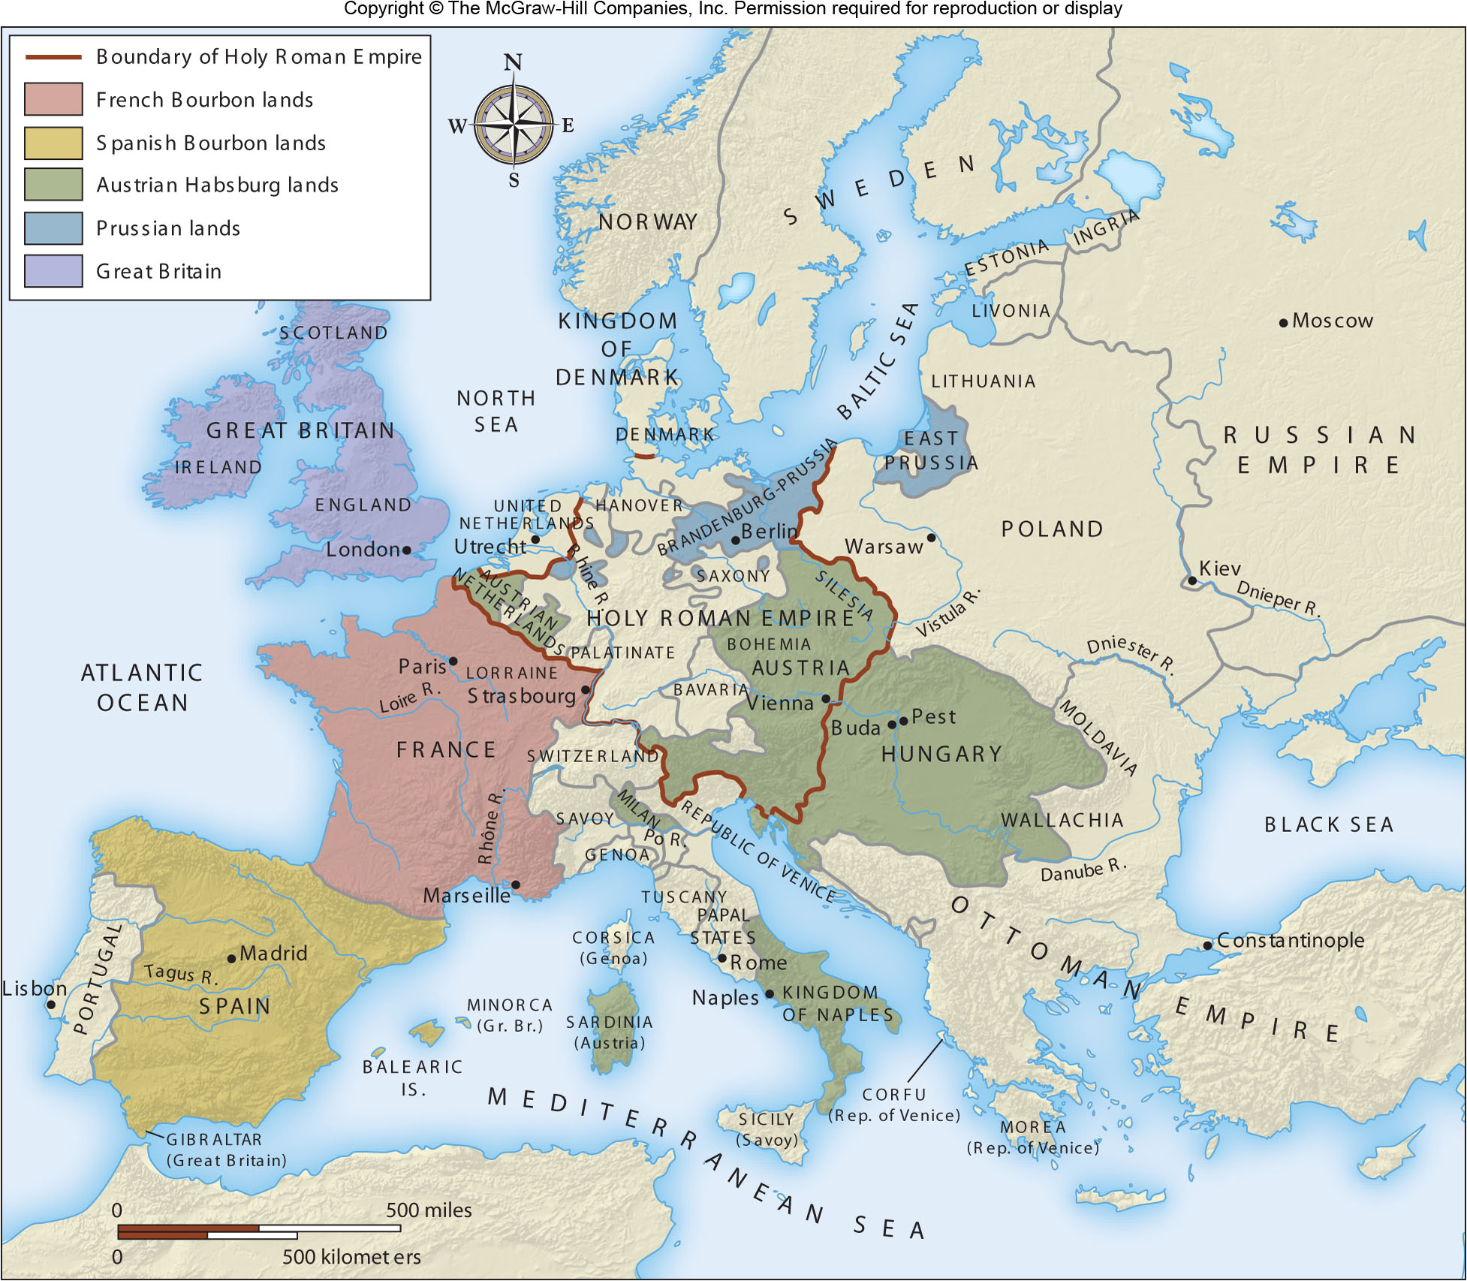
19th-Century Europe
Figure 10C.2

Slide 9
10D: Variations in Modern States
Not all states are created equally
Satellite state
States with less than full sovereignty
Examples: Eastern European countries during the Soviet Union era
Sovereignty is not always universal
Homelands in South Africa were only recognized as states by the white South African government during the apartheid era
Micro-states

Slide 10
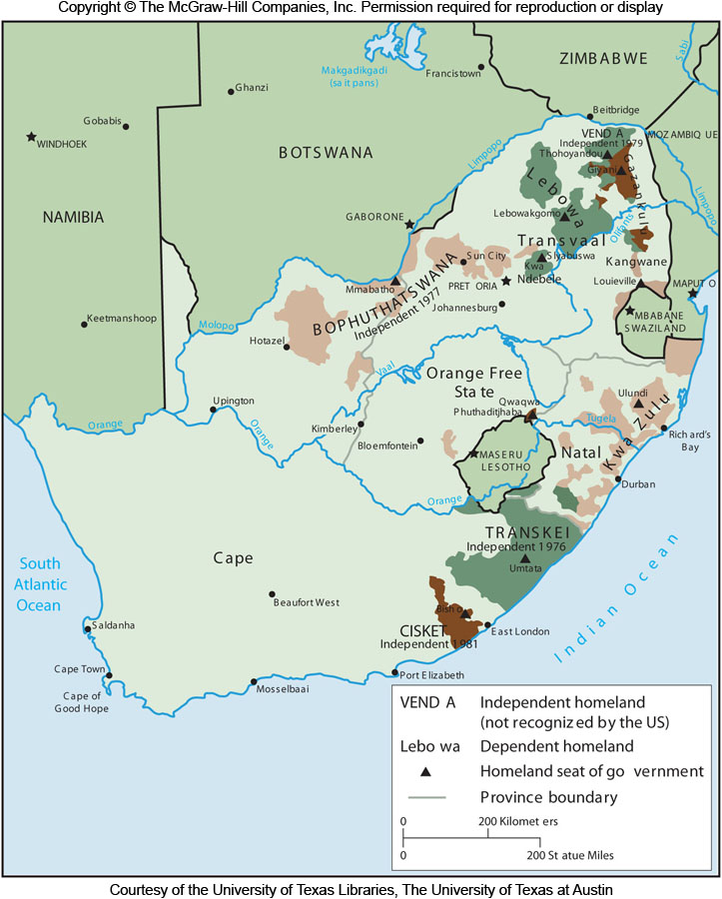
Apartheid-Era Homelands
Figure 10D.2

Slide 11
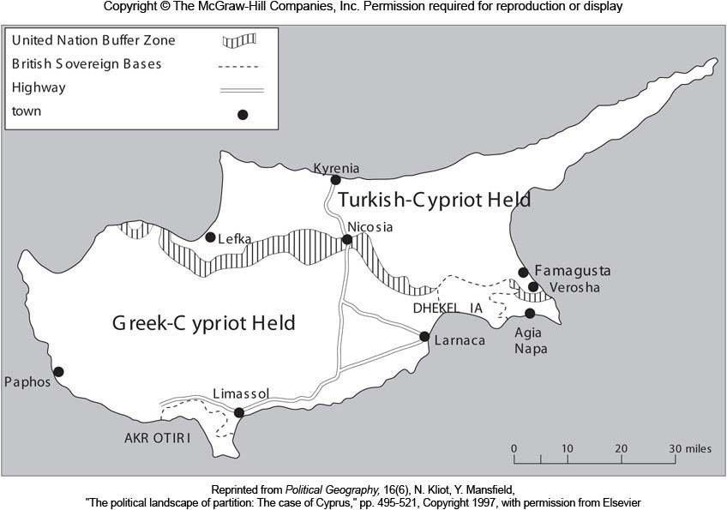
Cyprus
Figure 10D.3

Slide 12
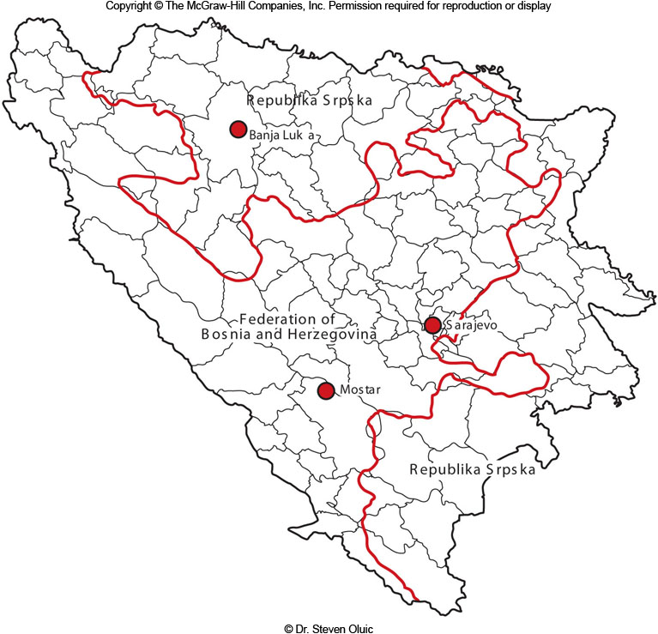
Bosnia & Herzegovina
Figure 10D.4

Slide 13
10E: Four Markers of a Nation
A shared cultural heritage or shared belief
Loyalty
Horizontal loyalty, i.e. loyalty to the nation, not forced by a ruler (vertical loyalty)
Primary loyalty, transcending other allegiances
Exclusivity, i.e. loyalty to just one nation
Territorial expression, a natural homeland
The quest for self-determination
A key component of nationalism

Slide 14
10F: The Relationship Between Nations & States
The nation-state ideal is that every nation has its own state, but this is unlikely
Multinational states are the norm
Multistate nations are those divided among many countries
Stateless nations are common
Nations may also be scattered to somewhere other than their homeland because of war or chaos
A diaspora

Slide 15
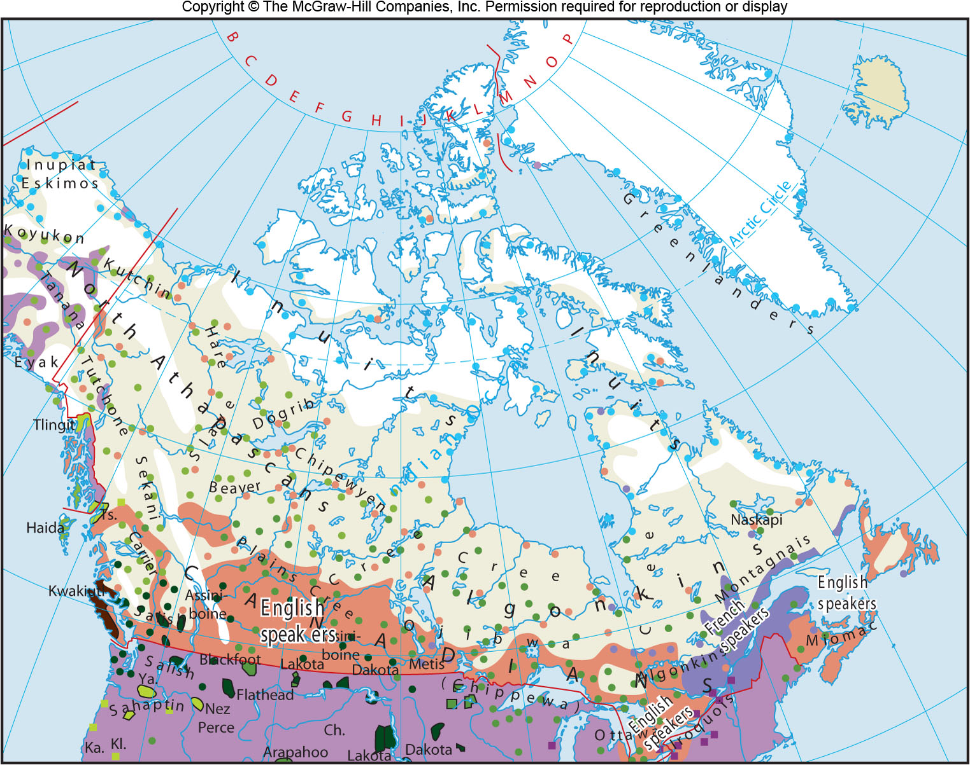
Canada’s Two Nations
Figure 10F.2

Slide 16
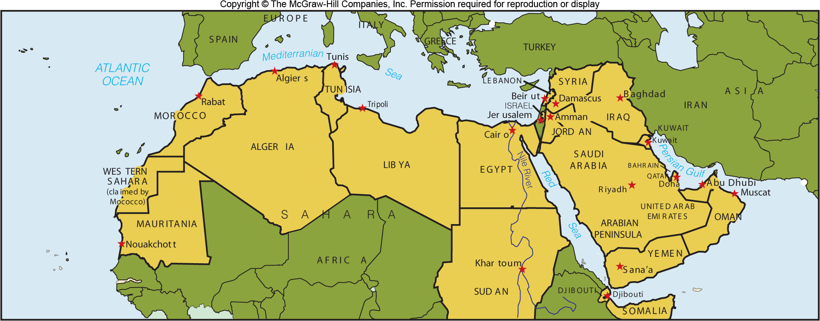
The Arab “Nation”
Figure 10F.3

Slide 17
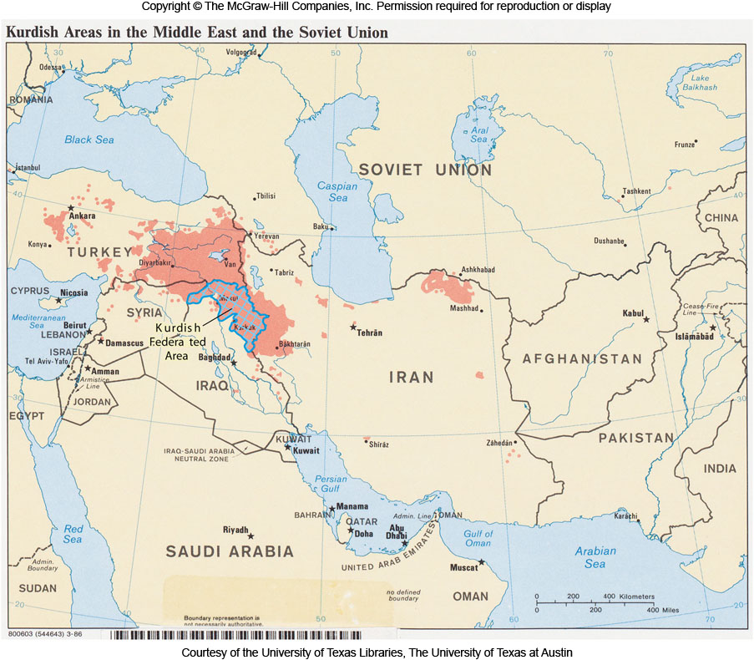
Kurdistan
Figure 10F.4

Slide 18
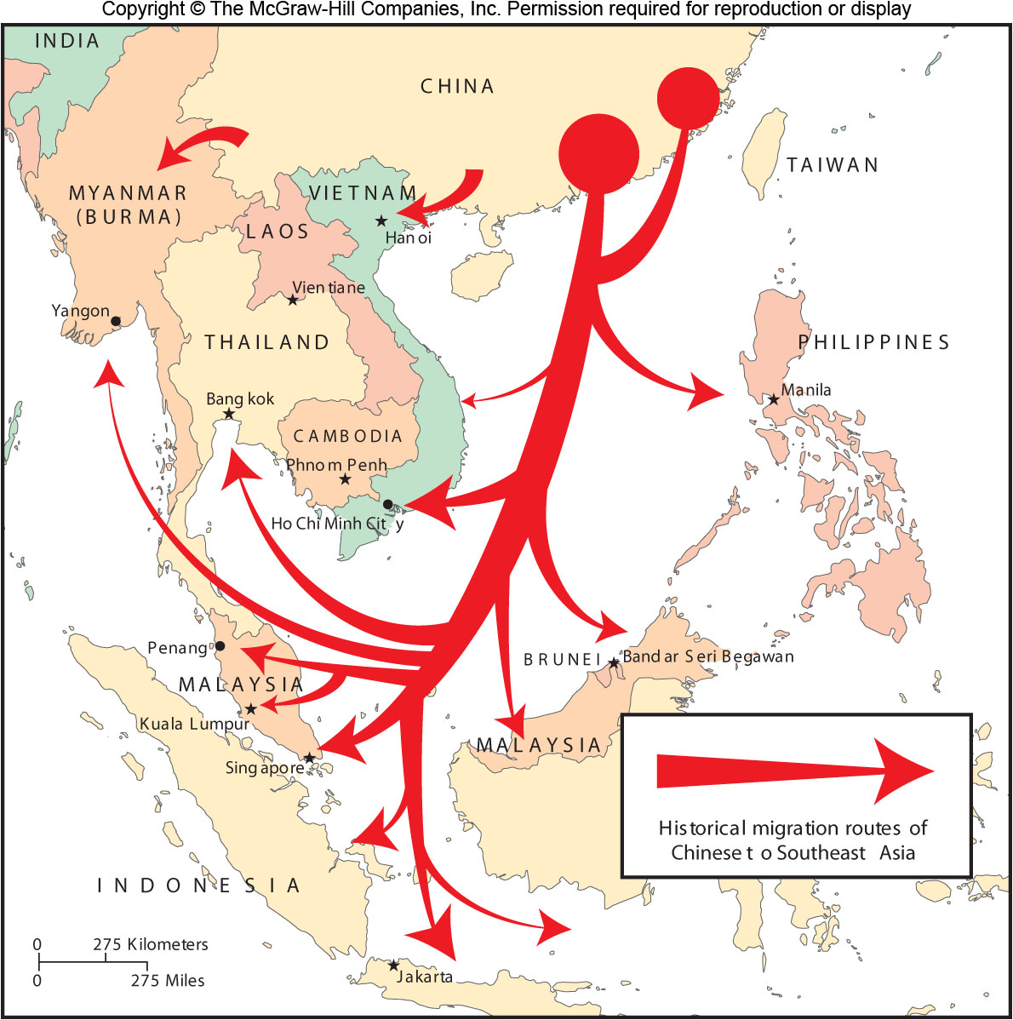
Overseas Chinese
Figure 10F.5

Slide 19
10G: Nationalism as an Ideology and Force in Statecraft 1
Three views on nations:
Primordialism
Nations are organically grown entities
Nationalism is just an awakening of something that already exists
Constructivism
Nations are artificial constructions from modernization and the goals of the elite
Instrumentalism
Nations arise to meet the needs of a particular situation

Slide 20
10G: Nationalism as an Ideology and Force in Statecraft 2
Centripetal Forces
Forces that help to unify a state, such as a strong national identity
Unifying institutions such as a national military, a common church, or a great infrastructure
Centrifugal Forces
Forces that pull apart and disperse
Ethnoregionalism when a minority national group is concentrated in a particular area
Irredentist movements that seek to leave a state to join similar peoples on the other side of a border

Slide 21
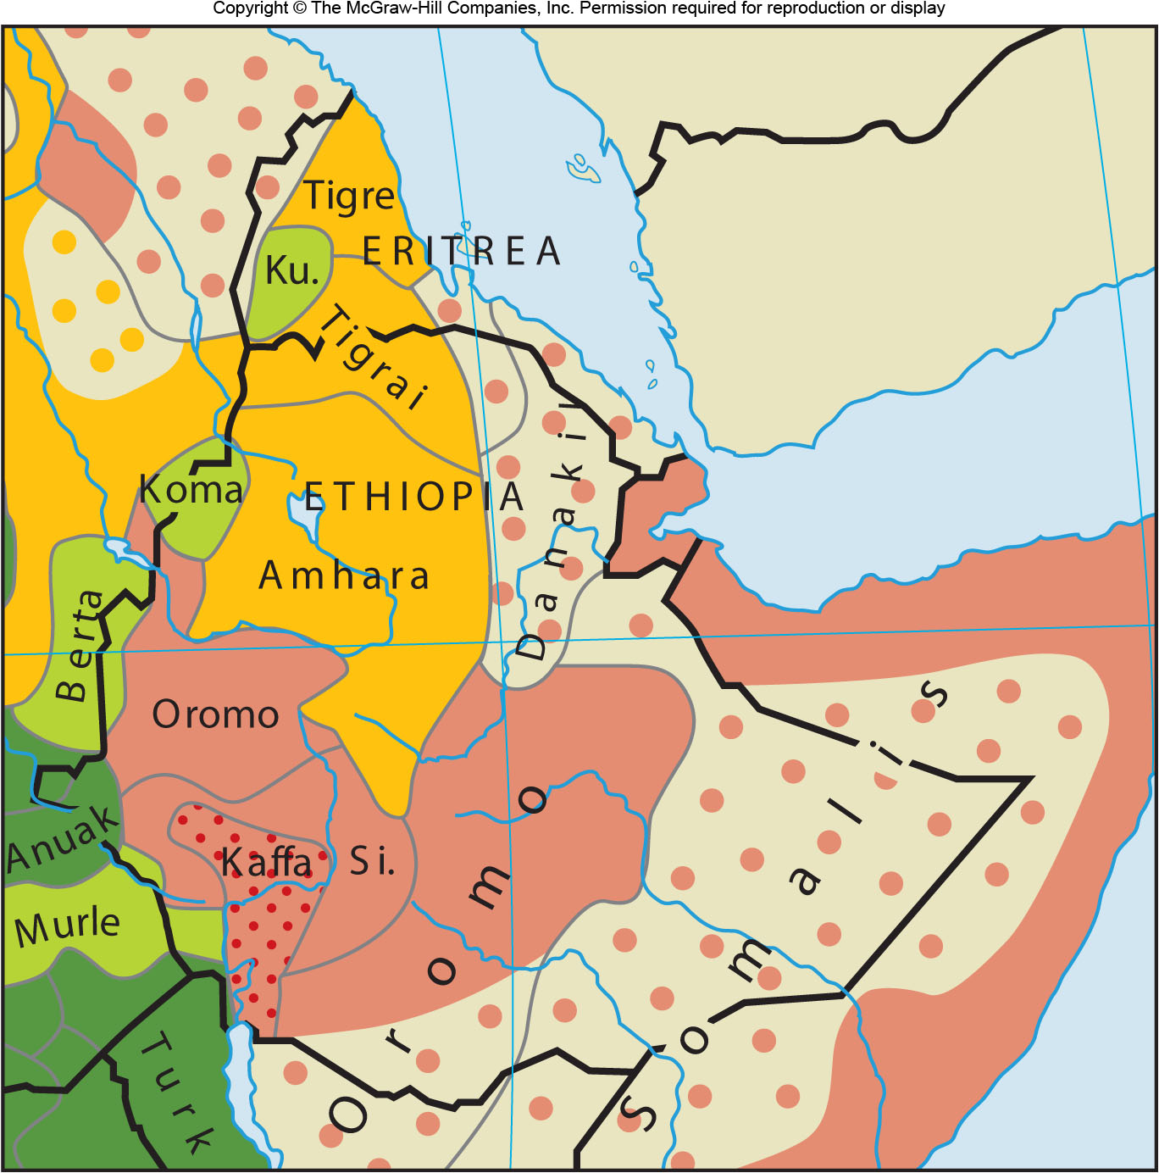
Eritrea
Figure 10G.2

Slide 22
10H: Boundaries & Borderlands 1
Boundaries are an essential aspect of a political unit
International boundaries are recognized lines that separate one state from another
A borderland is the area that surrounds the boundary
A border is an area, a boundary is a line
Effective national territory can include legally controlled territory (de jure area) and sometimes other areas controlled (de facto area)

Slide 23
10H: Boundaries & Borderlands 2
Natural boundaries
When natural features divide countries
Geometric boundaries
Lines drawn on a map without much interest in what is on the landscape
Antecedent boundaries
Boundaries created before an area is known or populated
Subsequent boundaries
Created after recognized settlement
Often drawn to separate existing cultural groups

Slide 24
10H: Boundaries & Borderlands 3
International boundaries have many functions:
Boundaries disrupt traffic (goods, people, information)
Such as militarized boundaries
Separate governments & economic systems
Help embody the edge of national identity

Slide 25
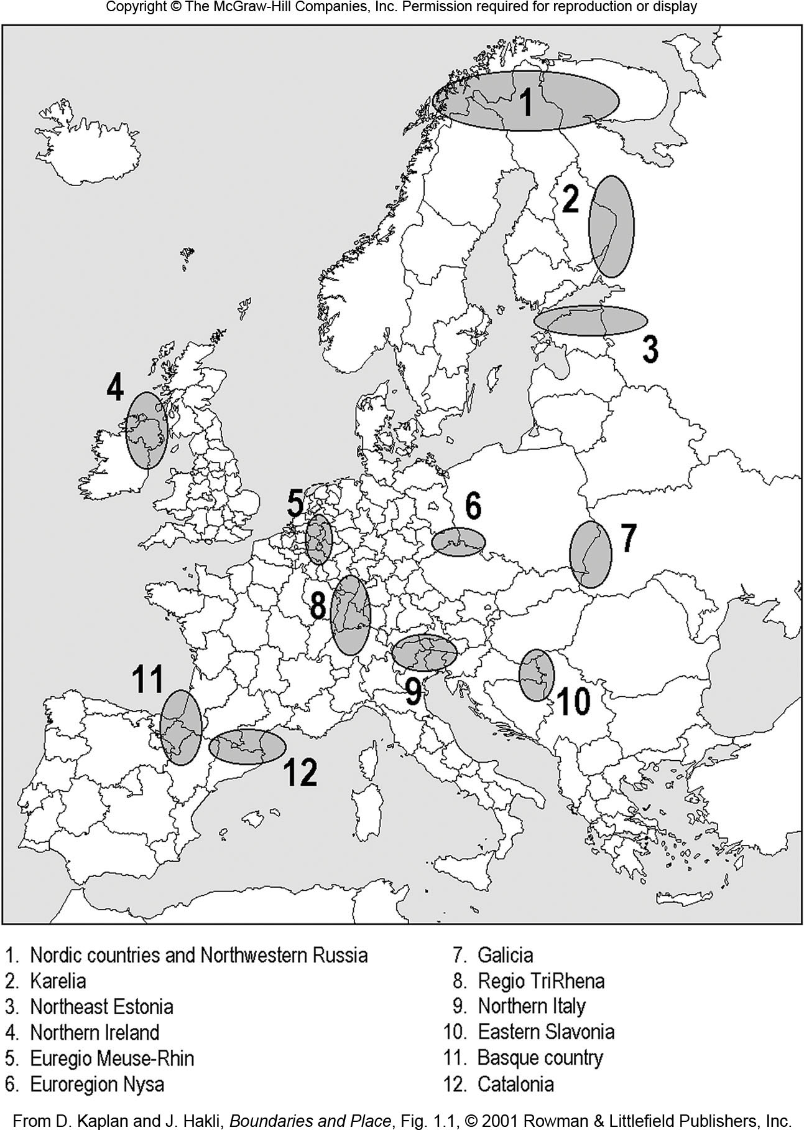
Euroregions
Figure 10H.12

Slide 26
10I: Geopolitics & the Global Order 1
Geopolitics
The study of how geographical space—including the types of interrelationships between states, the different functions of states, and the different patterns of states—affects global politics.
Key early thinkers were Mackinder, Mahan, De Seversky
Also many used by Nazis to justify German expansion
Lebensraum, or living space

Slide 27
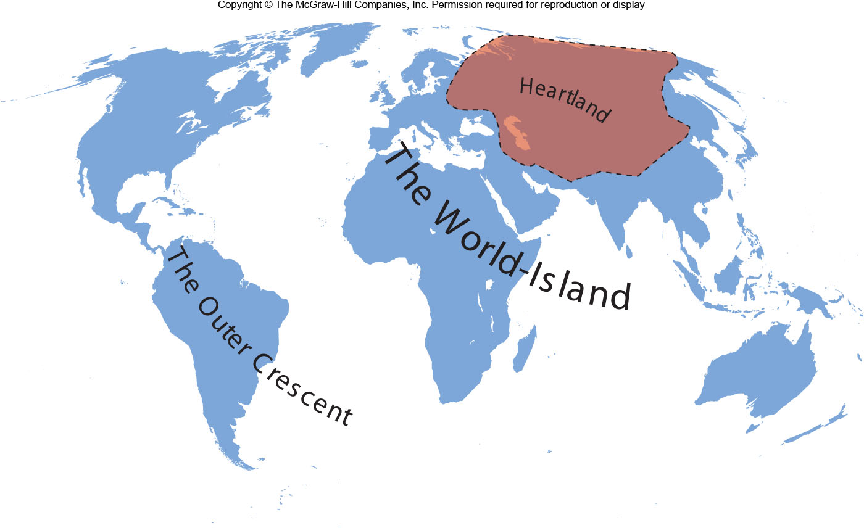
Mackinder’s View
Figure 10I.1

Slide 28
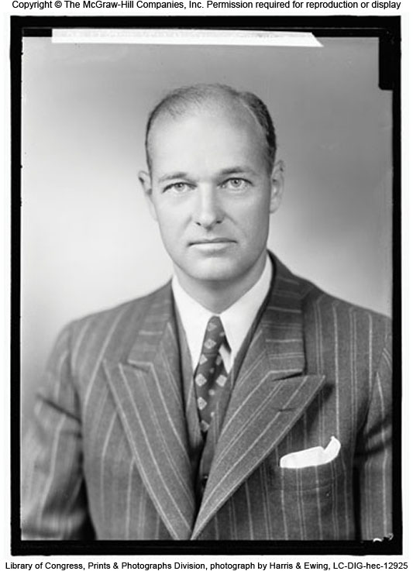
10I: Geopolitics & the Global Order 2
U.S. foreign policy after World War II
Containment to stop Soviet influence in nonaligned countries
George Kennan
Belief in the domino theory, or a fear that if one country became communist, others would follow, like falling dominos

Slide 29
10I: Geopolitics & the Global Order 3
Post-Cold War geopolitics:
Geopolitical regions formed by spatial contiguity and political, cultural, military, & economic interaction
Shatterbelts
Regions that are politically fragmented and often zones of competition between ideological or religious realms
Critical geopolitics:
Used to dissect the ways state boundaries are perceived, relationships between states, and the ways the world is portrayed

