Slide 1
The Spanish American War & American Imperialism

Slide 2
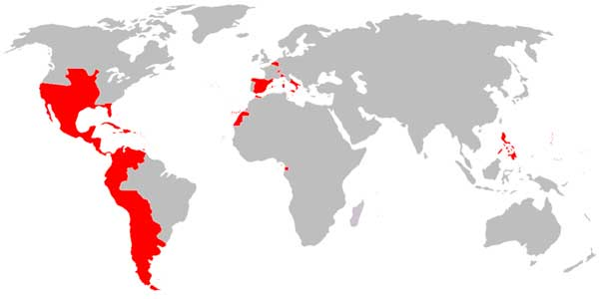
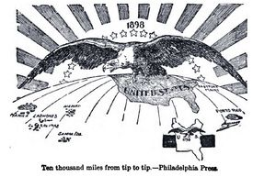

Slide 3
The Dying Spanish Empire
1898: Cuban & Puerto Rico are Spain’s last American possessions, Americans don’t like the Spanish so close
Cuba has made Spain rich, supplied 1/3 of world sugar
Spain abolishes Cuban Slavery in 1886
1868: Failed Cuban rebellion, leaders flee to U.S.
Jose Marti and others exiled to NYC and Tampa
1895: Economic relations with U.S. make poor conditions for Cubans, new rebellion declares Cuba independent
Marti dies in battle

Slide 4
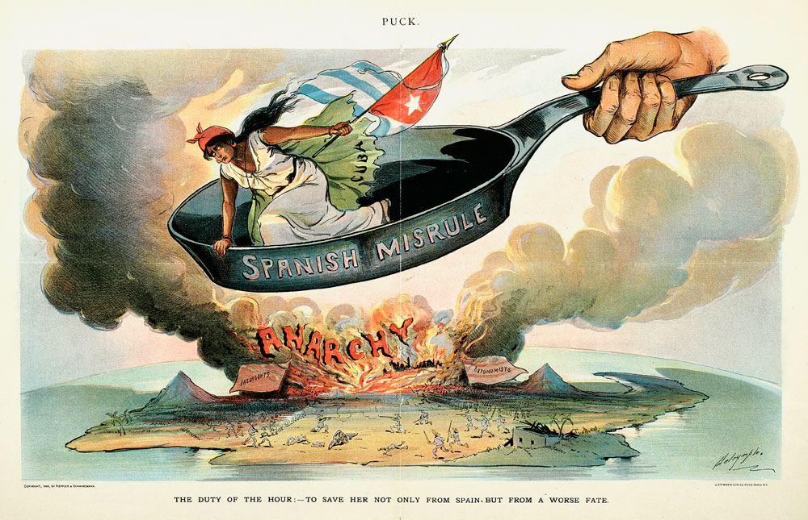
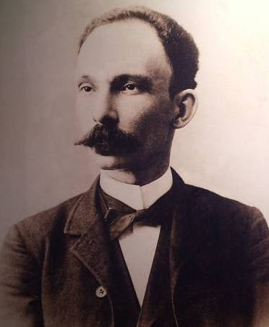
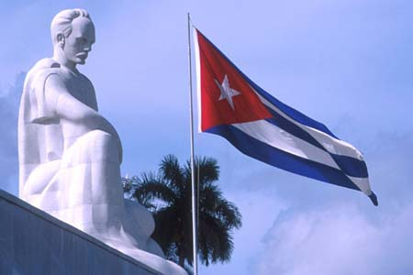
Jose Marti

Slide 5
American Support for Cuba
Two NYC newspapers make up stories about Spanish atrocities, Americans angry with Spain
yellow journalism
Stories were made up, but Spain did abuse Cubans
200,000 Spanish soldiers herd thousands of Cubans into concentration camps, many die
To avoid American intervention, Spain offers Cubans autonomy—Cuban refuse
1898: Pres. McKinley sends battleship U.S.S. Maine to protect American interests in Cuba
February 15, 1898: U.S.S. Maine explodes in Havana Harbor.

Slide 6
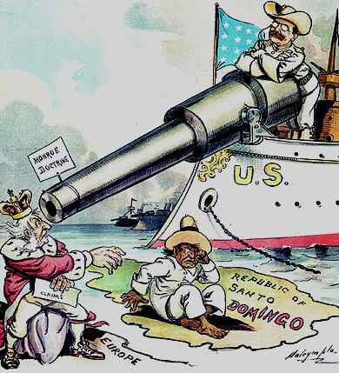
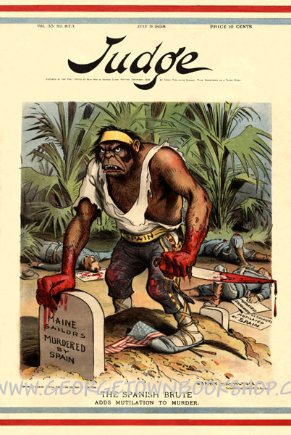
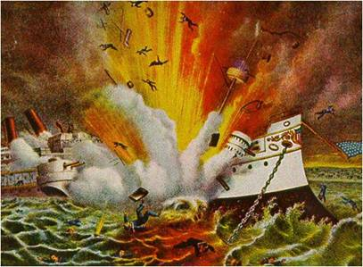

Slide 7
The Spanish American War
“Remember the Maine!” was battle cry for Republican jingoism (extreme nationalism)
April 19, 1898: Congress recognizes Republic of Cuba
4/24/98: Spain declares war on United States
U.S. Navy blockades Cuba, destroys Spanish fleet in Philippines
20,000 U.S. troops sent to Philippines, take Guam from Spain along the way
U.S. teams up with Filipino rebels, take control of capital
Now, time to concentrate on Caribbean colonies

Slide 8
The United States in Cuba
June 22-24: 17,000 U.S. troops land east of Santiago de Cuba, including volunteers called “Rough Riders”
Col. Theodor Roosevelt second in command of R.R.
Together with African-American 9th and 10th Cavalry Regiments, the Rough Riders take San Juan Hill
Spanish get nervous and send navy fleet stationed in Santiago Harbor out to sea for protection
The American fleet was waiting and destroys Spanish navy in Cuba
Spain surrenders, the U.S. also takes control of Puerto Rico

Slide 9
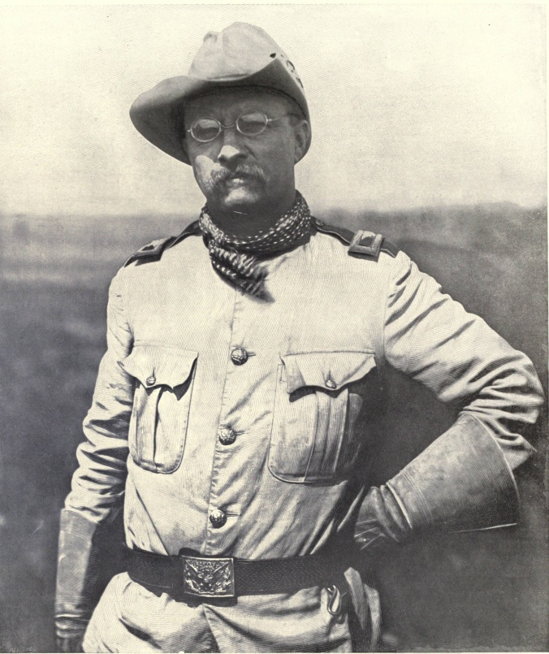
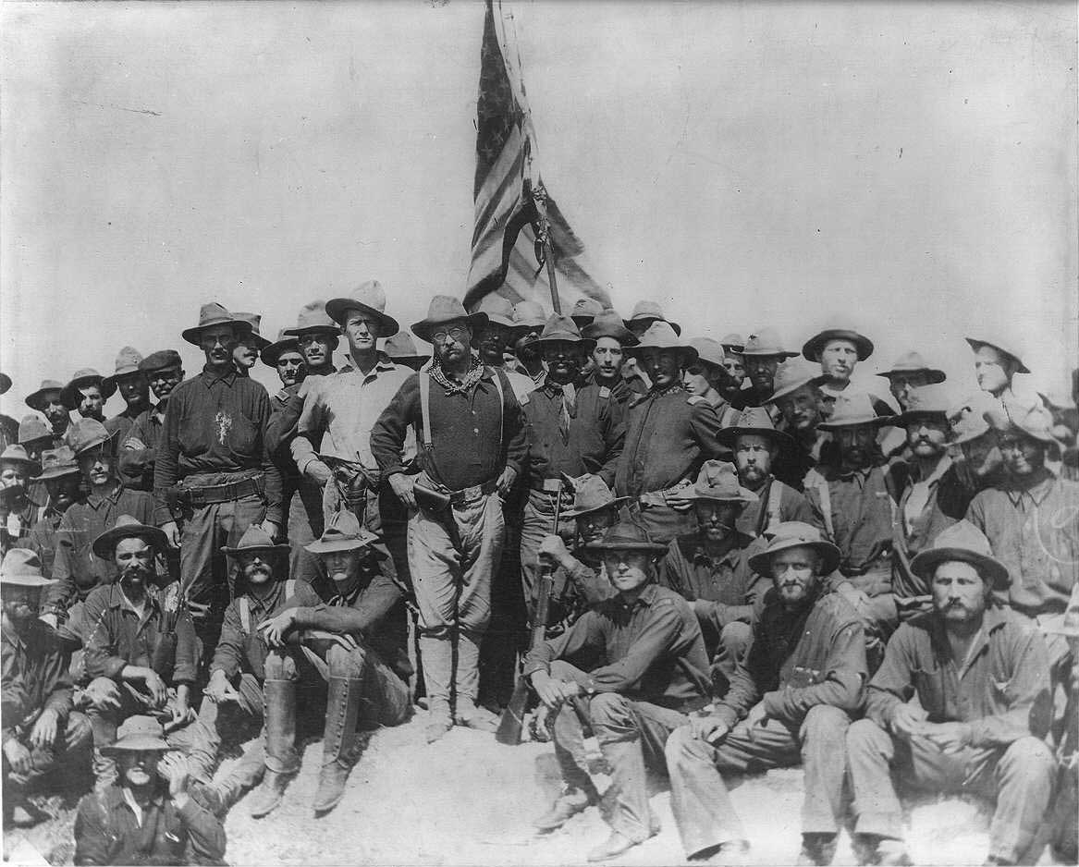
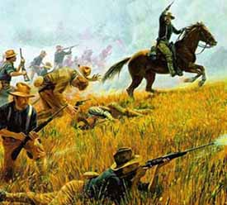
The Rough Riders

Slide 10
America’s Empire
U.S. had promised Cubans independence
Spain agrees to U.S. annexation of P.R. and Guam
But what about the Philippines?
December 10, 1898: Treaty of Paris
Cuba becomes independent
U.S. help write Cuban constitution, add Platt Amendment:
1. Cannot make treaties that weaken Cuban independ.
2. U.S. can buy/lease Cuban land for navy bases
3. Cuba can’t be too indebted to point of lost independ.
4. U.S. and intervene if Cuba’s independence threatened
Platt Amendment stays in effect until 1934

Slide 11
American Puerto Rico
Foraker Act (1900): est. government of Puerto Rico
Elected legislature, governor appointed by U.S. pres.
Supreme Court: “Puerto Ricans not U.S. citizens”
1917: Puerto Ricans given citizenship
1947: Puerto Ricans can elect own governor

Slide 12
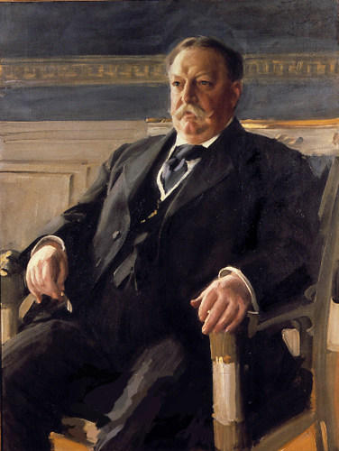
Americans in the Philippines
1899: Emilio Aguinaldo orders attack on U.S. troops
Fighting lasts three years
To make Filipinos happy, U.S. Gov. William Taft makes reforms in health care, education, transportation
Reforms work, 1901 Aguinaldo is captured
1930s: Filipinos allowed to elect their own president and Congress
1946: Philippines given full independence

Slide 13
Classwork:
On page 150, O.P.V.L. the documents concerning the Philippines, then write and answer question 1 & 2

