Slide 1
Social & Political Change

Slide 2
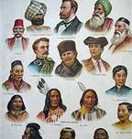
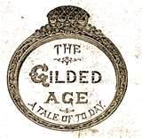
Gilded Age Ideas
1870-1900: The Gilded Age
Mark Twain first used term to describe USA; covered in gold, but rotting on inside
New Ideas:
~Individualism
~Natural Selection
~Social Darwinism
- “Survival of the fittest”: some people are more evolved than others
~Carnegie’s Gospel of Wealth: Philanthropy
~Many Christian churches reject Darwin’s Theory of Evolution

Slide 3
Social reform
Many challenged Social Darwinism
Edward Bellamy’s Looking Backward
~Promoted Socialist ideals
Lester Frank Ward’s Reform Socialism (people are different from animals)
Naturalism: “people are victims of circumstance”
The Social Gospel
Settlement House movement (Chicago’s Hull House)
Public Education
~Americanization

Slide 4
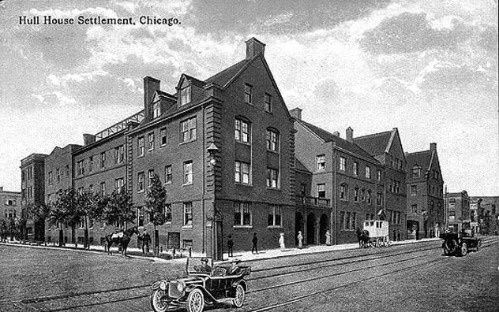
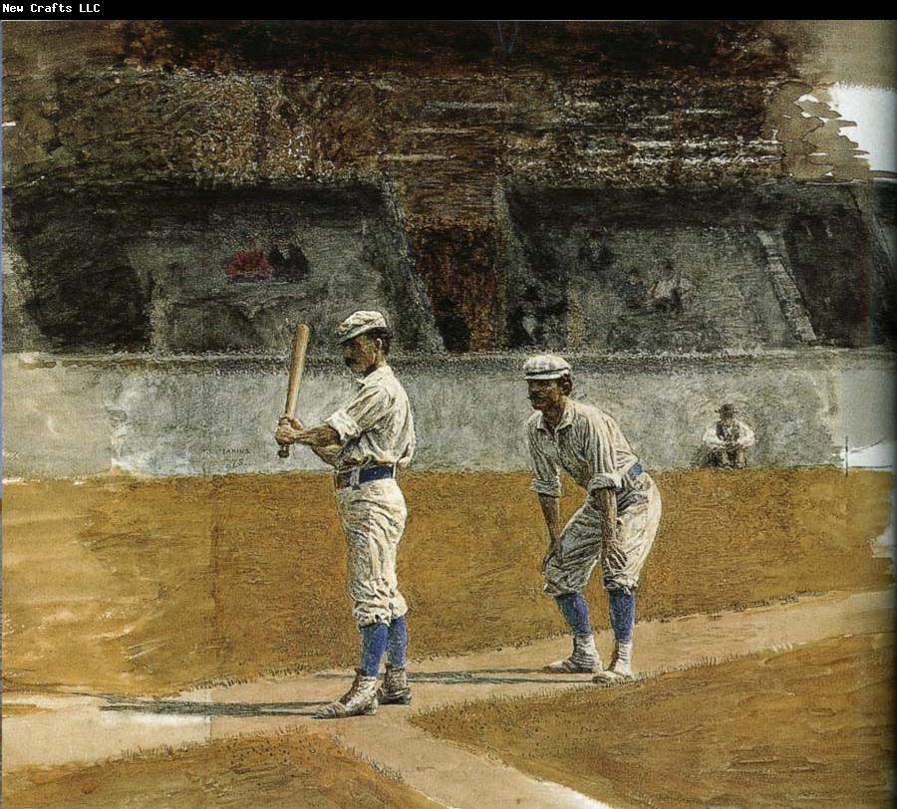

Slide 5
Cultural change
Realism
~Writers published books portraying real life
-Mark Twain’s Adventures of Huckleberry Finn
Rise of Popular Culture
~Industrialization improved ability to spend money on recreation
~Saloon culture
~Amusement Parks
~Professional Sports (Cincinnati Red Stockings)
~Recreational Sport (basketball invented)
~Vaudeville theater

Slide 6
Political Reform
Spoils System: presidents handed out civil service jobs to friends
~ 1881: One rejected job seeker shoots President Garfield
Civil Service Reform
~1883: Pendleton Act: some jobs filled through exams
Election of 1884
~Democrat Grover Cleveland elected president
~angered both Democrats and Republicans, but was popular for economic reforms:
-Interstate Commerce Act
-Fought to cut tariffs

Slide 7
The Rise of Populism
1888: Republican Benjamin Harrison wins close election (lost pop. vote)
~Sherman Antitrust Act
Populism advocated for farmers, traditional Americans
Greenbacks: paper money that could not be exchanged for gold or silver
~Inflation: increased money supply + no rise in available goods
~3 US Currencies: greenbacks, gold and silver coins, banknotes tied to bonds
~Congress stops making silver coins and printing greenbacks, pays off bonds
-Deflation: rise in the value of money, rising interest rates

Slide 8
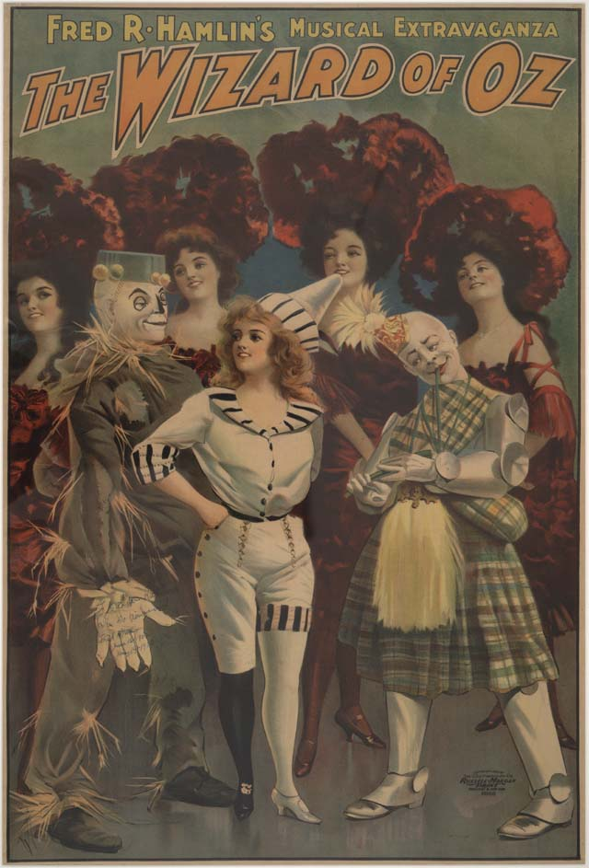
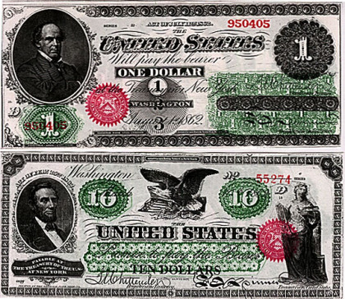
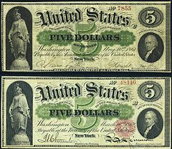

Slide 9
Life on the Farm
The Grange: Farmer’s organization
~1873: Recession causes farm incomes to fall
~The Grange argues for states to regulate railroads/warehouse rates
~Create cooperatives where farmers work together
-Cooperative strategies did not help farmers
Farmer’s Alliance replaces the Grange, but failed
Farmers turn to populist politics to help their cause
~Graduated Income Tax
~Government ownership of railroads
~Eight hour workday & Immigration Reform
Populist ideas unpopular with urban voters

Slide 10
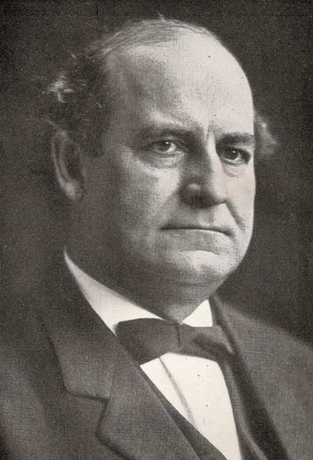
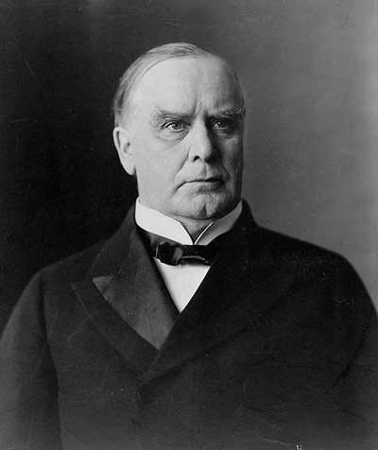
Election of 1896
Populist People’s Party pushes for coinage of silver
~Republicans & Democrats endorsed “gold standard”
~People’s Party candidate William Jennings Bryan
Republican William McKinley promises “full dinner pail”
McKinley wins the election easily
Populist Movement declines, but issues survive:
~graduated income tax
~further government regulation of economy
~farm subsidies

Slide 11
Classwork:
On page 132, write and answer questions 1-6

