Slide 1
The Rise of Segregation

Slide 2
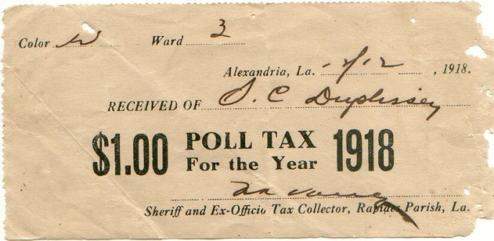
Resistance & Repression
After Reconstruction, most African-American sharecrop
Poor and indebted
Many AA join Populist Party
To appeal to more whites, Democrats use racism
Many African-American rights undermined
Poll Taxes and Literacy Tests to vote
1867 Grandfather Clause for poor whites

Slide 3
Legalized Segregation
Jim Crow laws: institutionalized discrimination and segregation in South
1883: Supreme Court overturns Civil Rights Act of 1875
1896: Plessy vs. Ferguson: “separate but equal”

Slide 4
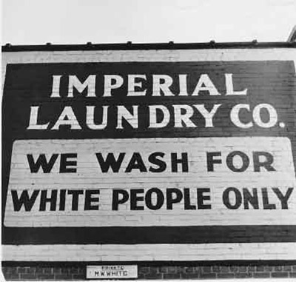
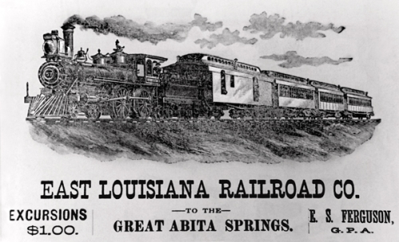
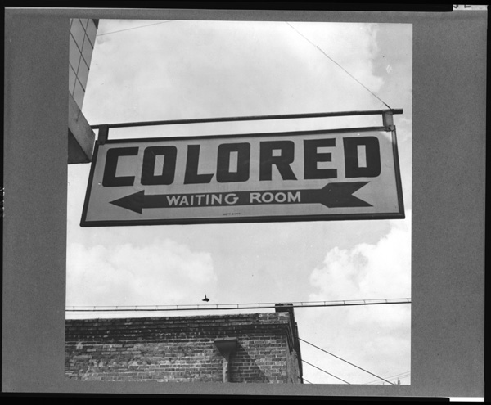
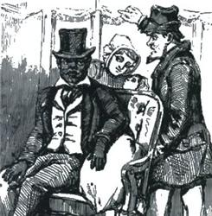

Slide 5
African-American Response
Ida B. Wells: fights against mob violence
Lynchings
Mary Church Terrell: Fights for women
To compromise, or not to compromise
W.E.B. Du Bois vs. Booker T. Washington

Slide 6
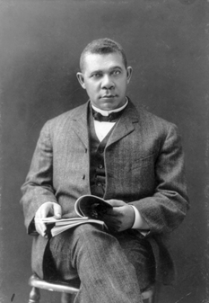
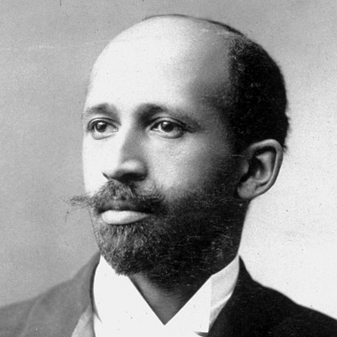

Slide 7
On page 137, write and answer questions 1-5

